Slide 1
Our family: (Picture here of everyone who lives at home)
Where we live: (EG: We live in a cosy little cottage in Yate and there is a lovely café round the comer. There is a lovely open green space over the road Bristol city centre is not too far and sometimes we go on the bus into town and we go to the cinema or go for some food.)
Our names: All individual family names here and animals. (EG: Lian, Chen, Oceania and Jovian Lee and our dog Rex.)

Slide 2
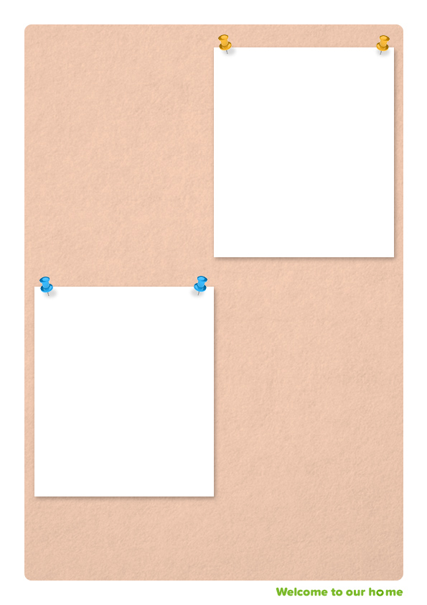
Example: My name is Lian, I work part time as a secretary in the local area. It means I am still available for school drop offs but sometimes you might walk home with Oceana.
I enjoy keeping fit and you might see me going to play tennis with my friends. I also love spending time with the family.
My favourite food is a healthy meal I especially like fish. I like to read books to myself but also with the children so I hope I can read some stories to you.
Example: Picture of Lian
Example: My name is Chen, I work as a dentist from Monday to Friday so you will mostly see me in the evenings and at weekends.
I enjoy going to play golf with my friends and would love to take you along too if you would like to.
I like going for walks in the park with the family at the weekends.
My favourite food is chili and pizza, although I am not the best cook!
Example: Picture of Chen

Slide 3
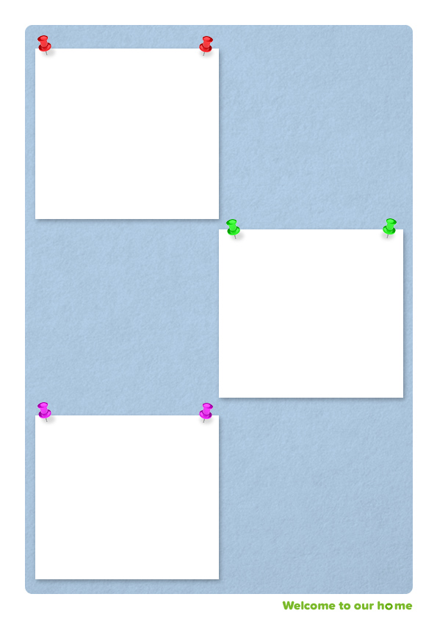
Example: My name is Oceana and I am 10 years old.
I love playing sports and I am on the football team at school!
I also love to read books and magazines so I have lots of magazines that I am happy to share with you.
My favourite food is children pasta and I love baking cookies at the weekend.
Example: Picture of daughter here
Example: My name is Jovian and I am 6 years old. I have lots of energy and love to be busy. I love playing in the garden with the footballs and digging in the mud!
I love to play outdoors and really enjoy exploring. We have woods near our house, and I love running through the trees.
My favourite food is ice cream!
Example: Picture of son here
Example: Picture of dog here
Example: This is our dog Rex. He is very friendly. He loves to go on long walks and to sleep in front of the fire.

Slide 4
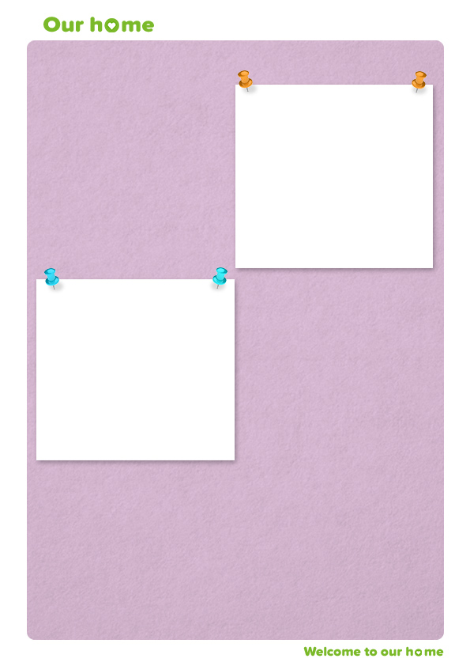
Your bedroom: (This will be your bedroom. When you get here, we can decorate it with all your favourite things, and you can make it your own.)
Example: (Picture of child / young person’s bedroom here)
Example: (Picture of communal space kitchen, living room, playroom garden)
Communal space room: (Depending on where you and your family spend the most time in together. For example, this could be your kitchen, living room, play room or garden.)
What we do as a family: We like to go to the cinema, the park and we love to bake a cake together once a week. We often get a take away every other Friday for a treat. We always try and be kind together and not hurt one another.
We look forward to meeting you and you being part of this family.

