Slide 1
Overview of the long term fostering matching process March 2023

Slide 2
Overview
This presentation should be regularly presented by Service Managers and Team Managers to their Social Care teams and Placement Team to ensure the long-term matching process is fully understood and followed.
This presentation should be talked through to all new starters to Social Care, Family Placement team and Children’s Commissioning Placement team as part of their Induction.

Slide 3
The Long-Term Matching Overview
Local authorities are expected to have an agreed process for the long-term fostering matching consideration. To ensure that the requirements have been met.
The decision to make a particular long-term foster placement must be discussed and recorded as part of the child’s review process. The same process must be followed for assessing the suitability of all potential long-term placements, whether this involves remaining with an existing foster carer or moving to a new family.
If the child’s permanence plan is long-term foster care and their existing foster carer wishes to be considered to provide this, the child’s responsible authority is expected to consider this in a reasonable timescale taking account of the existing relationship between the child and the foster carer, the length of time in placement, the child’s relationships with the foster carer’s wider family and community, and the progress of the child in placement recorded through the review process.
If the authority does not consider it appropriate to assess the ability of the current foster carer to become the long-term foster carer, it should give the carer clear reasons in writing, and also communicate the decision to the child as appropriate to their age and understanding.

Slide 4
Your Responsibilities as Staff
Staff are responsible to ensure they have read and understood the Long term fostering matching staff guidance document.
The process is undertaken in a timely manner.
Staff are responsible to ensure the Mosaic process is undertaken correctly.
To challenge if the process is not being followed
To ask for more training if you are unsure

Slide 5
Question?
How do you currently make long term fostering matching placements?

Slide 6
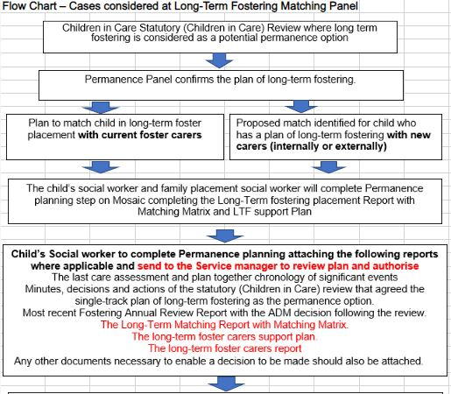
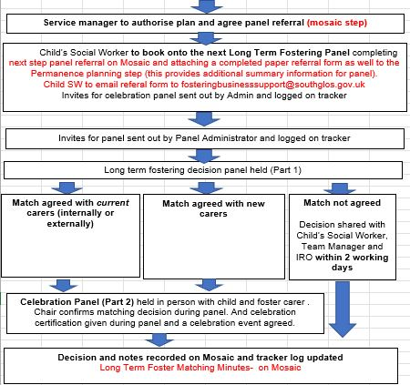
What will the new process look like?

Slide 7
The importance of completing the Mosaic steps
It supports good care and support.
It is a legal requirement and part of staff's professional duty.
It promotes continuity of care and communication with other agencies.
It is a tool to help identify themes and challenges in a person's life.
It provides our management reporting information.
Improving recording is part of our improvement journey!!!!

Slide 8
Mosaic Steps long term fostering
CIC / Pathway Planning
2nd CIC/Pathway review
Permanence planning process
Review plan and authorise
Permanence panel placement decision
Action
Childs social worker to start permanence planning process.
Action
Permanence plan pack sent to service manager.
Mosaic Forms to be used
Permanence Plan
The long-term fostering support plan
Long Term Foster Matching Minute.
Mosaic Forms to be used in the Permanence Plan
The long-term foster carers report
The Long-Term Matching Report with Matching Matrix
The long-term fostering support plan.
+ any other document identified in the Long term fostering matching checklist
Action
Next step panel referral in Mosaic and
Paper referral form to be attached to Permeance planning step and emailed to fosteringbusinesssupport@southglos.gov.uk
.

Slide 9
Who completes what
Form | Location | Who
Permanence Plan | Mosaic | Childs SW
Long Term Fostering – Foster Carers report | Mosaic | Family Placement SW (Child SW must send work request in Mosaic)
LT Fostering Placement Report & Matching Grid | Mosaic | Child SW and Family Placement SW (Child SW must send work request in Mosaic)
Long Term Fostering – Support Plan | Mosaic | Child SW and Family Placement SW (Child SW must send work request in Mosaic)
Long-Term Fostering Matching checklist | Mosaic | Childs SW
Referral form for long-term fostering matching panel | K drive and Mosaic next step | Childs SW
Long Term Foster Matching Minute | Mosaic | Panel Administrator / Service mgr
Tracker log | Share point site | Panel Administrator
Matching certificates | K drive | LTF panel

Slide 10
Activity

Slide 11
Committed, long term stable, family. Settling, reassuring, warm, caring, being loved, community, friends, valued, accepted, proud, included, positive.
Tenacious, clear, curious, questioning, healthy cynicism,
Challenging, rigorous, determined, accountable
Honest, open, reflective, thorough, caring,
Emotionally intelligent, considered, balanced, fair,
Analytical.
Realistic

Slide 13
Long Term Matching Panel.
The Long-Term Matching Panel considers
Children with a plan of long-term fostering being potentially matched with their current carers. In this instance, the long-term fostering plan with the child’s current carers should be agreed in a statutory (Children in Care) review.
Children with a plan of long-term fostering being potentially matched with new carers.
The Long-Term Fostering Match Panel will not consider:
Cases that are subject to Care Proceedings, where the final Care Plan is for children to remain with family & friends carers under a long term fostering arrangement.
Plans for Special Guardianship Orders or Child Arrangement Orders.
Plans of Adoption
*These cases / plans will be considered with the Permanence Panel process.

Slide 14
Long Term Matching Panel.
The Long-term Fostering Matching Panel has two parts
Part 1 - Decision making with relevant practitioners in attendance and can be a virtual meeting
Part 2 – Celebration time held in person with child and foster carer . Chair will confirms matching decision during panel.

Slide 15
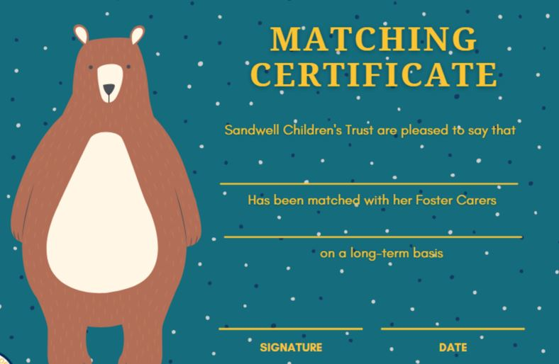
Celebration
After a successful match, the social worker will celebrate by:
Chair confirms matching decision during panel
A celebration certification will be given during panel
A celebration event agreed (for example trip out for a meal / cinema)

Slide 16
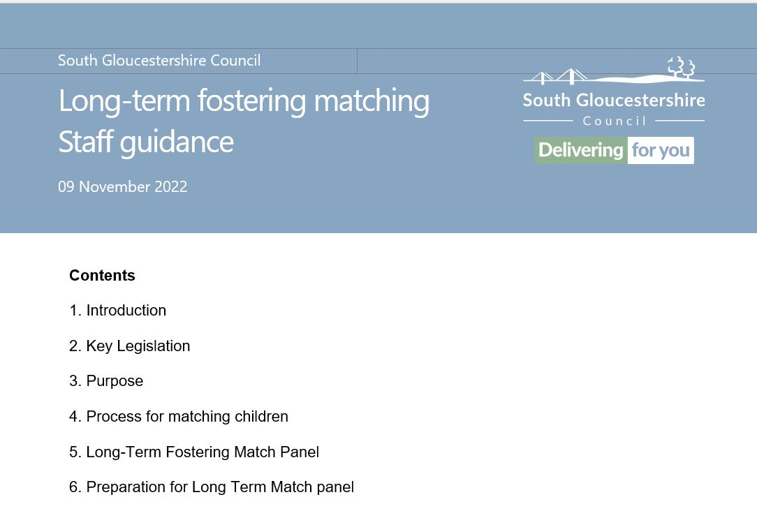
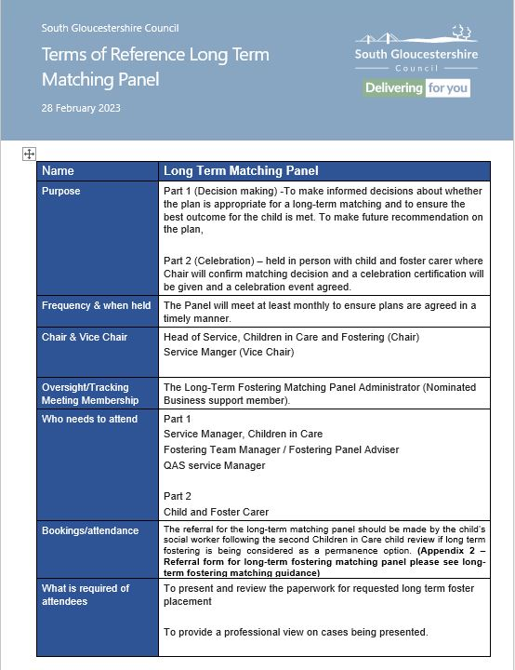
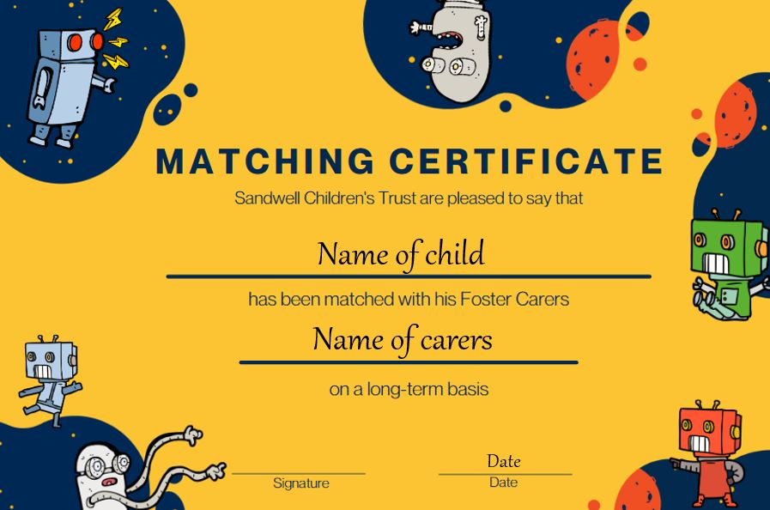
Tools to support you!!!!
Staff Guidance and panel terms of reference

Slide 17
Where to find the forms
Forms are available on your shared drives
K:\integrated services\new service folders\long term fostering matching
Referral for Long-term Fostering Matching Panel
Matching Certificates
Forms are available on Mosaic
Long Term Fostering - Foster Carer's Report
LT Fostering Placement Report & Matching Grid
Long Term Fostering - Support Plan
Long Term Fostering - Matching Checklist
Fostering Panel - Minute
All referral forms should be emailed to fosteringbusinesssupport@southglos.gov.uk

Slide 18
Question and Answers

Slide 19
Thank you for your time
Shanti Eaves
Head of Service, Localities, Corporate Parenting and Fostering

