Slide 1
CS Exceptional Payment Request
CONTROLLED
V1.0 August 2020
Sarah Hill & Paula Lievesley
MOSAIC Implementation Team
CSMosaic@derbyshire.gov.uk

Slide 2
Contents
Visio of Workflow
Guidance on Exceptional Payments
Guidance on Workflow Step for Social Worker
Guidance on Workflow Step for Fostering Worker
Guidance on Workflow Step for Team Manager
11. Guidance on Workflow Step for Head of Service
13. Guidance on Workflow Step for Assistant Director

Slide 4
Guidance around Exceptional Payments
Exceptional Payments differ from core payments and can include one off payments, top up monies to standard core payments or allowances and/or purchases for goods or services. It is essential that any exceptional payment requests sit within the financial procurement levels and regulations.
The cumulative total therefore needs to be considered when determining authorisation levels with reference to the latest Derbyshire County Council’s Financial Regulations.
It is essential that you demonstrate why additional and/or exceptional payments are required above the core payment for the child.
‘Spend to Save’ considerations need to be evidenced within the request if the exceptional payment enables longer term saving opportunities for the Council.
The Supervising Social Worker recommendations need to be included if the exceptional payment relates to a foster carer or child placed with Local Authority foster carers.
Discussions with relevant decision makers need to be held before the Workflow Step is completed and provisional agreements sought. Please alert the authorising manager by email when the workflow step is completed, and the relevant task sent, to ensure there is no delay when requests are made.
Where exceptional payments are being considered as part of a child's final care plan the financial assessment of the carers is to be completed prior to the making of a Final Order so that this can be taken into account when considering any requests for exceptional payments.

Slide 5
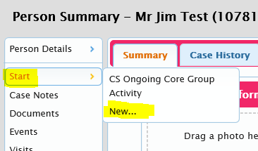
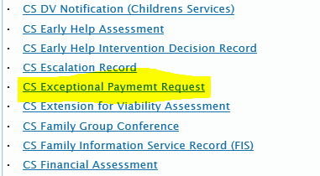
How to Use the Workflow Step
Social Worker
This workflow step needs to be opened on the Carer the payment is going to be made to.
On the Adult record, click Start and New and select ‘CS Exceptional Payment Request’.
Please read the Guidance Notes (within the Workflow Step and within this PowerPoint) prior to completing the Workflow Step.
Please complete all fields within the Workflow Step.
Payments will only be made monthly in exceptional circumstances. The usual frequency of payments is weekly.
CONTROLLED V1.0 August 2020

Slide 6
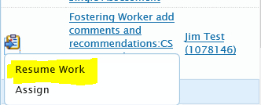
When completing the Review Information, please identify which Area Team will be responsible for the review i.e. High Peak North Dales Children’s Services.
Please send the initial 2 requests:
Fostering Worker add comments and recommendations
Team Manager Review Exceptional Payment and Confirm Decisions
Fostering Worker
The Fostering Worker who receives the request must firstly complete the request.

Slide 7
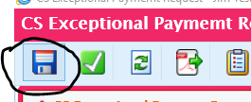
The Fostering Worker must then complete the ‘Fostering Worker Recommendations’ under the Worker Recommendations section.
Once this has been filled out, the worker then must save and close.

Slide 8
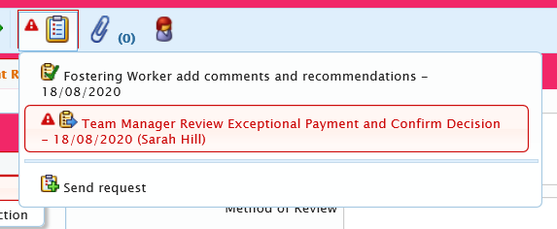
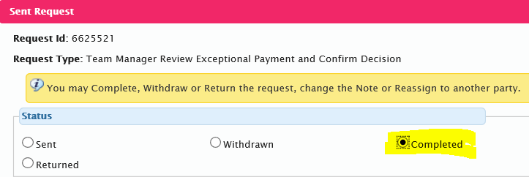
Team Manager
On receiving the Request, the Team Manager must review the content of the form and complete the ‘Team Manager Recommendation’ box and tick the verification box.
The Team Manager must complete the Request

Slide 9
If the Exceptional Payment is NOT agreed:
The Team Manager should input a Next Action of ‘Does Not Qualify for Payment’ and finish the Workflow Step. Please ensure the worker is aware of this.
If the Exceptional Payment IS agreed:
The Team Manager should sent the ‘Head of Service Review Exceptional Payment and Confirm Decisions’ Request. The Manager should then Save and Close the Workflow Step.

Slide 10
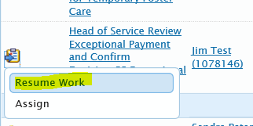
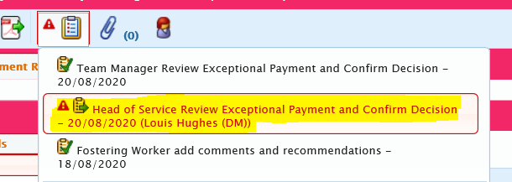
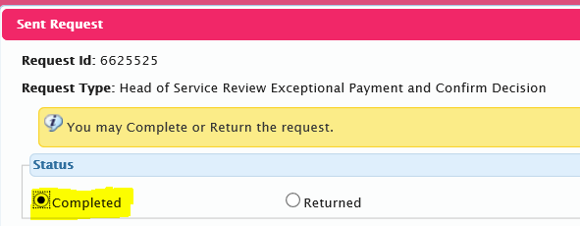
Head of Service
On receiving the Request, the Head of Service must review the content of the form and complete the ‘Head of Service Recommendation’ box and tick the verification box.
1. 2.
3. 4.

Slide 11
If the Exceptional Payment is NOT agreed:
The Head of Service should input a Next Action of ‘Does Not Qualify for Payment’ and finish the Workflow Step. Please ensure the worker is aware of this.
If the Exceptional Payment IS agreed:
The Head of Service should send the ‘Assistant Director Review Exceptional Payment and Confirm Decisions’ Request. The Head of Service should then Save and Close the Workflow Step.

Slide 12
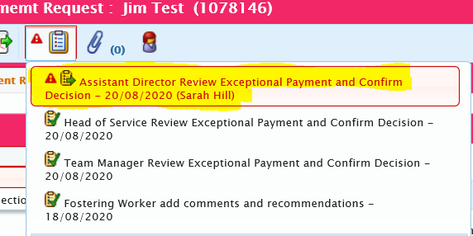
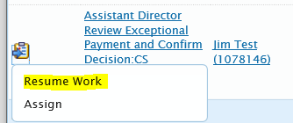
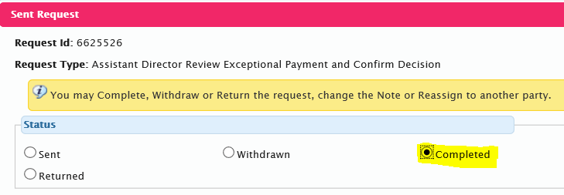
Assistant Director
On receiving the Request, the Assistant Director must review the content of the form and complete the ‘Assistant Director’ box and tick the verification box.
1. 2.
3. 4.

Slide 13
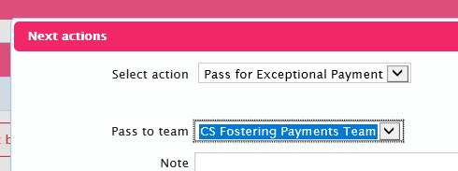
If the Exceptional Payment is NOT agreed:
The Assistant Director should input a Next Action of ‘Does Not Qualify for Payment’ and finish the Workflow Step. Please ensure the worker is aware of this.
If the Exceptional Payment IS agreed:
The Assistant Director should input the Next Action ‘Pass for Exceptional Payment’ to the CS Fostering Payments Team and finish the Workflow Step.

