Slide 1

Active Lives
Bitesize
Paul Wallingford
Service Manager – Active Lives
Provider Services
Adult Social Care & Health
May 22

Slide 2

The Active Lives Service enables adults with disabilities to live the life they choose by offering Person Centred support that is
aligned to the values of
Community Led Support.
PW – Active Lives

Slide 3
We were once called Day Opportunities and before that we were Day Services or even Day Centres.
But we have always been the Council’s provision for adults with disabilities particularly learning disabilities and autism.
PW – Active Lives

Slide 4
For many years our service has lead in Person Centred thinking and working…
We have helped to change the old ‘day centre for life’ mind-set for external day services too, by leading on the ‘Active Lives project’..
PW – Active Lives

Slide 5
We only want to work with people when needed and only for as long and as often as necessary. We are passionate about supporting emotional and physical wellbeing and ensure that ‘independence’ is at the core of all we do.
PW – Active Lives

Slide 6
We have a range of sessions and support based in the Community and at our Hubs.
We talk about sessions not ‘days’ but two sessions in a Hub is one day. One session can be up to half a day.
PW – Active Lives

Slide 7
We aim to empower individuals and their families to transition from us to other options that are identified and explored whilst we are developing skills and confidence. Our outreach support and autism mentoring are time measured and our other services seek to step down support partly or wholly as appropriate to the individual.
PW – Active Lives

Slide 8
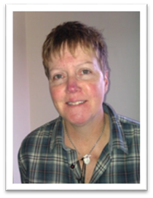
Meet the Management team……
Caz Clarke
Caz and team offer support to individuals with more complex needs, they are based at Addington Heights and the Cherry Hub.
PW – Active Lives

Slide 9
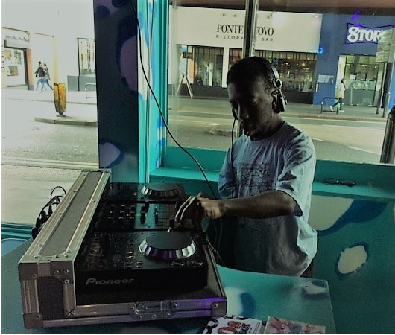
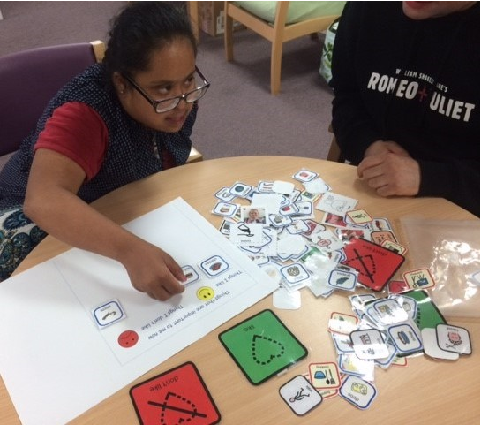
PW – Active Lives

Slide 10
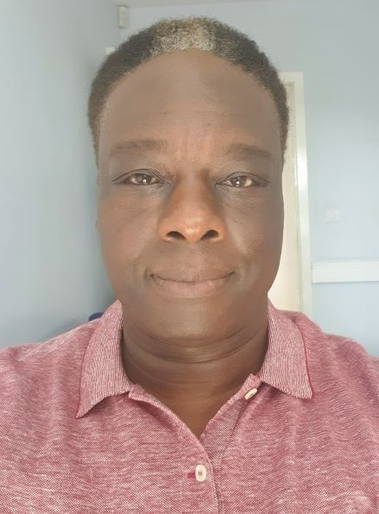
Kevin Mitchell
Kevin and team offer a wide range of sessions from the Whitehorse Hub, the local community and the Cherry Hub. They are famous for their work with the Brit School and developing the Active Lives virtual offer.
PW – Active Lives

Slide 11
PW – Active Lives

Slide 12
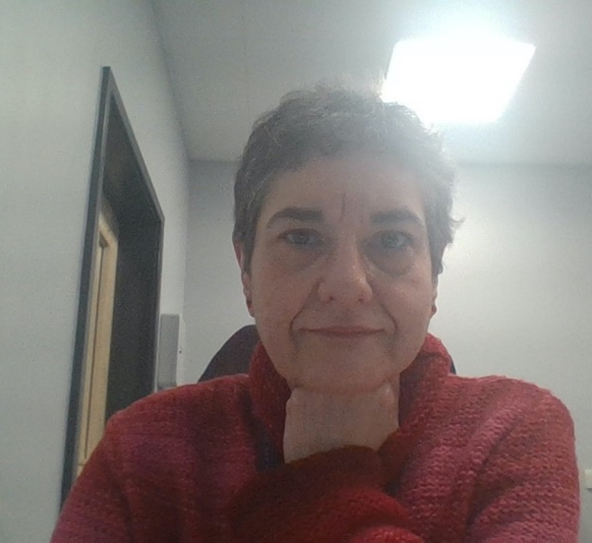
Maria Esteban
Autism Team
Maria and team offer a range
of bespoke support to the Autism
community which includes the non-LD community. Options include sessions, mentoring, training, support groups. The team work closely with the Autism Partnership Board and to support the delivery of Croydon’s Autism Strategy
PW – Active Lives

Slide 13
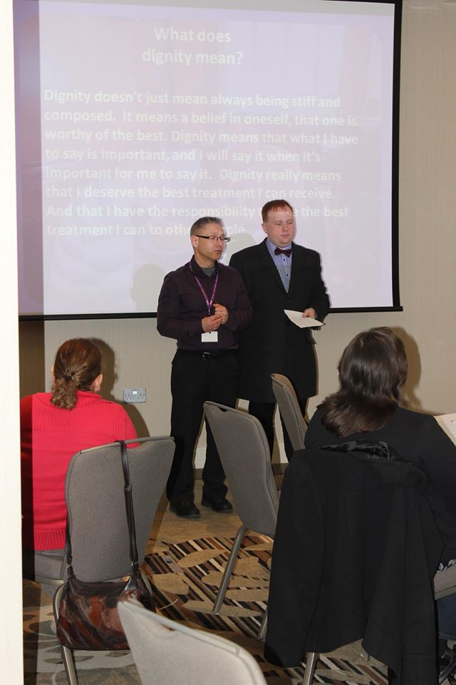
Example of training coproduced and delivered with Simon a young man with Autism.

Slide 14
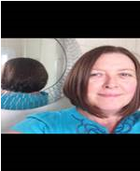
Rachel McCarthy
Outreach Team
Rachel and the team offer
outcome focussed support that
enables individuals to develop confidence and independence within agreed time limits based in their local community or home environment. Rachel also oversees the Cherry Hub site.
PW – Active Lives

Slide 15
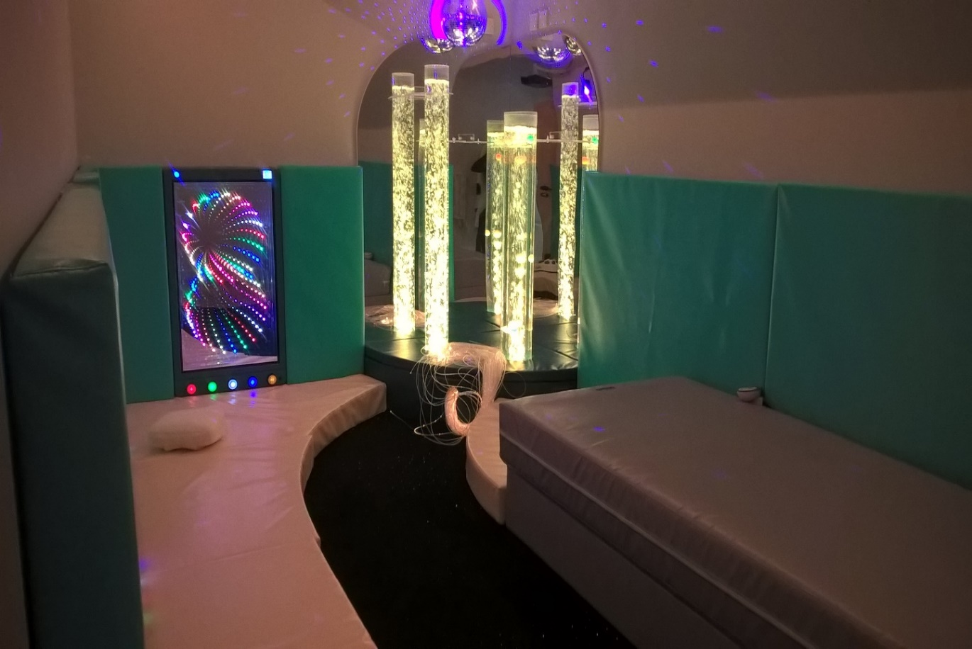
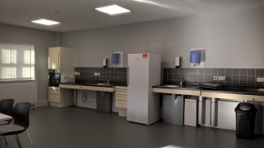
Sensory Room & Training Kitchen
Cherry Hub
PW – Active Lives

Slide 16
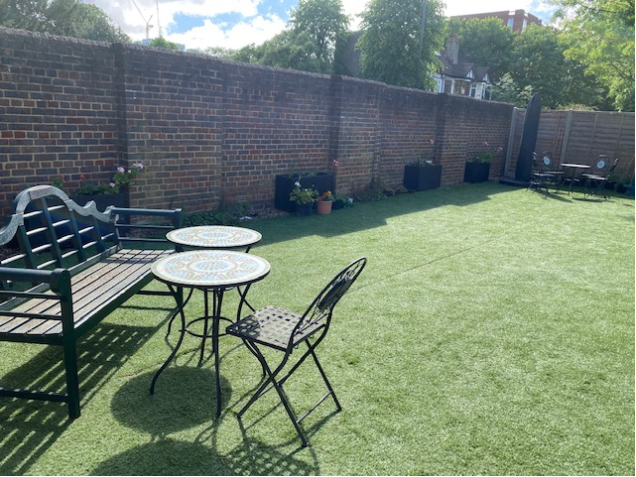
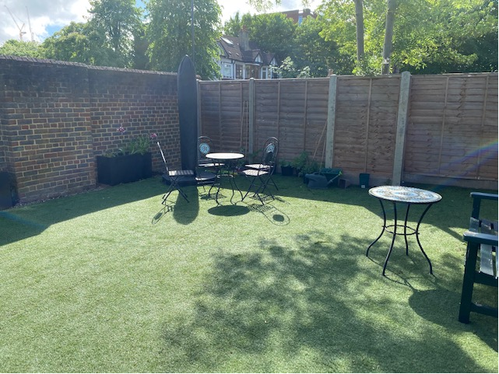
The Garden
Cherry Hub
PW Active Lives

Slide 17
The Cherry Hub Garden Centre is run by volunteers with disabilities overseen by Sue Symes Rivers and John Williams. As well as growing and selling plants to the public, they liaise with CALAT and deliver a City&Guilds in horticulture course designed for individuals unable to complete paperwork in the usual way.
PW – Active Lives

Slide 18
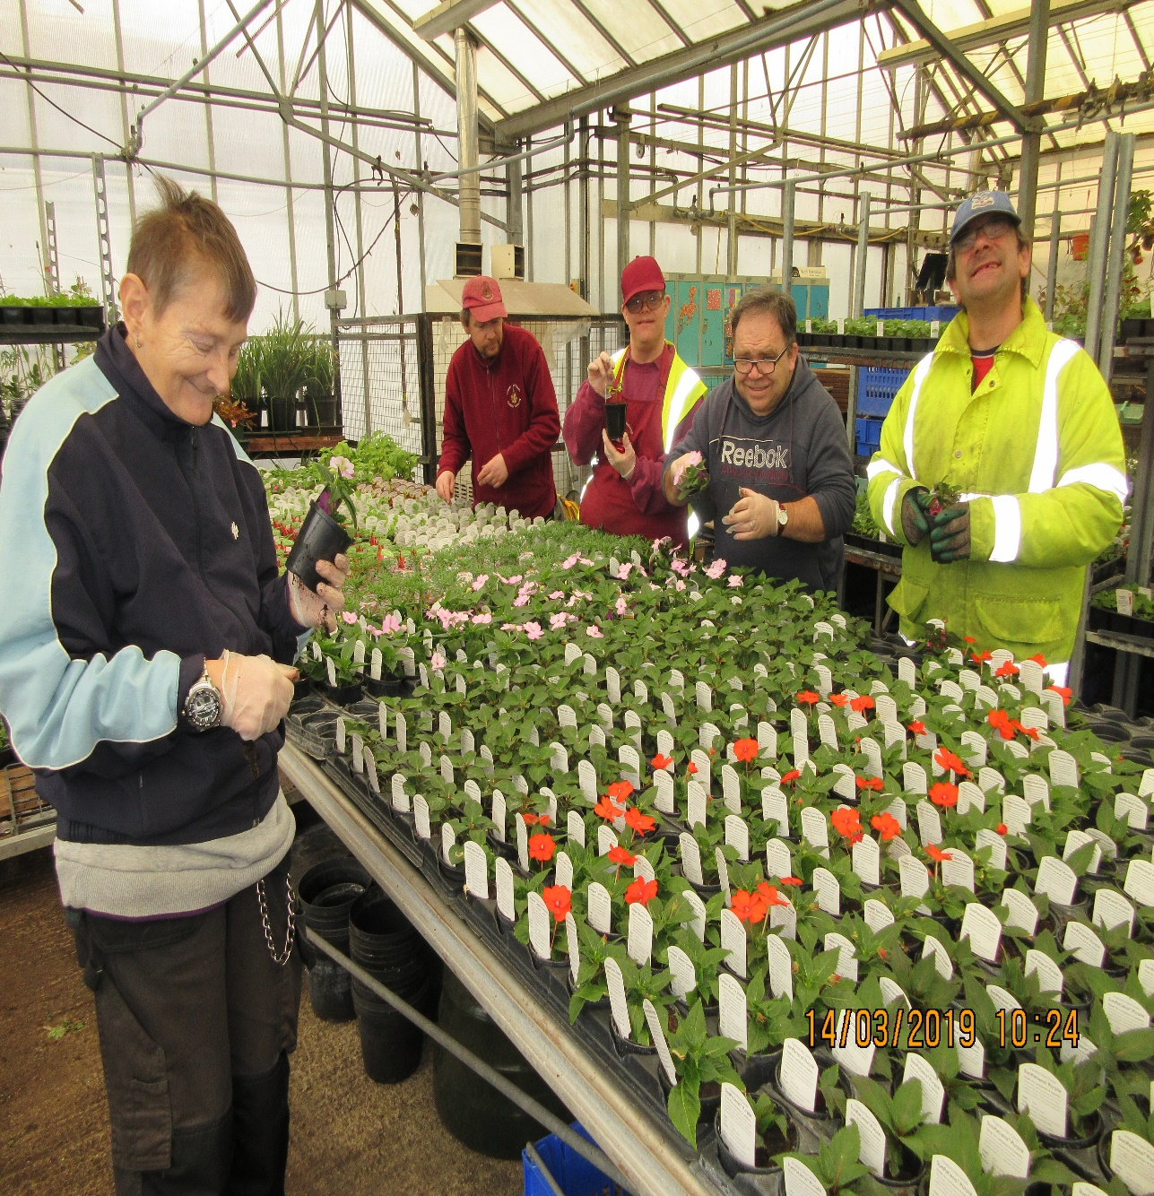
Cherry Hub Garden Centre
PW – Active Lives

Slide 19
As an in-house service we work with the Social Worker to ensure that the resident is supported in the most appropriate way possible.
We have a simple referral form and we will then carry out our own good conversation with the individual and their carers. We carry out Person Centred reviews too..
PW – Active Lives

Slide 20
To reiterate – where and when appropriate, we will seek to step down our support of individuals, seeking always to transition into ordinary life opportunities and utilise other more long term options such as technology, PA’s, voluntary groups, family and friends.
PW – Active Lives

Slide 21
We are unique in that we are the Council, one team, open and transparent. We can work together to ensure best outcomes for all. We have an excellent reputation and others in the P&V sector seek our advice too, as has been shown during the Covid19 crisis.
PW – Active Lives

Slide 22
ActiveLivesReferrals@croydon.gov.uk
We cannot accept Direct Payments (We are the Council).
Sessions need to be entered on an individual’s Support Plan on LAS.
Current costs as displayed on Council’s fees and charges….
1 session £31.03 …. 1 day (2 sessions) £62.07
PW – Active Lives

Slide 23
Active Lives Options Appraisal 2022
Active Lives was validated by an Options Appraisal conducted by Commercial Gov.
We are working through a number of their recommendations AND will continue to deliver person-centred support enabling people to develop a mixed blend of opportunities to meet their assessed needs, based on their personal interests, outcomes and aspirations.
PW Active Lives

Slide 24
A quote from the Options Appraisal Report
‘During the engagement work every single staff member spoken to, described the model and its vision with passion and a great level of commitment to delivering personalised support’
PW Active Lives

