Slide 1

Induction Handbook
Social Care
New Employee Guidance
2023 - 2024
PEOPLE AT THE HEART OF OUR PLACE
London Borough of Waltham Forest

Slide 2
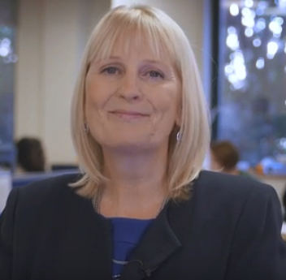

WELCOME
Dear colleague,
Congratulations on your appointment and a warm welcome to Waltham Forest.
It is an exciting time to be joining us!
We have recently introduced a number of improvements in how we support and develop our social care staff; including this induction handbook, an ambitious Continuing Professional Development (CPD) offer and practice model, establishing a Social Care Academy and engaging in various pilots, programmes and partnerships; to name a few.
In Waltham Forest, we take pride in placing people at the heart of our place and work collaboratively to achieve the best possible outcomes for those who we work for and with.
As part of your induction you will meet with a range of colleagues for an opportunity to ask questions about the organisation, employee-led networks, CPD opportunities and any other areas you would like further information on. As a new member of the team you may well see things that you think would benefit from changing and we look forward to you helping us to learn about practice innovations.
I hope you enjoy your role in our organisation. This induction handbook has been set out to support you and help you become orientated to your new work place, colleagues and to our borough.
I look forward to meeting and working with you in the future.
Heather Flinders – Strategic Director, People – DCS/DASS

Slide 3
CONTENTS
YOUR INDUCTION JOURNEY | 5
Key Tasks | 6
Induction Communication | 7
Day One | 8
Weeks 1 to 2 | 9
Months 1 to 6 | 10
STRUCTURE CHARTS – SOCIAL CARE | 11
CSC & ASC Structure Charts | 12-13
Our Vision | 14
PRACTICE SUPPORT | 15
Social Care Academy | 16
Learning & Development | 17
CPD and Career Progression | 18
Useful Links for Social Care Staff | 19
HEALTH & WELLBEING | 20
Mental Health & Wellbeing | 21

Slide 4
CONTENTS CONTD…
HELPFUL INFORMATION | 22
Staff Portals | 23
Policies & Procedures | 24
Genograms & Chronologies | 25
Employee-Led Networks | 26
Staff Forums & Away Days | 27
ABOUT WALTHAM FOREST: | 28
The London Borough of Waltham Forest | 29
Local Facts & Figures | 30
Getting Around | 31
HOW WAS YOUR INDUCTION EXPERIENCE? | 32

Slide 5
YOUR INDUCTION JOURNEY

Slide 6


KEY TASKS
An excellent induction is hugely important as it helps new staff receive a warm welcome and feel part of our organisation from the outset. This handbook has been developed to provide guidance for all new starters, including those who join with managerial responsibilities.
The guidance below identifies some of the key tasks that should be completed during your induction journey…
DAY ONE
Meet & greet with your line-manager Take a tour of your work location/s (including facilities, fire exits etc) Meet the team and your buddy (if applicable) Key equipment issued relevant to your role and reasonable adjustments implemented if required Arrange induction meetings with other key staff members in your service area; including practice improvement and workforce leads
MONTHS THREE TO SIX
You are familiar with the wider CPD opportunities (OD and social care) and employee-led networks open to you You have met with a wide range of staff members You have successfully completed your 12 and 24 week Probation period You have completed the Induction Feedback Survey
By the end of your induction, you should have a good understanding of the tools, resources and facilities that are available to enable you to perform your role effectively.
In particular, at the end of your induction you should be familiar with:
Your service area
Expectations relating to your role
Where your work base is and where other offices and resources are located
The Intranet and any other relevant systems (Oracle, Hornbill, Mosaic, Clear Review etc)
CPD opportunities, your personal development needs and performance objectives
Organisational structure, corporate objectives and core values
WEEKS ONE TO TWO
Familiarise yourself with all sections of this handbook Arrange supervision or ‘check in’ appointments with manager or direct reports and ensure you have access to all relevant systems (Clear Review etc) Provided with copies of relevant policies, procedures and strategies and have all relevant meetings in your schedule
MONTH ONE
Supervision or ‘check in’ has taken place Your Personal Development & Performance Objective/s have been set All mandatory E-Learning training has been completed (Cyber Security, GDPR etc) You are familiar with all relevant polices, procedures and strategies You have met with key staff members outside your immediate team

Slide 7

INDUCTION COMMUNICATION
Your Role: As a new employee, we ask you to help shape your induction – try and make it your own, so it meets your needs. Although your line manager will have a role-specific induction prepared for you, it is your responsibility to understand what is expected and to use the guidance outlined in this handbook. If anything has been missed, please do speak to your line manager.
Line Manager: It is your line manager’s responsibility to ensure the induction process prepares you for your role. Although overall responsibility lies with the line manager, they may ask others to support the process and therefore act as a co-ordinator. Your line manager should greet you on your first day at work.
‘Buddy’: Staff should have access to a ‘buddy’ during their first few weeks. It is likely that you will be introduced to them on your first day. Your ‘buddy’ will be a friendly face who can help with any day-to-day questions and will help you access shadowing opportunities, although it is not expected that all shadowing opportunities will just be undertaken by the ‘buddy’.
The Team: Your colleagues within your team will be able to support you with opportunities to shadow. This may not be exclusive to your new team - you might want to explore opportunities to meet with colleagues across the organisation.
Agency and temporary staff: This induction process applies to all staff within social care, including agency staff. They should complete all aspects of the induction checklist.

Slide 8

DAY ONE
By the end of your first day you should have received a copy of this handbook.
You should now have all the key equipment required for your role and should know…
  Your work location/s and the wider, organisational and service-specific structures
  Your line manager and your direct reports (if applicable)
  Your log-in details (if applicable)
  Your wider team members and allocated buddy (if applicable)
Your way around your place/s of work [kitchens, washroom, faith room, meeting rooms, fire escapes etc]
  Where other key colleagues are located or how they can be contacted
  How and where to access key documents that you need to read [for example: corporate policies and strategies, service or team plans and policies, Health and Safety, Health & Wellbeing, HR etc.]

Slide 9

WEEKS 1 TO 2
By the end of week two you should…
  Be familiar with the contents of this handbook
  Have arranged supervision or check in appointments (including your 12 week probation)
  Had the opportunity to talk with your ‘buddy’ (if applicable)
  Have access to all the relevant systems (HR E-Learning platform, Oracle, Clear Review, SharePoint etc)
  Updated your Outlook calendar with key induction tasks (meetings, forums, shadowing etc)
  Completed or booked the relevant mandatory training (Cybersecurity, Mosaic, GDPR etc)
  Shared your contact information with key colleagues
  Have access to all the relevant policies, procedures and strategies

Slide 10

MONTHS 1 TO 6
By the end of your first month, you should have…
  Completed all mandatory training relevant to your role
  Received an invitation from Organisational Development (OD) to attend a Corporate Induction
  Attended your first supervision or ‘check in’ session to discuss how you are settling into your role and to provide and receive feedback with your manager. New starters with supervisory responsibility should have supervision planned with their direct reports at this stage to understand their objectives so they can support them in the best way possible
  Established your personal and performance objectives. Please ensure you discuss these regularly with your manager and keep them up to date with progress as they form part of your annual performance review.
  Met with a key number of colleagues relevant to your role and service area and have all the key meetings and events in your Outlook Calendar or diary
Read all the relevant policies, procedures and strategies (council-wide and service specific)
In your first month, you should be balancing opportunities to build experience of the organisation, the role and your team with your knowledge and skills.
Your manager will check in with you during this period and offer feedback; they may also collect feedback from colleagues, clients and other professionals during your induction journey.
Months three to six
Most, if not all, of your induction process will now be complete. By month 6, you should have successfully completed your full probation period and be aware of the wider CPD opportunities available to you to enable you to excel in your role.
Please do remember to complete the Induction Feedback survey! Link here

Slide 11
STRUCTURE CHARTS

Slide 12
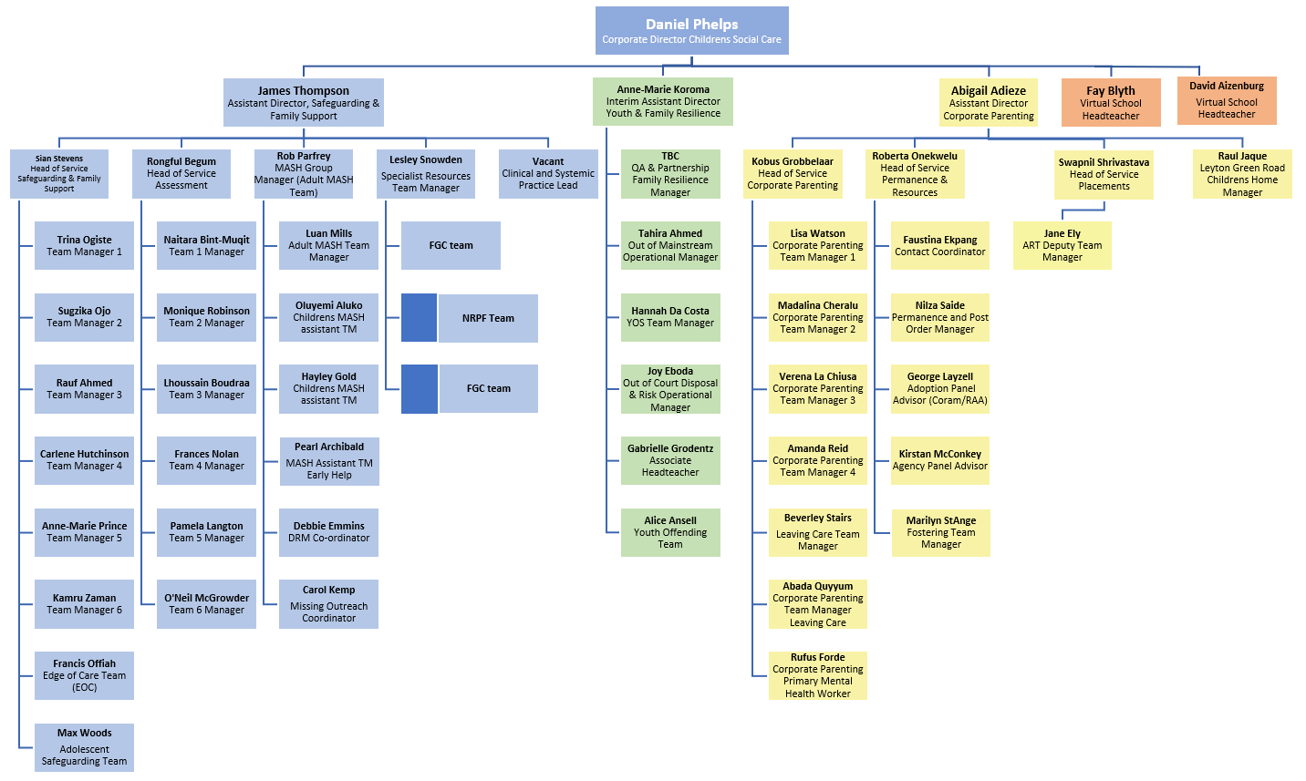

Slide 13
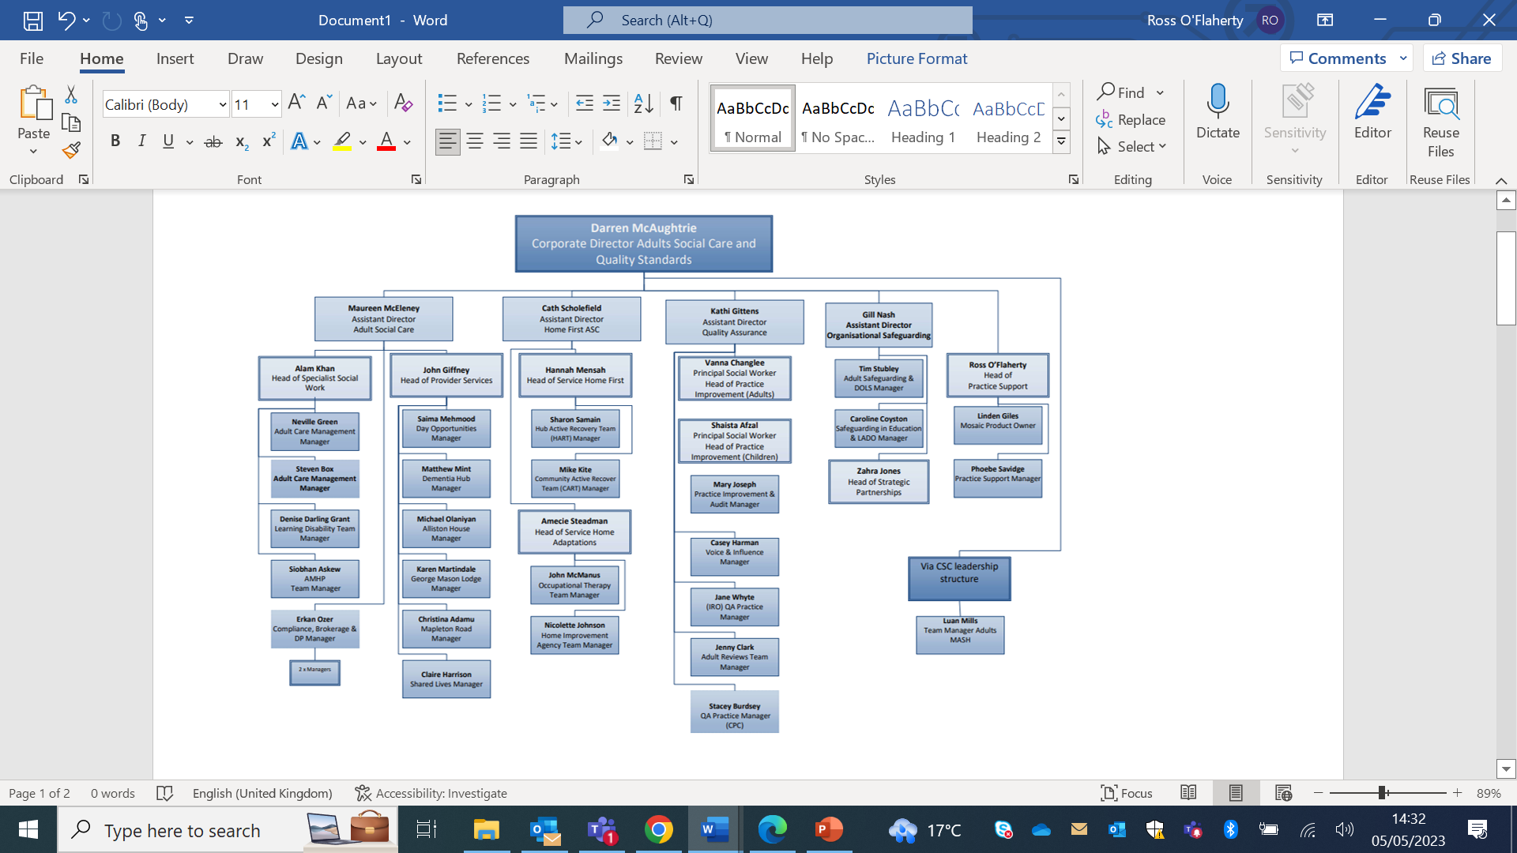

Slide 14

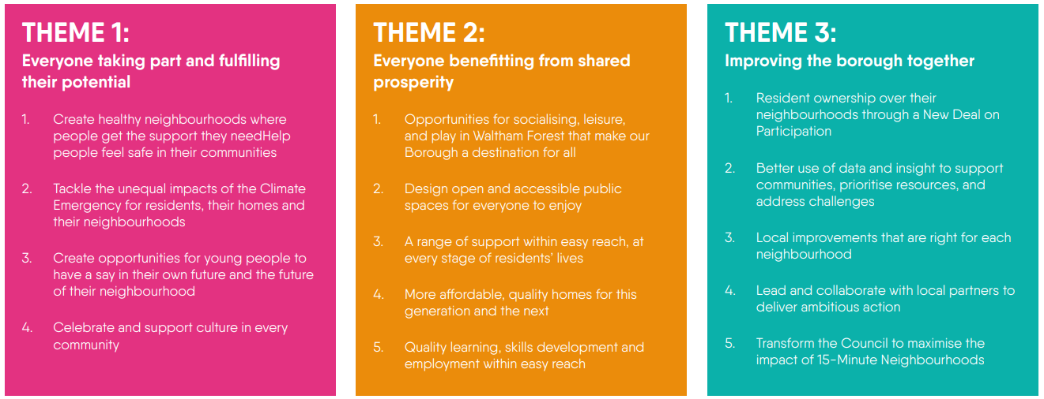
OUR VISION
15-MINUTE NEIGHBOURHOODS: OUR CORPORATE FRAMEWORK
Here in Waltham Forest we know the power neighbourhoods have to inspire, care, and create opportunities that change the lives of the unique people that live here. 15-Minute Neighbourhoods: Our Corporate Framework sets out a new vision for residents, councillors and staff that proudly celebrates our amazing local neighbourhoods and the communities they are home to. The aim is to ensure residents can easily reach most, if not all, of the facilities, experiences and activities they need on a daily basis, within a short walk, wheel, or cycle from home.

Slide 15
PRACTICE SUPPORT

Slide 16
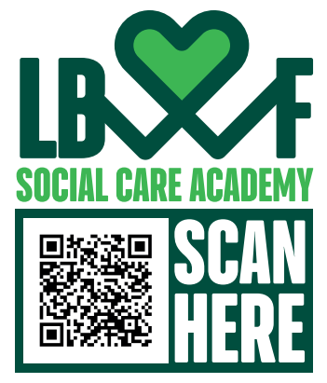

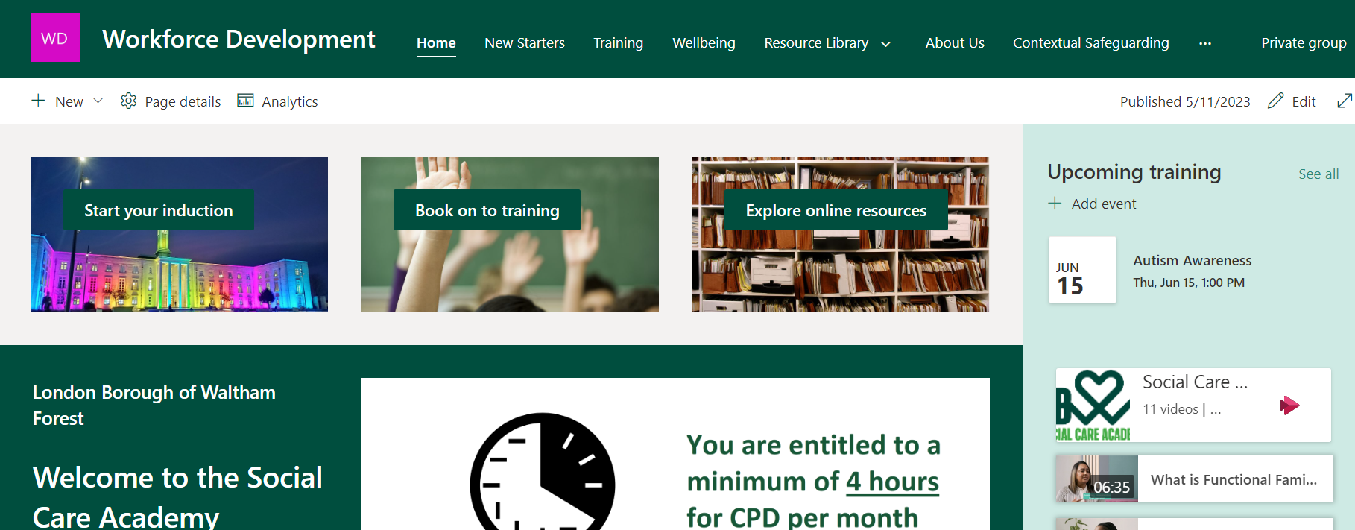
SOCIAL CARE ACADEMY
2023 saw the launch of the Social Care Academy. The Academy is a one stop shop for your learning and development needs!
The Social Care Academy is an internal SharePoint site where you can register for training, access online learning resources, watch staff videos and understand about your individual learning style.
Just scan the QR code above and log in with your council password to access training, videos and resources.
You can access the site here:
https://lbwf.sharepoint.com/sites/WorkforceDevelopment
Get Involved
We are always interested in how we can change and develop the learning opportunities we offer. So please contact us if you have any feedback on workforcedevelopment@walthamforest.gov.uk

Slide 17



LEARNING & DEVELOPMENT
Training
To ensure that your learning, development and training opportunities are utilised from the moment you join Waltham Forest, it is essential that you access the e-learning zone where you will be able to complete courses relevant to your service, role and level of experience.
Please note that some e-learning courses are mandatory, such as GDPR and Cyber Security training and should be completed within the new employees first few weeks.
Learning
Aside from e-learning courses there will be other training that is also mandatory, for example; WRAP training (Workshop to Raise Awareness about Prevent).
The Care Certificate
The Care Certificate is an identified set of standards that health and social care workers adhere to in their daily working life.
Designed with the non-regulated workforce in mind, the Care Certificate gives everyone the confidence that workers have the same introductory skills, knowledge and behaviours to provide compassionate, safe and high-quality care and support.
If you are new to the role of carer, please note that you will be required to complete the Care Certificate.
Further information about the Care Certificate can be found here.
Safe and Together
The Safe & Together model has been developed over many years of research and experience to help child and family practitioners become more domestic-abuse informed.
It is designed to support children and family services and their surrounding systems to improve outcomes for families impacted by domestic abuse and improve competency across the workforce. Safe & Together is a child-centred model that provides a framework for partnering with survivors and intervening with perpetrators to improve the safety and wellbeing of children.
For details of what resources are available click here or for training and further information please email the Waltham Forest Safe & Together inbox: safeandtogether@walthamforest.gov.uk

Slide 18

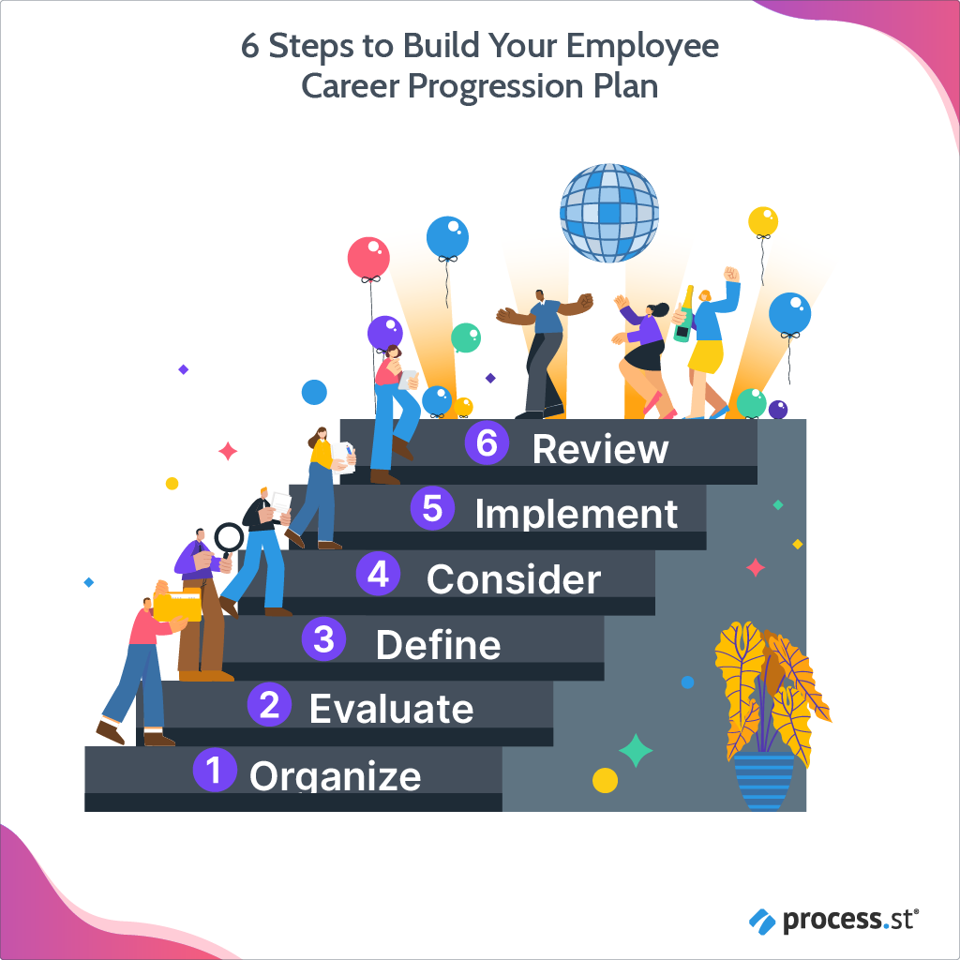
CPD AND CAREER PROGRESSION
NB: Remember that Training is the giving of information and knowledge, through speech, the written word or other methods of demonstration in a manner that instructs the trainee.
Learning is the process of absorbing that information in order to increase skills and abilities and make use of it under a variety of contexts.
Your Continuing Professional Development is not confined to attending formal training sessions and can also include reading, coaching, mentoring, shadowing, supporting others, cascading information via team meetings and supervision etc
Continuing Professional Development
There are a range of CPD opportunities available to ensure our staff are equipped to deliver an outstanding service to our residents. Many of these courses are advertised in the Workforce Development calendar (listed under ‘Workforcedevelopment’ in the email address book) and require you to book your place via the dedicated SharePoint site here.
There are also training opportunities through the North-East London Teaching Partnership (NELTP).
Career Progression Frameworks
There are clear career progression frameworks in place, and these have been designed to provide guidance on how the organisation supports your long-term development in a structured way.
Your readiness to be considered for progression will be decided by your manager/supervisor in conjunction with yourself and through the Performance Development Review (PDR) process.

Slide 19








USEFUL LINKS
Link here
Link here
Link here
Link here
Link here
Link here
Link here
Link here

Slide 20
HEALTH & WELLBEING

Slide 21



MENTAL HEALTH & WELLBEING
How are you?
Many of us will answer ‘fine’, even when we’re not. Too often, mental health problems are treated as a taboo subject, especially at work. However, mental health affects us all and we should feel able to talk about it and here at Waltham Forest we encourage open conversations about mental health.
We want all staff to feel they can be open about their mental health and ask for support if they need it from colleagues, managers or our staff support line on 0800 243 458.
Employee assistance scheme
Waltham Forest operates an Employee Assistance Scheme whereby staff have access to team of counsellors and advisors who can help with a wide range of problems including work-related issues and personal and family issues. Please note that this is a confidential service.
Further information about the Employee Assistance Scheme can be found here.
Further, all Waltham Forest employees have free access to Thrive, a mental wellbeing app approved by the NHS that staff can download to their personal or work smartphones.
You can find all the information about Thrive here.
More information and support about maintaining health and wellbeing is available on
Forest Hub
KWNEL was launched in December 2020 to support the wellbeing and resilience of the 76,000 health and social care staff in North East London, in response to the unprecedented pressures of the Covid19 pandemic.
Click here for more information

Slide 22
HELPFUL INFO

Slide 23



STAFF PORTALS
Clear Review is the council’s performance management system. It allows you to add performance and personal development objectives, provide feedback and arrange ‘check-ins.’ Managers can even set team-wide objectives and run objectives, feedback and check-in reports for their team.
You can access Clear Review here.
Waltham Forest’s Intranet site is located on a dedicated SharePoint platform.
The platform hosts information for all the different services in the council, from Human Resources to Health & Safety. It also provides access to the Staff Benefits portal.
You can access SharePoint here.
The newly renovated Fellowship square is a community space that hosts a range of cultural events throughout the year.
Fellowship Square boasts state of the art technology, team neighbourhoods as well as an innovative working space for staff.
Hornbill is the portal used by staff to view/update and log various support requests.
These requests include advertising vacancies, appointing new staff, ordering stationery, accommodation bookings and many more. The Hornbill self-service portal can be accessed here. Please note that in order to use these services you must obtain authorisation from your line manager.

Slide 24


POLICIES AND PROCEDURES
Supervision
We consider that the core purpose of supervision is to enhance the skills and knowledge of our staff whilst providing them with a strong basis of support to enable them to carry out their roles to the best of their ability.
As an organisation we place a great deal of importance upon supervision. Whether you are providing or receiving supervision, a safe, reflective space enables us to provide the best possible service to our residents in need of care and support.
Please familiarise yourself with our supervision policy. The policy explains what supervision is, how it works, frequency, and how you, your manager and supervisees can get the most from it.
Tri-X Policies & Procedures
All policies and procedures for both Adult and Children’s Services can be accessed via tri-X; a web-based manual.
The Children’s services procedures can be accessed here.
The Adult’s services procedures manual can be accessed here.
If you are new to this manual, or new to working in Waltham Forest please ensure that you are kept up to date with tri-X policy briefings by completing the ‘Register for Updates’ form which is located on the home page of the manual.
Please speak to your manager to ensure you are accessing the most relevant policies for your role.
Your induction is underpinned by the HR process which contains information for new starters, pay and staff benefits, annual leave entitlement, sickness and absence policies.
It is important that the new starter familiarises themselves with these processes during their induction period.
The Human Resources section can be accessed via the council’s SharePoint site here.

Slide 25
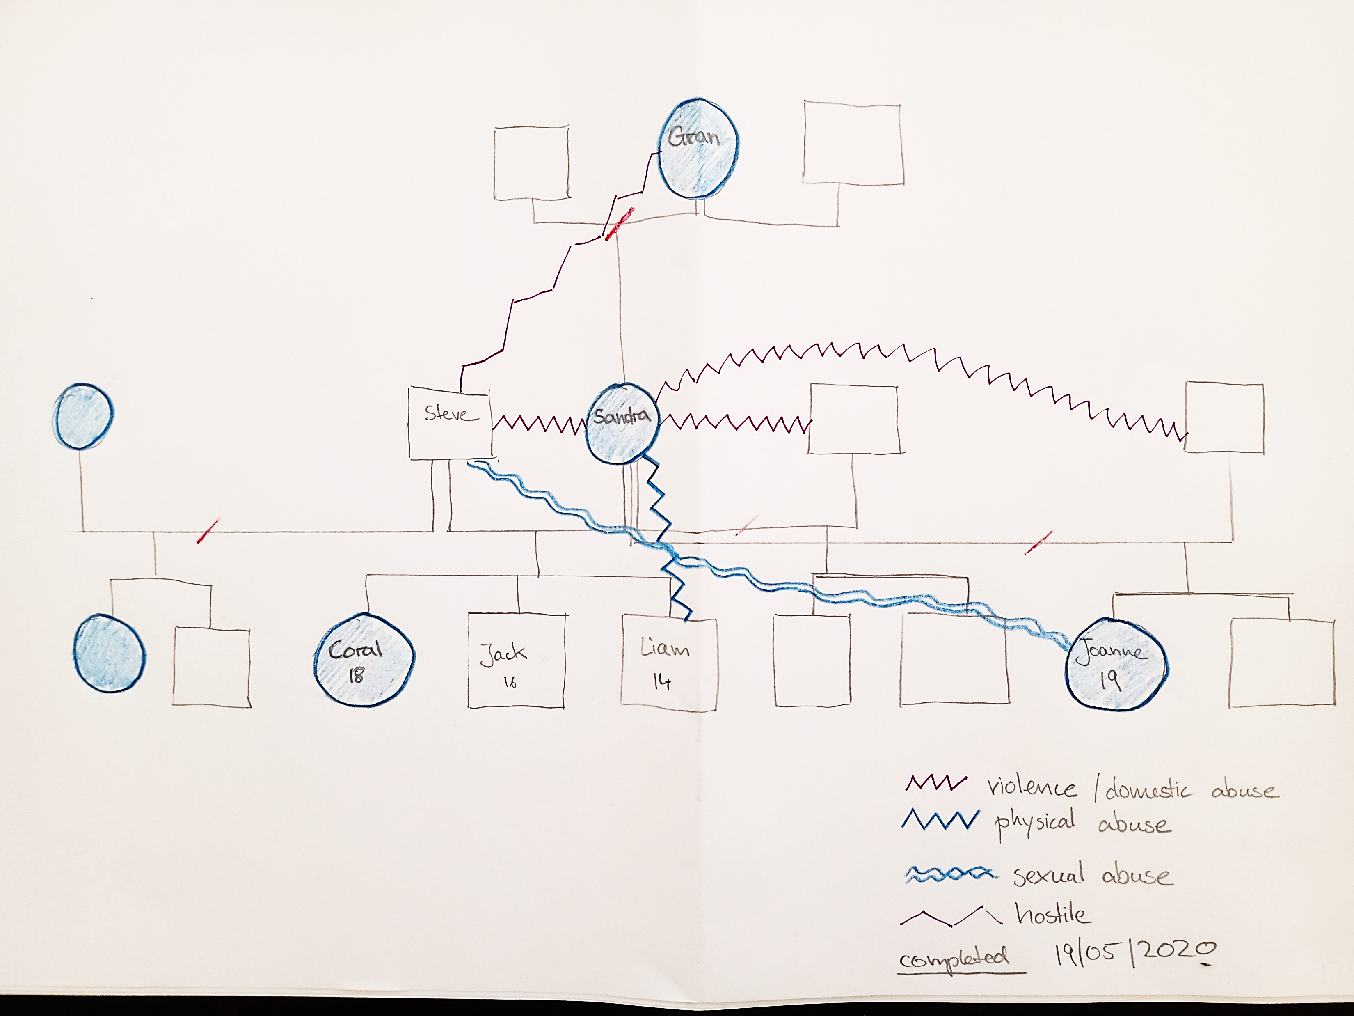
GENOGRAMS AND CHRONOLOGIES
Genograms
Chronologies
A chronology written for any purpose is a record of key events, in a sequential order. It is based on a study of recorded information, and its overall purpose is to support the analysis of the history of someone you are working with.
There are different purposes for writing a chronology:
A chronology should frame your understanding of a service user/family and tell the story of their lives. In this respect, they complement a genogram – the chronology describes the past
A chronology is a tool for a professional to use while working with a service user and professionals, and a tool for a service user to help understand their own life, and any relevant patterns – in other words, a wholly practice-based document;
It also has a key role in assessments, as a point of reference for the completed assessment as well as an analytical tool to help create the assessment in the first place.
You can find the template for a chronology here.
A genogram is structurally similar to a family tree but serves a very different purpose. A genogram includes information about relationships and interactions between family members, while a family tree only depicts lineage.
A genogram becomes most valuable when it includes information about several generations. Patterns that are usually hard to decipher seem to jump out once they've been mapped on paper. Maybe you've already noticed a trend of marital trouble in a family's history, but a genogram can highlight the pattern of aloofness and anger that's at the root of those marital problems.
You can access information and guidance on how to draw a genogram here.

Slide 26
EMPLOYEE-LED NETWORKS
Waltham Forest prides itself as being a diverse borough and our organisation is no different. There are a range of vibrant, employee-led networks that provide support, enhance career development and contribute to personal development in the work environment. They create safe, supportive and inclusive spaces which help bring people together!
Race Equality Network (REN)
REN is an activist group promoting the rights and fair practice for non-white staff across all employment related matters. It supports non white employees to successfully obtain senior positions within the council, new or via promotion - this may include positive action. REN is a safe space to share experiences and seek peer support. Join here
Differently Abled Forum (DAF)
DAF is a private group for council employees who self-identify as disabled, impaired or differently abled. The group meets once a month and is designed to give mutual support. It also helps to educate others and address the challenges the community faces. Join here
Women’s Network
This has been established to support the interests of women at the council.
The Women of Waltham Forest meetings take place approximately once every two months, for 1.5 hours. The network is open to people who identify as women. More information is available here
LGBTIQ+
This network promotes the interests of LGBTIQ+ colleagues: that is, lesbian, gay, bisexual, transgender, queer, intersex, as well as any other sexualities and gender identities. The network provides informal peer support, awareness events and scrutiny of council policy and practice. The network is open to council staff who identify as LGBTIQ+. Find out more here

Slide 27


STAFF FORUMS & AWAY DAYS
Forums and All-staff away days
There are Manager’s Forums which take place on a bi-monthly basis. These forums are an opportunity for managers to get together and discuss various topics. Members of the Senior Leadership Team attend these, and it is important to note that attendance is mandatory so please do look out for, and accept, the invitations in your Outlook calendar.
There are also all-staff away days, service area away days and Families staff workshops which take place. These can be themed events and are opportunities to celebrate good practice, deliver key organisational messages and keep staff informed regarding wider developments. Please note that attendance at these events is mandatory.
Families Hour
Families Hour is a regular forum and safe space where social care staff can come together to discuss pertinent issues within Diversity & Inclusion and agree on a set of actions to take away and implement. Topics have included Black History Month, juggling caring responsibilities and work, LGBTIQ+ history, mental wellbeing, random acts of kindness, International Women’s Day or other events, themes, issues or areas that matter, are relevant and are of interest to staff.
Services within the People’s Directorate rotate and are responsible for preparing monthly sessions. All sessions are updated on a dedicated Teams channel for those staff unable to attend. Families Hour Teams Channel
All-Staff Briefings/Check-ins:
All staff receive Outlook invitations on a regular basis for all-staff briefings/check-ins. These are hosted by the Chief Executive and guest speakers provide updates on various council projects and initiatives that are in development or already taking place.
This event is recorded and available to watch on demand so those unable to attend can still keep up to date with wider council developments.

Slide 28
ABOUT WALTHAM FOREST

Slide 29

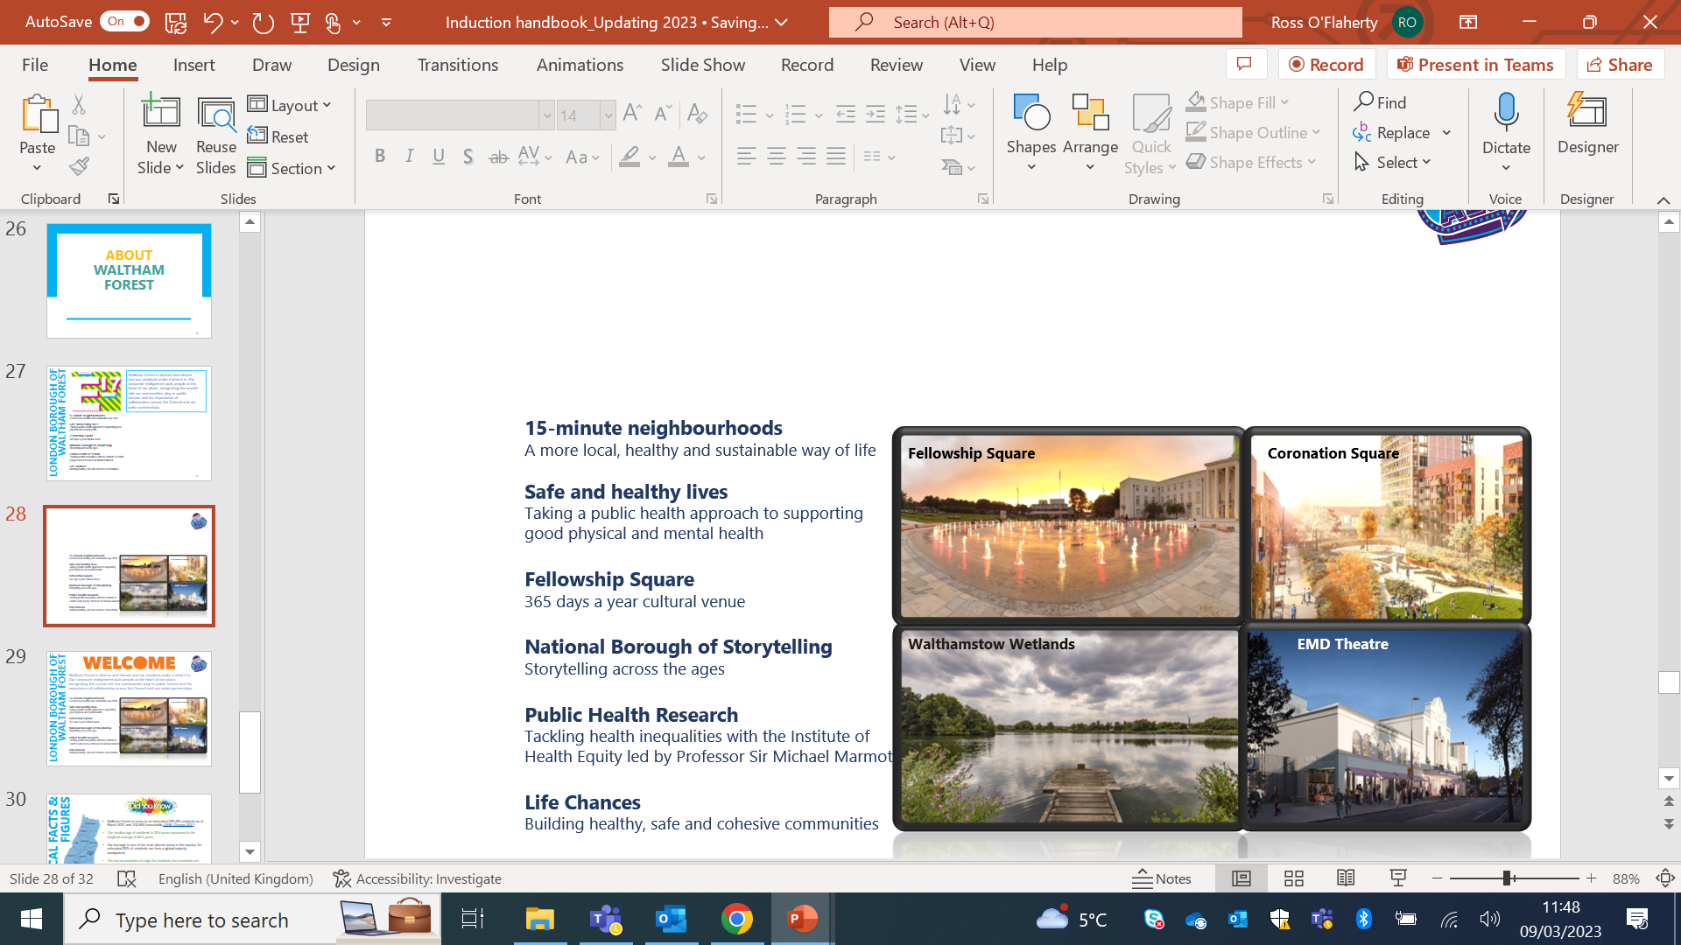
Waltham Forest is one of the most ethnically diverse areas in London and we believe it is this diversity that makes the borough so great. More than two thirds of residents are from a global majority background around a third of residents are born outside the UK and around one in five are EU nationals.
Our Corporate Strategy positions people at the heart of our place, recognising the crucial role our communities play in public service and the importance of collaboration across the Council and our wider partnerships.
LONDON BOROUGH OF WALTHAM FOREST
15-minute neighbourhoods
A more local, healthy and sustainable way of life
Safe and healthy lives
Taking a public health approach to supporting good physical and mental health
Fellowship Square
365 days a year cultural venue
National Borough of Storytelling
Storytelling across the ages
Public Health Research
Tackling health inequalities with the Institute of Health Equity led by Professor Sir Michael Marmot
Life Chances
Building healthy, safe and cohesive communities

Slide 30

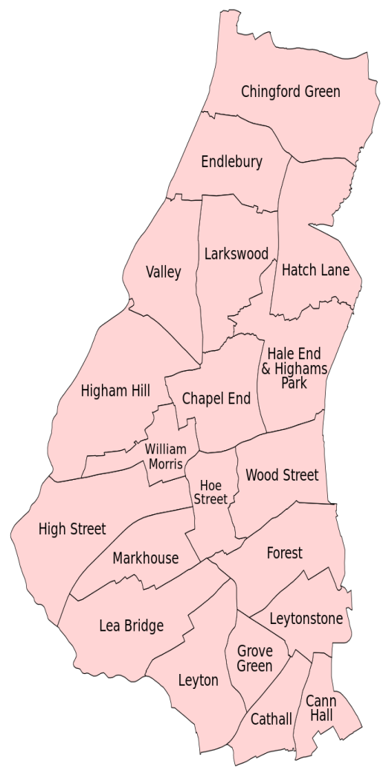
LOCAL FACTS & FIGURES
Waltham Forest is home to an estimated 278,400 residents as of March 2021 and 102,900 households (ONS, Census 2021)
The median age of residents is 35.6 years compared to the England average of 40.2 years
Our borough is one of the most diverse areas in the country. An estimated 53% of residents are from a global majority background
The top six countries of origin for residents born overseas are Romania (11,000), Hungary (6,000), Poland (6,000), Bulgaria (5,000), and Lithuania (5,000) and Pakistan (5,000)
The top five languages spoken locally other than English are Urdu, Polish, Romanian, Turkish and Lithuanian
94.3% of enterprises in Waltham Forest are micro businesses employing fewer than 10 people

Slide 31







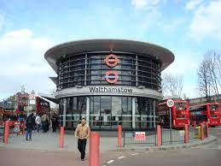
GETTING AROUND
Waltham Forest has good public transport links and parking facilities may be available dependent on your conditions of employment (subject to essential or casual car user requirements).
As a Greater London borough, Waltham Forest has excellent rail links at several locations including Walthamstow Central (underground), Walthamstow Queens Road, Leyton Midland, Leytonstone High Road and St. James Street, to name a few.
In addition to links to underground rail services [Victoria line] there is also an overhead rail service that links to London Liverpool Street. You can access the London Underground tube map here. The London Overground map can be accessed here.
Various bus services also operate throughout the borough and you can access a comprehensive bus map here.

Slide 32


We hope this handbook has provided some useful guidance to you as you start your journey with us...
We want to continuously improve the induction experience for all social care staff so would kindly ask you to spare a few minutes to complete our Induction Feedback Survey!

