Slide 1
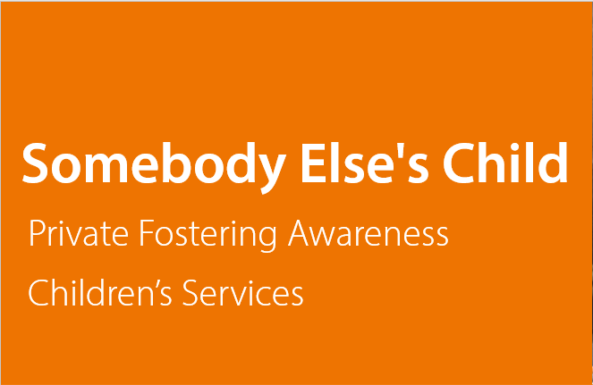
Somebody Else's Child
Private Fostering Awareness
Children’s Services

Slide 2
Learning Outcomes
Know how to recognise a Private Fostering arrangement.
Understand the Local Authority’s duties towards Privately Fostered children.
Know how to notify of a Private Fostering arrangement.

Slide 3
What is Private Fostering?
A private arrangement between a parent and a carer
For a child who is under 16 (or under 18 with a disability).
To live away from home and be cared for by someone who is not a parent, a person with PR or a close relative.
Arrangement is for 28 days or longer.
Notes:
The difference between PF and Mainstream Fostering as we know it. No intervention of the state .
A Family Arrangement.
28 days or more – however if parents/families/professionals are aware of an arrangement that is likely to last more than 28 days it is important to know.

Slide 4
Definition of a Close Relative
Private foster carers can be from the extended family, but are not ‘’close relatives’’ as defined by the Children Act 1989.
Close Relative:
Grandparent
Brother, Sister
Uncle, Aunt
Step Parent
(Full blood, half blood, or by affinity, e.g. marriage), or other persons having parental responsibility.
Not a Close Relative:
Cousin
Great Grandparent
Great Uncle or Aunt
Friend of family
Neighbour
Notes:
Definition of family – different communities and cultures have different ideas of families – what is considered immediate family to me may not be to you. That is why there is definition of ‘CLOSE RELATIVE’. Cousins, great aunts, great grandparents, step brothers and sisters not close relative nor are family friends, neighbours, your mums best mate who you have always called Aunty. Always good to ask questions.

Slide 5
Why is Private Fostering Important?
Privately Fostered children are not the same as children who are ‘’looked after’’.
Privately Fostered children are potentially vulnerable.
By law there is a duty for parents, carers and professionals to notify of any Private Fostering arrangements.
Many Privately Fostered children do not receive the services and protection they are entitled to because they are not known to the local authority.
Notes:
Looked After children are cared for by the state and usually there is a court ordered direction for the LA to share PR with birth parents. Privately fostering is instead a family arrangement with no court ordered direction.

Slide 6
Decision Flowchart
Is the child looked after
Yes
Not Private Fostering
No
Is the child over the age of 16 over 18 if disabled?
Yes
Not Private Fostering
No
Is the child living with someone else with parental responsibility (e.g. a child arrangements order)?
Yes
Not Private Fostering
No
Is the child living with a step-parent, grandparent, brother, sister, uncle or aunt?
Yes
Not Private Fostering
If the child has been there for 28 days or more, or if the plan is for them to be there for 28 days or more then this arrangement will be classes as Private Fostering and you must follow the private fostering procedures.
No
Notes:
Need a better version of this decision flow chart!

Slide 7
Private Fostering Consent
Discussions will be held with the child’s parents to confirm that they consent to the arrangement. The following will be considered:
A written agreement detailing responsibilities, will be shared between those with parental responsibility and the Private Foster carer.
The Local Authority is only responsible for assessing suitability and making a recommendation. If there are concerns about the welfare of the child, safeguarding procedures will be followed.
NB: For some older children, especially teenagers approaching 16, parents may know of their whereabouts but whilst not consenting, choose not to intervene.
Effectively, this may still be classed as private fostering.
Notes:
Private Fostering should be a spirit of partnership between parents and the person who is caring for their child. Agreements should be drawn up and discussions should take place about who will provide what – will the child benefit be transferred to the carer, how will the child keep in touch with their family etc.
Where possible its good to know in advance of PF arrangements taking place – guidance suggests this should be 6 weeks in advance of the arrangement taking place.
However, often we don’t know and even if its been going on for years, its still relevant so please tell us.

Slide 8
Why might a child or young person become Privately Fostered?
During boarding school holidays | Parent in prison
Children can be sent to the UK as families hope it will offer them a better life | Family breakdown or row with parents
Parent from overseas studying in the UK | Parent gone overseas or working elsewhere
Trafficked into the UK | Attending language school
Parenting capacity | Attending a sports academy
Parent has become ill | Overcrowding in family home
This is not an exhaustive list...
Notes:
What do we have in Derbyshire? Children living with a neighbour due to a parents health issue. Child living with great- grandparent due to mum being unable to care. Children coming to the Ice Hockey academy with Derbyshire and expecting some Ukrainian refugee children who are accompanied by distant relatives.

Slide 9
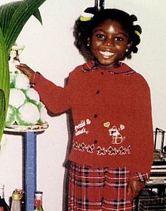
Victoria Climbié was a Privately Fostered child
Victoria was brought to the UK in 1999 from the Ivory Coast via France by her great aunt Therese-Marie Kouao and her partner, a stranger to the child. This was a Private Fostering arrangement as the great-aunt is not defined as a close relative.
Therese-Marie Kouao offered Victoria’s parents the chance of a good education for their daughter.
On 25 February 2000, Victoria died. She was systematically beaten, tortured and left to die of hypothermia and starvation.
Notes:
Victoria’s tragic death brought about reformation and changes in the 2004 Children Act which introduced a tighter framework for LA’s around private fostering – as such we have a duty to raise awareness.

Slide 10
Private Fostering can be successful.
In 2010 a 15 year old, Raheem Sterling travelled from North London to North West England to train with Liverpool FC.
He was Privately Fostered by hosts Peter and Sandra Reeves and continues to share his positive story with media outlets.
“(Sandra and Peter) really treated me like their own grandson. Every morning, I’d come down, and they’d have a bacon butty waiting for me. It was unbelievable. Beautiful garden out back. All these flowers, trees. It was like a different world.”
Notes:
Private fostering when done well can be a positive experience for the family and the child.

Slide 11
Professional Roles and Responsibilities
All those working with children and families should be able to identify Private Fostering arrangements
All those who identify a Private Fostering Arrangement must notify the Local Authority.
The Local Authority must satisfy themselves that the child’s welfare is promoted and safeguarded.
Notes:
IDENTIFY, NOTIFY, SATISY

Slide 12
Identify Private Fostering Arrangements
Do not assume it is a formalised arrangement, revisit the Derbyshire County Council guidance if necessary.
Notice if the child is being taken to and from school/childcare provision by a new adult. Ask curious questions.
Listen to what children and young people are telling you about their caring arrangements.
Clarify the parents understanding of their child’s living arrangement – admission forms, in year transfers, consent forms for trips and visits etc.

Slide 13
Notify the Local Authority
If you think you may have identified a Private Fostering arrangement don’t ignore it. Speak to the parent or carer and make sure they are aware of their duty to notify.
If you know the intention is for 28 days or longer, then please notify anyway as early intervention is key. Ideally we should be given 6 weeks advanced notification of any arrangement.
Follow up and let Children’s Services know if you have reason to believe the Local Authority has not been notified.
If you feel it is not appropriate to speak to the parent or carer don’t ignore it. Pass the details on to Children’s Services who will follow up on your behalf.

Slide 14
Satisfy the child’s welfare
A Statutory Assessment will be conducted by children’s social worker, to identify the child’s needs, risks or any safeguarding issues.
A Private Fostering Assessment will be undertaken by a social worker, to assess whether the carer, accommodation and arrangements are safe and suitable for the child, or young person.
Action will be taken to protect the child where the arrangements are assessed as not safe or suitable.
Make sure the young person is happy with the arrangement and offer support and advice to the child, carer and parents.
Visit the child regularly (6 weekly for the first year and 12 weekly until the child is 16) to make sure everything is going smoothly and the arrangement remains safe and suitable for the child.

Slide 15
Private Fostering and Unaccompanied Ukrainian Minors
On 15th July 2022, the government released new guidance that allows children and young people aged 18 and under, to travel from Ukraine without a parent. Some may travel with extended family members or could come to the UK unaccompanied.
The government has specified that the hosts of all of these children who are under 18 will be assessed under the Private Fostering Framework.
The children will also be considered under Section 17 of the Children Act due to their vulnerabilities.

Slide 16
Key Messages:
Privately Fostered children are NOT Looked After Children.
The children’s parents retain Parental Responsibility (PR) and should make the day to day decisions about education, health and matters relating to consent.
Financial Arrangements remain the responsibility of the parents and Private Foster carers.
Safeguarding is everyone's responsibility.

Slide 17
Who to contact:
Need advice or guidance then please don’t hesitate to Derbyshire County Council Fostering Service
Telephone on 0800 083 7744.
Email address privatefostering@derbyshire.gov.uk
Website- https://www.derbyshire.gov.uk/social-health/children-and-families/foster/thinking-of-fostering/types-of-fostering/private-fostering/private-fostering.aspx#:~:text=Private%20fostering%20arrangements%20are%20used,agrees%20to%20care%20for%20them.
Website-

Slide 18
Additional Resources:
Private fostering: better information, better understanding (Ofsted)
The Children (Private Arrangements for Fostering) Regulations 2005
National Minimum Standards for Private Fostering 2005
Replacement Children Act 1989 Guidance on Private Fostering 2005
www.privatefostering.org.uk
Introduction to private fostering https://www.youtube.com/watch?v=XlgHVynA070
Somebody Else's Child: A film about private fostering- https://www.youtube.com/watch?v=vQDVzHXdISA

Slide 19
Thank you
https://www.derbyshire.gov.uk/fostering

