Slide 1
EXTRA CARE HOUSING
(SPECIAL SHELTERED)
GUIDANCE FOR SOCIAL WORKERS

Slide 2
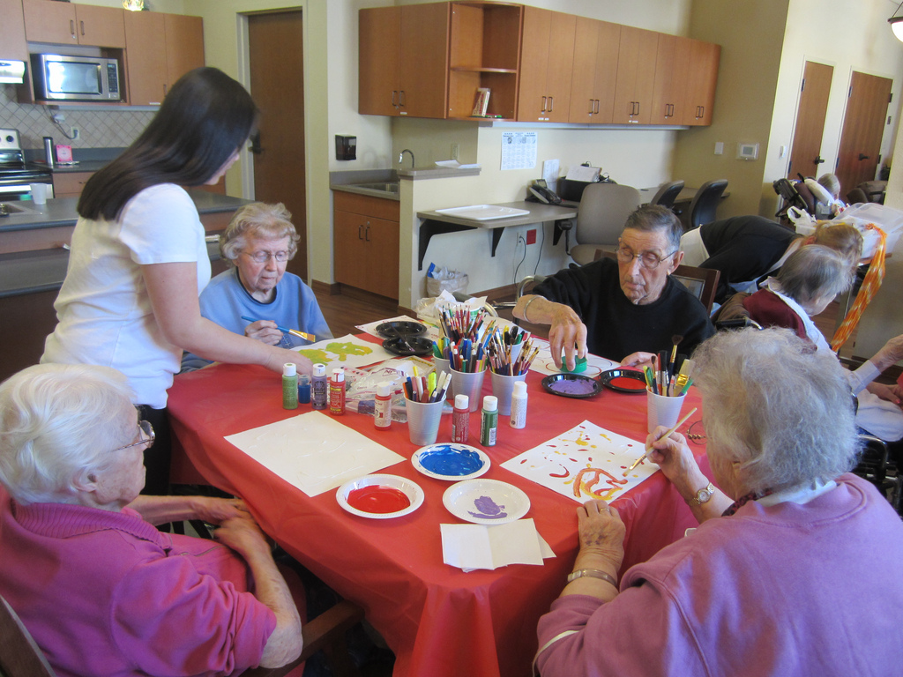
Guidance on making referrals for older adults with care and support needs including the criteria and the housing application process
Full guidance available via the intranet: just type in Standard Operating Procedure (SoP)

Slide 3
Extra care housing (also known as Special Sheltered or Assisted Living) is a type of 'housing with care' which means the individual retains independence while receiving assistance with tasks such as washing, dressing, toileting, hot meals or taking medication
The Housing LIN describe it as
The term 'extra care' housing is used to describe developments that comprise self-contained homes with design features and support services available to enable self- care and independent living.
We can | We can’t
Provide double or single carer calls | Manage tenants money
Support with basic food prep | Fully administer medication (place in mouth)
Support with medication | Hold tenants medication or money in the staff office
Encourage and enable independence | Facilitate DOLS

Slide 4
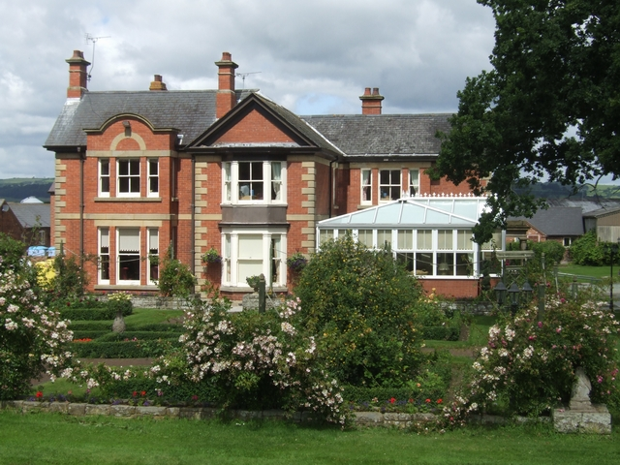
Criteria for Extra Care Housing
The client is required to be over the age of 55
The client is required to have support needs that requires the care of professional carers. The level of need upon entering the tenancy agreement cannot exceed that of a domiciliary package (i.e. not be at a level of need that is aligned with nursing needs). Special Sheltered can be seen as an alternative to residential care. This includes the use of district nursing.
Extra Care cannot support with shopping or cleaning (from December 2019). Ideally this should be sourced from the individuals support network or a voluntary provider.
The client has to be a resident of Croydon (“Ordinarily resident”)
The client will need to have the ability to sign a tenancy (or have one signed for him by Court appointed Deputy, Lasting Power of Attorney or Court of Protection)
The client will need to accept aspects of communal living
The client themselves (or associates of the client) cannot be a risk to staff or fellow tenants through criminal and/or anti-social behaviour
The client cannot have another tenancy in Croydon
The client will need to have sold a property, or be making reasonable attempts to do so, at the point of entering a tenancy agreement for special sheltered housing

Slide 5
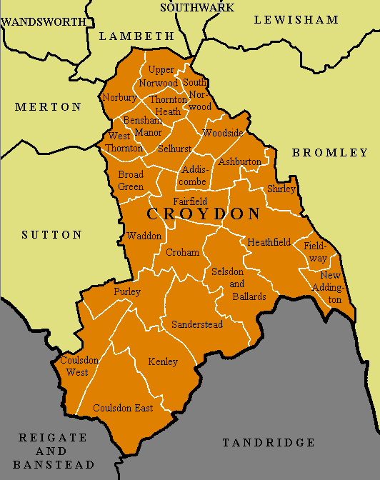
Criteria for Extra Care Housing
Reside in the borough; be eligible for
registration under the Housing Application
and Transfer Scheme; or be a nominee to
LB Croydon under the Mobility Scheme,
having a specific need to be near relatives
or close friends in the borough.
(If the person lives outside of the borough
of Croydon they will get low priority but will
be considered)

Slide 6
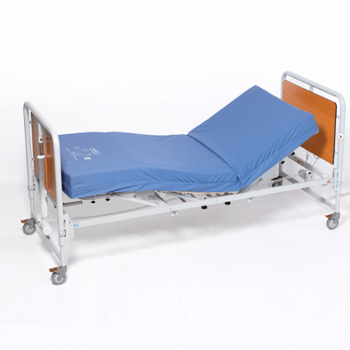
Adults who are owner/occupiers or who are living in Council property, housing association property or private rented accommodation.
Adults who might not be suitable for extra care accommodation include people who have nursing care needs, or whose care needs vary significantly throughout the day or week, require very high levels of care or whose health conditions are likely to deteriorate rapidly.

Slide 7
Croydon Council
Brookhurst Court
Freemans Court
Frylands Court
Southsea Court
Toldene Court
Truscott House
London Care
Fellows Court
Eldon Housing
Westdene Court
Lindsay Court
Referrals via social workers/Health & Wellbeing Assessors only

Slide 8
RENTS CROYDON COUNCIL SCHEMES (WEEKLY) subject to change Rent 94.06 Heating 10.58 Service charge 10.38 Water rates 1.88 New rents: Truscott (Rent) £145.56 Service Charge £ 12.64 Southsea Court (Rent) £147.28 Service Charge £12.64 Current extra care rates for commissioned care and support visits are:- 60mins = £18.10 45mins = £14.05 30mins = £9.38 15mins = £4.68 | Laundry = £10.11 per load/hour (please ensure this is entered as SSH laundry on LAS) Domestic = as per rates above You are unlikely to be asked about service fees, but again, just for information, the service charge for Tenants has not been increased and remains at £73.77 per week. This is charged separately and in addition to the care visits.

Slide 9
Fellows Court Extra Care charge rate (since April 2019) - Care £16.32/hr, £12.24/45min, £8.16/30min, £4.08/15min - Shift £16.00 - Waking Night (ECS) £16.00 ELDON HOUSING (WESTDENE, LINDSAY COURT – WEEKLY) subject to change Westdene Lindsay Court Rent £151.95 £164.44 Services £288.58 £190.80 Enhanced Management £ 70.60 £ 70.60 Supplement £144.03 £108.69 Care Level 1(Spot Purchase) £210.61 £ 72.65 Care Level 2(Spot Purchase) £235.40 (Dementia) £108.55 The rent, service charge and enhanced management is eligible for housing benefit if applicable and the supplement charge is not eligible for HB and is payable by the tenant and is for meals, heating and water.

Slide 10
FELLOWS COURT (weekly rates)
Rent £139.85
Services £102.09
Enhanced Management £ 13.21
Supplement £136.88 This amount is for meals, utilities and laundry and is not applicable for HB
TOTAL £392.02

Slide 11
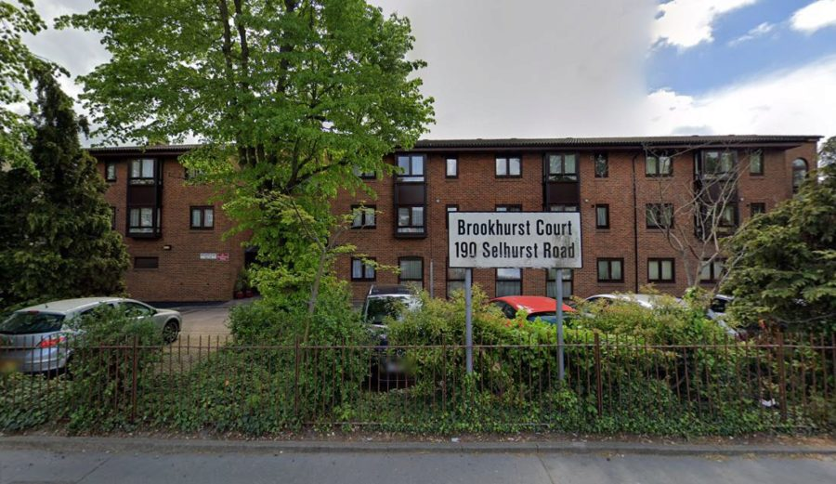
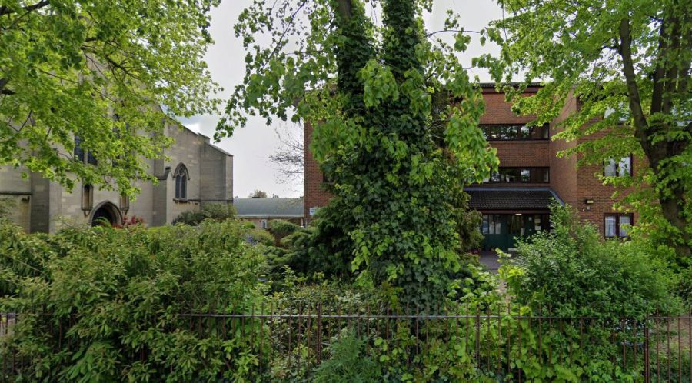
BROOKHURST COURT

Slide 12
BROOKHURST COURT
190 Selhurst Road
South Norwood
SE25 6XX
Phone: 020 8771 7560
Manager:
Eunice Anteh
Eunice.Anteh@croydon.gov.uk
Main facts
30 flats. Sizes 1 bedroom. Includes mobility standard properties
Extra Care Housing scheme with on-site care staff (with waking night staff)
Lift, lounge, dining room, laundry, guest facilities (under review), garden, assisted bathing facility
Whole site accessible by wheelchair. Access to site fairly easy. Distances: bus stop 30 yards; shop 50 yards; post office 50 yards; town centre 70 yards; GP 30 yards; social centre 2 mile(s)
Regular Social Activities include: Bingo, parties, entertainment.
Cats only generally accepted (decision made by scheme manager on individual basis)

Slide 13
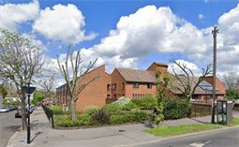
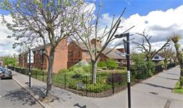
FREEMAN COURT

Slide 14
Main facts
60 flats. Sizes 1 bedroom. Includes mobility standard properties
Extra Care Housing scheme with on-site care staff (with waking night staff)
Lift, lounge, dining room, laundry, guest facilities, garden, assisted bathing facility
Whole site accessible by wheelchair. Access to site fairly easy. Distances: bus stop 20 yards; shop 0.5 mile(s); post office 0.5 mile(s); town centre 1 mile(s); GP 0.5 mile(s); social centre 2 mile(s)
Regular Social Activities include: Bingo, parties, entertainment.
Cats only generally accepted (decision made by scheme manager on individual basis)
FREEMAN COURT
94 Stanford Road
Norbury
SW16 4QR
Phone: 020 8679 3587
Manager:
Mimi Nduka
Mimi.Nduka@croydon.gov.uk

Slide 15
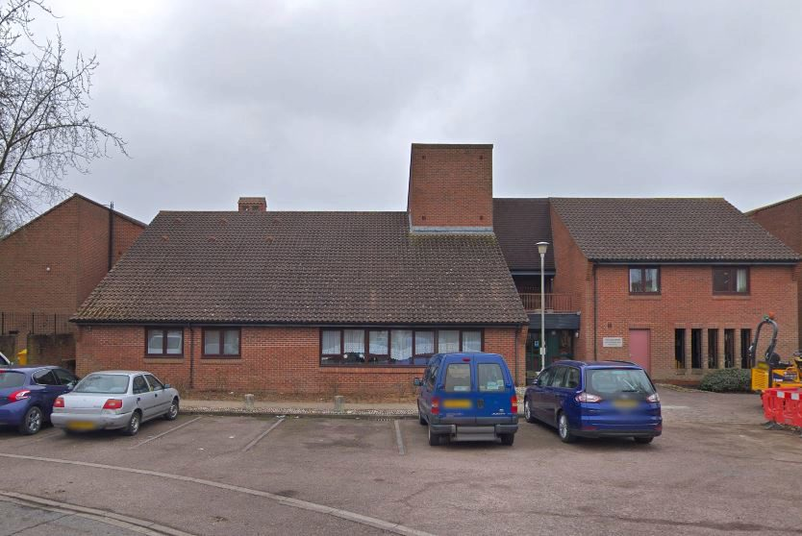
FRYLANDS COURT

Slide 16
Main facts
40 flats. Sizes 1 bedroom. Includes mobility standard properties
Extra Care Housing scheme with on-site care staff (with waking night staff)
Lift, lounge, dining room, laundry, guest facilities, garden, assisted bathing facility
Whole site accessible by wheelchair. Access to site fairly easy. Distances: bus stop 0.5 mile(s); shop 0.5 mile(s); post office 0.5 mile(s); town centre 0.5 mile(s); GP 1 mile(s); social centre 0.5 mile(s)
Regular Social Activities include: Bingo, parties, entertainment.
Cats only generally accepted (decision made by scheme manager on individual basis)
FRYLANDS COURT
24 Hutchingsons Road
New Addington
CR0 0BD
Phone: 01689 847233
Manager:
Rodica.rogojanu@croydon.gov.uk
07926085078

Slide 17
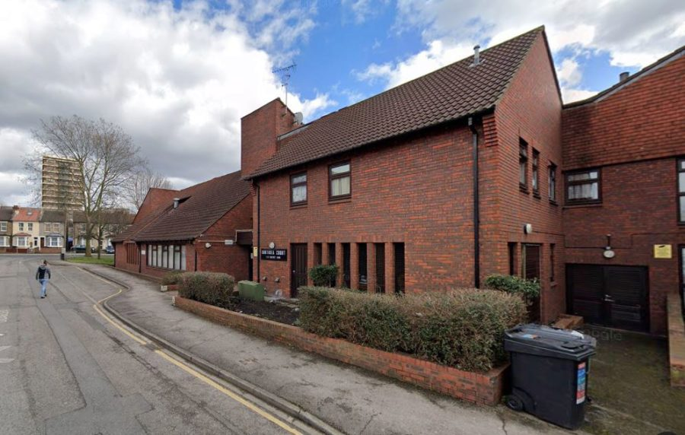
SOUTHSEA COURT

Slide 18
Main facts
40 flats . Sizes 1 bedroom
Extra Care Housing scheme with on-site care staff (waking night staff)
Lift, lounge, dining room, laundry, garden, assisted bathing facility
Not suitable for wheelchairs. Access to site fairly easy. Distances: bus stop 50 yards; shop 0.5 mile(s); post office 0.5 mile(s); town centre 1 mile(s); GP 0.5 mile(s); social centre 2 mile(s)
Regular Social Activities include: Bingo, parties, entertainment.
Cats only generally accepted (decision made by scheme manager on individual basis)
SOUTHSEA COURT
1/41 Eastney Road
Croydon
CR0 3TB
Phone: 020 8680 2831
Manager:
Rodica Rogojanu
Rodica.rogojanu@croydon.gov.uk
07926085078
and Marie Stuart
Registered Manager

Slide 19
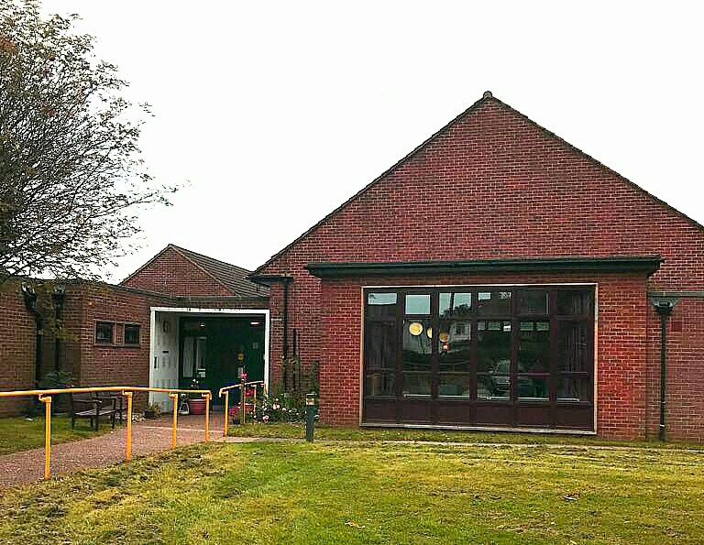
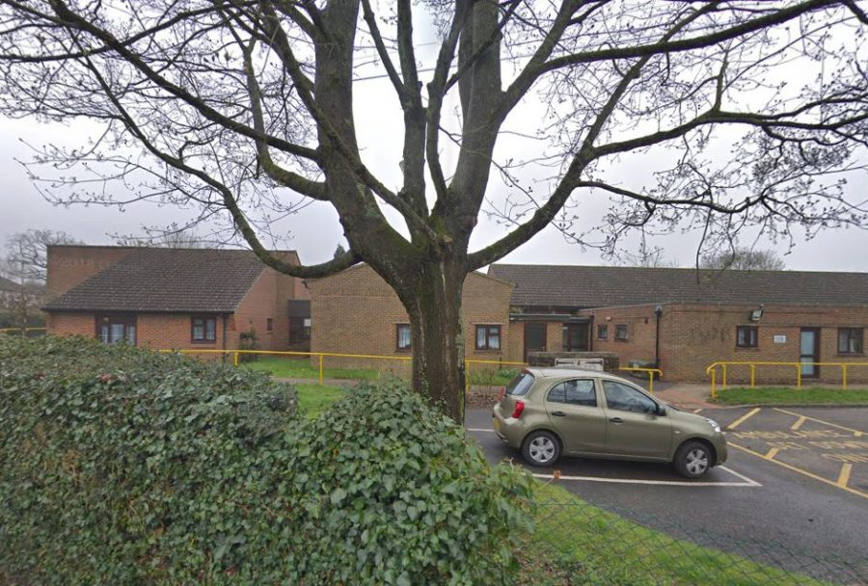
<iframe
TOLDENE COURT

Slide 20
Main facts
49 flats. Sizes 1 bedroom. Extra Care Housing scheme with on-site care staff (waking night staff)
Lounge, dining room, laundry, garden, assisted bathing facility
Whole site accessible by wheelchair. Access to site fairly easy. Distances: bus stop 50 yards; shop 70 yards; post office 0.5 mile(s); town centre 2 mile(s); GP 70 yards; social centre 2 mile(s)
Regular Social Activities include: Bingo, parties, entertainment.
Both cats & dogs generally accepted (decision made by scheme manager on individual basis)
TOLDENE COURT
106 Tollers Lane,
Coulsdon CR5 1BD
Telephone 07892 789023
Manager
Marie Stuart
Marie.Stuart2@croydon.gov.uk

Slide 21
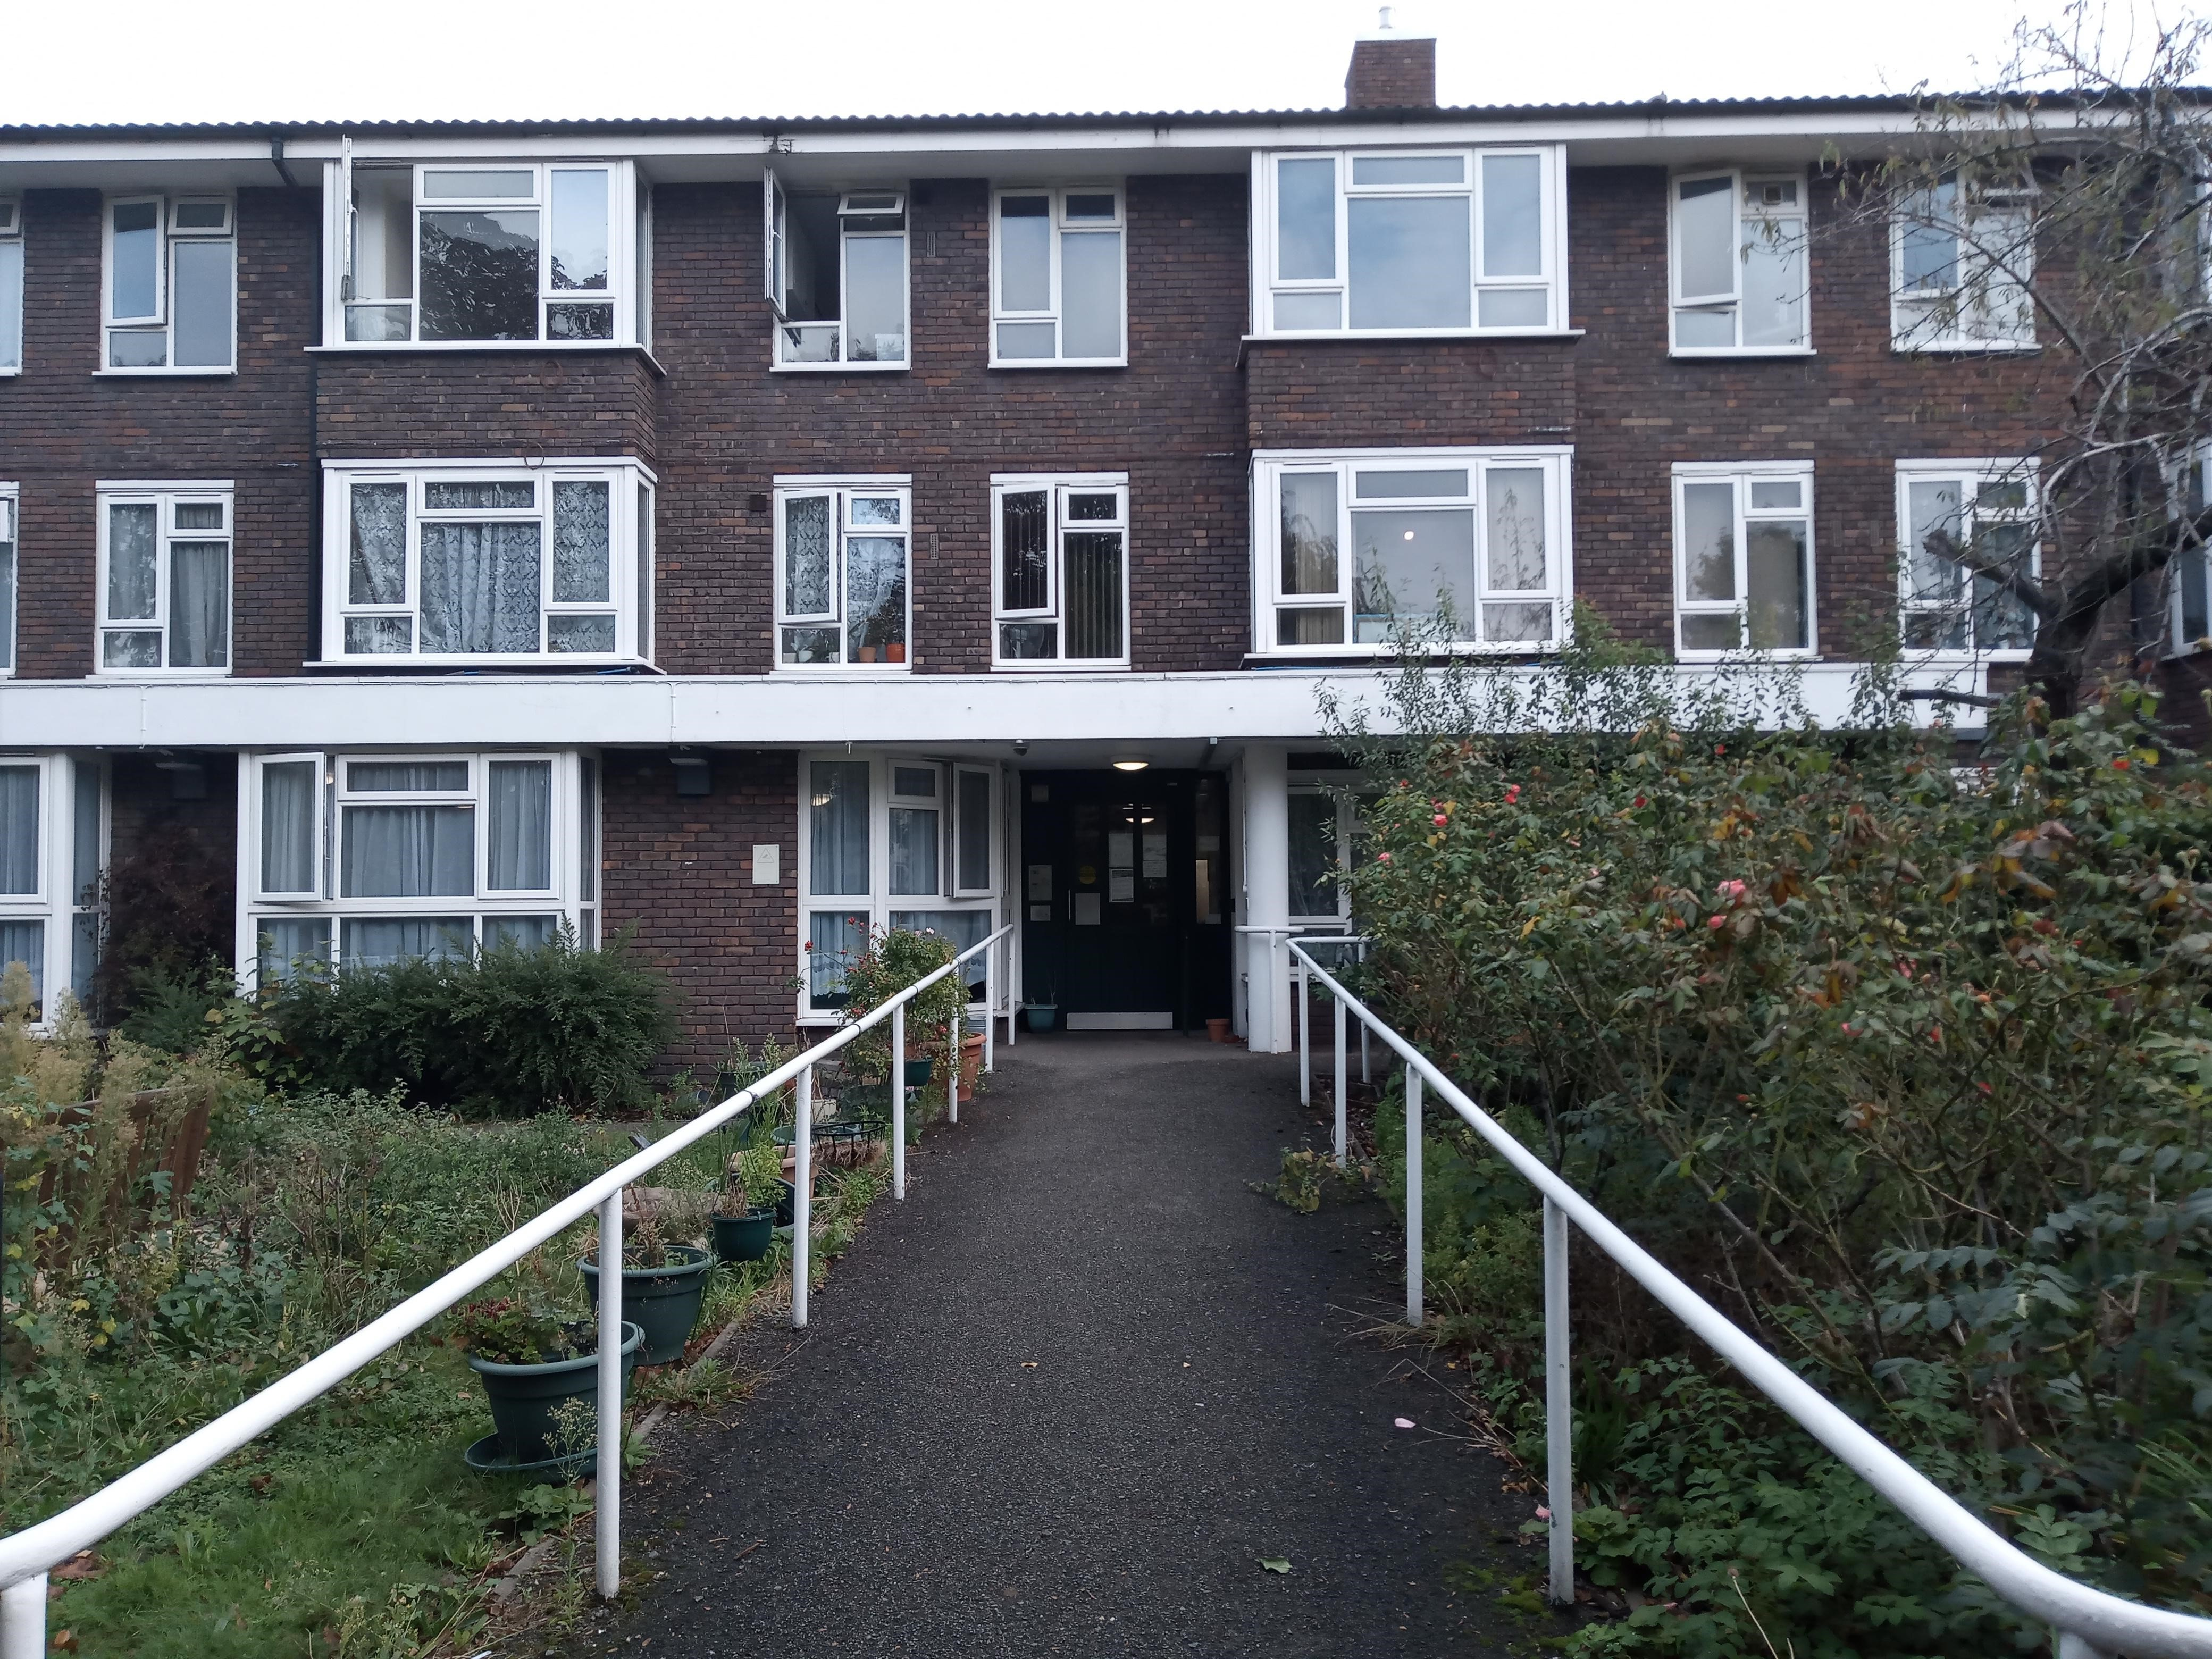
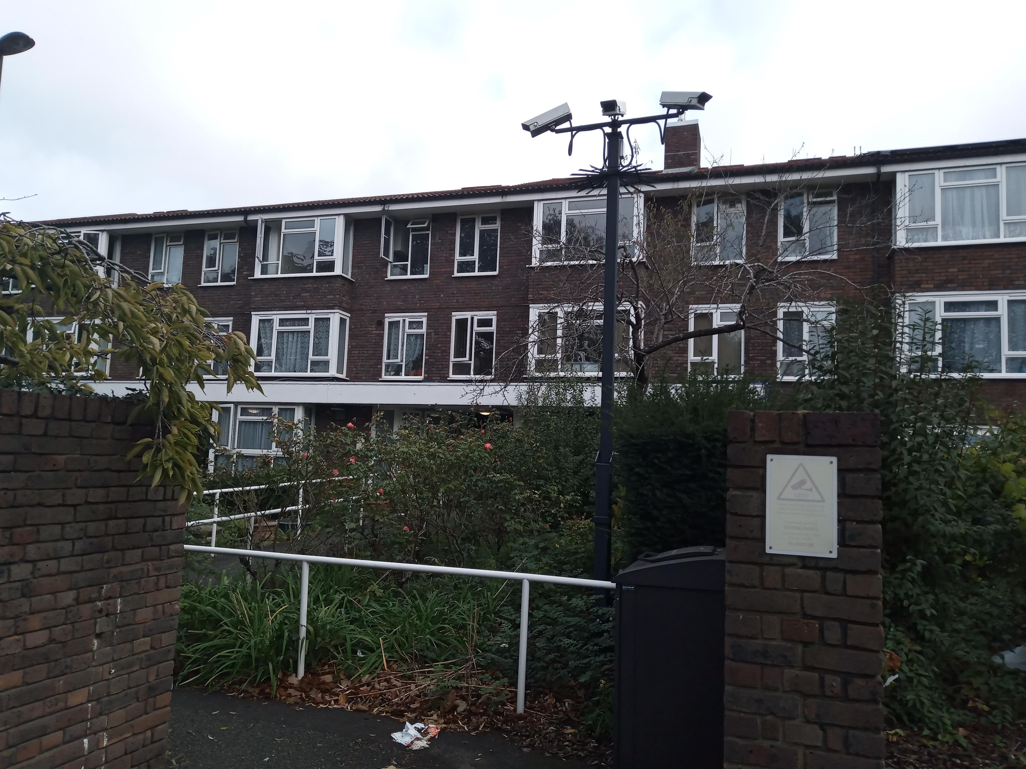
TRUSCOTT HOUSE

Slide 22
Main facts
Extra care housing
40 flats. Sizes 1 bedroom
Extra Care Housing scheme with on-site care staff (waking night staff)
Lift, lounge, dining room, laundry, guest facilities, garden, assisted bathing facility
Not suitable for wheelchairs. Access to site fairly easy. Distances: bus stop 50 yards; shop 50 yards; post office 0.5 mile(s); town centre 1 mile(s); GP 0.5 mile(s); social centre 2 mile(s)
Regular Social Activities include: Bingo, parties, entertainment.
Tenure(s): Rent (social landlord)
TRUSCOTT HOUSE
14 Stanley Grove
West Croydon
CR0 3QU
Phone: 020 8684 9263
Manager
Cristina Sande
Cristina.Sande@croydon.gov.uk

Slide 23
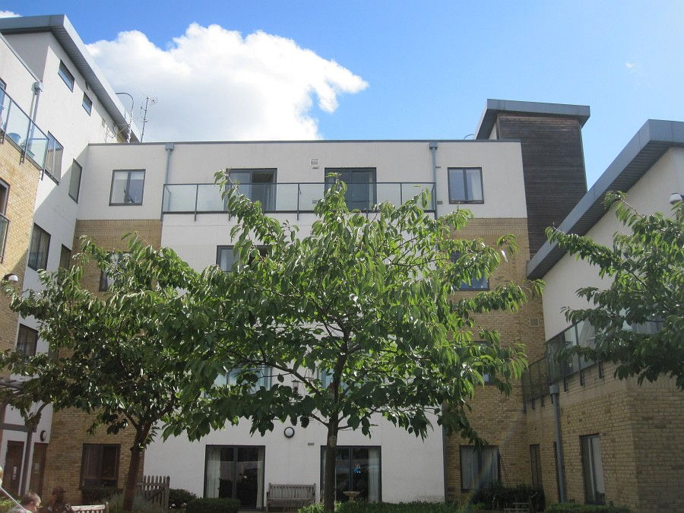
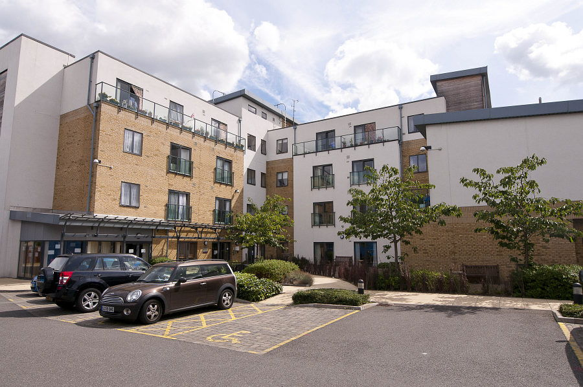
FELLOWS COURT

Slide 24
Main facts
For higher dependency applicants who have been assessed as needing extra care only
40 flats. Built in 2008. Sizes 1 bedroom, 2 bedroom
Extra Care scheme with on-site care staff (24 hours / 7 days), non-resident management staff
Lounge, laundry, garden, community centre
Some meals available (Lunch 7 days a week)
Tenure(s): Rent (social landlord)
Care provider: London Care Limited
Developed by Eldon Housing Association Ltd
FELLOWS COURT
(London Care)
34 Morland Road, Croydon, CR0 6AZ
Sharon Johnson
Eldon Housing Association Ltd
Phone: 0208 655 6724
Fax: 0208 763 8763
SJohnson@eldonhousing.co.uk
Shorai Udia
Registered Manager
London Care Fellow’s Court
32-34 Morland Road
Croydon CR0 6NA
Tel: 02086545216
Mobile: 07884902993
Shorai.Udia@cchmail.co.uk
www.candchealthcare.co.uk

Slide 25
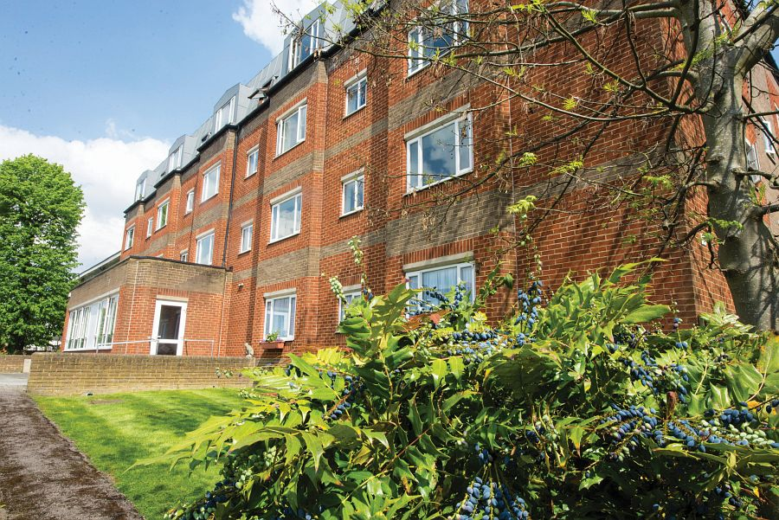
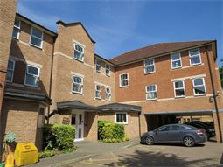
WESTDENE
LINDSAY COURT

Slide 26
WESTDENE
(Eldon Housing)
Hilda Matovu – Registered Care Manager
E-Mail – HMatovu@eldonhousing.co.uk
Direct Dial: 020 8688 7603
16 Chatsworth Road, Croydon CR0 1HA
Housing Officer
Sharon Johnson
Eldon Housing Association Ltd
Phone: 0208 655 6724
Fax: 0208 763 8763
SJohnson@eldonhousing.co.uk
Main facts
20 flats. Built in 1988 and renovated in 2014. Sizes 1 bedroom, 2 bedroom. Includes mobility standard properties
Extra Care scheme with on-site care staff, non-resident management staff (24 hours, 7 days)
The scheme has the ability to support and accommodate people living with Dementia, physical disabilities and mental heath. (Designated dementia flats available.)
Lift, lounge, dining room, laundry, guest facilities, garden
Access to site fairly easy, but less so for less mobile people
Regular social activities. New residents accepted from 60 years of age
Tenure(s): Rent (social landlord)
Care provider: Eldon Housing Association
Developed by Eldon Housing Association Ltd

Slide 27
Main facts
29 flats. Built in 1995. Sizes studio, 1 bedroom. Includes mobility standard properties
Extra Care scheme with 24 hours / 7 days), Non-resident management staff (24 hours, 7 days)
lift, lounge, dining room, laundry, garden
Access to site fairly easy
Regular social activities. New residents accepted from 60 years of age
Tenure(s): Rent (social landlord)
Care provider: Eldon Housing Association
LINDSAY COURT
(Eldon Housing)
Janice Hughes, Registered Manager JHughes@eldonhousing.co.uk
2 Eden Road, Croydon, Surrey, CR0 1FA
Housing Officer
Sharon Johnson
Eldon Housing Association Ltd
Phone: 0208 655 6724
Fax: 0208 763 8763
SJohnson@eldonhousing.co.uk

Slide 28
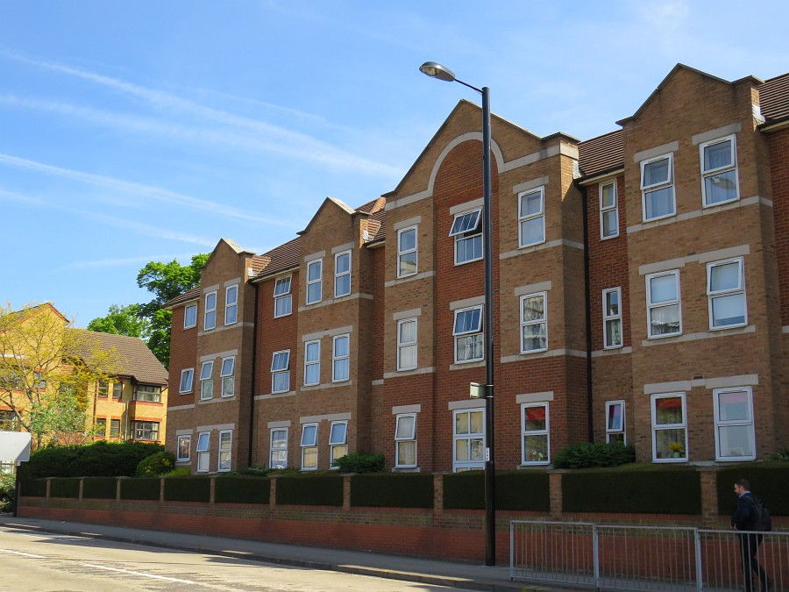
NOMINATION RIGHTS FOR ELDON HOUSING – WESTDENE AND LINDSAY COURT
The Council has nomination rights for Eldon Housing’s Westdene and Lindsay Court.
Eldon provide both the care and housing management in these services, so they complete the tenancy sign up with individuals who are accepted to move in. As well as standard extra care flats, Westdene has six one-bedroom flats for people with dementia and two flats which are able to accommodate wheelchairs for older people with a physical disability.
Lindsay Court

Slide 29
Application process for Extra Care Housing
Ensure your team manager has checked and approved the adult’s assessment and care and support plan
Ensure that a Housing Application or Housing Transfer form
(for existing Council tenants) has been completed by the
applicant/family and submitted to Housing Regiser
for applications to LB Croydon-owned schemes
Please Note: A referral cannot be considered until this has been
done. The housing form does not have to be completed for
applications for Fellows Court, Lindsay Court or Westdene as the
landlords are Eldon Housing, not Croydon Council

Slide 30
Workflow the Good Conversation Record through to the Extra Care Housing task box on LAS. For SLaM referrals a risk assessment is also required. Record in notes which unit(s) the adult has chosen in order of preference.
Please Note: It is essential that you clearly write the
hours of care and support in the care and support plan,
and that you complete the indicative budget. In the care
and support plan, detail all the tasks the carers need to
complete and how many staff are required to complete
each task.
Ensure that potential clients or their relatives complete a financial assessment form. Both the Council and Eldon Homes www.eldonhousing.org have charging policies concerning care and support provision. Ensure that the applicant and their family understand and respond appropriately to these policies.

Slide 31
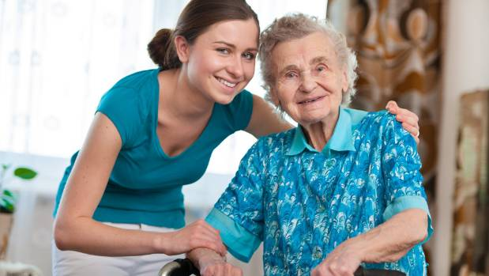
Following referral, the SBSO will save, update records and then send the paper work to the Scheme Manager for them to invite the adult in for an Assessment.
If the adult has no support, the care manager is expected to help facilitate the Assessment and if necessary, accompany the adult to the scheme. Following the Assessment, the scheme manager will email the SBSO stating whether the adult is suitable or unsuitable. At this point, a void can be nominated to the adult or they may have to wait for a void.

Slide 32
the referral process has been re-modelled for the purpose of speeding up applications, and ensuring the suitability of the individuals being referred. Whilst all referrals should still be sent via LAS, and will be facilitated by Debbie Bentley-Ross, the main change is that the housing panel meetings will now only happen by exception. All suitable referrals will go straight to an assessment visit (formally known as a familiarisation visit) on site at the chosen scheme and panel will only need to be attended if there is a query around suitability. This new referral process will commence on September 1st 2022.
Cases from other boroughs will be considered but automatically be given a lower priority than those who live within Croydon.
Tenants wanting an internal move within the same building will get low priority unless
there are medical grounds.
Fellows Court provides higher levels of care than the six LB Croydon-owned Extra Care housing schemes. Fellows Court has waking night staff and higher levels of staffing. If a tenant’s needs cannot be met in one of the six special sheltered units then an application for Fellows Court can be made. Applicants would not ordinarily be on the list for Fellows Court and on the list for one of the other Extra Care schemes simultaneously.

Slide 33
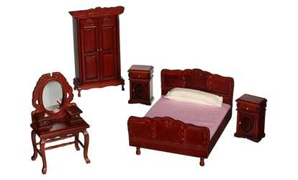
MOVING IN (please make sure that the scheme has at least 24 hours notice (ideally 48 hours)
Offer support to the adult if needed, including support to move in to the flat.
Please remember that the flat will need
to be furnished (including carpets and curtains) (if the adult does not have a family or friend then you will need to help the adult with this and order in any special items such as hospital bed). Contact local
charitable organisations for help with furniture if funding is an issue.

Slide 34
Reassure yourself that the applicant has understood the tenancy agreement, including the arrangements for ending the tenancy. (Please note that bills are
the responsibility of the tenant and carers are unable to pay bills on their
behalf)
• Enter the date of the start of the tenancy on Liquid Logic, which is also the date for charging to begin.
• Give contact information for the Croydon Contact Centre and for Occupational Therapy services to the adult concerned, their next of kin (carer and/or support person). Inform them that if the wellbeing of an adult with care and support needs deteriorates, or their circumstances change and it is felt that the provider can no longer meet the person’s needs, they can contact Croydon Contact Centre. All safeguarding referrals should be made through the link there.

Slide 35
Review
If the placement in Extra Care Housing has been made from the community, the case remains allocated to the placing practitioner after the adult has moved in to extra care accommodation until the first review.
If the placement in Extra Care Housing has been made on discharge from hospital, the case is allocated to a Locality team worker after the adult has moved in to extra care accommodation. The Locality team worker then carries out the first review at 6 weeks.
Social Worker/Health & Well Being Advisor:
Complete a 6-week review and record on Liquid Logic. Workflow to the Review Team for the next annual review.
Team Manager: Check and authorise review on Liquid Logic.
Social Worker/Health & Well Being Advisor:
Give a copy of the review and a detailed care and support plan to the resident and the manager or deputy manager of the extra care accommodation.

