Slide 1
EXTRA CARE HOUSING
(SPECIAL SHELTERED)

Slide 2
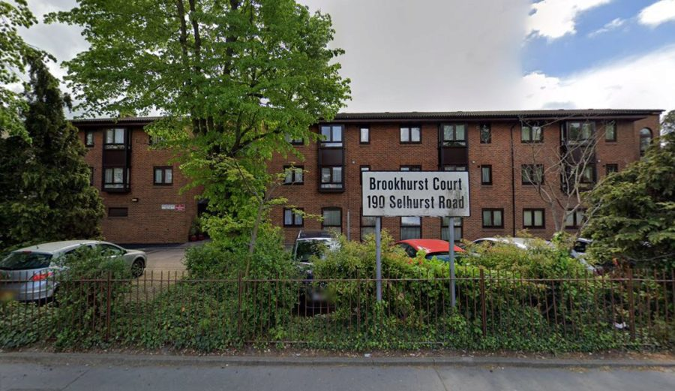
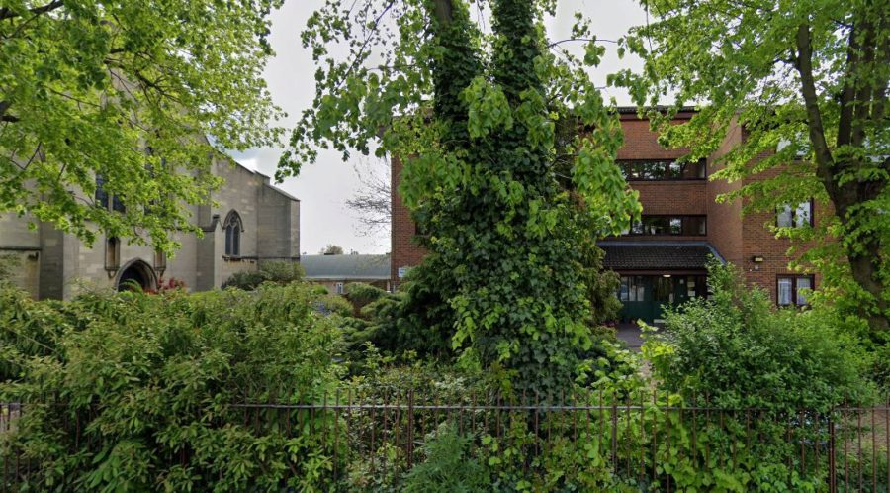
BROOKHURST COURT

Slide 3
BROOKHURST COURT
190 Selhurst Road
South Norwood
SE25 6XX
Phone: 020 8771 7560
Manager:
Eunice Anteh
Eunice.Anteh@croydon.gov.uk
Main facts
30 flats. Sizes 1 bedroom. Includes mobility standard properties
Extra Care Housing scheme with on-site care staff (with waking night staff)
Lift, lounge, dining room, restaurant, laundry, guest facilities, garden, assisted bathing facility
Access to site fairly easy. Distances: bus stop 30 yards; shop 50 yards; post office 50 yards; town centre 70 yards; GP 30 yards; social centre 2 mile(s)
Regular Social Activities include: Bingo, parties, entertainment. Some meals available (Mon to Fri).
Cats only generally accepted (decision made by scheme manager on individual basis)

Slide 4
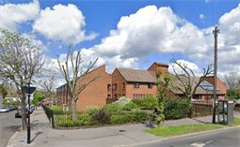
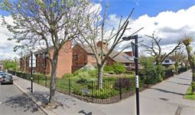
FREEMAN COURT

Slide 5
Main facts
60 flats. Sizes 1 bedroom. Includes mobility standard properties
Extra Care Housing scheme with on-site care staff (with waking night staff)
Lift, lounge, dining room, restaurant, laundry, guest facilities, garden, assisted bathing facility
Whole site accessible by wheelchair. Access to site fairly easy. Distances: bus stop 20 yards; shop 0.5 mile(s); post office 0.5 mile(s); town centre 1 mile(s); GP 0.5 mile(s); social centre 2 mile(s)
Regular Social Activities include: Bingo, parties, entertainment. Some meals available (Mon to Fri).
Cats only generally accepted (decision made by scheme manager on individual basis)
FREEMAN COURT
94 Stanford Road
Norbury
SW16 4QR
Phone: 020 8679 3587
Manager:
Mimi Nduka
Mimi.Nduka@croydon.gov.uk

Slide 6
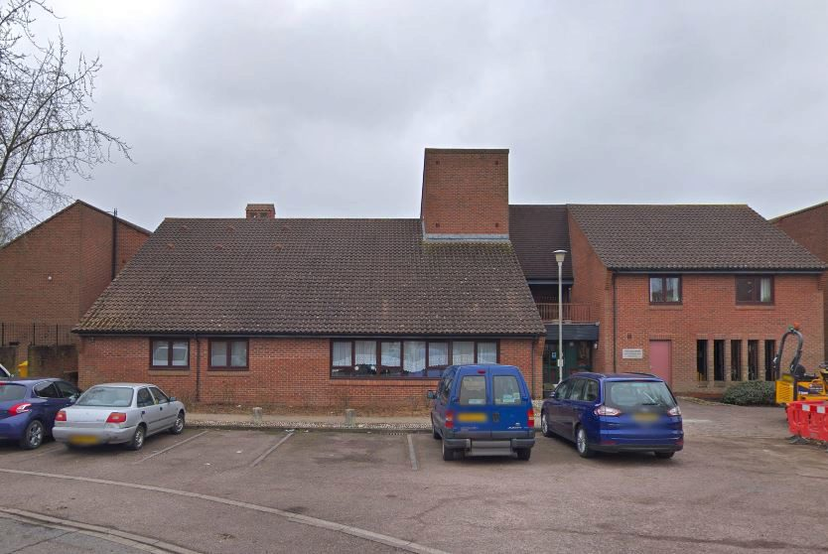
FRYLANDS COURT

Slide 7
Main facts
40 flats. Sizes 1 bedroom. Includes mobility standard properties
Extra Care Housing scheme with on-site care staff (with waking night staff)
Lift, lounge, dining room, restaurant, laundry, guest facilities, garden, assisted bathing facility
Whole site accessible by wheelchair. Access to site fairly easy. Distances: bus stop 0.5 mile(s); shop 0.5 mile(s); post office 0.5 mile(s); town centre 0.5 mile(s); GP 1 mile(s); social centre 0.5 mile(s)
Regular Social Activities include: Bingo, parties, entertainment. Some meals available (not every day).
Cats only generally accepted (decision made by scheme manager on individual basis)
FRYLANDS COURT
24 Hutchingsons Road
New Addington
CR0 0BD
Phone: 01689 847233
Manager:
Amanda Johnson
Amanda.Johnson@croydon.gov.uk
07840640261

Slide 8
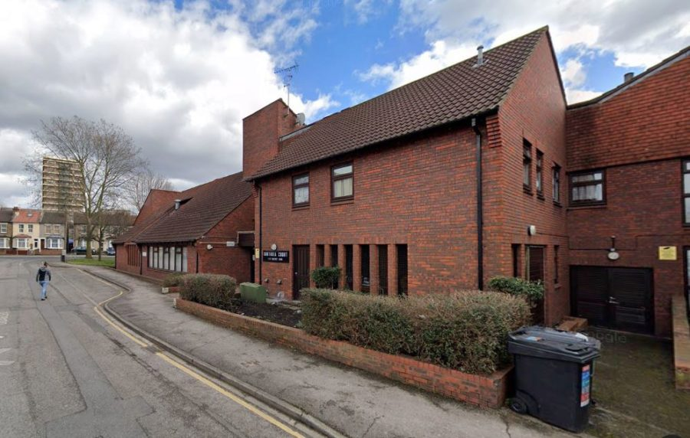
SOUTHSEA COURT

Slide 9
Main facts
40 flats . Sizes 1 bedroom
Extra Care Housing scheme with on-site care staff (waking night staff)
Lift, lounge, dining room, restaurant, laundry, garden, assisted bathing facility
Not suitable for wheelchairs. Access to site fairly easy. Distances: bus stop 50 yards; shop 0.5 mile(s); post office 0.5 mile(s); town centre 1 mile(s); GP 0.5 mile(s); social centre 2 mile(s)
Regular Social Activities include: Bingo, parties, entertainment. Some meals available (Mon to Fri)..
Cats only generally accepted (decision made by scheme manager on individual basis)
SOUTHSEA COURT
1/41 Eastney Road
Croydon
CR0 3TB
Phone: 020 8680 2831
Manager:
Rodica Rogojanu
Rodica.rogojanu@croydon.gov.uk
07926085078

Slide 10
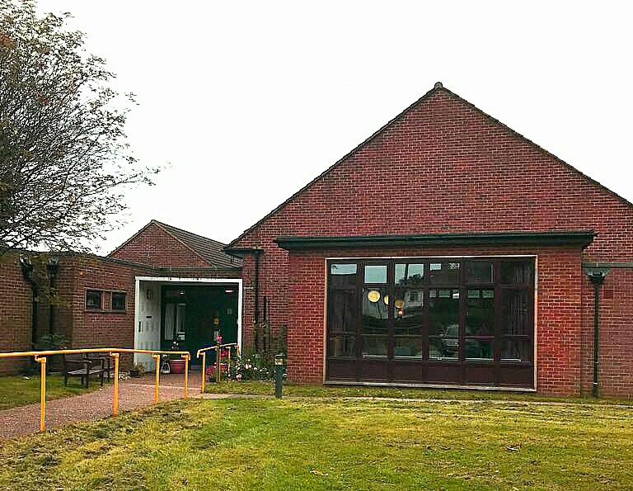
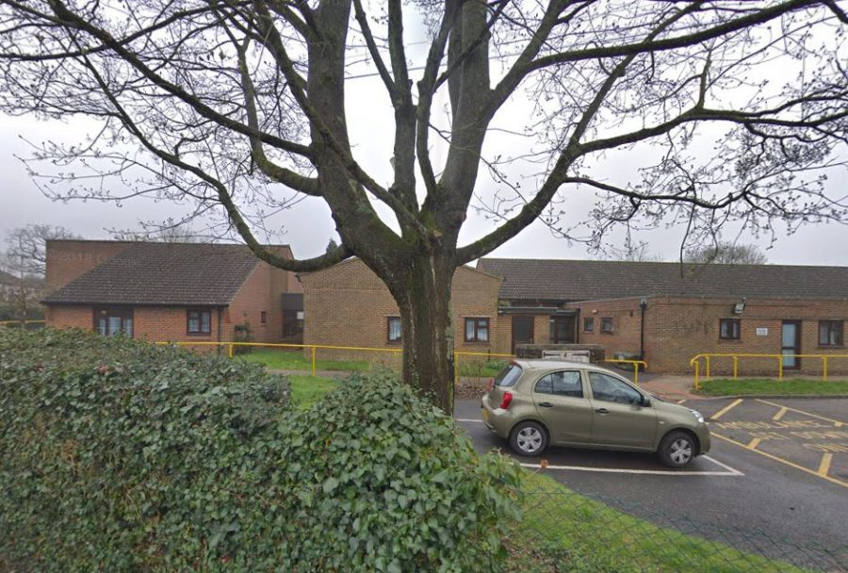
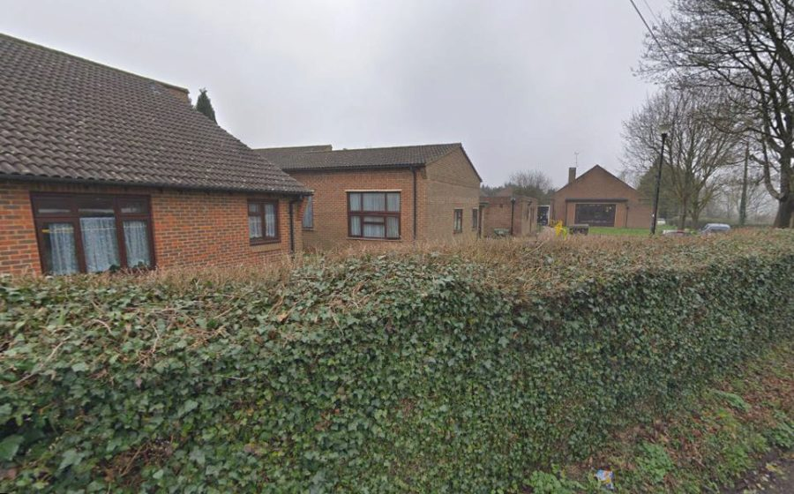
TOLDENE COURT

Slide 11
Main facts
49 flats. Sizes 1 bedroom. Extra Care Housing scheme with on-site care staff (waking night staff)
Lounge, dining room, restaurant, laundry, garden, assisted bathing facility
Whole site accessible by wheelchair. Access to site fairly easy. Distances: bus stop 50 yards; shop 70 yards; post office 0.5 mile(s); town centre 2 mile(s); GP 70 yards; social centre 2 mile(s)
Regular Social Activities include: Bingo, parties, entertainment. Some meals available (not every day).
Both cats & dogs generally accepted (decision made by scheme manager on individual basis)
TOLDENE COURT
106 Tollers Lane,
Coulsdon CR5 1BD
Telephone 07892 789023
Manager
Sameerah Arshad
Sameerah.Arshad@croydon.gov.uk

Slide 12
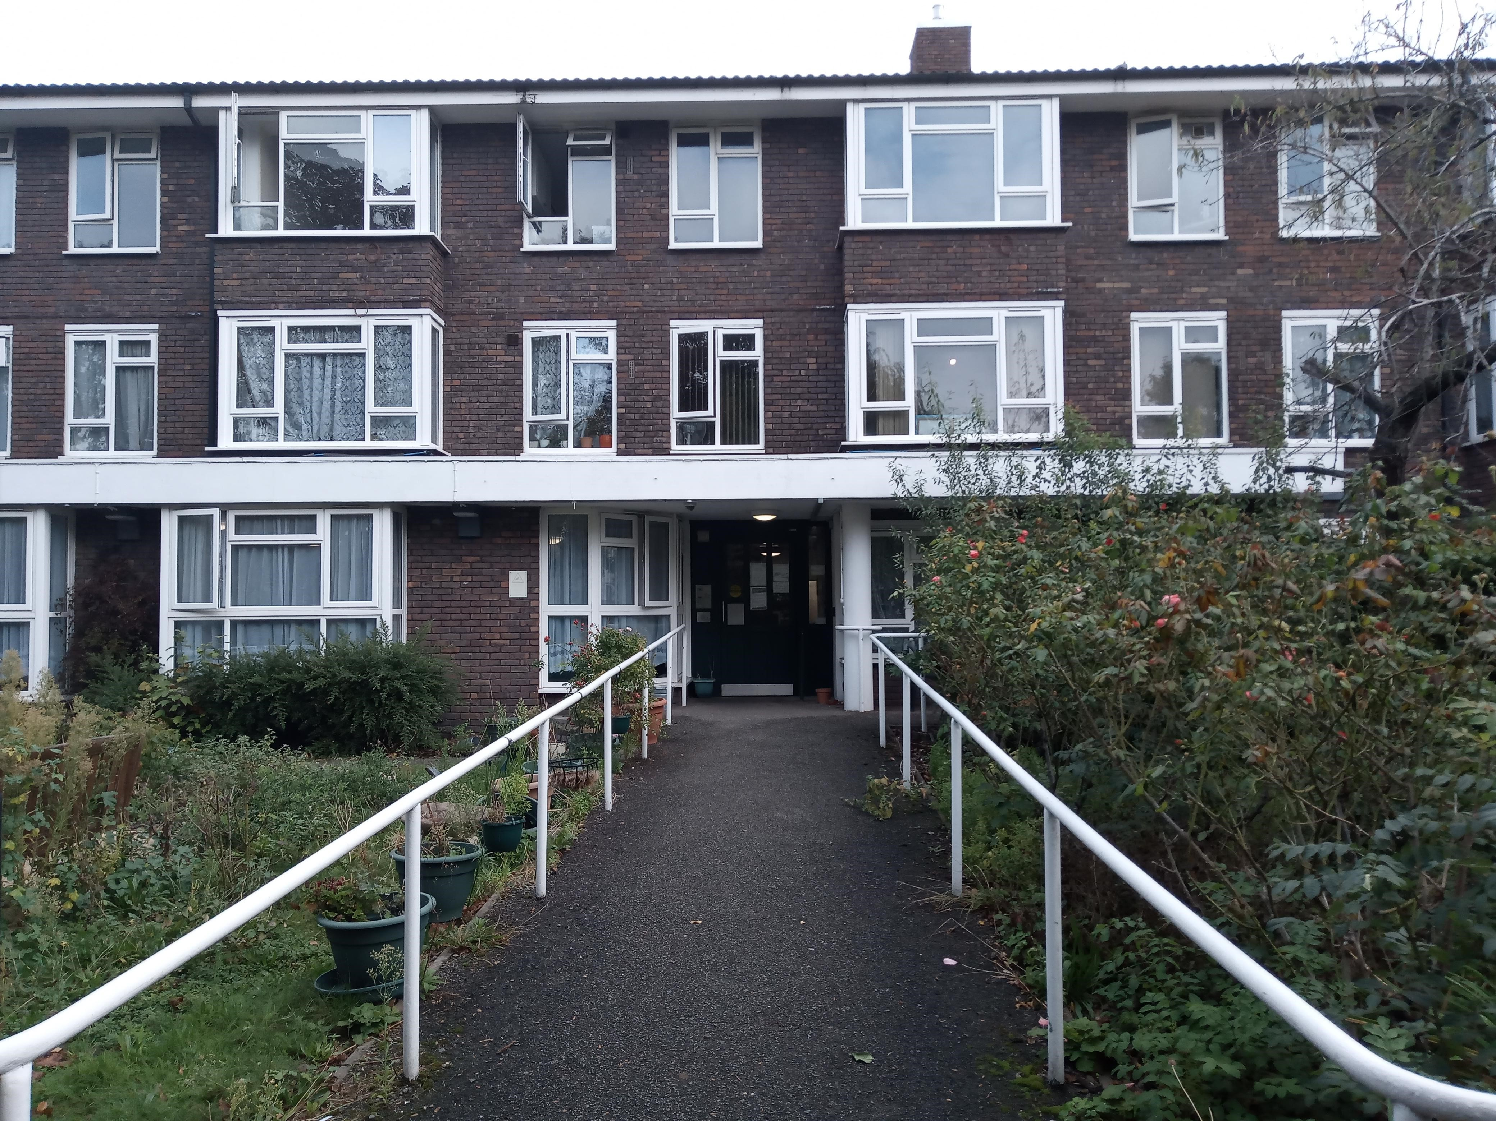
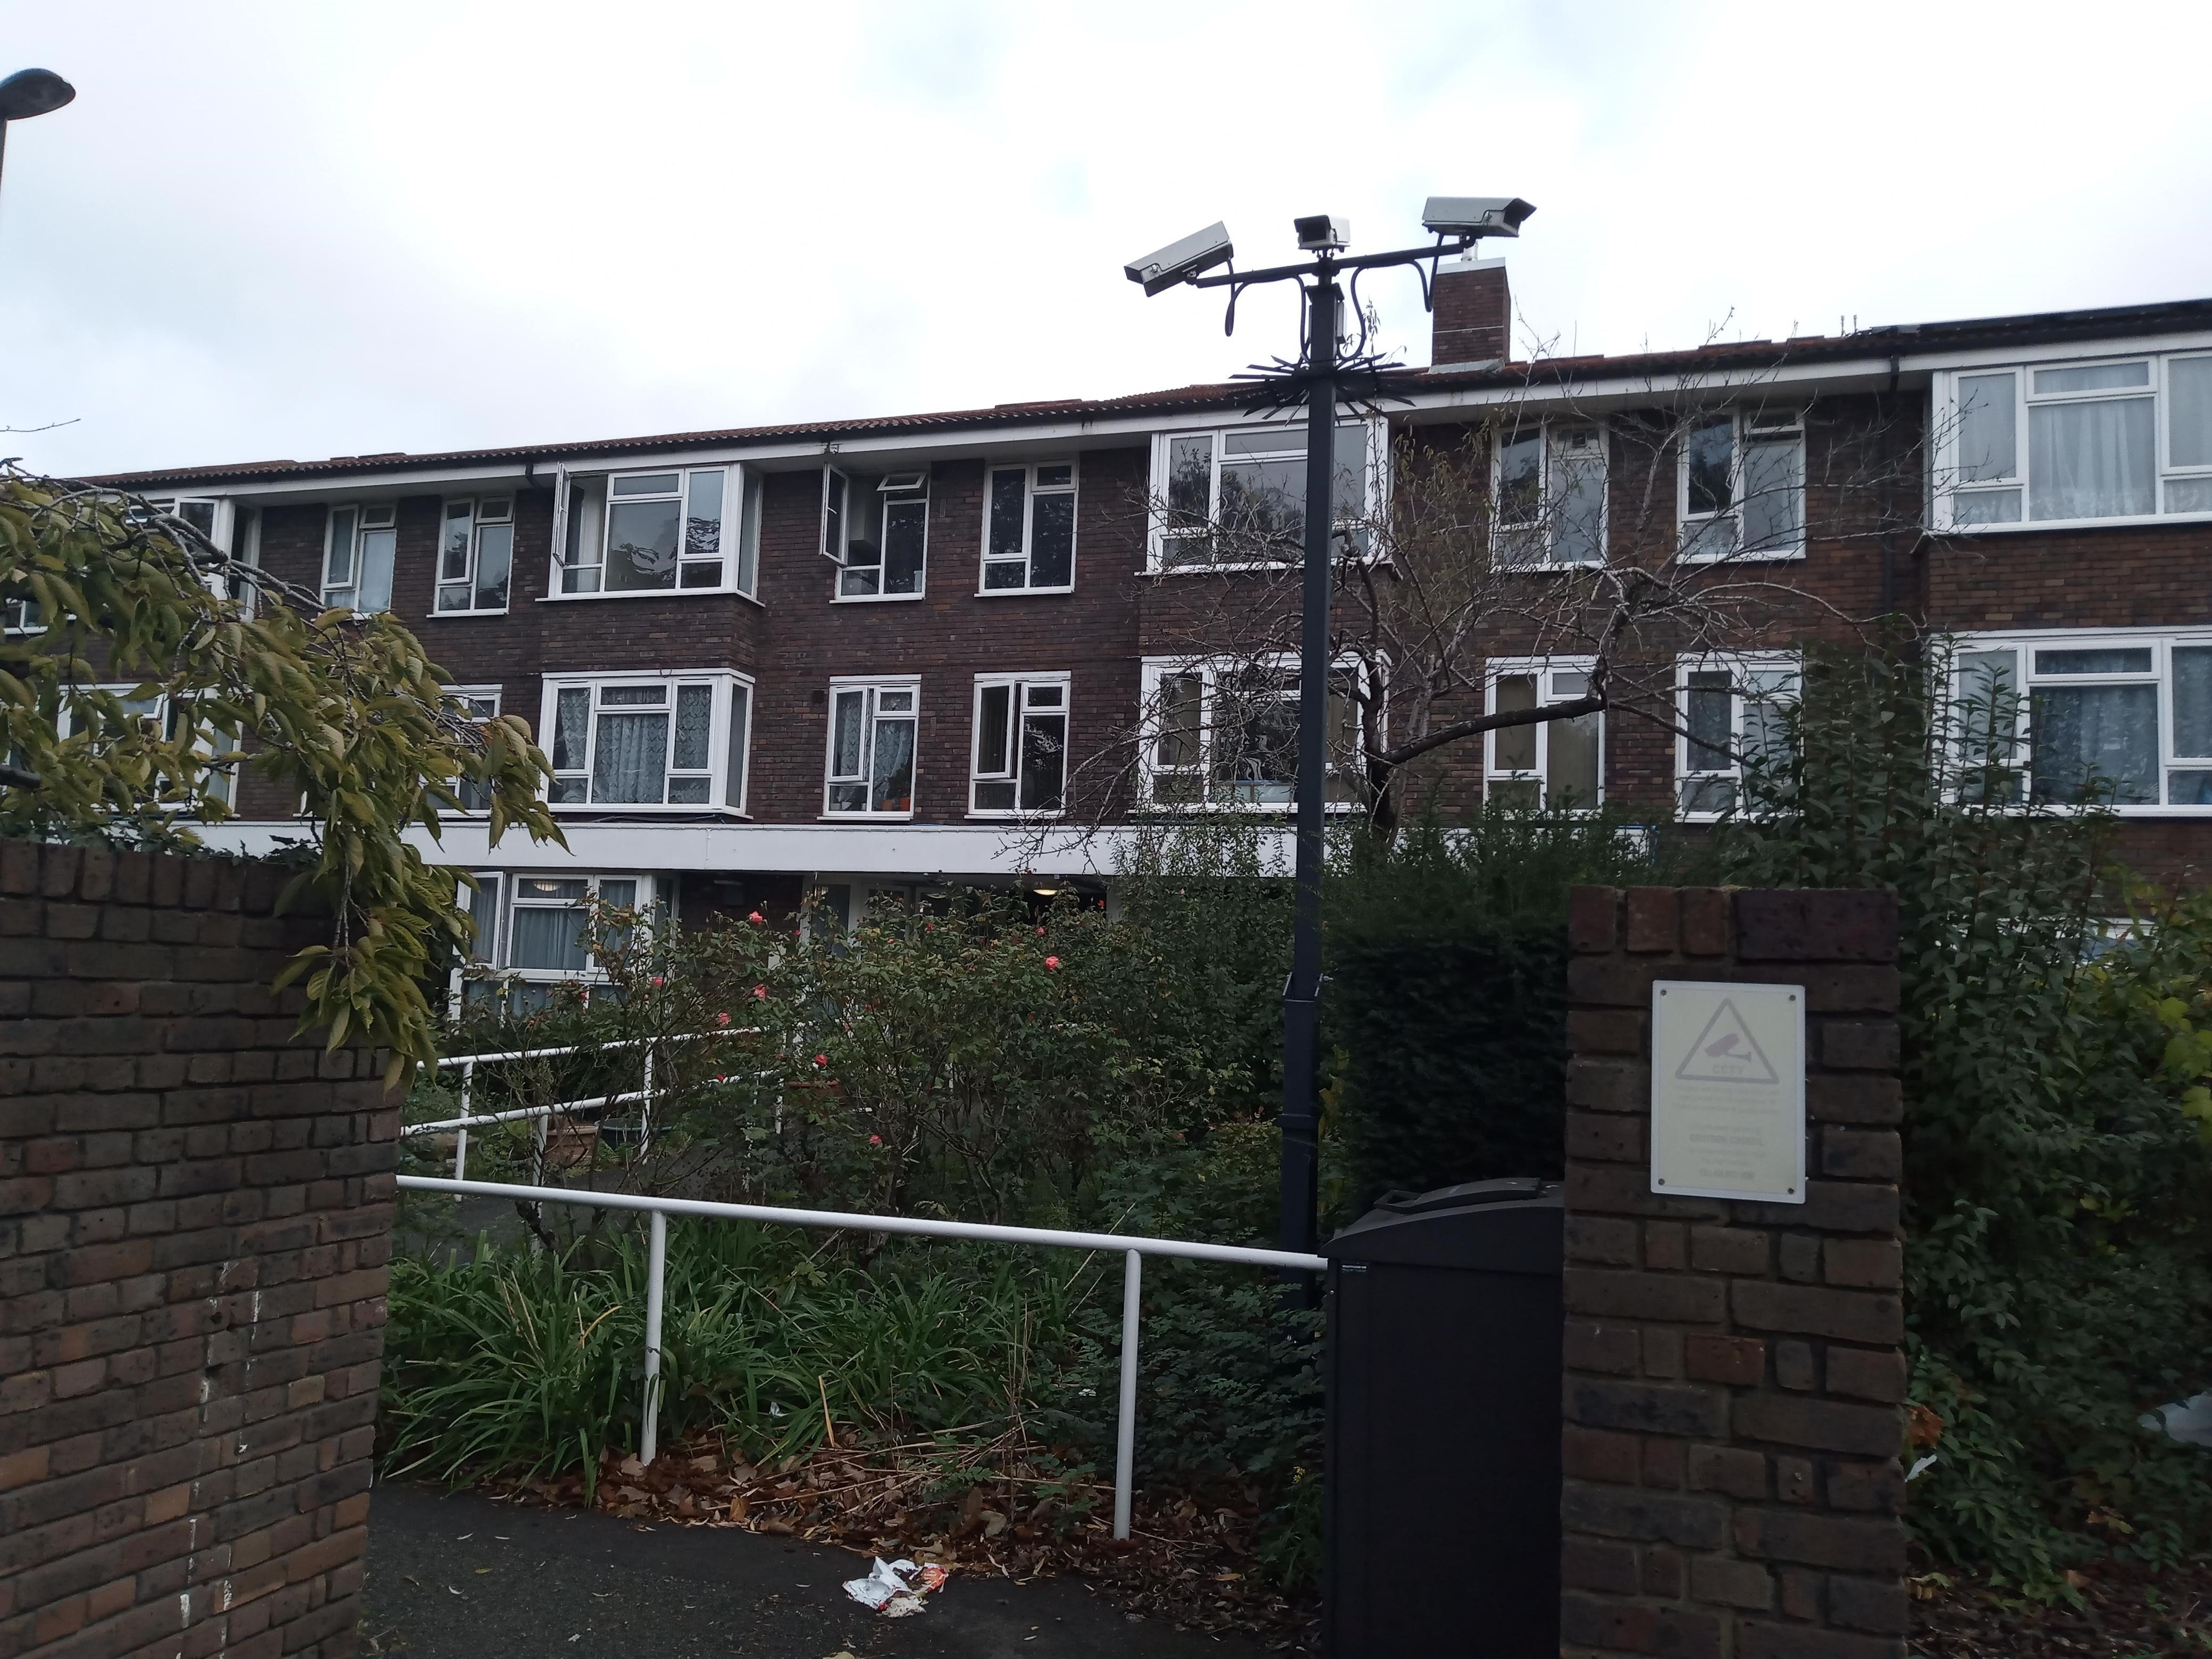
TRUSCOTT HOUSE

Slide 13
Main facts
Extra care housing
40 flats. Sizes 1 bedroom
Extra Care Housing scheme with on-site care staff (waking night staff)
Lift, lounge, dining room, restaurant, laundry, guest facilities, garden, assisted bathing facility
Not suitable for wheelchairs. Access to site fairly easy. Distances: bus stop 50 yards; shop 50 yards; post office 0.5 mile(s); town centre 1 mile(s); GP 0.5 mile(s); social centre 2 mile(s)
Regular Social Activities include: Bingo, parties, entertainment. Some meals available
Tenure(s): Rent (social landlord)
TRUSCOTT HOUSE
14 Stanley Grove
West Croydon
CR0 3QU
Phone: 020 8684 9263
Manager
Cristina Sande
Cristina.Sande@croydon.gov.uk

Slide 14
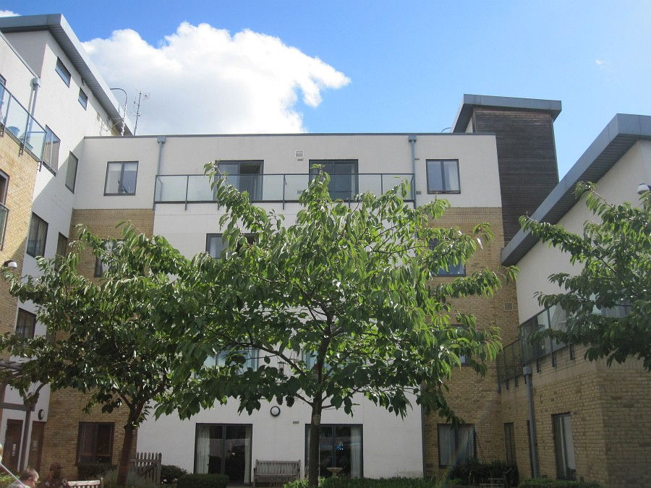
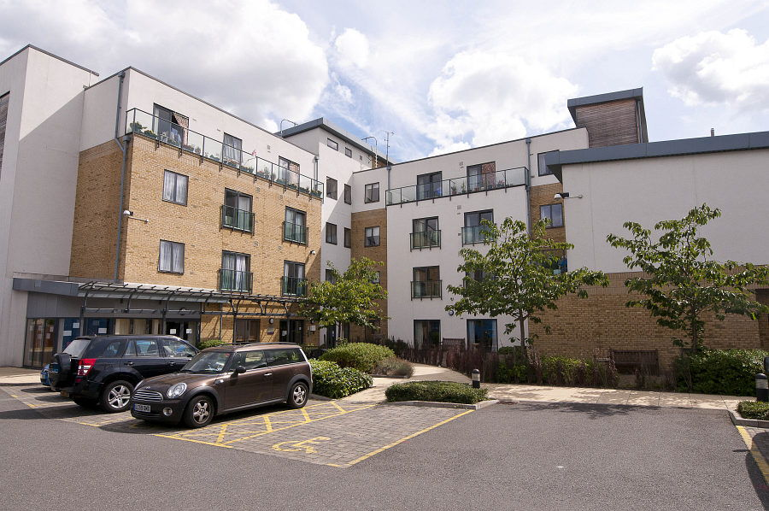
FELLOWS COURT

Slide 15
Main facts
For higher dependency applicants who have been assessed as needing extra care only
40 flats. Built in 2008. Sizes 1 bedroom, 2 bedroom
Extra Care scheme with on-site care staff (24 hours / 7 days), non-resident management staff
Lounge, laundry, garden, community centre
Some meals available (Lunch 7 days a week)
Tenure(s): Rent (social landlord)
Care provider: London Care Limited
Developed by Eldon Housing Association Ltd
FELLOWS COURT
(London Care)
36 Morland Road, Addiscombe, Croydon, Surrey, CR0 6NA
Shorai Udia
Registered Manager
London Care Fellow’s Court
32-34 Morland Road
Croydon CR0 6NA
Tel: 02086545216
Mobile: 07884902993
Shorai.Udia@cchmail.co.uk
www.candchealthcare.co.uk

Slide 16
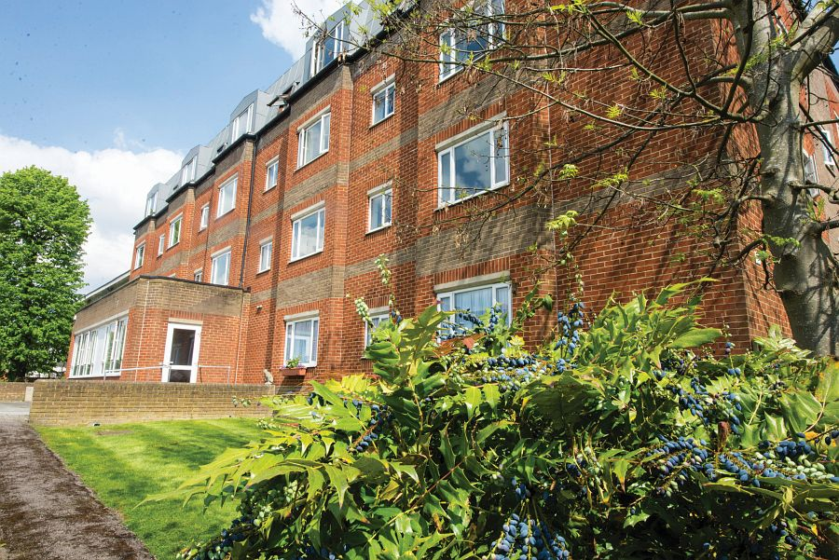
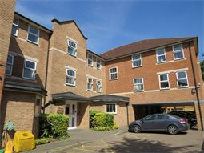
WESTDENE
LINDSAY COURT

Slide 17
WESTDENE
(Eldon Housing)
16 Chatsworth Road, Croydon CR0 1HA
Housing Officer
Sharon Johnson
Eldon Housing Association Ltd
Phone: 0208 655 6724
Fax: 0208 763 8763
SJohnson@eldonhousing.co.uk
Main facts
20 flats. Built in 1988 and renovated in 2014. Sizes 1 bedroom, 2 bedroom. Includes mobility standard properties
Extra Care scheme with on-site care staff, non-resident management staff (24 hours, 7 days)
The scheme has the ability to support and accommodate people living with Dementia, physical disabilities and mental heath. (Designated dementia flats available.)
Lift, lounge, dining room, laundry, guest facilities, garden
Access to site fairly easy, but less so for less mobile people
Regular social activities. New residents accepted from 60 years of age
Tenure(s): Rent (social landlord)
Care provider: Eldon Housing Association
Developed by Eldon Housing Association Ltd

Slide 18
Main facts
29 flats. Built in 1995. Sizes studio, 1 bedroom. Includes mobility standard properties
Extra Care scheme with 24 hours / 7 days), Non-resident management staff (24 hours, 7 days)
lift, lounge, dining room, laundry, garden
Access to site fairly easy
Regular social activities. New residents accepted from 60 years of age
Tenure(s): Rent (social landlord)
Care provider: Eldon Housing Association
LINDSAY COURT
(Eldon Housing)
2 Eden Road, Croydon, Surrey, CR0 1FA
Housing Officer
Sharon Johnson
Eldon Housing Association Ltd
Phone: 0208 655 6724
Fax: 0208 763 8763
SJohnson@eldonhousing.co.uk

Slide 19
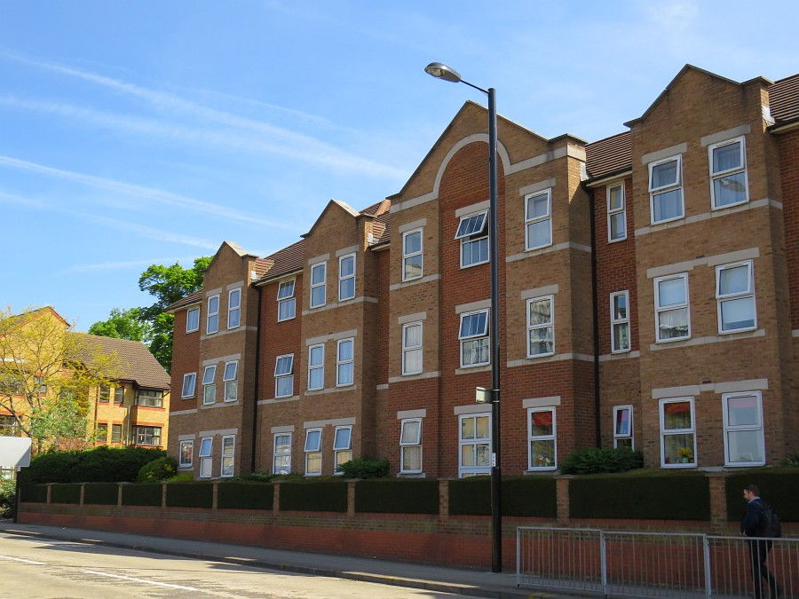
NOMINATION RIGHTS FOR ELDON HOUSING – WESTDENE AND LINDSAY COURT
The Council has nomination rights for Eldon Housing’s Westdene and Lindsay Court.
Eldon provide both the care and housing management in these services, so they complete the tenancy sign up with individuals who are accepted to move in. As well as standard extra care flats, Westdene has five one-bedroom flats for people with dementia and two flats which are able to accommodate wheelchairs for older people with a physical disability.
When any applications for Lindsay Court are made by practitioners Lindsay Court should only be offered to full-paying customers rather than ones receiving housing benefit and whose care is being paid for by Croydon.
Lindsay Court

