Slide 1
ECHo Pathway – Intake and developing ECHo support plan
Edge of Care
“For children on the edge of care due to risk of family breakdown”
Intensive and responsive ECHo support
ECHo weekly triage meeting to identify needs and develop MDT plan
Joint visit ECHo worker & SW – to develop the ECHo plan with family, plan approved by ECHo manager
Family therapist inputs to every plan
MDT members allocated & input where relevant
FGC offered & encouraged to every family
Intake/ allocation decision by ECHo Team Manager and Senior Worker
(Quick response – approx. 1 day)
Referral by email/verbal
Allocated to an ECHo family support worker
Agree ECHo Support Plan
Accepted
CIN / CP plan
EDGE OF CARE
Referral from child’s social worker
ECHo, SW, Child, Family
Discussion – ECHo Manager, ECHo worker, SW to clarify outcomes
Child in need, Child protection, C&F Assessment
Families First check-in
Reunification
“For children who can leave care to live with their immediate or extended family”
LAC review endorses decision to commence reunification plan
Accepted
Allocated to an ECHo family support worker
Agree ECHo Support Plan
CIN / LAC plan
REUNIFICATION
Referral by email/verbal
Discussion – ECHo Manager, ECHo worker, SW to clarify outcomes
Referral from child’s social worker
ECHo, SW, Child, Family
Declined – disputes escalated to Head of Service, then AD
Families First check-in
Declined
Child in care (any legal status)
1 working day
5 working days

Slide 2
ECHo pathway (2) – Intervention & Closure
Allocated social worker remains responsible for case
ECHo Support Plan –
Edge of Care
ECHo Team implement plan with family – 3-6 months programme
Final review of ECHo Plan and Family Plan
7-day intensive family support available at start; this reduces as plan progresses
Family Group Conferencing
4-6 week review
Final ECHo report provided to child’s social worker
4-6 week review
4-6 week review…
EDGE OF CARE
Family Plan in place
(within first 4 weeks)
May include a short period where the child is accommodated to give the family a break and space to plan a way forward
If risks escalate, safeguarding protocols take precedence and child may be taken into care
Families First check-in
Allocated social worker remains responsible for case
ECHo Support Plan - Reunification
ECHo Team implement plan with family – 4-6 months programme
7-day intensive family support available at start; this reduces as plan progresses
Child should return home 4-8 weeks into plan, majority of ECHo support provided after return home
Family Group Conferencing
Return home
REUNIFICATION
4-6 week review
4-6 week review
4-6 week review…
Family Plan in place
(within first 4 weeks)
Start process to make application to court at 4-month point if possible;
effort should be made to discharge the care order at pace, as quickly as is safe

Slide 3
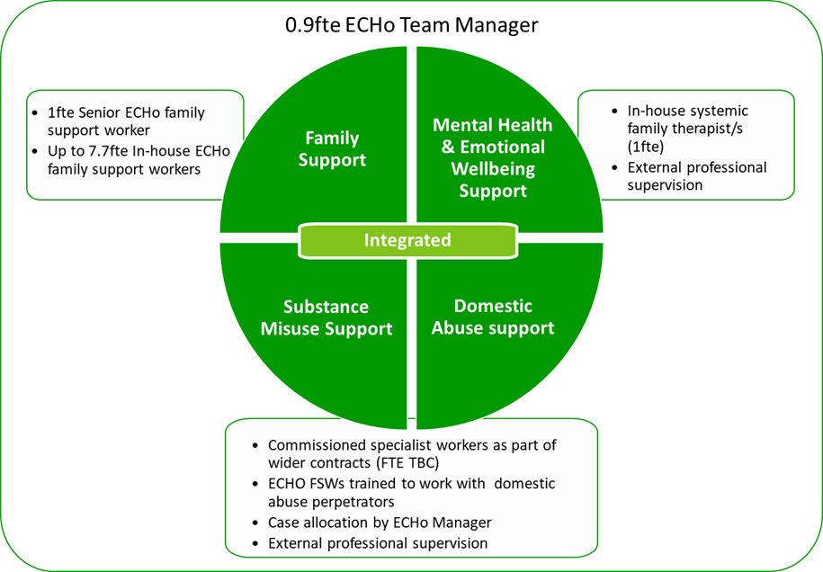
ECHo (Edge of Care/Home) practice model
Led by a multi-disciplinary team
“The ECHo (Edge of Care/Home) model is strengths-based and solutions-focused”
Weekly Echo team triage meetings
Core principles:
We work with the whole family, mainly in the home environment but also in other community settings
We dedicate more time to support individual families than other types family support or social care roles can normally offer
We work together as a multi-disciplinary team
We apply evidence-based interventions
We work with each child and family to develop clear and measurable goals, which we will review on a regular basis
We are responsive to changing needs
We work closely with the Safeguarding and Looked After services, with multi-agency partners and the voluntary sector

Slide 4
ECHo practice model (2)
Signs of Safety
A strengths-based, safety-oriented approach to child protection social work
Signs of Safety plan for every child (CIN/CP/LAC plan)
Solihull Parenting
A parenting programme focusing on containment, reciprocity and behavior management
ECHo family support workers trained in Solihull Approach
Research-informed family reunification
Family Group Conferencing
A process led by family members to plan and make decisions for a child who is at risk.
Every family is offered a family group conference
Danger statement
Scaling questions
What is working well / what is not working well / what needs to change
All ECHo team (including MDT) trained in SofS basics
ECHo worker will attend & contribute to multi-agency safeguarding reviews
Solihull approach will guide family support workers’ interactions with children and families
ECHo will use research-informed reunification approaches, for e.g. informed by NSPCC reunification framework
At the end of ECHo support, family review their Family
Family Group Conference Coordinators will support families to develop a Family Plan, which can be reviewed throughout the period of ECHo support
The ECHo team may also apply elements or tools from other approaches, for e.g. Outcomes Star, PPP, Graded Care Profile and children’s and family yoga/mindfulness
Systemic Approach
ECHo works systemically, understanding families as a system, and investing time and resources into understanding how they relate to and communicate with one another
Systemic family therapist to make a systemic formulation of the family’s situation and offer family therapy
Systemic family therapist will guide ECHo team members to shape plan
Weekly triage meetings will allow systemic family therapist to support ECHo workers

