Slide 1
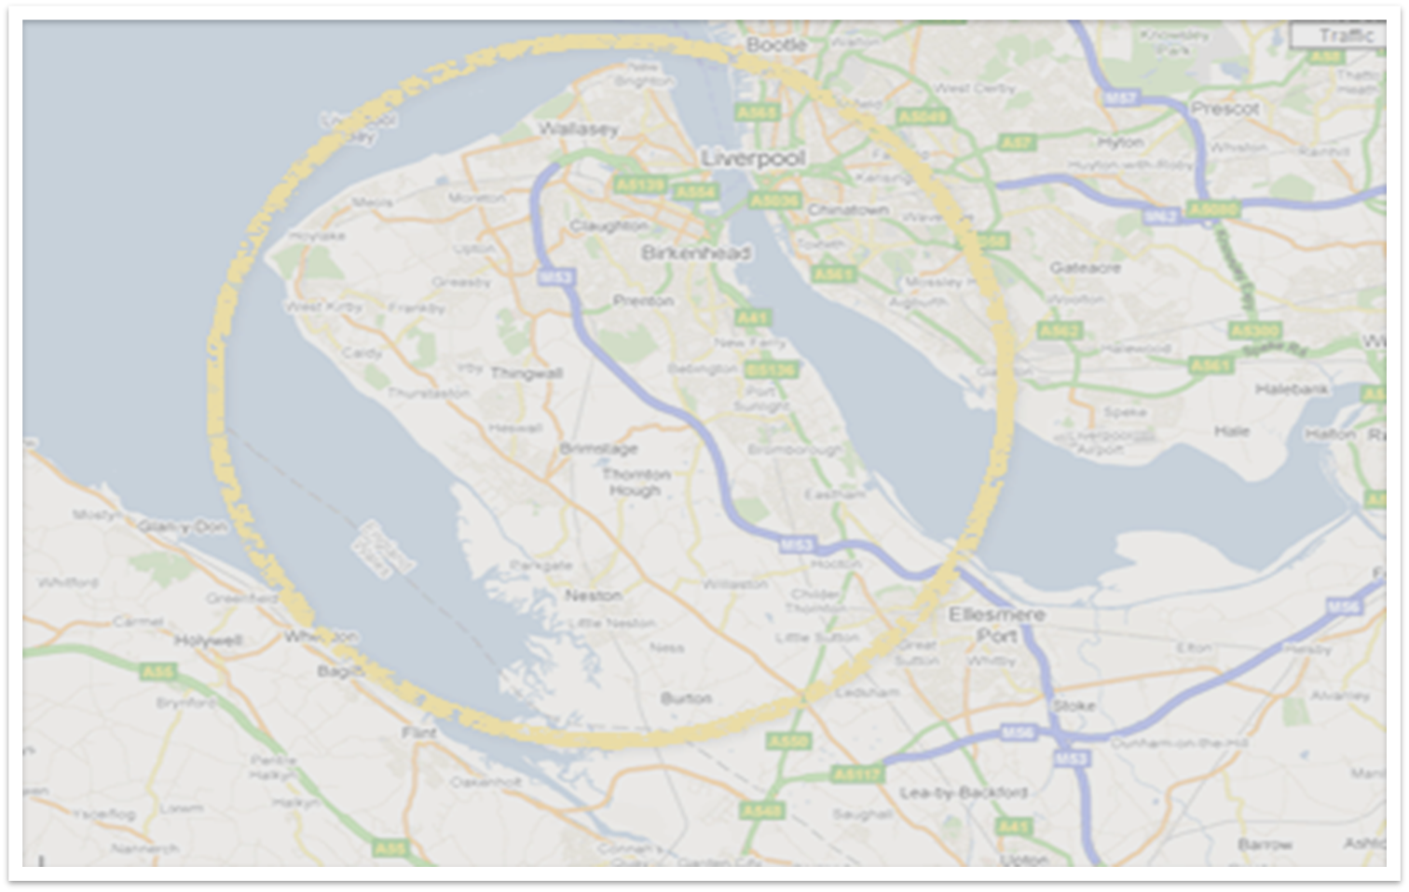
Use of Social Media in Social Work
WIRRAL PLAN 2025

Slide 2
Introduction
Social media can provide critical information to keep young people safe, inform an assessment or form part of a report for court; however the access and use must be subject to controls.
This is a growing area of practice but can be a very complex legal area. Monitoring activity can potentially stray into activity requiring a magistrates approval in some instances.
This area is overseen nationally by the Office of Information Commissioner; and the authority is subject to regular inspection as to how we comply with the various aspects of legislation and regulation. Misuse of data and inappropriate access could result in fines and has the potential for reputational damage for the organisation.
This activity must not be undertaken by colleagues using their own social media access.
WIRRAL PLAN 2025

Slide 3
Support
To support colleagues in staying within the bounds of permitted and authorised use of social media information we have set up a process to gain better oversight; and support professionals with the right advice and guidance.
There is a now a central email for colleagues to use in seeking advice and support to research social media information, where appropriate: csdpaauthorisations@wirral.gov.uk
Any such activity must be undertaken by specific colleagues trained in the relevant areas of legislation and guidance; and under controlled conditions.
The above email address is the route through which to request any advice and support. An advice and request form is available to help gather sufficient information to provide accurate advice and inform any subsequent social media research. This will also help us maintain an accurate central record of our activity. The form and further information can be found at the below link: This link also names the local champions who will be able to offer advice and guidance.
https://wbcnet.wirral.gov.uk/business-support-childrens-services/use-social-media-information-social-work
WIRRAL PLAN 2025

Slide 4
Guidance
The council has a corporate policy and procedure document, within which the considerations on use and access of social media for this purpose is set out.
There are some key points to consider:
Activity which is deemed to be covert (where the subject of any research is unaware of its existence or possible existence); and happens more than on a one off/preliminary basis requires specific approval from a senior officer within the authority.
If the issue being investigated by colleagues relates to a crime in law, this approval must come from a magistrate.
Searches will not be undertaken where they are merely speculative in nature.
Those seeking support in the more routine overt monitoring of social media (where the subject is aware of the activity) must complete the advice and request form and submit via the dedicated email address.
Private information must always be handled in accordance with GDPR rules.
The following link contains the policy and procedure for retention.
https://wirralchildcare.proceduresonline.com/t_retention_records.html?zoom_highlight=retention
WIRRAL PLAN 2025

