Slide 1
Communication Pack: Young Black Men Mental Health Crisis Tools
Helping professionals identify young Black men’s needs during a mental health crisis
August 2022
#CrisisTools
https://crisistools.org.uk/

Slide 2
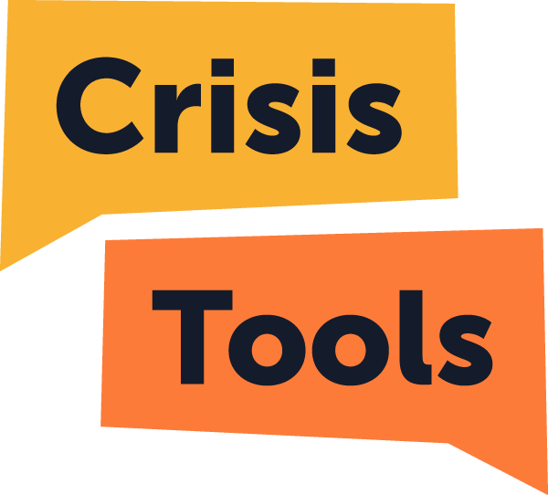
Background
In 2019, it was founded that Young Black men are eight times more likely than their white counter parts to be given a community treatment order (CTO) after being treated in hospital under the Mental Health Act (NHS Digital, 2019). Furthermore, when engaging with young people to develop the core Crisis Tools (launched in August 2021), it was identified that staff needed a greater awareness on how best to support young Black men accessing mental health services.
HEE has worked with Healthy Teen Minds in partnership with 42nd Street, working with young people with lived experience, to launch an extension of Crisis Tools – Guides Supporting Young Black Men.
The 4 Crisis Tools Guides Supporting Young Black Men are:
Barriers to access
What we need crisis services and practitioners to know
Understanding our perspective
Top tips from young Black men
The learning aims to help professionals identify young Black men’s needs during a mental health crisis. The guides focus on sharing young people’s experiences of barriers and discrimination and what can be most helpful in offering support during a mental health crisis.
#CrisisTools
https://crisistools.org.uk/

Slide 3
Audience
“Thank you to Healthy Teen Minds and Health Education England for providing 42nd Street’s young Black men’s group, Jet 42, the opportunity to have a national voice and share their experience of mental health support in order to create a resource for professionals so that they have the confidence to work alongside young Black men. This has been an incredible opportunity for the young men, showing them the power of sharing their own lived experience to benefit others.”
The Crisis Tools are aimed at mental health crisis team members who want to develop their confidence, knowledge and skills. The guides will also be relevant to anyone who may find themselves supporting young people in mental health crisis in a range of settings, including:
Health and care professionals – mental health, acute, primary care and specialist services
Youth workers and volunteers
Educational staff
Emergency response workers
Families and carers
Karina Nyananyo, Head of Service -
#CrisisTools
https://crisistools.org.uk/

Slide 4
Your support
We want to work with partners who can help us reach our audiences (see page 3). This will ensure we are reaching professionals and providing them with the tools to improve their confidence and skills when supporing young Black men in mental health crisis.
Support could be:
Developing creative and authentic content to promote across your platforms
Sharing our communication assets via your channels and networks
We are open to exploring ideas and welcome your expertise. By working together and utilising the influential voice and channels you hold.
Want more information?
Email: crisistools@healthyteenminds.com
#CrisisTools
https://crisistools.org.uk/

Slide 5
Assets
You can download assets to promote the Young Black Men Crisis Tools learning. Assets include draft social media copy, images, YouTube video and newsletter copy for you to use and adapt across your channels. There will also be a launch webinar on Thursday 8 September 2022, 13:00-14:00. To register, visit the young Black men Crisis Tools event page.
When promoting the Young Black Men Crisis Tools, please individually tag/mention HEE, Healthy Teen Mind’s and 42nd Street social accounts:
Twitter: @NHS_HealthEdEng @HTMideas @42ndStreetmcr
LinkedIn – HEE and Healthy Teen Minds
Facebook – HEE and Healthy Teen Minds
Instagram: @nhshee
Please use the hashtag #CrisisTools in all posts.
#CrisisTools
https://crisistools.org.uk/

Slide 6
Key messages
There is a priority need to ensure people can access health and care education and learning to understand the conditions in which people from different communities’ experience care in their day-to-day lives. This is especially important for the mental health service provision for young Black men.
Young Black men crisis tools learning resource will help address the urgent need for individuals working in a range of settings to have the awareness and confidence to support young Black men in a mental health crisis.
This is a co-produced learning resource developed with young Black men with lived experience from 42nd Street, and triangulated with a national Virtual Advisory Network of clinical staff
This online mental health crisis learning is an extension of HEE and Healthy Teen Minds Crisis Tools.
This open access toolkit is openly available to anyone who may encounter young Black men in mental health crisis
Each of the 4 guides take approximately 15 minutes to complete, focuses on sharing young people’s experiences of barriers and discrimination and what can be most helpful in offering support during a mental health crisis.
The 4 15-minute young Black men crisis tools learning covers:
Barriers to access
What young Black men need from crisis services and practitioners
Understanding a young Black man’s perspective
Top tips
#CrisisTools
https://crisistools.org.uk/

Slide 7
Further information
https://crisistools.org.uk/
crisistools@healthyteenminds.com
https://www.hee.nhs.uk/
#CrisisTools
https://crisistools.org.uk/

