Slide 1
Foster Carer Workshop Children in Care and Children returning home

Slide 2
Learning Objectives
Explore the role of foster carers in strengthening family relationships and supporting children to return home where possible
Consider how contact/family time could be used to support children to re-build relationships with birth family.

Slide 3
“In the majority of cases, families become involved with children’s social care because they are parenting in conditions of adversity, rather than because they have caused or are likely to cause significant harm to their children. We have a shared obligation to help families raise their children.” The Case for Change The independent review of children’s social care https://childrenssocialcare.independent-review.uk/

Slide 4
Part Three Children Act 1989
Provision of services for children in need & their families:
(1) It shall be the general duty of every local authority
(a) to safeguard and promote the welfare of children within their area who are in need; and
(b) so far as is consistent with that duty, to promote the upbringing of such children by their families, by providing a range and level of services appropriate to those children’s needs
Any service provided by an authority may be provided for any member of his family, if it is provided with a view to safeguarding or promoting the child’s welfare

Slide 5
Vision and values of Family Safeguarding approach
Our primary duty to children is to safeguard them from actual or likely significant harm and promote their upbringing by their families
We do this by:
assessing needs & providing actual services to meet needs of children & their families
taking a restorative approach to working with families, building, maintaining and repairing relationships where harm has been caused
caring for children until it’s safe for them to go home
fulfilling our duties to share PR and promote contact/family time
developing MI skills to promote engagement of families and create change
believing all people have intrinsic worth and a right to help and support

Slide 6
Mentimeter
What are your views about children returning home from care?

Slide 7
Outcomes for care experienced people
Many care experienced people leave care and live happy and fulfilling lives, and that care can provide the lifeline which leads to a better life than they would have had if they remained at home. Care can be a positive, transformational and life saving experience.
(Care Review Report, May 2022)

Slide 8
Outcomes for care experienced people
Over-represented in mental health and prison settings
More likely to die prematurely
Lower educational attainment & subsequent disadvantage
More likely to be unemployed/in low skill jobs
More likely to have their children removed by Children’s Service (Rahilly & Hendry 2014)
Negative outcomes linked to lack of support, isolation, loneliness (Munro 2011)
Relationships are key to emotional wellbeing, quality and continuity
Care often breaks children’s existing relationships with family & friends (Care Review, 2013)

Slide 9
Need for change
Children want to maintain strong links with their family
Recognise that for some children being in care may not be better off in the longer term
Moving away from identifying and managing risks to meeting family needs
Needs of family and the likelihood of harm can change over time- families change.
Are children still in care for the right reasons?
Impact of unsuccessful return home for children and families and re-entry into care- Need to break this cycle
Children returning home from care to a parent or relative, planned or unplanned is a “common outcome”

Slide 10
Discussion
For most children, returning home to a parent or relative after being looked after is a “common outcome"(Wilkins and Farmer, 2015)
What does this mean for practice?

Slide 11
What gets in the way of planning for children to return home?

Slide 12
Barriers to planning for children to return home
No time for planning or preparation
Worries/Fears
Attitude towards parents

Slide 13
Group discussion: How can foster carers support children to return home?
Notes:
20 minute discussion and feedback

Slide 14
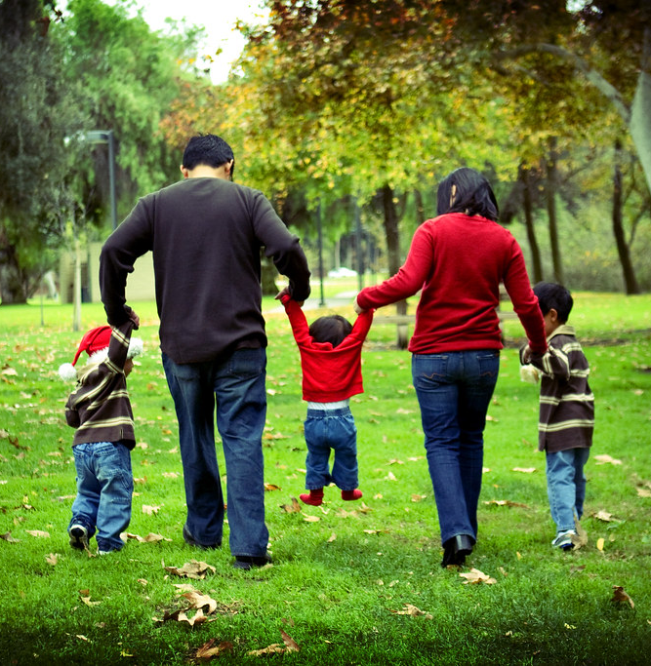
MS Teams chat What makes return home for children more successful?

Slide 15
What makes return home more successful?
Good relationships between carers and birth families
Preparation
Support for parents and carers
Support from foster carers when children are returning home

Slide 16
Some messages on carers supporting children to return home
Support from foster carers and residential workers play a significant role in children returning home. (Thorpe 2007 cited in Thoburn 2009, Fernandez,2012
When placement caregivers and foster carers develop an exceptionally supportive relationship with parents, there are significantly fewer return breakdowns (Farmer et al. 2011). Foster carers remaining available and involved after child leaves the foster home.
Provided after-care services to assist parents or children, such as respite after children had returned home, which is highly valued by the children and their parents (Aldgate and Bradley 1999).
Social workers are influenced by the views of residential workers and foster carers about children returning home (Thoburn, 1980)
Residential workers work closely with parents to encourage return and parents may feel more able to trust them (Farmer and Parker 1991).
Research in UK, Australia, US shows the importance of foster carers mentoring parents, supporting contact and playing a supportive role after children return home ( Child Welfare Information Gateway 2006, 2011, Fernandez 2012, Farmer 2014).
A positive relationship between foster carers and parents may allow children to avoid the stress of divided loyalties.
Caregivers sometimes find that planning for return happens outside the review process, so that they do not have sufficient opportunity to help children prepare for returning home. This highlights the importance of involving carers in preparing children to return home and providing follow up support.

Slide 18
Family Time Nurturing life- long relationships

Slide 19
Mentimeter
Why is family time important for children?

Slide 20
Some reasons why family time with birth family is important…
Reassures the child that their family are safe, valued and not forgotten
Supports children to know and embrace their family, origins, culture, identity- who they are and were they come from.
Creates opportunities to strengthen relationship with family, siblings, extended family and connected people
Children understand their life story better and contact creates opportunities for parents to contribute to their child’s understanding of their life story.
Creates opportunities for parents to become more involved in understanding and meeting the needs of their children
Strengthens possibilities for children to return home
Progression of good quality family time from supervised to unsupervised naturally moving towards children returning home
Gives children permission to enjoy a relationship with their birth family and their foster family- they don’t have to choose sides or split their loyalties

Slide 21
Children Act 1989 on contact
One of the key principles of the Children Act 1989 is the presumption that there should be continued contact between the child and their family while the child is in the care of the local authority.
This is appropriate for care provided under the 1989 Act, where the underlying philosophy is to work in partnership with the family and towards children returning home where possible, provided that this is consistent with the individual child’s welfare

Slide 22
Some research messages on contact/family time
Cleaver’s (2000) research found that successful return home of children can be promoted by ‘purposeful, planned, well-paced, well-resourced and reviewed contact, supported by parental motivation, a positive child response to increased contact and good attachment between parent and child’ (Sinclair 2005).
Often, too little work is done with birth families prior to children returning home; contact offers the opportunity for purposeful work to be done in preparation for return home(Boddy et al. 2013).

Slide 23
Relationships matter
Every child who leaves care should have at least 2 loving relationships to support them in the future
(Care Review, 2022)
Lemn Sissay (Care experienced adult) shared at a webinar that he will be collecting his OBE award alone because there is no family member who wants to go with him
(March 2022, Community Care)
Notes:
Not all children will successfully be able to return home but if we help them connect with 2 family members who will be available to them, we have at least fulfilled some of their identity and mental health needs as well as connected them with positive means of support for the future.

Slide 24
Mentimetre
What support would you need to assist children to return home to their birth family?
Notes:
Feedback survey

Slide 25
Mentimeter What would you take away from today’s session to support you?

Slide 26
Suggested Reading
The Children Act 1989
The Care Crisis Review: Options for Change - Family Rights Group (frg.org.uk)
Lecture by Lord Justice McFarlane: Holding the risk - The balance between child protection and the right to family life (judiciary.uk)
Family Rights Group – Lifelong Links: https://frg.org.uk/lifelong-links/
The Care Planning, Placement and Case Review (England) Regulations 2010 (legislation.gov.uk)
Reunification: an evidence-informed framework for return home practice (nspcc.org.uk)
Final Report - The Independent Review of Children's Social Care (independent-review.uk)
Ethnicity and children’s social care (publishing.service.gov.uk)
Improving the chances of successful reunification for children who return home from care: a rapid evidence review (whatworks-csc.org.uk)

Slide 27
Contact us:
FSProjectTeam@Hertfordshire.gov.uk

