Slide 1
We are doing:
We have created a ‘Working group’ reviewing family time arrangements and taking on board the feedback from YVIC
Staff who attended the Bright Spot events have made promises to how they will change their practice or work within their teams as a result of what our children and young people have said.
Our IROs have promised that as part of a child or young person’s looked after review, they will always ask questions about family time. As part of this, they will make sure there is a clear plan for children and young people around having time with people who are important to them and explanations when this is not possible.
Our family time workers now sit within our social care teams so children and young people get consistency and timeliness in regards to being able to spend time with people who are important to them.
We are in the process of facilitating more training on life story work as every child and young person should have as much information about their life as possible from before they were looked after. Practice learning sessions are taking place to support social workers to help them find the best ways of getting information about children’s families and history, so they know where they came from and who was part of their life.
I at least want to see my mum again [even] if it’s one time, because I don’t remember anything.
11-18yrs
Arranging contact takes too long, we don’t know enough about why we can’t see certain family. Family time can help us cope.
- YVIC Feedback

Slide 2
I live far away from school and don’t get to see my school friends outside of school.
8-11yrs
In looked after reviews, IROs will always ask children and young people about their friendships and consider that hobbies and activity groups do not mean a young person or child always has friends at these groups.
More will be done by social workers and IROs in reviews to make plans around children and young people being able to go out with their friends, have mobile phones and be able to go on sleepovers, to stop children and young people feeling different.
Staff who attended the Bright Spot events have made promises to how they will change their practice or work within their teams as a result of what our children and young people have said, including the impact when a child or young person has had to move out of area.
Further support and training is being offered in regards to delegated responsibility to make sure everyone knows what this means, to stop children and young people missing out on opportunities with their friends.
We are doing:
It’s not just about hobbies: we want chance to just ‘hang out’ with friends.
It’s too difficult to go to friends’ houses/ have friends over – it should be easier.
Foster carers/ social workers need to understand it’s important for us to have friends.
Having a mobile phone is important to stay in touch with my friends
- YCVIC Members

Slide 3
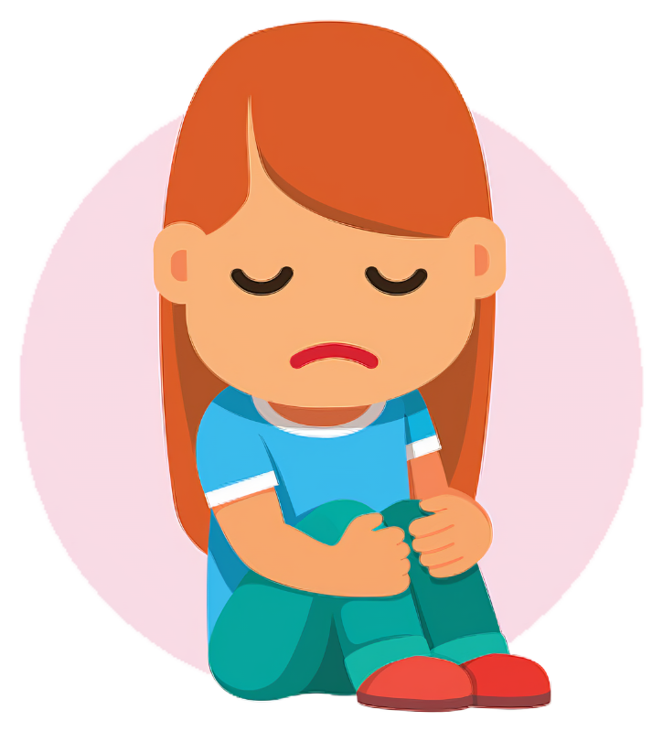
The virtual headteacher for Hull City Council attended one of our Bright Spot events. They have made a promise to ensure practitioners always ask the right questions in PEP meetings about what life is like for a child looked after in school
We have made it an expectation that our social workers should not go and see children in school without their permission unless there is an absolutely vital reason to do so.
We know we have further work to do around school taxi pick ups, and making sure professionals don’t do things that make our children and young people looked after stand out as being different and will be working closely with schools around this.
Staff who attended the Bright Spot events have made promises to how they will change their practice or work within their teams as a result of what our children and young people have said, including always ensuring they ask the child where they want to be seen, and advocating for them when there are bullying issues.
All school designated teachers will spent time thinking about this issue at their conference this half term.
Social workers constantly singling me out at school for work and coming into school for stuff.
11-18yrs
We are doing:
Looking ‘different’ leads to bullying
School ‘interventions’ make things worse
- YCVIC Members

Slide 4
I don’t like to talk about where I will go next and I also don’t like to talk about being in care because if I am happy and somebody talks about me being in care it makes me upset. - 8-11yrs
As part of reviews, IROs have promised they will always ask children and young people about their friendships and recognise that hobbies and activity groups don’t mean people have friends at these groups.
More will be done by social workers and IROs in reviews to make plans around children and young people being able to go out with their friends, have mobile phones and be able to go on sleepovers, to stop children and young people feeling different.
Our social workers have made promises that I speak to children and young people about how my role as a social worker is impacting on their life, and what I can do differently to make sure they don’t stand out to their friends.
We are training and supporting our social workers to use Mind of My Own (MOMO) as a platform where our children and young people can share their wishes and feelings, and where social workers can promote the ‘all about me’ option to allow young people to share the best ways they like to share their views and feelings.
We are doing:
14% of our children in care said they didn’t have a good friend.
I liked my bedroom but it is small. I didn’t have anyone to play football with yesterday.
4-7yrs

Slide 5
“I don’t like it when you get a new one and they ask you the same questions over and over again. Surely they keep a file, they don’t need to start again every change?”
Every child or young person will get a written explanation and a meeting where their old social worker introduces their new social worker whenever possible.
We have made a promise that children and young people will always be told the reason when this has happened so they will never feel like it is their fault.
The social work standards have been revised and updated with these practice expectations.
YVIC created a podcast looking at how they felt about a change of social worker. So far, over 100 social workers have heard the Podcast and many more will hear it over the next couple of months. We will now be playing the podcast as part of the induction training when new social workers start working for Hull City Council
We have a task and finish group that are creating words and pictures and letter templates for social workers to personalise for children and young people.
We will be creating a poster of promises on what we promise to do when you have a change of social worker.
We are doing:
“When social workers have to change there should be a really good reason why, we need a proper explanation as we have a lot of things going on and worry about things”

