Slide 1
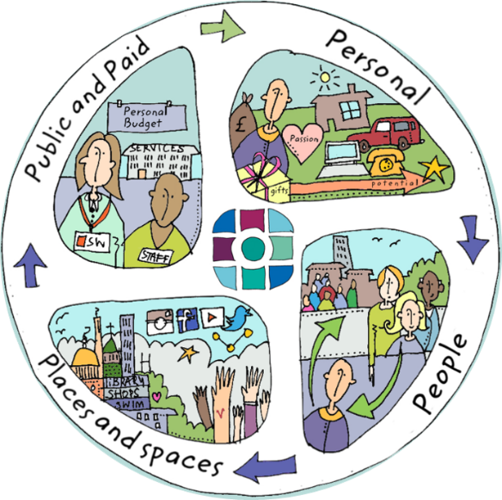
 | hkhkjhjhj

