Slide 1
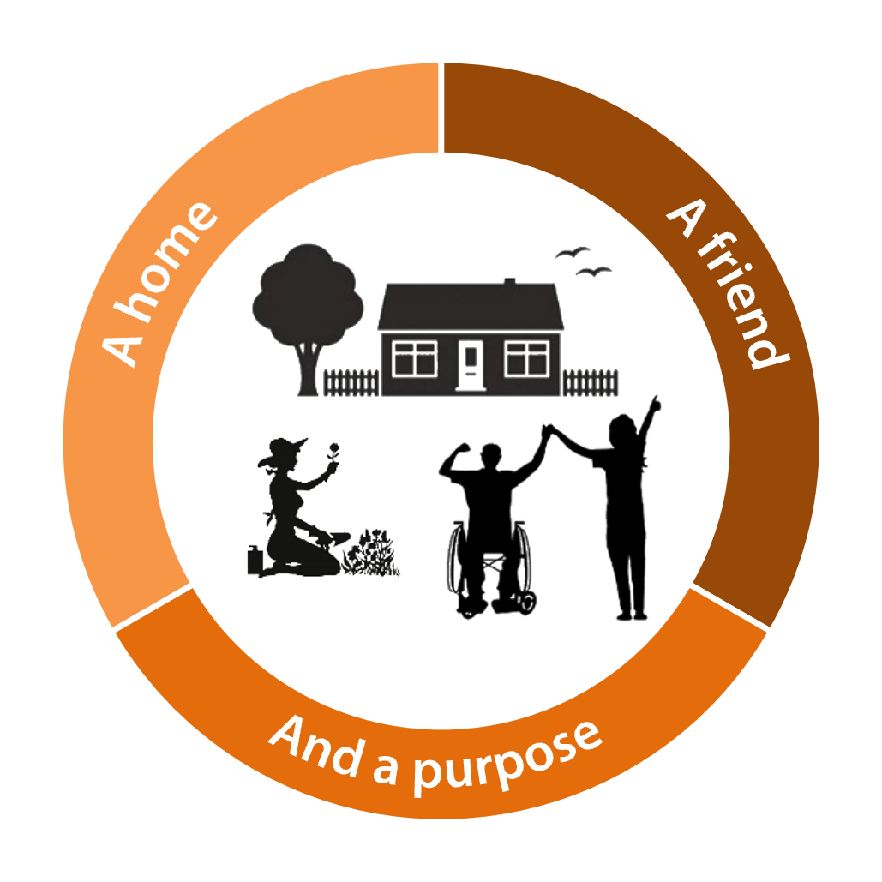
Outcomes
2 Minute Guide
Adults Services

Slide 2
What is an outcome?
A desired outcome is what the person wants, or needs, to achieve. What do they want to happen?
Understanding a person’s desired outcomes should be at the heart of the strengths based assessment.
As far as possible, try and link the person’s desired outcomes to a feeling and try to record them in the person’s own words.

Slide 3
Outcomes are not…
Outcomes should not be confused with inputs, processes and outputs (which are the steps that might be taken to meet an outcome).
E.g. a care visit for a person, or a wet-room adaptation, is not the outcome it is the output.
The person
The family member
The practitioner
The strengths based conversation & care and support planning.
The care package.
The wet-room adaptation.
Person feels happy knowing that they are clean and able to go out with confidence.

Slide 4
Outcomes and strengths based practice
Asking the right question can lead to improved outcomes for the person.
The “magic wand” or “miracle” question can help people with thinking about the outcomes they want to achieve:
“If you had a magic wand that made your difficulties go away, what would your life look like, what would be happening differently?”
See the strengths based myth buster for more information.

