Slide 1
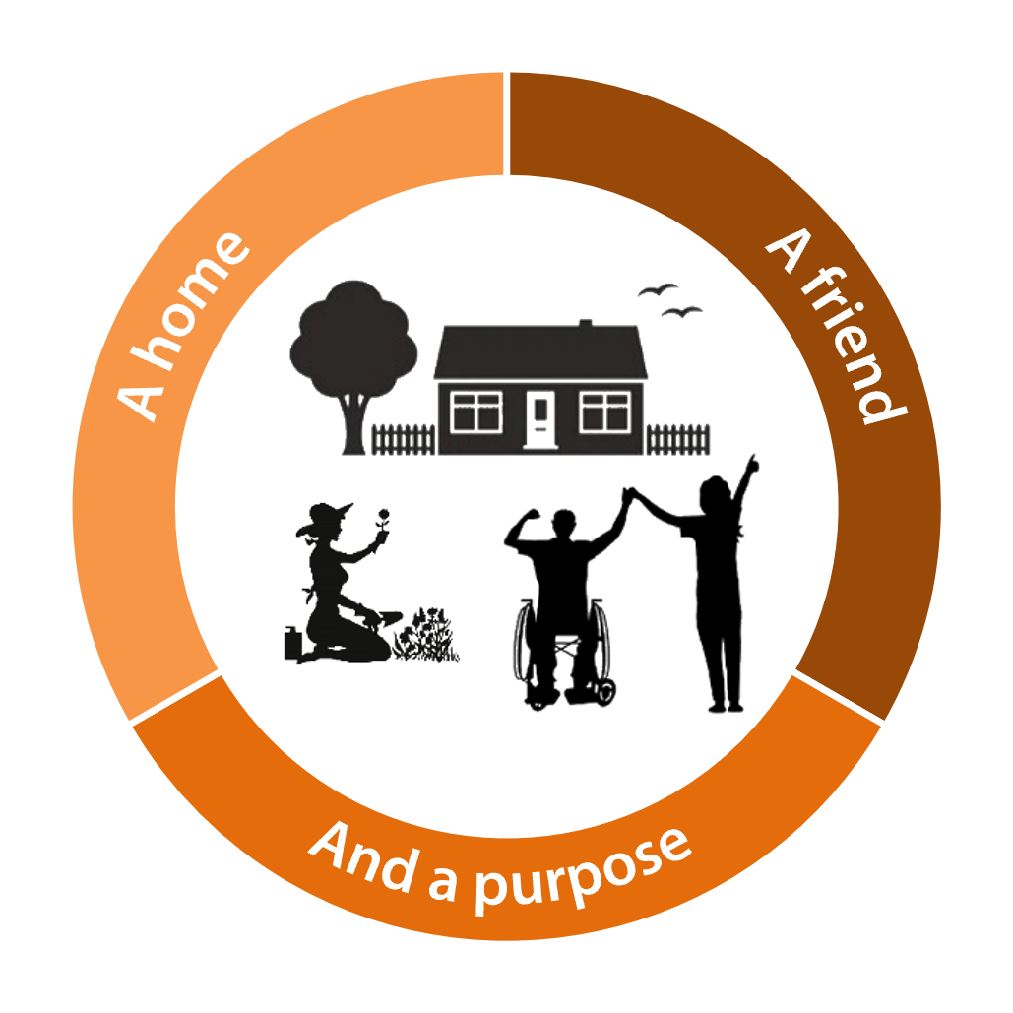
Strengths-Based Approach
2 Minute Guide
Adults Services

Slide 2
What is a Strengths-Based approach?
It is an approach that promotes building relationships with people we support, getting to know the whole person
It explores, in a collaborative way the person’s abilities and their circumstances rather than making the deficit (the care and support needs) the focus of the conversation/intervention
It is gathering a holistic picture of the person’s life; therefore it is important to engage and work with others (i.e. health professionals, providers, the person's own network)
It is seeing yourself as a ‘tool’ a ‘good conversation’ in itself is a service, & can deliver good outcomes
It is less about ‘what the end result is’, or ‘what we do’, and more about ‘how we do things'

Slide 3
How to use a Strengths-Based approach in assessments
A needs assessment (Care Act, Sec 9) is a semi-structured assessment with two key elements
One element requires us to capture the persons care and support needs
The other requires us to a ‘good conversation’ about the person’s whole life
The Wellbeing Principle (Care Act, Sec 1) sets out our duty to consider and promote a persons wellbeing (alongside the care and support functions), the wellbeing principles include
Personal dignity (treating the person with respect)
Emotional wellbeing
Control by the individual over day to day life, including how care and support is provided (choice)
Work, education, training and recreation
Social and economic wellbeing
Individuals contribution to society
Domestic, family and personal
Suitability of living accommodation

Slide 4
What are good Strengths-Based questions?
Asking the right question, can change the conversation and lead to improved outcomes for the person?
What would you like to happen next? (Desired Outcome)
Who are your favourite people, friends and or family
What do you know about your neighbours, who do you talk to most?
What do you know about the activities in your community?
How do you get out and about?
What does a good day look like to you?
When was the last time you laughed out loud what were you doing, who were you with?
How would you like to fill your day?
What would people who know you, say you are good at?
What is/was your experience of education, and or training?
What is/was your occupation?
What are your interests or hobbies?
What are the positive benefits to you of the the risks identified?

Slide 5

Interested to know more, about the theory and the practice – take a look at the Strengths-Based Practice Framework and Practice Handbook

