Slide 1
Occupational Therapy
Doreen Singleton
Professional lead for Occupational Therapy

Slide 2
Occupational therapy
What experience do you have of It ?
And what does it mean to you ?
One thing that you want to learn from this session?

Slide 3
We are all Occupational Beings
Balanced activities Health and wellbeing
Intrinsically active and creative
Shaping and being shaped interactions and environment
Creating identity and meaning through doing
Capacity to transform premeditated and autonomous action
Notes:
Occupational perspective
We are all occupational beings
intrinsically active and creative
Balanced daily activities to maintain health and wellbeing
Shaping and being shaped by experience and interactions with their environment
Creating identity and meaning through doing
Capacity to transform ourselves through premeditated and autonomous action
Defining OT COT 2009

Slide 4
Occupational Therapy Facilitates
Adaptation
Occupations are key to people’s health and wellbeing, because they make us who we are and shape our roles and responsibilities in life
` Cot careers handbook 2015 -2016 accessed 21.6.16
Occupations are everything we must do ,need to do, want to do
Well being is about occupational balance
Activity can be an effective medium for remediating dysfunction, facilitating adaption and creating identity
                COT 2009
Notes:
.
When occupational therapists talk about occupation, they mean all of the activities that people do.
Occupations are key to people’s health and wellbeing, because they make us who we are and shape our roles and responsibilities in life Cot careers handbook 2015 -2016 accessed 21.6.16
Occupational therapists view people as occupational beings. People are intrinsically active and creative, needing to engage in a balanced range of activities in their daily lives in order to maintain health and wellbeing. People shape and are shaped by, their experiences and interactions with their environments. They create identity and meaning through what they do and have the capacity to transform themselves through premeditated and autonomous action.
The purpose of occupational therapy is to enable people to fulfil, or work towards fulfilling their potential as occupational beings. Occupational therapists promote, function, quality of life and the realisation of potential in people that are experiencing occupational deprivation, imbalance or alienation. They believe that activity can be an effective medium for remediating dysfunction, facilitating adaption and recreating identity”
Defining OT cot 2009
.

Slide 5
Occupational Therapy
Paradigm
Philosophy, values and Ethics , knowledge OT practice framework
Occupation based models
Overarching theories
Frames of reference
practice guidelines in specific domains
( M Cole and R Tufano 2007)
Notes:
There are several applied models of health care in which are occupational practice frameworks are based , these include person centered approach carl Rodgers which focuses on the persons disability as the lack of full participation in life ,the medical model based on disease, illness and injury and the absence which identifies , social model to elaborate on .applied approaches of systems theory, attachment theory etc
OT therapy practice frameworks some outline scope and nature of practice and lets the therapist choose the occupation based models i.e the American OT practice framework and frames of reference whilst others have specific Occupation based theoretical models. The therapist can then use specific frames of reference practice guidance relevant to the specific area of practice.
Model of Human Occupations – Kielhofner 2004
Canandian model of Occupational performance- CMOP
Person- Environment –Occupation- Performance-PEOP christiansen and baum
all the models draw on key areas of the person, their enviroment, and occupations .
These 3 models have specific tools, MOHO in particular has been adapted for many different settings and shows efficacy of OT input a necessity in countries that have insurance based health systems that are driven by the persons improvement and outcome measures and increasingly used for efficecacy and cost effectiveness in practice in Great britain
Frames of reference
Paradigm- from the greek Root ,model example, pattern
taxonomy – principals of biological etc calssification

Slide 6
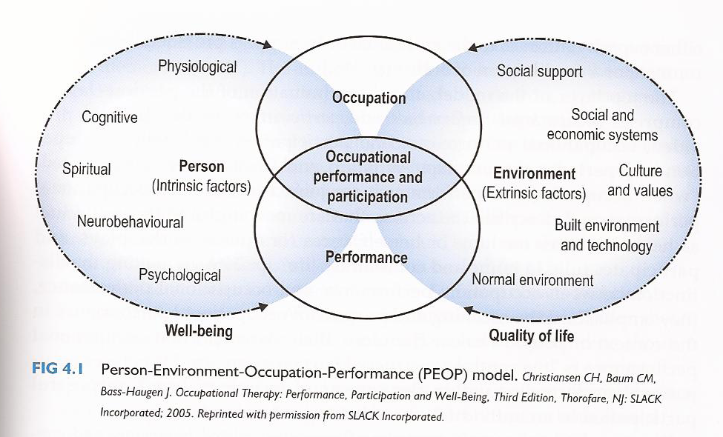
PEOP model Occupational
Notes:
Description
PEOP model explains OT THEORY & gives a visual explanation of the dynamic nature of occupational performance.
PEOP shows the transactional relationship between Person, Environment & Occupation - & the impact on Performance.
"The model is defined by its attempt to describe what people do in their daily lives, what motivates them, and how their personal characteristics combine with the situations in which occupations are undertaken to influence successful occupational performance" (Maclean, F. 2012, p.556).
Focus – on occupation, which ensures a client-centred, & ideally a collaborative approach that can be used to explain a baseline for occupational engagement & motivation by identifying barriers to & drivers for occupation/ & there is potential for this baseline snapshot to be compared with illustrative PEOP following intervention, as an outcome measure.
Function – top down theory/ medical model influence – can be applied to any individual or population because it clearly outlines which aspect(s) of the system (or domains) require therapist attention & = intervention. As we all know, occupation is ever-changing throughout our days & lives – PEOP allows for a holistic approach that reminds practitioners to resist a bottom-up approach to ‘skills’ & rather see ‘occupational performance,’
Application – PEOP defines change in terms of maximising occupational performance – OT intervention is designed to elicit this as an outcome, as a result of grading & adapting (the person factors; the environment; the demands of the occupation).
Disability – how is it defined? As the focus is on occupational performance, there is no definition of disability – rather the model is a tool to explain dysfunction/ impairment in terms of PEOP ‘mismatch.’
FOR EXAMPLE: when there is a good PEO fit/ occupational Performance/ engagement is possible; & conversely when there is a limited PEO fit/ occupational Performance/ engagement is limited, challenged, impaired.
The main goal of occupational therapy intervention is to foster occupational performance and participation and help the client achieve a level of functionality that meets their roles, responsibilities, and interests.
http://handtherapycanbefun.weebly.com/peop-model.html
https://clockthesis.wordpress.com/2009/02/19/application-of-the-person-environment-occupation-model-a-practice-tool/
http://khaszriealdnan.blogspot.co.uk/2013/02/model-and-frame-of-reference.html
https://prezi.com/t7epjuotkico/peo-model/

Slide 7
Model of human Occupation-MOHO
Kielhofner
adapted used in many services
uses own “language“
used in CPFT for efficacy of the service and improved service outcomes across the services

Slide 8
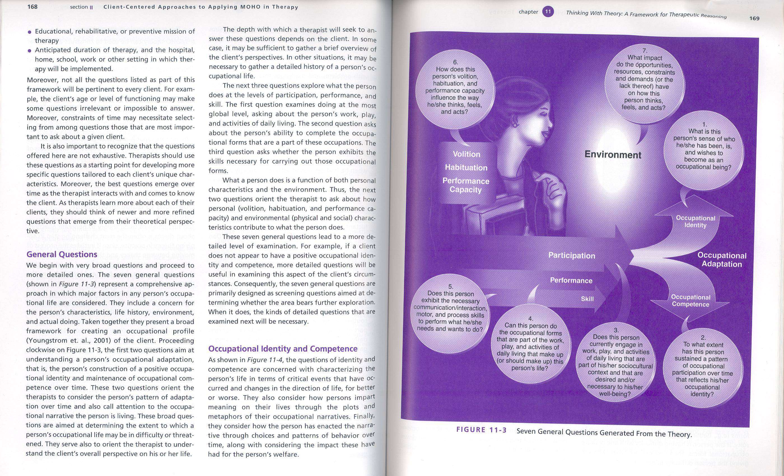
Kielhofner (2002 p169 or 2008 p148)
7 general questions generated from the theory
Notes:
MOHO has words and terms that are particular to the model – will go through some of these – hand out to explain vocabulary
Looking at and understanding the doing of occupations:
Use model to appreciate clients perspective and situation
Influenced by:
Occupational identity – Define self, who we are
Occupational competence – fulfilling a role and standard of performance
Person’s interaction with the environment provides experiences that construct clients perspective of self.
Key elements of MOHO are Volition, habituation, performance capacity
Help practitioner understand people’s choices and and help to come to solutions that will work for the person.

Slide 9
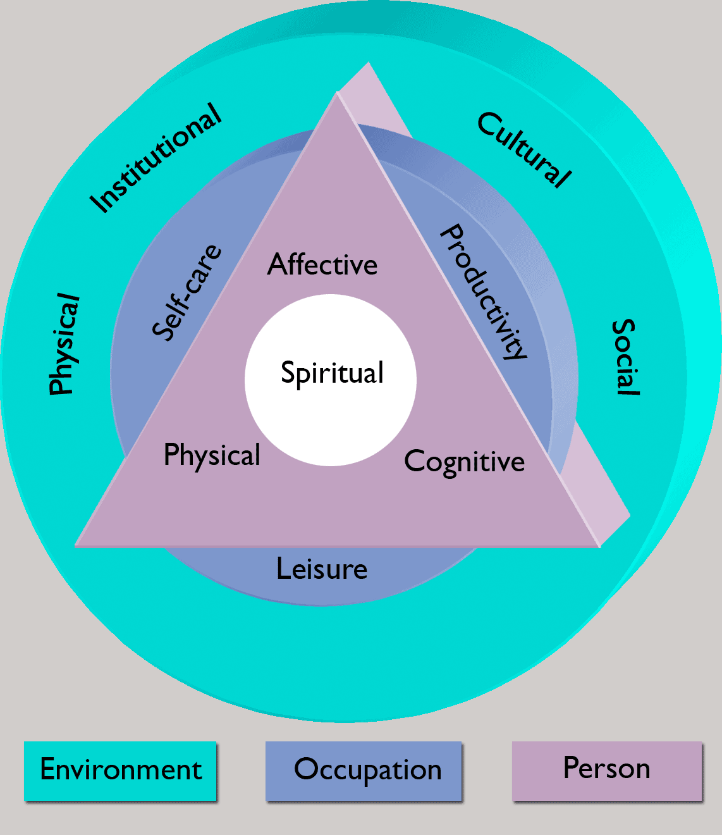
The Canadian Model of Performance and Engagement
environment
person
occupation
OT
Domain

Slide 10
Why do we use theory and models
Humans are occupational
Occupation is therapeutic
Occupation affects health and well-being
Occupation gives structure to time and life
Occupation defines cultures and individuals within those cultures
Each person’s occupation is unique.
Therefore if we use occupation as a bridge between self and environment individuals can achieve engagement.

Slide 11
Occupational therapy
Is holistic -Looks at all aspects of the person life
physical , psychological and social, includes spiritual and emotional
Is person centred
Aims to improve occupational :
engagement and performance
Promoting independence and choice and control

Slide 12
Occupational Therapy in NHS
Moved into more specialist areas in health .
Find in approximately 50+ of the services in CPFT , mental health, physical health , childrens and young people services
Work in acute sectors and specific health streams
safe discharge facilitation, promoting occupational function
Cumbria includes MBUH and NCUH , Westmorland general CIC and the West Cumberland hospital. Interface with hospitals further afield with elective surgery and specialist unit
Predominantly time limited service and focussed on outcomes and efficacy
Approx 250 staff not FTE

Slide 13
Occupational therapy role in adult social care
Previously in the work force for two specific reasons
Chronically Sick and Disabled Persons Act 1970- section 2
Housing Grants Construction and Regeneration Act 1996 as amended
Mainly concerned with services provision for disabled people including functional assessments and equipment and adaptations provision
Mainly dealing with long term issue
39 staff not FTE
Notes:
CS and DP Act 1970 section 2 - provision of assistance for that person in arranging for the carrying out of any works of adaptation in his home or the provision of any additional facilities designed to secure his greater safety, comfort or convenience ( the criteria under which OT staff were principally employed .
Housing construction

Slide 14
current legislation
The Care Act 2014
1. prevention secondary and tertiary
  Safety and independence
  Minimising the effects of disability
  usually involves skills relating to moving and handling postural management
Minor adaptations and equipment
Reablement.
Housing construction and regeneration Act 1990- funding now under the better care fund not directly to district councils/ Housing Authority
1 Disabled Facilities Grant are evolving
2. Rehousing

Slide 15
The change in legislation has changed practice
CS and DP Act 1970
Targeted approach to assessment
Assessments Deficit based
Targeted approach to deficits in support plan
Contingencies gradually introduced as good practice
Little effective prevention across the system
Positive risk taking approach
The Care Act
Holistic approach to assessment
Assessment strength based Support plan strength based and holistic
Contingencies essential part
Duty for prevention at every stage
Prevention services developing
positive risk taking approach is essential
Opportunities and threats No more capacity Need to work smarter
Notes:
In ASC our assessment has changed from a deficits based model to one which is holistic and strengths based. It is generic and is coloured by the dogma of the practitioner .
The limitations of statutory practice from the section 2 of the CS and DP act 1970 the provision of assistance for that person in arranging for the carrying out of any works of adaptation in his home or the provision of any additional facilities designed to secure his greater safety, comfort or convenience ( the criteria under which OT staff were principally employed . The care act has widened this to enable potentially better use of specific practitioner skills to be better utilised to meet the persons and carers needs .
the one thing that we generally do well is positive risk management- generally
this is not true of all staff but of many and the reason why is because following putting people first transformimg social care 2006 introduced 2007 where lincoln case study outlined the need to Develop skills to safeguard adults including risk enablement and interagency working and this was subsequently part of the A Vision for Adult Social Care:Capable Communities and Active Citizens 16.11.10
which emphasised the needs for a :
workforce who can provide care and support with skill, compassion and imagination, and who are given the freedom and support to do DOH .
We had positive risk taking training which was part of upskilling the workforce and training on personalisation and outcomes which we have subsequently tried to reinforce and embed with staff and give support to form a cultural change in this way.
it was underpinned by think local act perosnal 2010.

Slide 16
Adults social care
Seen as a prevention service :secondary , tertiary
Skill base is, enabling , facilitating occupational engagement
Assessment includes functional assessment as well as assessment interview to inform re the psychological and social aspects. Considers informal carer as joint or as self
Solution is occupational adaptation focus for the individual
practical solutions may be :
advice – information and alternative techniques ,use of community assets
equipment – hoisting , postural seating
adaptation- of the physical environment
In social care we don’t treat people , we enable – reablement

Slide 17
Factors considered when arriving at decisions
Desired outcomes
Assessment –physical, procedural, care plans and actions of others
Risk balance –quality outcomes Risk, risk management, risk, removal or reduction and review and monitor
The law, case law precedent
The standards
Regulatory body HCPC section 6 standards
Positive risk guidance
The person mental capacity (MCA 2005)
Collaboration, MDT approach
The organisational strategy
The individual practitioner -experience

Slide 18
Solutions must be substantiated
By defensible decisions – just like social workers !
A defensible decision has been defined as one that will withstand “ hindsight scrutiny “ should the case “go wrong” I and negative outcomes have occurred . (Carson , 1996:kemshall ,1998)
a decision is defensible if, in spite of a negative outcome, it can be demonstrated that all reasonable steps had been taken in its assessment and management. (Kemshall 2011)

Slide 19
Risk taking for positive outcomes
the person is capacitated in the area of interest.
For those people that choose to make decisions against best advice
it is safer than the alternative
safer than doing nothing

Slide 20
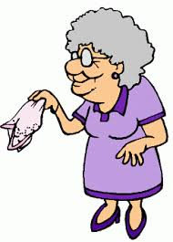
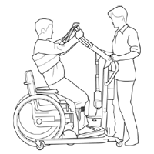
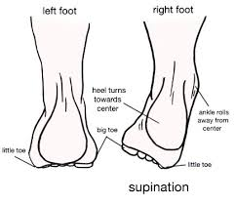
Positive Risk Taking
88 years young
Capacitated
Independent spirit
Feisty
Notes:
This example demonstrates the maintenance of mental and physiological wellbeing related to choice and control in how care is delivered to ensure that quality of life is enhanced.
88 year old lady with severe arthritis, history of fractures. Has Capacity. Using a stand aid unsafely, risk of damaging nerves under arms and fracturing left ankle which is internally rotated. Trialled all other options but Ms A wanted her care to be carried out as quickly as possible with as little movement to reduce pain and fatigue and therefore the stand aid was the only acceptable option. Completed positive risk taking documentation-. The risk was that Ms A could break her ankle with continued use of this.
Care agency were concerned that should her ankle break they will have bad publicity. They threatened to give 28 days notice however OT met with Ms A and the care agency to advocate her right to take the risk, OT put measures in place so the care agency was happy to continue- e.g. Ms A had to move her foot onto the footplate, and there would be regular review by the OT .
This continued for 2 years where Ms A remained at home. Her ankle then broke whilst using the stand aid and was admitted to hospital. She became end of life and ASC OTs facilitated d/c home so she could die in her own home.
Pro’s- Ms A was empowered and in control of her care, she remained at home and had care delivered in a way which was acceptable for her,her dignity, mental and physical wellbeing.Her family were involved and fully on board.
Con’s- It was difficult for the carers to accept and it caused them a lot of anxiety, Ms A could be a difficulty lady and would tell the carers they were doing it wrong and hurting her, they were scared of blame if something happened. The OT felt that it was a risk she was taking with the lady and didn’t have a lot of multidisciplinary support. Others e.g. physio were happy to give their opinion but wouldn’t commit to supporting the risk taking. The lead OT supported the decision as it was defensible practice . I took legal advice re the risk assessment which was signed by the lady.
Human rights and the east sussex case applies here . The judge stressed that “
…..the rights to human dignity and physical and psychological integrity derived from articles 3 and 8 of the European convention on the human rights required exceptional manual methods to be used where there is prolonged resistance or great and obvious distress.”p9 cited in the guide to the handling of people 5th edition.
whilst blanket policies almost certaily unlawful – prcatice hasn’t really changed much – mect example

Slide 21
Current DFG
grant can be used for adaptations to give better freedom of movement into and around the home and/or to provide essential facilities within it. Examples of the work which may be covered by this assistance are:
widening doors and installing ramps
providing or improving access to rooms and facilities - for example, by installing a stair lift or providing a downstairs bathroom
bathroom conversion e.g. providing level access shower, accessible WC and wash hand basin
improving or providing a heating system which is suitable for the disabled person's needs
improving access to and movement around the home to enable you to care for another person who lives in the property, such as a child
alterations to door widths and ramps
specialist equipment i.e. baths/ kitchens
The maximum mandatory values of works is £30,000 in England; however the local authority can use discretionary powers released through a later RRO to increase the value of works.

Slide 22
Procedures
If you learn one thing from today – it is to work in partnership
If there is equipment in place someone has very probably supplied or advised about it
is it meeting their needs? who supplied it ?
often for carers benefit as well as that of the person
P19- Support and Care at Home – Moving and Handling
(Incorporating Formal and Informal Carers in Moving and Handling Tasks, and Requirements for Two Carers)
P33- INSPECTION OF COMMUNITY EQUIPMENT
P39 – PROCEDURE- Community Equipment
Transition- include Occupational therapy involvement

Slide 23
What’s Occupational Therapy got to do with you
Should be a whole systems approach across organisations
should be holistic assessment of person ( carer)and review
Need to involve other members of the multi- disciplinary team
Need to ensure that outcomes achieved

Slide 24
Review
When reviewing please ensure that you take a holistic approach if people have equipment check where it originated from and if it is still meeting needs .
We have a equipment procedure
Inspection of community equipment procedure
moving and handling procedure
community equipment procedure

Slide 25
minor adaptations equipment and eligibility
Adaptations under 1k
Process in house
criteria and cost
equipment free -
Improving prevention streams to self serve other than bringing everyone into the statutory service

Slide 26
Moving and handling
independence
informal /formal carer
Rules and regulations LOLER 1998 PUWER 1998 , MHOR 1992 (as amended 2002), HSAW ACT 1974 management of health and safety at work regs 1999.
Transfer between agencies
ONGOING REVIEWS – legal mandate

Slide 27

Wellbeing principle
Participation
Dignity
Domestic, Family and Personal
Protection
Control
Suitable Accommodation
Contribution
For our service users the well being principle only works, if we work together –A holistic approach

Slide 28
Was the area you wanted to know about addressed?
1 thing you have learnt
1 thing you will apply

Slide 29
References
Christianson, C. Baum, C. Person environment occupational performance: a conceptual model of practice.
Cramm, H. (2003) The person environment occupation circle tool: a simple way to bridge theory into practice. Available at: http://www.caot.ca/otnow/may09/peo.pdf
Strong, S. Rigby, P. Stewart, D.Law, M. Letts, L. Cooper, B. (1999) Application of the person environment occupation model: A practical tool. Available at: http://cjo.sagepub.com/content/66/3/122.short?rss=1&ssource=mfr
Polatajko, H.J., Townsend, E.A. & Craik, J. 2007. Canadian Model of Occupational Performance and Engagement (CMOP-E). In Enabling Occupation II: Advancing an Occupational Therapy Vision of Health, Well-being, & Justice through Occupation. E.A. Townsend & H.J. Polatajko, Eds. Ottawa, ON: CAOT Publications ACE. 22-36.
Kielhofner, G. (2008) Model of Human Occupation: Theory and Application (Model of Human Occupation: Theory & Application) 4th Edition, Wolters Klvwer, USA

