Slide 1
What Makes a good Foster Carer Review?

Slide 2
THE LIQUID REVIEW PROCESS;
1. FSSW Creates the review form,
2. Within the FSSW review form is the FSSW report. Once you have finished the report you must send it to the Manager for their approval (tab at the top of the page).
3. The Manager may send the report back for alterations once quality assured, if so just repeat the process. ( Please give yourself time for this. Do not leave the report until the last minute!)
4. When the Manager is happy with the report they will approve the document. This will automatically send the report back to FSSW task tray.
5. Once you have received the Report in your task tray you must then progress the whole review form to the Manager. The review form will then disappear from your task tray and into your Managers tray.
6. The Manager writes their comments and progresses the document to the Fostering IRO.

Slide 3
There are a number of supporting documents that need to updated and available for the review. These documents will be Quality Assured by Team Managers prior to the review being forwarded to the IRO. These documents are;
Health and safety questionnaires
Safe care policies
Animal risk assessments
Fire policy
Unannounced visit form

Slide 4
Process and compliance
Using the Liquid Logic Review Process.
All forms should now be consolidated. FSSW report to be forwarded to Team Manager 2 weeks prior to review date.
All supporting documents should be forwarded to admin 2 weeks prior to review date. Fostering admin are now responsible for uploading the documents as ‘attachments’ on to the review form. By doing so, attachments will also automatically save in ‘Documents’ store. (There should be no need for any documents to be sent direct to the Fostering IRO or Team Managers as they should be on the system)

Slide 5
The key to good quality and success!

Slide 6
Children’s feedback is vital;
Meet and talk to young people in placement. They should know who you are and why you visit.
Explain to young people what the Foster Carer review is for and ask them if they want to contribute. Children can contribute in a number of ways. (MO MO, written questionnaire, by having a discussion with you or by using any other means that they may prefer)
If young people don’t wish to contribute then this is ok. But please write about your observations on your visits, what does it tell you?
Foster carers should not be filling children’s response in with them!
It is not just about foster children but also carer’s children, they are still sometimes over- looked.
Adult household members views should also be sought and documented.

Slide 7
A note on SW feedback;
The forms should now be sent to SW through liquid. (The allocated SW must be allocated the form otherwise this just sits in the task tray)
If the form is not returned then please follow up on this. Even an email response is better than nothing at all!
Don’t wait until the review is due, collate this throughout the year and celebrate the carers successes at each point of the year.
Learn and reflect from feedback.
SW feedback is important, not only from a procedural perspective but also for the carers who, especially this year, have had such a tough time.

Slide 8
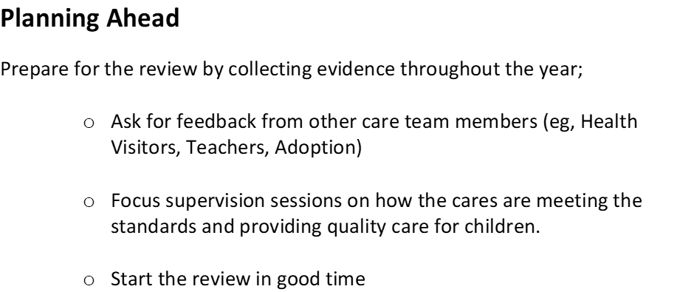

Slide 9
The FSSW report
It is clear, taking into account the Local Authority’s adoption of Signs of Safety and observations made by OFSTED in 2019, more consistency is required.
There is currently too much variation,
sometimes too little information, sometimes too much, sometimes enough but in the wrong section!.
In general, reports need to be more succinct and less descriptive with clear development plans.

Slide 10
What have carers done well and what do they need to work on;
The LA have adopted the Signs Of Safety approach to working with each other, children and their families. This includes those who care for them on behalf of the Local Authority. The following is now the structure that most people have now adopted.
Please note; Remember this is about the carer’s skills and qualities and what they bring to the table and how they adapt and use these skills to provide the best quality care for our children.
What is working well,
What are we worried about,
Complicating factors,
What are we worried about if nothing changes,
Next steps.
Please note; There is no analysis required in this section, it needs to be short and snappy so the reader can grasp the strengths and vulnerabilities. The ‘meat to bones’ is provided at the end of the report (which we will come onto)

Slide 11
Work with Children and Families, The STANDARDS;
This is where the analysis part of the review needs to be.
The evidence recorded from supervision sessions automatically populate this section of the review report so the actual evidence is already there.
FSSW must then summarise what this evidence tells us and explain to the reader what that means for the child who is living there .
In contrast, summarise what the carers struggle with and what this means for the child who is living there

Slide 12
STANDARD 7, ‘leisure activities’
Evidence, has already populated this box
(Summary bit comes next) The evidence suggests that Bill and Ben recognise the importance of children’s leisure time. Bill and Ben utilize after school clubs and have been proactive in looking for local football clubs for Penfold. Bill and Ben take turns to take Penfold to training twice a week, it is clear he loves football and Bill and Ben enjoy going to watch Penfold play every weekend and cheer him on. Bill and Ben also appreciate how important friends are to young people. Bill and Ben therefore love to invite Penfold’s friends over for tea and encourage him to play with friends nearby. Bill spends lots of one to one time with Penfold helping him/ teaching him with wood work and how to mend his bike.
(Analysis- impact on child) Penfold feels important, he is part of a team, he is learning how to communicate and work with other children who have the same goal. Penfold feels proud of his achievements, he reacts positively to praise, he has a real excitement the night before the games, this serves as a distraction from the worries he has about his family. Penfold is learning to develop and sustain friendships, he learns from the good and bad times when he may fall out with them. Penfold is playing, he is learning to enjoy life and catch up on areas in his life that he has missed out on. Bill and Ben spend time with Penfold, he senses that the carers are fond of him and that he is a valued part of the family. Penfold is feels that he has a sense of worth, his self-esteem is boosted and he is learning a trade.
Or, if you prefer, use bullet points or side headings…………………..

Slide 13
STANDARD 9, ‘Promoting and Supporting Contact’
Evidence has already populated this box (which means that any new worker picking up the case will have information on what the carers are capable of).
Summary
The evidence highlights that Bill and Ben have a healthy attitude to contact. Bill and Ben communicate effectively with Mr Spoon, they do this through contact books, text messages and emails. Bill and Ben talk to Penfold about his mum and dad and his brothers and sisters, they encourage him to talk about the good times and listen when he talks about the challenging times. Bill and Ben recognise the importance of gaining the trust of Penfold’s parents, they can see why they may feel powerless and upset at the loss of their child. Bill and Ben’s commitment is also extended to sibling relationships, they communicate and meet up with the foster carers of Penfold’s bothers and sisters.
Analysis (Impact on child)
Penfold does not feel that Bill and Ben are trying to take over the role of his parents.
Penfold is able to see that Bill and Ben respect his mum and dad, they both talk to Penfold about them and listen to him.
Penfold doesn’t feel that this is a subject that needs to be avoided. Penfold can see that his carers and his parents are working together, he recognises that his parents support Bill and Ben’s rules.
Penfold is able to see his brothers and sisters, they are important to him, he misses them and looks forward to their visits.

Slide 14
Safe care;
There should be 2 policies uploaded onto the system;
Generic
Individual to the needs of the child in placement
It is important that these are updated on a regular basis, especially where there are risks from aggression, allegations, self-harm and social media.
Complaints/ allegations/ un-planned endings;
There is a section on the foster carers liquid file where these are to be recorded.
The minutes of Standards Of Care meetings and Disruption Meetings must be recorded and shared promptly following meetings. This will delay a Foster Carer Review and could be avoided.

Slide 15
Recommendation; This should be short, concise. Is approval category to remain the same?, Are levels and preferences to remain the same?. There should be very little in terms of description here, any major changes to approval should have been explained in previous sections.
Development plan; This is the last and most important section for the year ahead. It is not just an action list but a plan of what the carers need to focus on/ do in the year ahead to work on vulnerabilities. It is very similar to our appraisals, all too often they are bank but very few of us are perfect in all areas of work, it is the same with foster carers!

Slide 16
Training
Improvements need to be made in terms of;
Training plans,
Evidencing training, carers need to evidence and discuss in supervisions, this needs to be recorded in the appropriate section on Liquid file
Crucial that new carers complete the 11 mandatory courses,
Crucial that FIRST AID and FOOD HYGEINE are renewed every 3 years.
Previous Actions; A lot of the actions requested at historical reviews are not always completed. As a result of this the IRO will now be setting time in the diary to check that actions have been completed and approvals accurate. SORRY:☹

Slide 17
QUESTIONS

