Slide 2
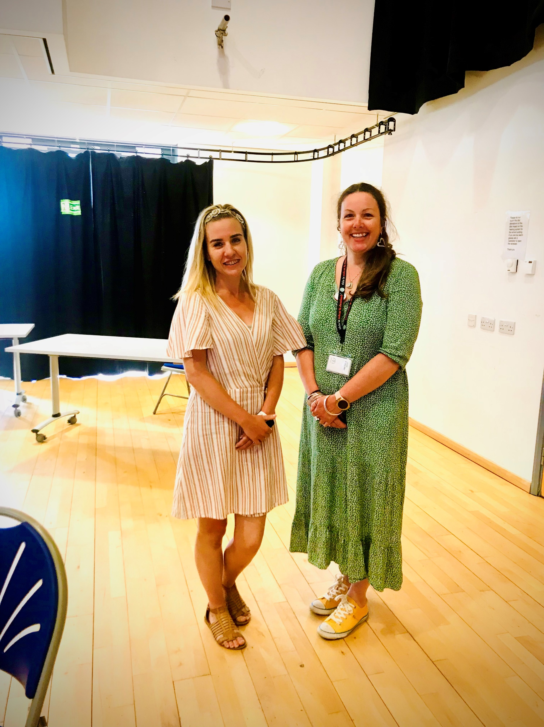
Redcar and Cleveland SGO Team
Rachel McGillicuddy – SGO Social Worker
Charlotte Williams – SGO Support Worker

Slide 3
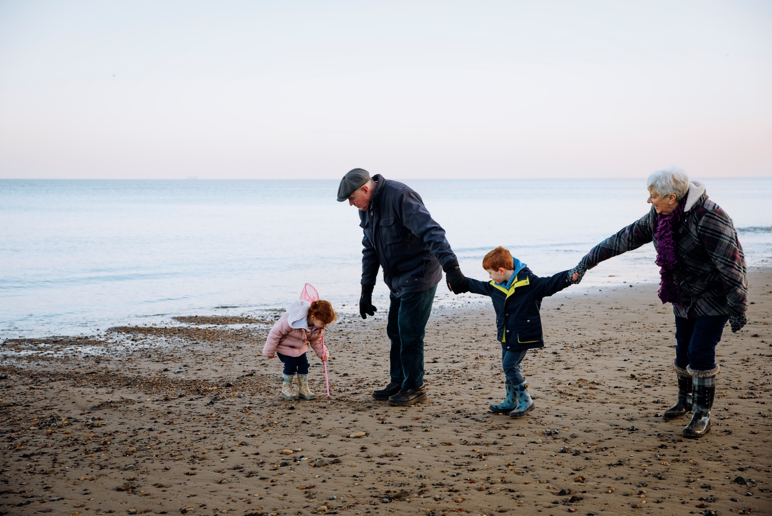
What’s a Special Guardian?
Kinship care: Anyone, outside of fostering and adoption who is looking after a child that is not their own by birth.
A Special Guardian is a type of kinship carer
SGO: A Special Guardianship Order (SGO) is a legal order that provides kinship carers greater parental responsibility of the child in their care. A SPECIAL GUARDIANSHIP ORDER (SGO) IS A LEGAL ORDER WHICH PROVIDENSHIP CARERS GREATER PARENTAL RESPONSIBILITY FOR THE CHILD IN THEIR CARE.
A carer can be identified as anyone, outside f fostering and adoption, who is looking after a child that is NOT their own by birth. This may be a family member,

Slide 4
The number of children in kinship care arrangements is increasing
In the UK, there are around 180,000 children being raised in kinship care
There are more SGOs being made than AOs!
2019 – The development of the SGO Team

Slide 5
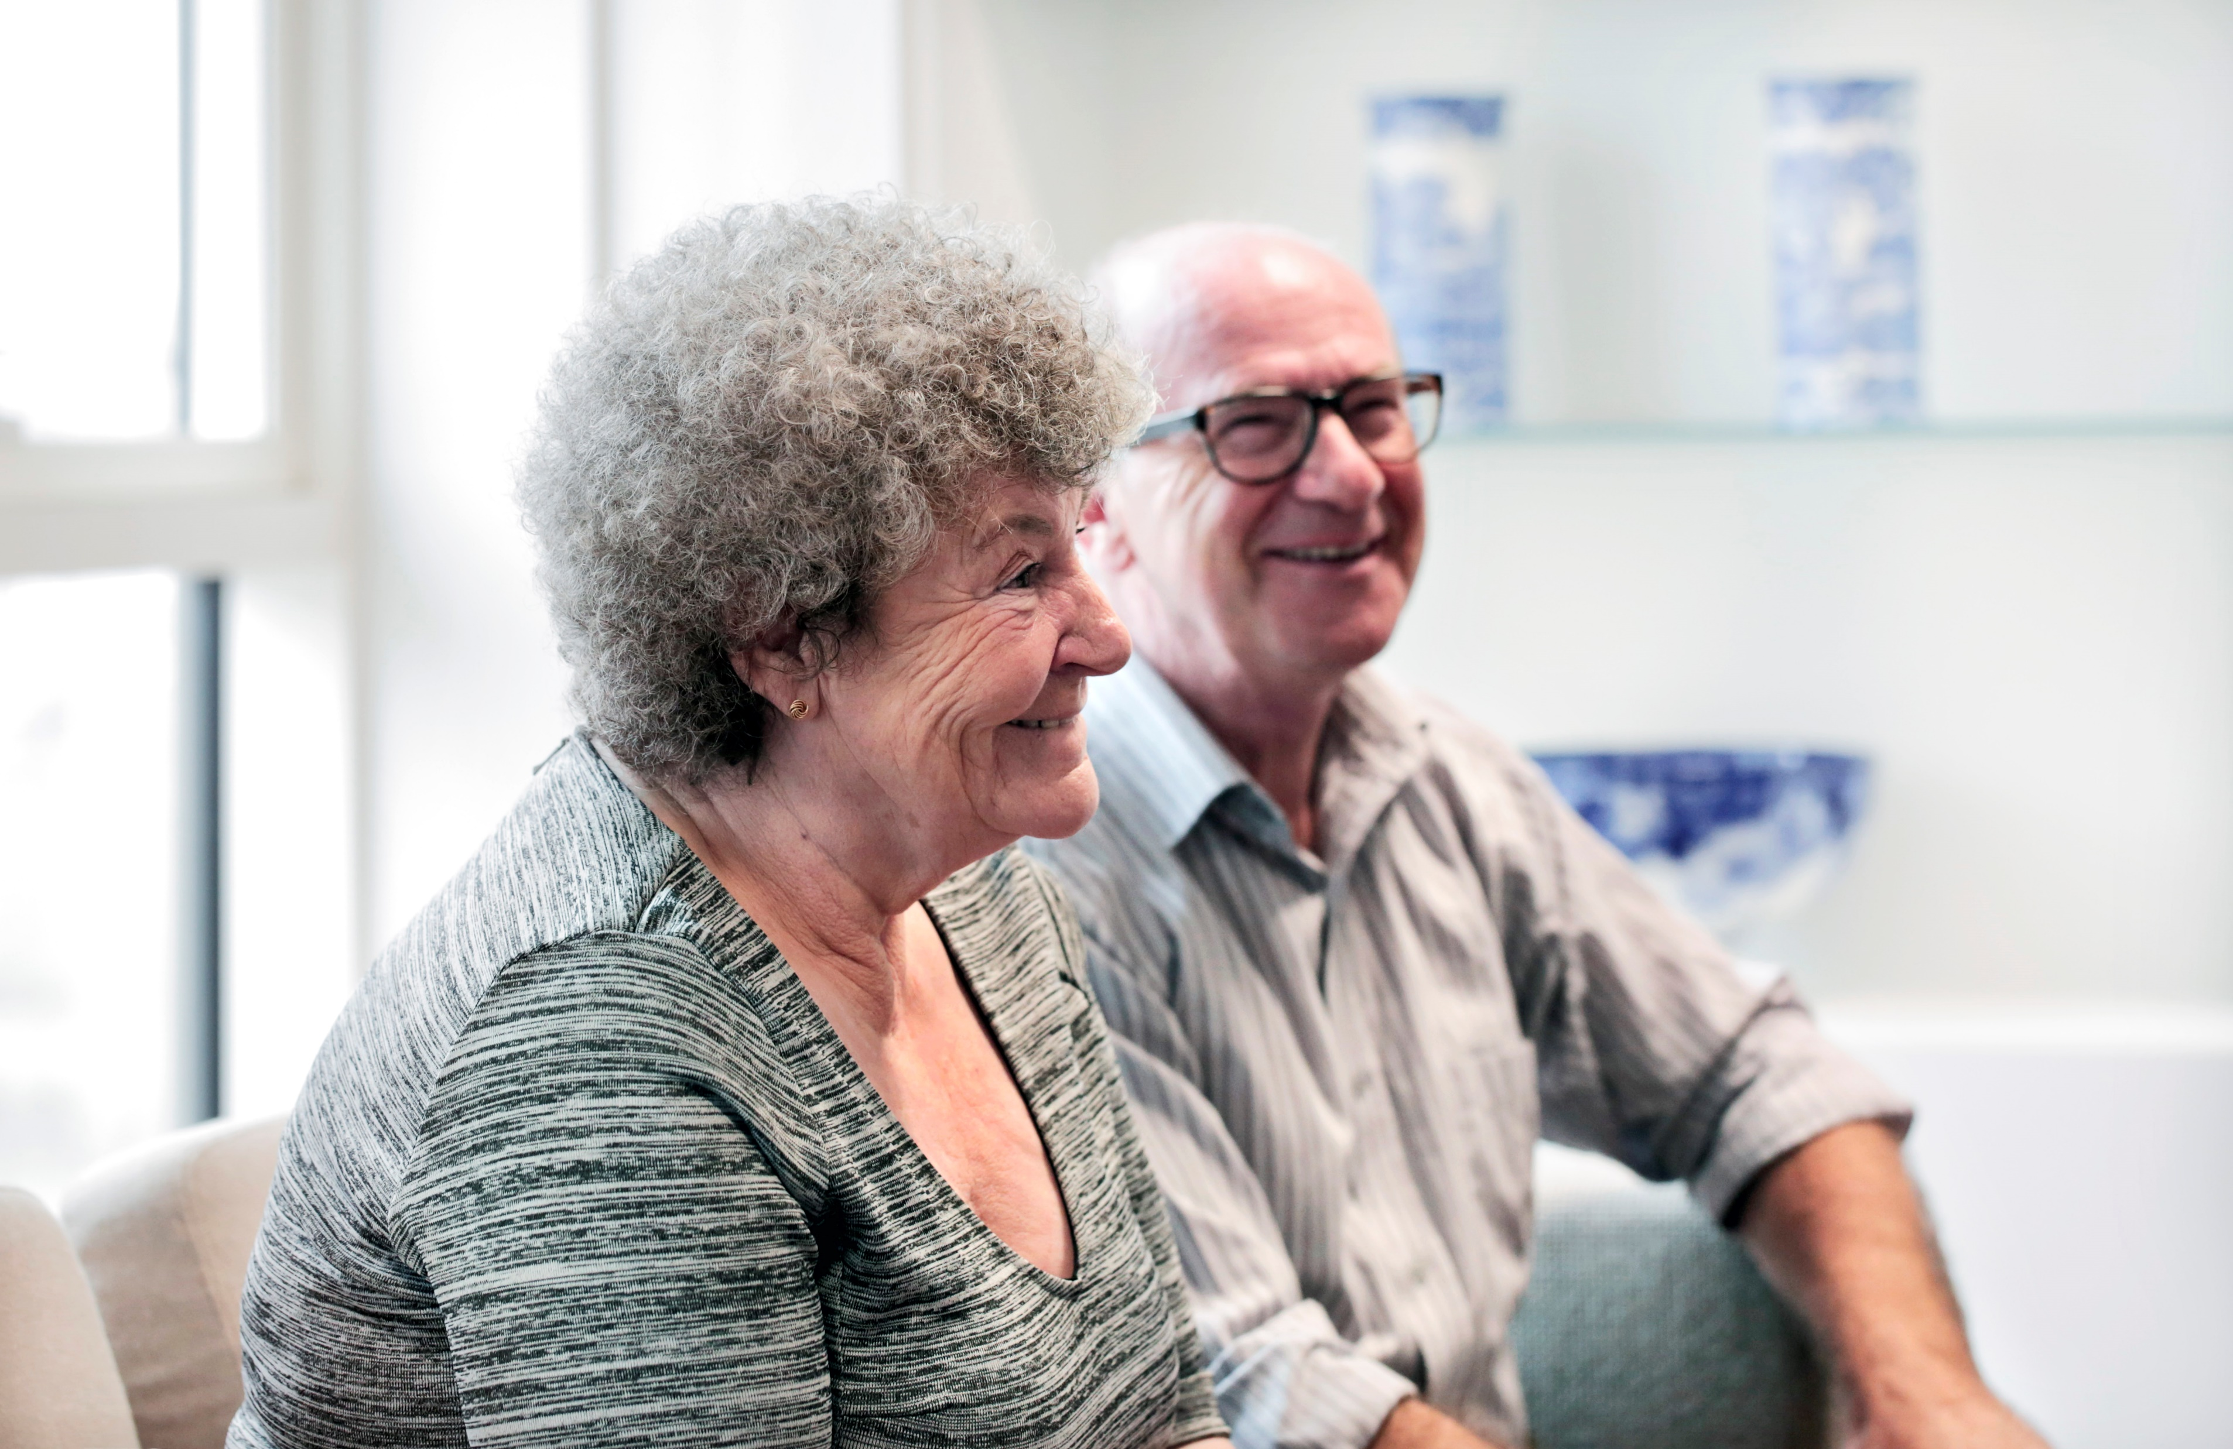
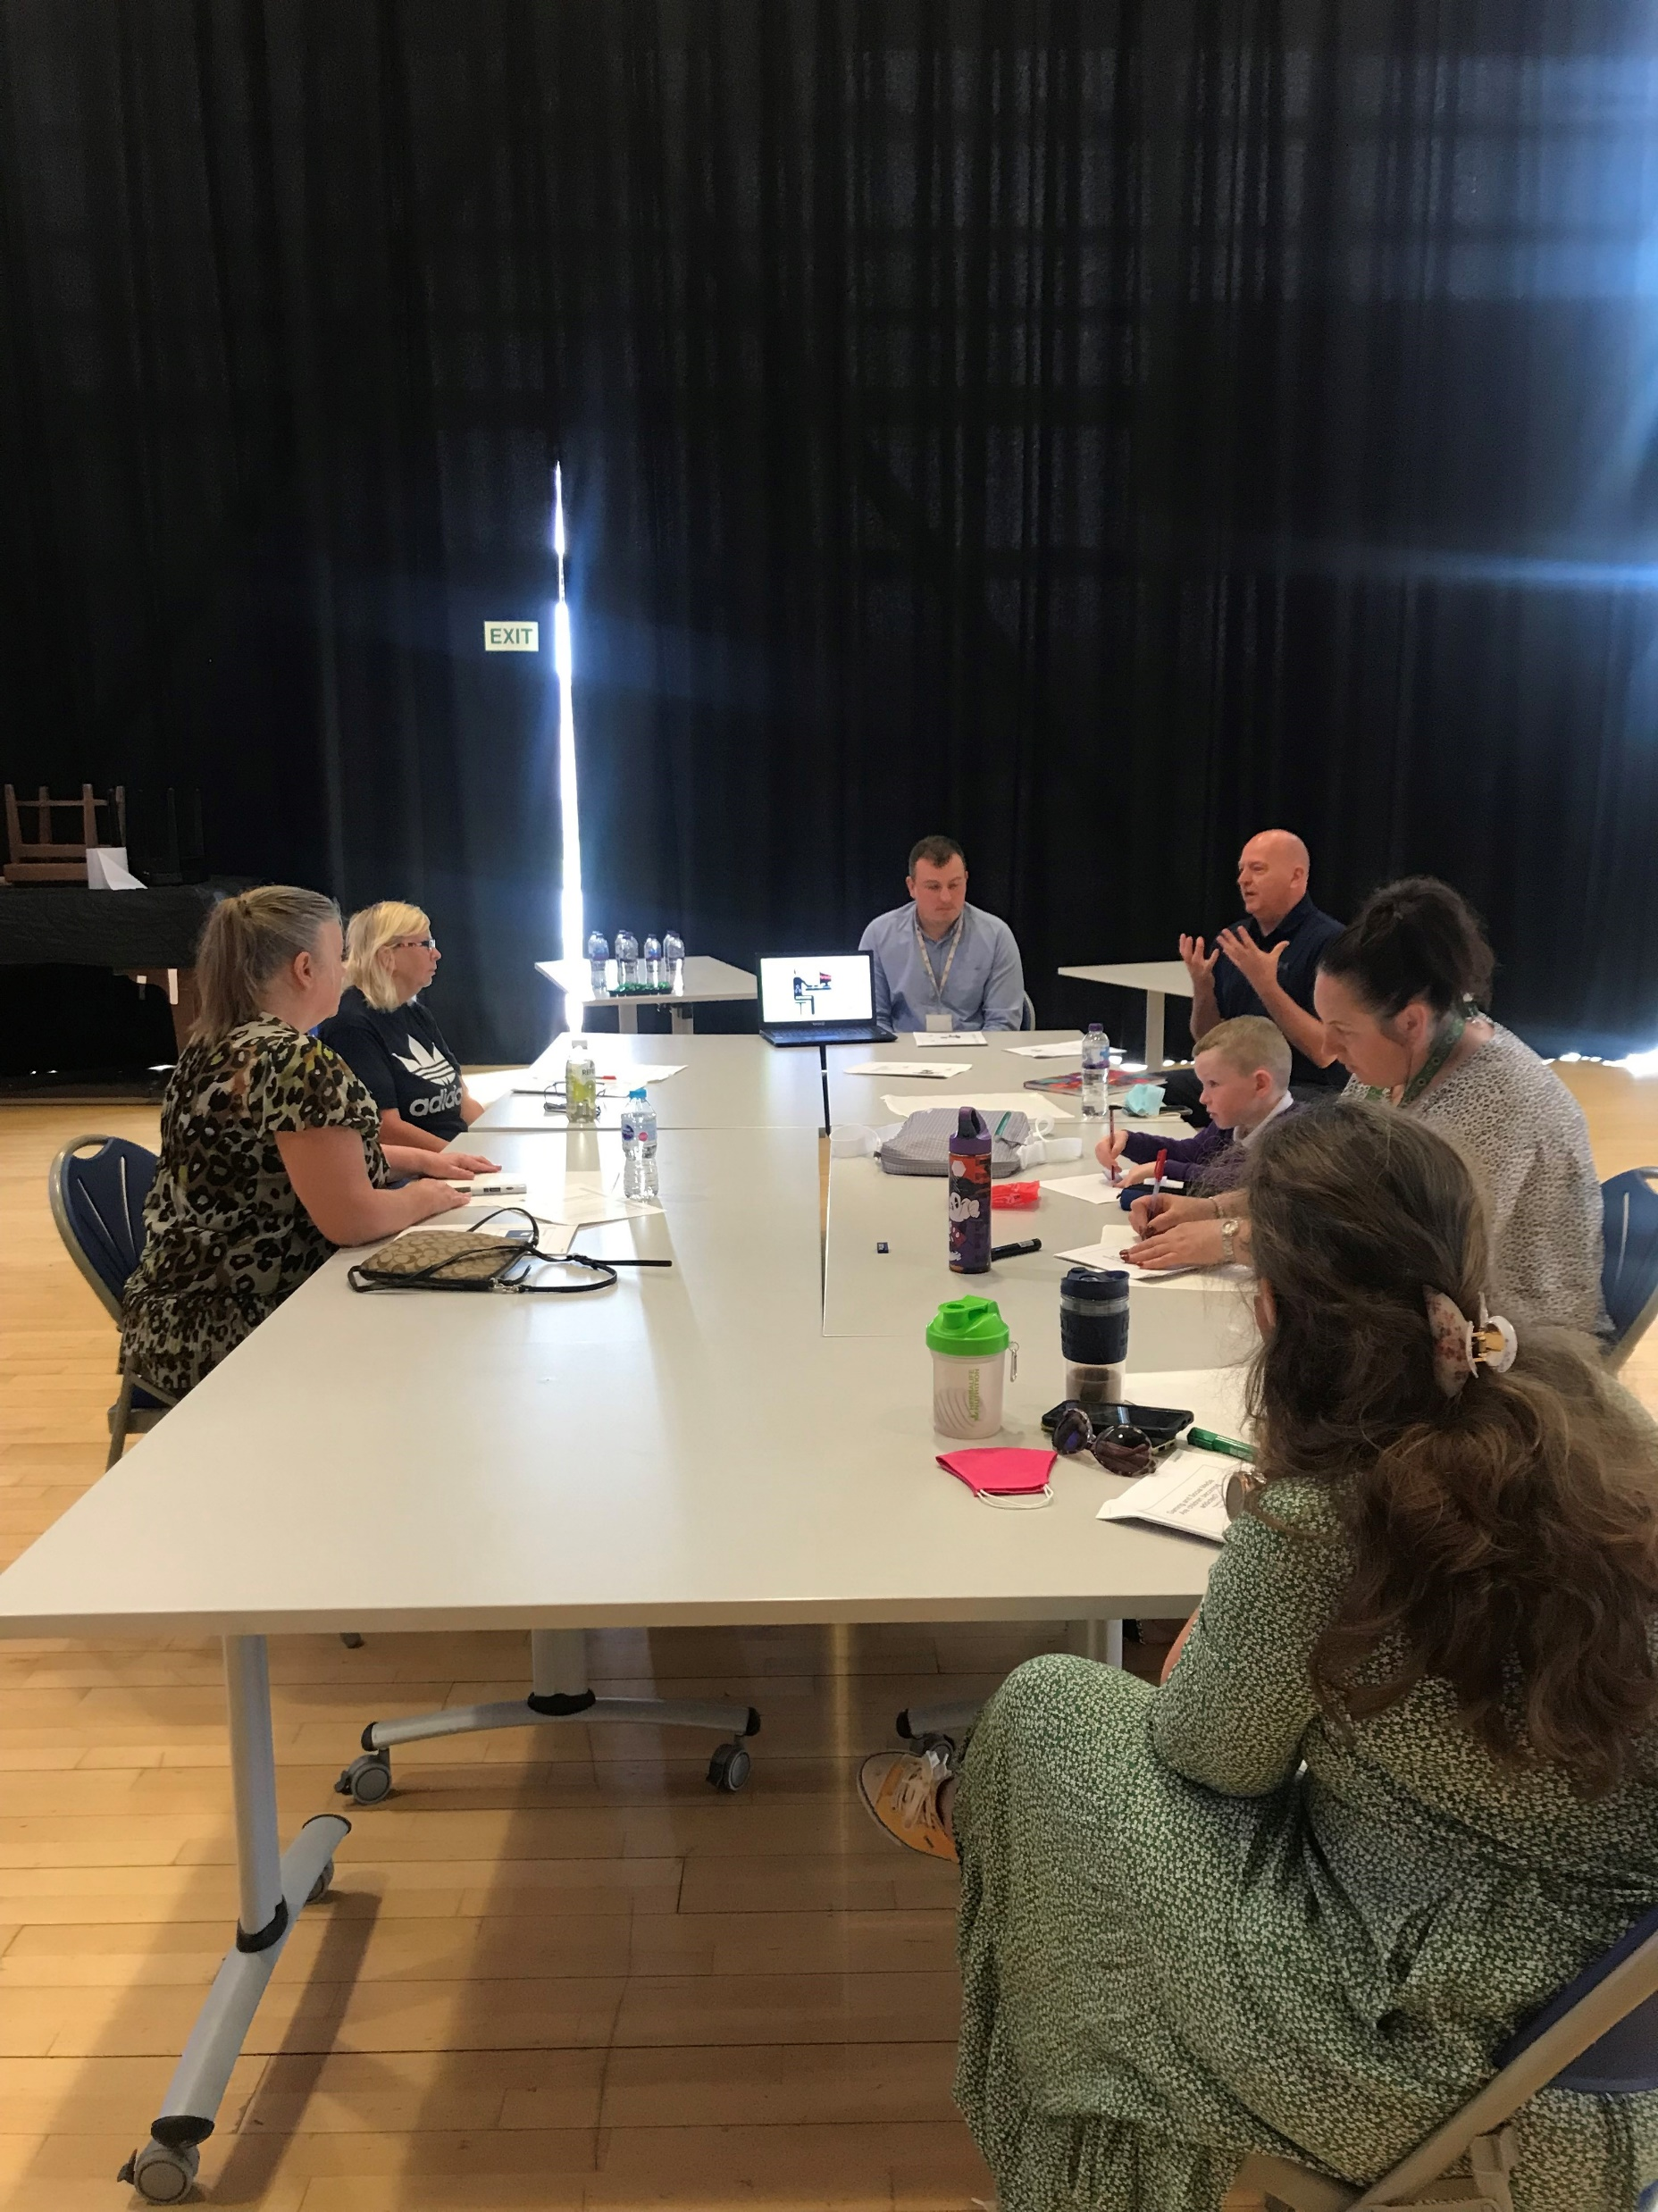
Support for Carers
coke bottle effect
Advice and Information
The SGO Team provide all kinship carers optional ongoing support via telephone or home visits.
Training and Parenting Programmes
We source tailored training for carers. Sessions address trauma and attachment difficulties.

Slide 6
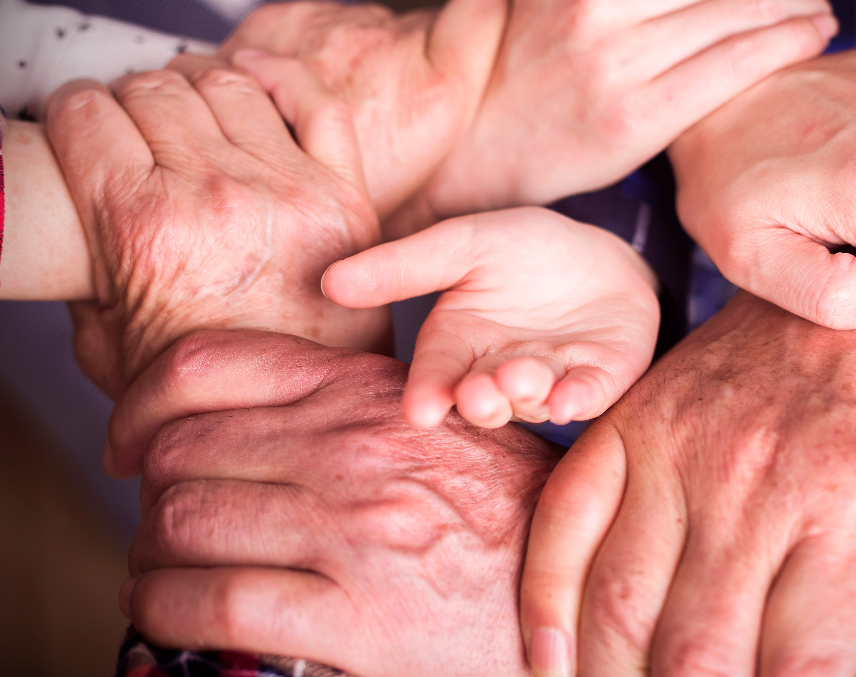
Emotional Support and Outreach
SGO family referrals can be made for:
Emotional Regulation Support (1-1)
Outreach in the Community
Adoption Support Fund (ASF)
Specialist Therapeutic Support

Slide 7
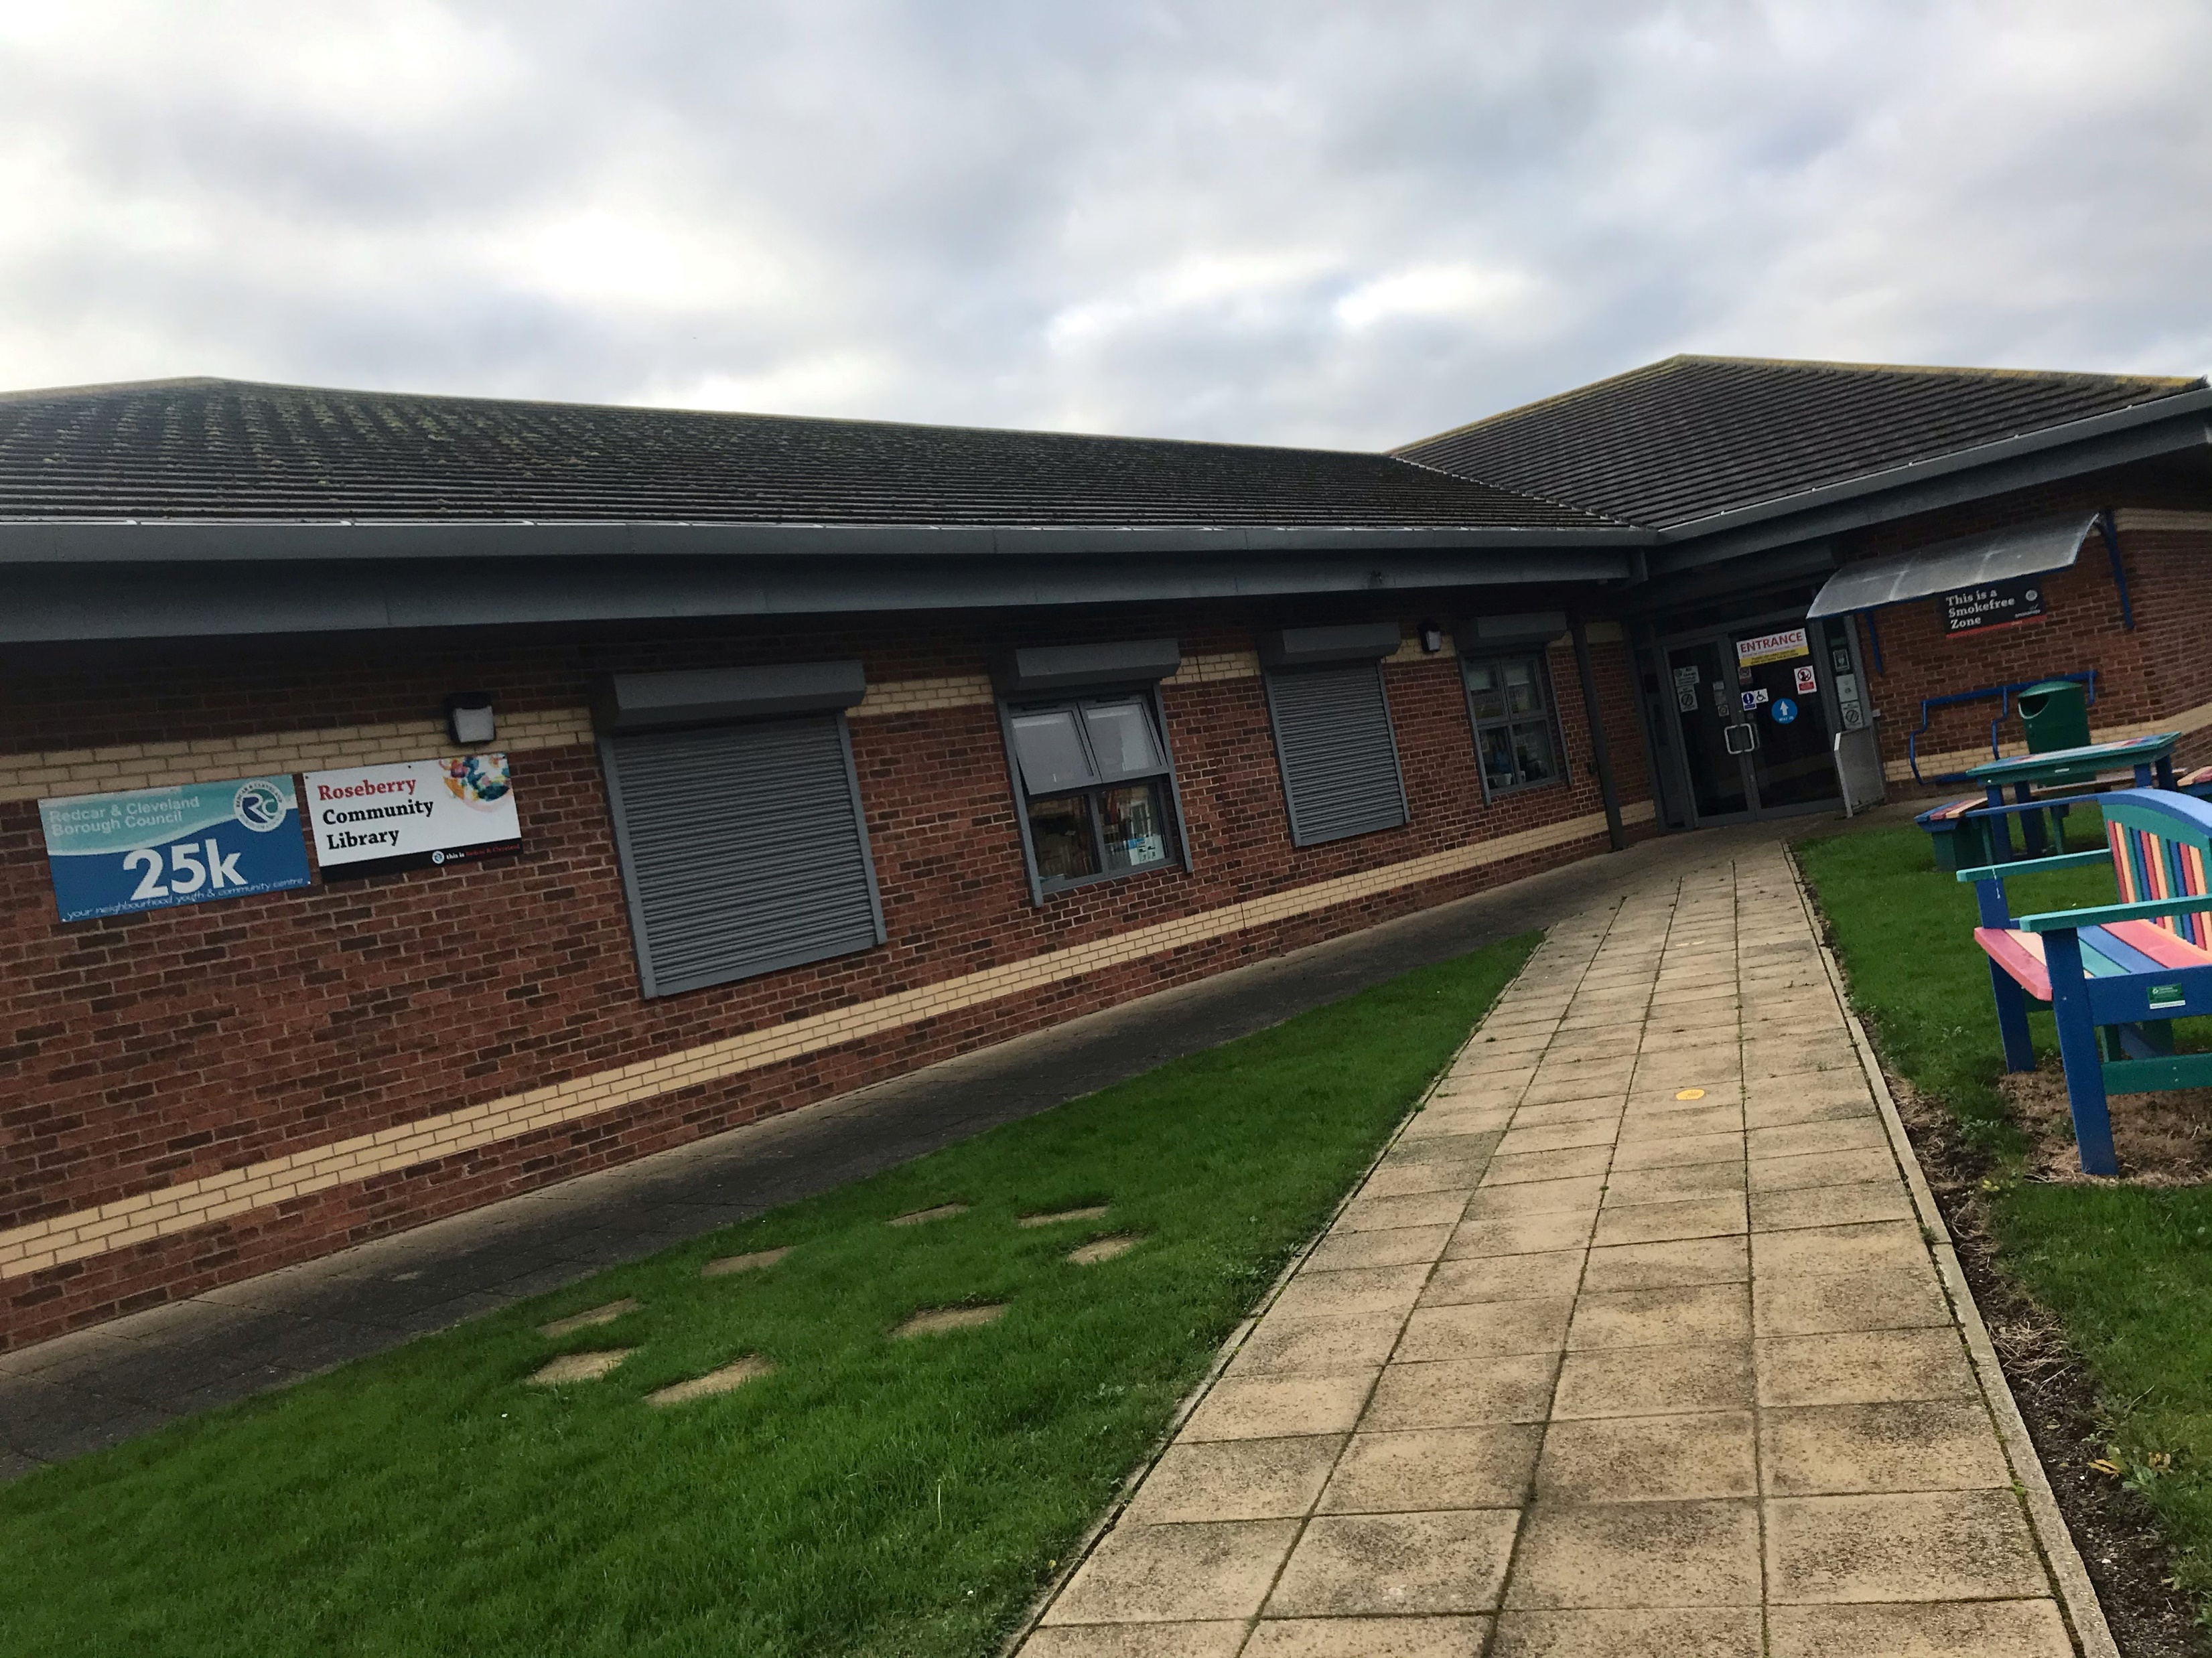
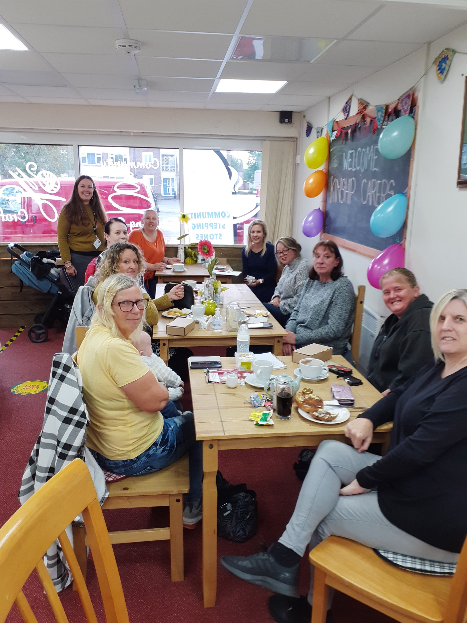
Kinship Care Support Group
Carers have access to face to face and virtual support groups
The group is fully constitutionalised which means they can raise funds in their own right

Slide 8
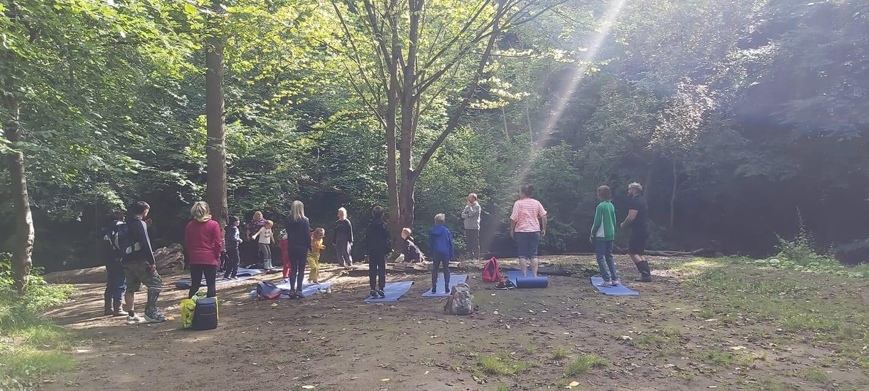
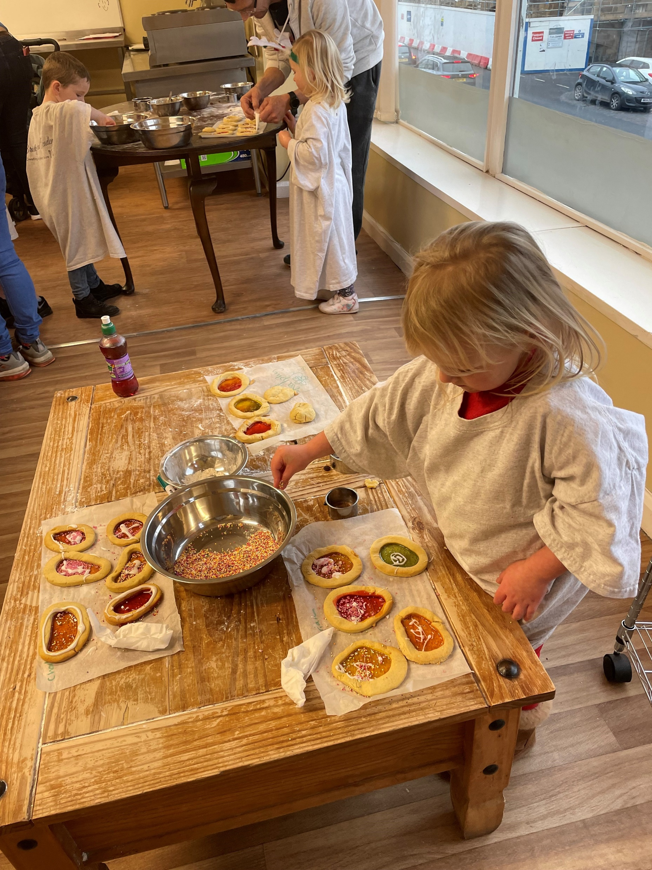
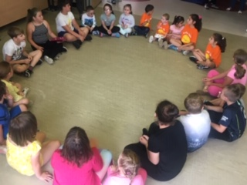
Seasonal Events and Activities
The SGO Team are responsible for organising
days out, activities, and events.

Slide 9
Working in Partnership
The SGO Team works with regional authorities, schools, and voluntary agencies
We are proud of what we do!

Slide 10
Thank You!
To make a referral or to discuss a family, please call us on (01642) 444121 or email
SGOTeam@redcar-cleveland.gov.uk
You can also find us on the Peoples Information Network
www.peoplesinfonet.org.uk

