Slide 1
Webcam with confidence
Notes:
Important : before using this presentation, please check that the film Consequences, which is embedded on slide 6, plays correctly. If not, you need to embed it again using the copy of the film included in the zip file.

Slide 2
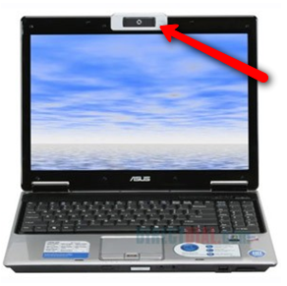
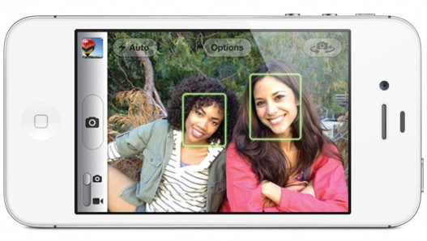
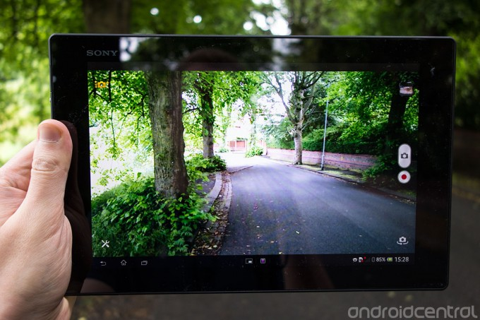
Notes:
How many people here have a camera on your phone, tablet or laptop?
Webcam can be a brilliant thing. It's a fun, cheap way to chat. You can stay in touch with people who live far away, even on the other side of the world. It's also easy to take pictures and videos of you and your friends.
But webcam can be risky too. It's important to know how to keep yourself safe on screen.

Slide 3
What are you concerned about?
What can go wrong?
Notes:
Ask the questions and take a few suggestions.

Slide 4
Webcam Abuse
A few people want to trick or pressurise young people into doing sexual things on webcam.
This can happen to boys and girls.
Notes:
Today we're going to talk about how you can protect yourself, and protect your friends from a serious risk: webcam abuse.
Some people who contact you online really do want to chat or be friends. But the problem is, it’s very easy to lie online. There are a few people out there, we'll call them ‘abusers’, who pretend to be friendly but they want to hurt young people.
They want to get a young person to chat on cam and then film them doing sexual things. This is something that has happened to both boys and girls.
We’ll talk about how this can happen, and then we'll watch a short film to find out more. After that we'll talk about how you can keep yourself safe, and where you and your friends can get help if you are worried.

Slide 5
How does it happen?
An abuser might pretend to be a boy or girl your age.
They might even pretend to be someone you know.
They chat and flirt online. They start to chat about sex.
They ask for naked selfies, or to go naked on webcam.
Then they threaten: “I will share this pic with everyone you know if you don’t do more things on webcam/ hurt yourself/ give me money... ”
Notes:
So what do webcam abusers do?
Abusers start by chatting to a young person, and flirting with them. They might pretend to be a boy or girl your age.
They could even pretend to be someone the young person knows, like a boyfriend, girlfriend or friend: they could have hacked into that person’s account and taken it over.
They start saying more sexual things, and convince the young person to chat about sex too. Then they ask them to send them naked selfies or go naked on webcam.
Then once they've got an embarrassing photo or video of the young person, they try to use it to blackmail or threaten them, to try to get them to do more sexual things on cam, hurt themselves, or give them money. They say that if the young person doesn't do what they say, they will post the pictures online for everyone to see. These are very horrible people, who ask young people to do horrible things.
This is really scary, but unfortunately we know that it does happen.

Slide 6
Consequences
Notes:
[Please note before - if you are experiencing problems playing the film you can re-embed it by choosing the ‘Insert’ tab from the Main Menu, then select ‘Movie’ from the ‘Media Clips’. box From the ‘Movie’ dropdown menu select ‘Movie from file...’ open the ‘Webcam with confidence’ folder that you have downloaded from Thinkuknow and select ’11-16yearolds - Consequences’ and choose ‘OK’. When prompted choose for the movie to play ‘When clicked’. To play the film in full screen mode select the film, and choose ‘Options’ and from the ‘Movie Options’ box check the ‘Play full screen’ box.]
To find out a bit more and learn how to stay safe, we're going to watch this film from CEOP. CEOP is an organisation which helps young people stay safe online.
VIEW CONSEQUENCES (8 minutes 30 seconds)
As you can see, Justin started by chatting to Jade online, and made her think they were close. She said some things she wouldn't want her friends and family to know. Justin used this to blackmail her into giving him sexual pictures.
In the film, Justin didn't pretend to Jade that he was someone else. But remember, an abuser might pretend to be your age. They might send pictures or stream movies of the girl or boy they are pretending to be. Or they might say their webcam is broken, so you can't see them.
In the film, Justin got Jade to put the pictures on a memory stick. But webcam is even more risky. If Justin was talking to Jade on webcam, he wouldn't even need to know where she was. If he tricked or forced her to do sexual things on webcam, he could just record it straight away.
Let’s talk about how you can keep yourself and your friends safe.
The film showed us some ways to stay safe from abusers online. Can anyone remember them?
Elicit:
Keep your social networking profiles private: don't share personal information or pictures with strangers online.
Make sure you know who your online friends really are.
If anyone threatens you, you can report it to CEOP by clicking the ClickCEOP button. You can find the ClickCEOP button on [as appropriate: e.g. school website/www.thinkuknow.co.uk]

Slide 7
Stay Safe
Don’t do anything on webcam you wouldn’t want your friends or family to see.
Notes:
This week, CEOP sent a message to schools warning that unfortunately, webcam abuse is happening more and more often. We know it has already happened to hundreds, probably thousands, of boys and girls.
It could happen to anyone. It could have happened to someone you know.
To help you stay safe, CEOP asked me to give you the following advice.
The best way to stay safe is by never doing anything on webcam you wouldn’t want your family or friends to see.
Remember: even if you think you are only sharing a selfie with your boyfriend or girlfriend, you can never be sure where that picture might end up. And don’t forget, you might not be sharing it with who you think you are: abusers can take over other people’s accounts.
Once you’ve shared that embarrassing photo or video, it’s out there and you can never get it back. Better not to share it in the first place.

Slide 8
If it has already happened, it is never too late to get help.
It is not your fault. You won’t be in trouble.
If someone pressures or threatens you, block them and report them to CEOP.
Tell an adult you trust as soon as possible.
Call Childline at any time on 0800 1111.
The abuser has broken the law. The police will find and arrest them.
Notes:
If you or your friend have shared something you regret, it’s never too late to get help. Sometimes we all do things we wish we hadn’t.
Even if the video or image is shared, no matter how embarrassing it is, it is not the end of the world.
Remember – it is not your fault. Whatever you’ve shared on webcam, the abuser is the only person to blame. They will be held responsible. You won’t be in trouble.
1. Don’t feel pressured to get naked on webcam. If someone is pressurising you to go on cam, block them and report them to CEOP.
2. If someone threatens you, tell an adult you trust as soon as possible. If you can, get up from your computer immediately, walk away and tell an adult you trust.
3. It’s never too late to get help. No matter how far things have gone, there are always people out there to help. You can call Childline at any time on 0800 1111.
NOTE: during September/October 2013 Childline will operate a dedicated helpline for reporting webcam abuse. During this period, please signpost this number to your students. The number will be published on the Thinkuknow Blog at www.thinkuknow.co.uk/teachers/blog.
4. The abuser has broken the law. Encouraging a young person to get naked or do sexual things on webcam is a serious crime. The police will find and arrest them.

Slide 9
Stay safe on webcam
Notes:
So remember, if you are worried about anything that has happened to you or a friend, please tell an adult as soon as possible so they can help.
In school, you can talk to [as appropriate, eg. your tutor/Year Head/Safeguarding lead].
You can always call Childline on 0800 1111, and report to CEOP using the ClickCEOP button at [as appropriate: school website/www.thinkuknow.co.uk].
NOTE: during September/October 2013 Childline will operate a dedicated helpline for reporting webcam abuse. During this period, please signpost this number to your students. The number will be published on the Thinkuknow Blog at www.thinkuknow.co.uk/teachers/blog.
You can get more advice about how to keep yourself safe online at www.thinkuknow.co.uk.
Following the assembly, factsheets should be distributed to students and letters sent out to parents.

