Slide 1
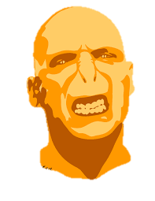
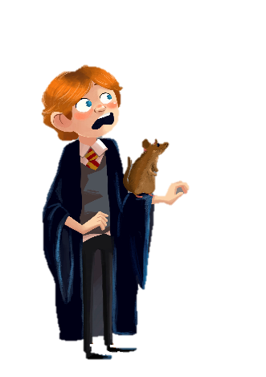
Zones of regulation
Sick
Sad
Tired
Bored
Moving Slowly
Happy
Calm
Good to Go
Focused
Ready to Learn
Frustrated
Worried
Silly/ Wiggly
Anxious
Excited
Mad/ Angry
Out of Control
Yelling/ Hitting
I Need Time and Space
I can use this chart to notice what zone I am in, and think what I can do to get into the Green Zone

Slide 2
You can change the characters to match the childs interest, I cut them out and laminate them. It helps the child show you how they are feeling without having to verbalise it.

