Slide 1
Staff wellbeing - let’s talk about it slides and images to help promote discussion about wellbeing in teams

Slide 2
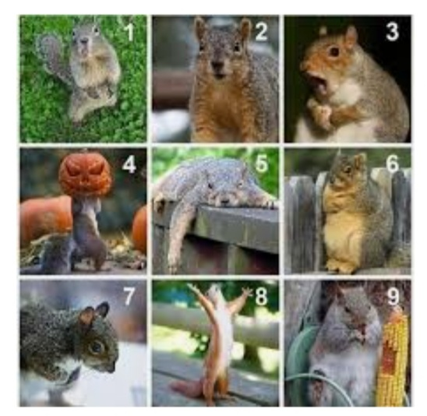
Using visual check in’s…
How are you feeling this week ?
How are you really feeling ?
Ask – listen with intention

Slide 3
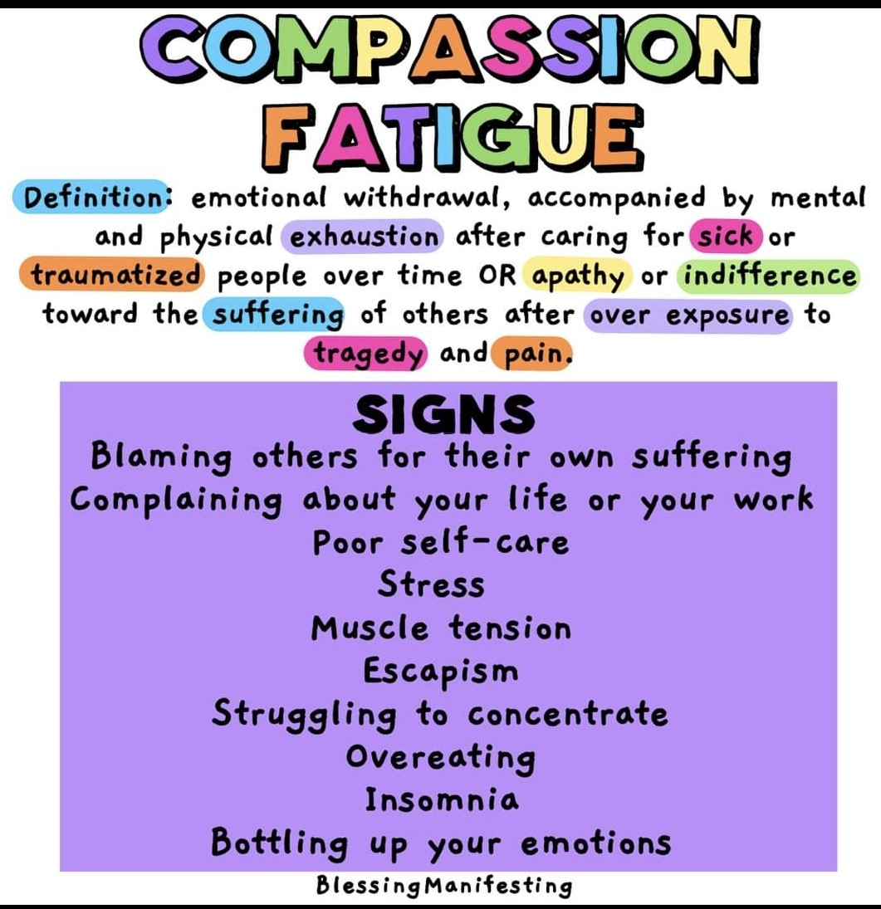
Tricky topics requiring sensitivity and that may provoke an emotional response:
Moral Injury
Compassion fatigue – emotional and physical exhaustion and loss of empathy or desensitization
Vicarious trauma - reading about , writing about and working with trauma
Burnout - Rust out
Anticipatory grief – the news about covid / vaccines / Brexit/ BLM etc
Homelife and personal circumstances impacting on work - work impacting on home
Competing demands, caseloads and service pressures

Slide 4
Moral injury , compassion fatigue , vicarious trauma & burn out

Slide 5
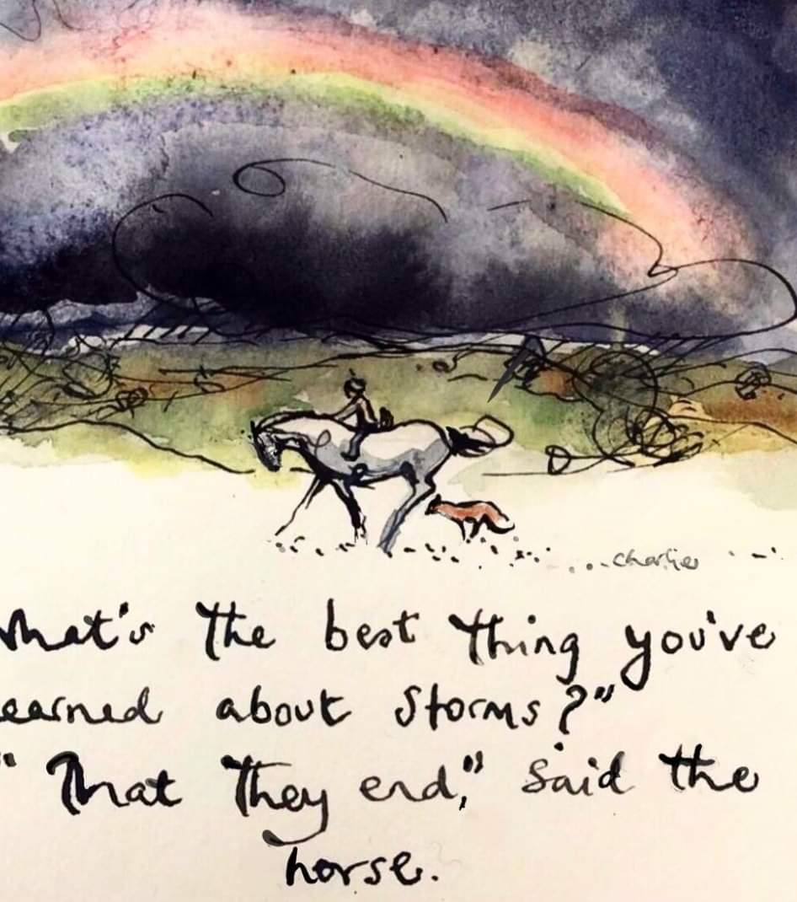
Here is some information about moral injury:
Historically Moral injury has been a concept linked with soldiers or emergency medics. Greenberg et al (2020) highlighted the potential for health and social care workers for significant moral injury during Covid because they need to:
Respond to increased demand and staff shortages
Constantly think about allocating scant resources
Be process and compliance focussed although wanting to focus on quality
Balance their own physical and health care needs with those of their service users
Make decisions about how to align their value base – duty to their family with duty to their service users – juggling homeschooling / caring
The is a particular lack of public support for social care in the media which can make us feel undervalued
They may be dealing with significant challenges in their personal life - bereavement, loss , fertility, relationship
This can impact on morale and productivity and emotional well-being - it can impact on quality of practice which obviously impacts on the outcomes for children and young people and can lead to sickness absence or presenteeism in teams which impacts caseloads and retention. It can place a particular pressure on Team Managers and supervisors who absorb team pressures and emotion whilst balancing three ed for business as usual.

Slide 6
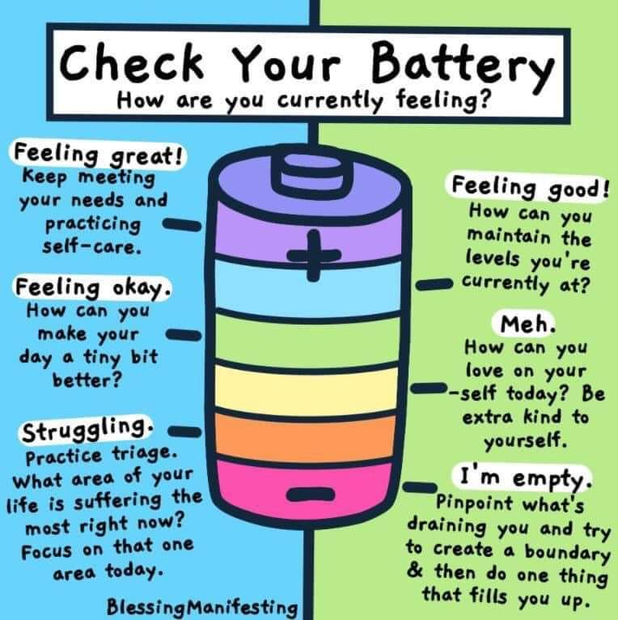
Where are you on this battery today ?
What would help you recharge ?
Who would you talk to about your feelings ?
Signs – changes in sleep patterns, significant or persistent changes in behaviour, irritability, lack of patience, mistakes, isolation / withdrawal, weakened sense of empathy, feelings of hopelessness
Who: Not just Social workers – could be anyone in the team – business admin support, family workers , Social Workers , middle managers , senior leaders – at any stage in one’s career

Slide 7
The good news - What can mitigate / what can help ?
Strong reflective culture
Education and space to reflect on the concept of moral injury
Building a sense of team
Recognition in the service at senior level
Emotional wellbeing support for those in acute need
Physical exercise, nutrition, hydration, sleep, rest
Eye health –eye breaks from screens
In depth reflection time / good quality reflective supervision spaces
Planning annual leave and flexi for recuperation
Appreciation of hard work, effort and good practice
Connecting to our values and shared sense of purpose
CPD and time to build skills and knowledge

Slide 8
How do you cope when you feel overwhelmed ?

Slide 9
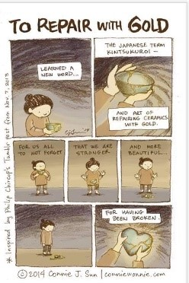
Listen, repair and heal
‘ long term negative consequences of moral injurious events are not inevitable…..most workers who experience this recover….some even develop a re-defined meaning in life and renewed moral and focus and can begin to incorporate their experience into growth to help others’ TCA 2021

Slide 10
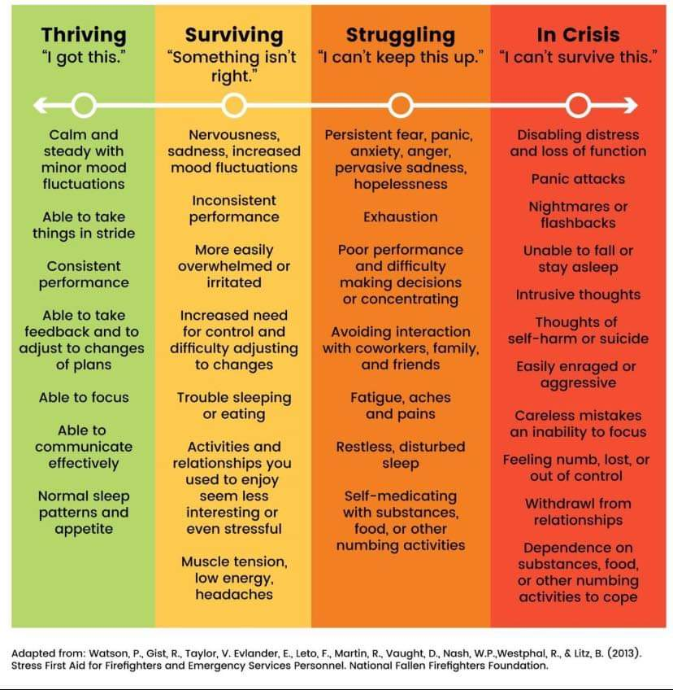
Where are you ?
Thriving
Surviving
Struggling
In crisis

Slide 11
Team talk
How do we normalize chat about wellbeing ?
How do we avoid catastrophizing ?
How do we celebrate achievements ?
How do we avoid celebrating ‘busy’ and honour boundaries such as taking lunch / taking leave ?

Slide 12
Trust
How do we build trust and relationships in teams?

Slide 13
Wellbeing support for staff in Children’s services:
Link for Info about health assured APP and our staff counselling offer
Employee Assistance24/7 confidential Counselling phone line
0800 716 017
http://intranet.durham.gov.uk/pages/EmployeeAssistance.aspx
Wellbeing Portal on the intranet – loads of info , links and services in themes topics - health , mental health , financial health , bereavement ,Domestic abuse , substances , fitness
http://intranet.durham.gov.uk/Pages/WellbeingPortal.aspx
Link to book on to the Stephen Mordue ‘How to thrive’ workshops and E Book link
Durham Learning and Development – Log In
Staff networks for peer support:
http://intranet.durham.gov.uk/Pages/StaffNetworks.aspx
Black and ethnic staff
LGBT staff
Staff with disabilities
Staff who are carers
Menopause forum
Traumatic incident response - debrief , reflective sessions or specialist counselling following a traumatic incident in casework – for individuals or whole staff teams https://proceduresonline.com/trixcms2/media/16060/12103-responding-to-and-offering-support-with-traumatic-events-critical-incidents-feb-22.pdf
Better health at work website
Social Care : Better Health At Work Award
Occupational health http://intranet.durham.gov.uk/pages/Healthpersonal.aspx

Slide 14
Health assured app – If you use playstore to get your apps search health assured - The app is called ‘Health assured my health advantage‘ and looks like a blue square with a HA smile in it - its free and asks for a code when you first log in which is MHA042951. The app has a whole range of services/trackers and info on it. Health assured offer a free phone confidential counselling line and can also offer video counselling sessions with qualified counsellors – confidential and minimal waiting lists so people can access counselling support from qualified experienced counsellors at the right time. It really is a very good staff wellbeing offer. Health assured also offer financial advice , relationship advice , bereavement support. They can also support and advise managers to support their role. The phoneline for staff to call and speak to a counsellor is 0800 716 017 – the line is always answered by a qualified counsellor and they can arrange counselling sessions in blocks of 6 sessions which are via the phone / video Staff with more complex emotional health needs may also benefit from an occupational health referral

Slide 15
What next/ resources and support:
Occupational health http://intranet.durham.gov.uk/pages/Occupationalhealth.aspx
Staff with additional health or learning needs may find an assessment with Access to work beneficial too :
Access to work https://www.gov.uk/access-to-work - encouraging staff to refer , participate in the assessment and give consent for Access to work to liaise with you . Access to work will then advise DCC on any special adaptions or reasonable adjustments to enable the new staff member to thrive
Wellbeing conversations 1-2-1 with staff , prioritise in team meetings , nominate a wellbeing champion – talk about it - honour it – normalise it – use humour – listen to each other
You can now record the date of wellbeing 1-2-1 conversations on Myview
Supervision framework, supervision resources and traumatic incident response flowchart on TriX
https://www.proceduresonline.com/durham/cs/local_resources.html

