Slide 1
Practice Week
Introduction to LSAB Hoarding Pathway
24/04/2023

Slide 2
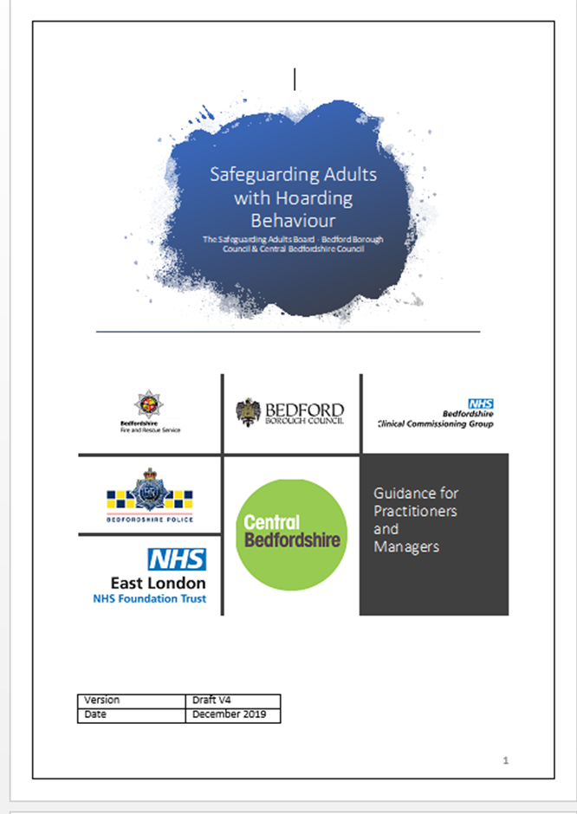
SAR findings and Hoarding
Multi-agency guidance was created 2020
Later Identified:
Guidance helpful but staff would like an easy user guide
Staff would like a panel to refer to get support/guidance
Think family approach needed
Hoarding households needed support
Notes:
Revised guidance being published May 2023

Slide 3
Definition of Hoarding
“A hoarding disorder is where someone acquires an excessive number of items and stores them in a chaotic manner, usually resulting in unmanageable amounts of clutter. The items can be of little or no monetary value.”4
Hoarding is considered a significant problem if:
the amount of clutter interferes with everyday living – for example, the person is unable to use their kitchen or bathroom and cannot access rooms.
the clutter is causing significant distress or is negatively affecting the quality of life of the person or their family – for example, they become upset if someone tries to clear the clutter and their relationship suffers.
Notes:
Hoarding disorders are challenging to both diagnose and treat because some people who hoard frequently do not see it as a problem or have little awareness of how it's affecting their life or the lives of others. Some may realise they have a problem but are reluctant to seek help because they feel extremely ashamed, humiliated or guilty about it.
It is therefore important to encourage a person who is hoarding to seek help, as their difficulties discarding objects can not only cause loneliness, environmental and mental emotional problems but may also pose a significant risk health, safety or fire risk. This risk may only affect the person themselves but often can affect others, neighbours and families.

Slide 4
Why someone may hoard
The reasons why someone begins hoarding are not fully understood.
It can be a symptom of another condition. For example, someone with mobility problems may be physically unable to clear any amounts of clutter they have acquired, and people with learning disabilities or people developing dementia may be unable to categorise and dispose of items.
Mental health problems associated with hoarding can include:
• severe depression
• psychotic disorders, such as schizophrenia
• obsessive compulsive disorder (OCD)
Notes:
The 2019 International Classification of Diseases Codes included for the first time in 10-CM Diagnosis Code F42.3 a separate category of a ‘Hoarding’ code, as a distinct disorder “despite the long-held view that hoarding is a symptom of both obsessive-compulsive disorder and obsessive-compulsive personality
disorder, increased evidence has emerged during the last 20 years suggesting that hoarding represents a distinct form of psychopathology.’5

Slide 5
Hoarding disorder
People affected by hoarding often are more likely to:
Self-neglect or not engage with services or agencies
Have suffered significant loss or trauma in the past
Live alone
be unmarried/single
have had a deprived childhood, with either a lack of material objects or a poor relationship with other members of their family
have a family history of hoarding
have grown up in a cluttered home and never learned to prioritise and sort items
Notes:
Neurodiversity

Slide 6
Types of Hoarding
Inanimate objects:
This is the most common. This could consist of one type of object or a collection of a mixture of objects such as clothing, newspapers, food, containers and papers, DVD’s, CD’s and books etc.
Animal hoarding:
This is the obsessive collecting of animals, often with an inability to provide minimal standards of care. The hoarder is unable to recognise that the animals are or may be at risk because they feel they are saving them.
Data hoarding:
Data hoarding is a newer type. There is little research on this matter, and it may not seem as significant as other types of hoarding, however people who do hoard data could still present with severe symptoms of hoarding.
Notes:
In addition to an inability to care for the animals in the home, people who hoard animals may also be unable to take care of themselves. Animal hoarding can lead to unsanitary and unhygienic conditions for both the animals and the human. Joint working with animal protection agencies is needed here.

Slide 7
Consent & Information sharing
In principle consent should be obtained whenever possible in order to share information.
Decisions about which information is shared and with who, needs to be taken on a case by-case basis.
There is an expectation that each agency ensures compliance with the General Data Protection Regulations and Data Protection Act 2018
Information sharing may take place without consent where it is
Necessary for the purpose for which it is being shared
Justifiable and proportionate
Accurate and up to date
Shared in a timely fashion
Shared securely
Notes:
Public task other lawful tasks

Slide 8
When does the local safeguarding adult’s policy and procedures apply?
The Care Act 2014, Section 42 requires for an enquiry to be initiated by the local authority when there is reasonable cause to suspect that an adult in its area (whether or not ordinarily resident there)—
(a) has needs for care and support (whether or not the authority is meeting any of those needs),
(b) is experiencing, or is at risk of, abuse or neglect, and
(c) as a result of those needs is unable to protect himself or herself against abuse or neglect or the risk of it.
Notes:
The Guidance is clear that decisions must be made on a case by case basis and consider the relevant person’s ability to prevent harm to themselves.
Therefore, if hoarding is likely to lead to risk or significant risk of harm of an adult with care and support needs a safeguarding alert or referral must be considered using the local safeguarding procedures8.
Not every adult who hoards can be defined as an adult at risk as described by the Care Act and therefore this may result in stated safeguarding criteria (a-c above) not being met and resulting in unresolved risks to the relevant person, their families and possibly neighbours and communities. Even in circumstances when safeguarding thresholds are not met, practitioners and professionals are encouraged to work together to identify how best to minimise risk and to work with the person.

Slide 9
What if Children are at risk?
Whenever children are at risk of harm through hoarding, local authorities should be alerted using local safeguarding children policies and procedures.
Where both children and adults are at risk a joined approach involving both children and adult services should be taken and involving other agencies (Fire and Rescue, Mediation etc.) as indicated.
https://bedfordscb.proceduresonline.com/p_neglect.html
https://bedfordscb.proceduresonline.com/files/hoarding_sab.pdf

Slide 10
Using the Clutter Scale - Kitchen
Notes:
Are you aware of a kitchen like this? Its more than just clutter.... A hoarding disorder is where someone acquires an excessive number of items and stores them in a chaotic manner, usually resulting in unmanageable amounts of clutter. Hoarding results in an increased fire risk and increases the risk when responding to fires due to increase in flammable materials in the property and the possible obstruction of escape routes, endangering all in the property and neighbouring properties as well as emergency services. There is a variety of help and support out there for people with hoarding disorders, if you are concerned about someone you know that lives in Berkshire who may be hoarding please request a free safe and well visit from the Fire and Rescue Service.

Slide 11
Using the Clutter Scale – Living Room

Slide 12
Using the Clutter Scale – Bedroom

Slide 13
What the scale indicate?
Images 1-3 indicate Low risk – self referral
Images 4-6 indicate Medium risk Multi-agency meeting
Images 7-9 indicate High risk Alert 24hrs and Multi-agency meeting

Slide 14
1-3 = Low Risk
Offer advice, sign post to other agencies
Arrange fire safety check with Bedfordshire Fire and Rescue Service
Enlist person’s supporters to help modify issue and prevent escalating
Consider arranging an inter-agency meeting to follow up to prevent worsening

Slide 15
4-6 = Medium Risk and 7-9 = High Risk
Convene multi-agency meeting- with action plan as the outcome
Lead agency and roles of each party identified
Ascertain via MASH which partners already involved
Consider GP and mental health assessment
Monitor and review
Lead agency for the case checks progress and triggers further multi-agency meeting(s) if issues start up again or escalate

Slide 18
Case Study
Case discussion regarding Family O
Rachel aged 9, Owen aged 12 and Polly aged 14
Please write down key points for your supervision session
What advice would you like the supervisor to give you as the supervisee?
As a supervisor what advice would you give
What do you think the next steps should be?

Slide 19
I wanted to talk to you about a home visit I made on the new case I was allocated last week. As you can see from the genogram there are three children, a girl called Rachel aged 9, and two older children, Owen aged 12 and Polly aged 14 who have a different father and they have a shared care arrangement. Polly and her parents live in social housing, her mum seems to have a chronic illness, is a wheelchair user and a family member helps out. According to mum, Owen and Rachel are supposed to predominantly live with their father who lives a few miles away. Rachel is a child with a disability and attends special school.

Slide 20
I’ve reviewed the case records and from the chronology it seems there have been four referrals in the past 12 months from the school, there was an early help assessment in June 2022 and a plan to provide support around parenting as mum was struggling with the older two children’s behaviour, practical support with maintaining the house and the school’s family worker was providing support with the older children’s attendance at school.
They also helped with school uniform, breakfast and after school club.
Things seemed to be going well and Rachel and Polly’ attendance improved. Owen’s attendance has never been a problem and he seems to want to be at school and engaged well with the breakfast club and afterschool clubs.

Slide 21
Following this period of improvement there were further referrals with concerns regarding the home environment poor school attendance, and a lack of appropriate supervision as all three of the children were wandering around the estate after 11pm and their parents didn’t seem concerned about not knowing their whereabouts and mum said there was just some confusion as to which parent they staying with. Mum was offered support through a single assessment as child in need but she initially declined consent.

Slide 22
This most recent referral there are similar concerns but in addition there has been a noticeable change in Owen’s behaviour, he is constantly tired and talks about having to help out at home. Both he and Rachel seem to have a new group of older friends, which they ‘do favours for’.
Mum has agreed for a single assessment to see what support the family can get, she also wants to talk about benefits for Rachel. When I visited the home was really chaotic with lots of boxes of old things, dirty litter trays, and old pet cage that has never been emptied, broken pushchairs etc, the walls are covered in writing from when they were small with ripped wallpaper and there are lots of flies in the home.
There were lots of bags of washing but Rachel said it didn’t matter as their mum’s friend buys them lots of new stuff, they wash at their dads and some else brought them a PS5. There was no food in the fridge or freezer but Rachel said it was fine and she ordered £40 of take away on her phone (which also looked to be brand new). Owen also had on brand new trainers which mum said she wasn’t sure where they had come from.

Slide 23
I didn’t get a chance to really speak to mum as her family member said she was tired and needed to rest and she took her back to her room. Her family member declined to let me look in the children’s bedrooms or in the bathroom. Rachel’s dad wasn’t present for the visit and hasn’t answered my calls.
Rachel’s school says that he doesn’t involve himself in Rachel’s education. Secondary school advise that Owen and Polly’s dad sometimes come to parents evening but he doesn’t really support the school in their plans to help the children.

Slide 24
Adult Social Care worker
Their home is really messy and dirty and extremely cluttered. They are storing bags of receipts from shopping and there are boxes of, I think their children’s clothing from when they were babies/younger. The bathroom is really bad and it is full of mould and dirt. The toilet hasn’t been cleaned for a really long time and the kitchen was filthy and cluttered. They usually just eat take-away food or ready meals. Sarah said her and Rob aren’t really fussy eaters.
Oh, and there was no running water- which Rob said he is trying to fix-they are using bottled water at present. Rebecca cares for Sarah during the day until about 8pm and then Rebecca lives her own personal life after that. Rob said that Rebecca has lots of male visitors to their home in the evenings.
Sarah is lovely to talk to and told me about when her and Rob met and how great it was, he made her feel special and valued but then they started having as they difficulties with her parents and sister and so the couple stopped talking to them/seeing them. This is still the situation and she can’t help feeling that Rob had created all the conflict with her family-but she can’t remember really clearly.

Slide 25
Community Health said
Not being able to move is impacting on Sarah, as she can’t apply for a new council property. She needs one that is more suitable to meet her needs, as she is living with a long-term chronic health condition, which affects her mobility and function and her ability to care for herself.
The previous time I saw her she could mobilise from her bedroom to the bathroom, but now, Sarah can’t walk or stand for long periods of time. Rebecca is home with her all day. Sarah mobilises/transfers with her help, from her wheelchair onto her commode or to bed. She needs Rebecca. Rebecca carries out Sarah’s personal care in bed, but only once a week, Sarah didn’t want personal hygiene wore than this.. Oh-the bed linen looked dirty-not changed maybe?
She lives in her bedroom and received support from the DN Service, for a urinary catheter and they still visit monthly for this and more recently has more frequent visits, as she has a sore on her leg, due to diabetes. The GP knows her and saw her in October and found her to be depressed-low mood, not eating very much and has made a MH referral. She still has no care package.

Slide 26
Housing said
The property doesn’t meet her needs as its too small and the required equipment (hoist etc.), can’t be put in such small spaces.
They have rent arrears so can’t move.
Sarah lives in council property with Rob got when they first got married (joint tenancy). At present, they either don’t talk or argue terribly. Rob gets on with his own life, but won’t move out (this is what Sarah wants), but he doesn’t want to lose his accommodation, or rights, as her husband.
Rob has an LPA for Sarah and keeps her bank card for her as he does the shopping for them. Sarah’s bank account holds the back payment from her pay-out via PIP (personal independence payment) and ESA (employment support allowance).
Oh, and one more thing-when I visited the home, the door was open. Rob said this is usually the case, as Rebecca received lots of packages, so it’s a bother to open the door all the time.

Slide 27
Some supervision considerations
What do we know about the children’s individual parents their relationship status, how they met and the quality of the relationships. Who else can help us understand this?
What do we know about mum’s condition and how it impacts on her and her parenting, does she have capacity?
Appropriateness of accommodation, is it a house of multiple occupancy, are there signs of overcrowding, what’s happening with conditions in the home?
Have you considered using GCP2 and the Hoarding Protocol?
What do we know about the relative living with them and their activities in the home?
What are the demands on the children in household tasks etc?
What are your concerns about where the children are getting their money and the favours for older friends?
Who have you spoken to about the children’s health and in particular Rachel’s disability – do we know who’s supporting her?
What’s happening for Owen around his behaviour being different at school?
What can you do to engage the fathers of the children in making a plan?

Slide 28
Reflections? Questions?

