Slide 1
Neglect and poverty aware practice
Louise Johnstone
Senior Partner Engagement Officer
Notes:
During the session we will do some personal reflection on our individual identity using social graces – use that reflection as context for thinking about anti-oppressive practice as a group.

Slide 2
Setting the scene
This session is for you, time out to reflect on what is important in your practice and will last around 60 mins.
What you do is incredibly impactful work. Your ability to do it well helps to achieve the best outcomes for those you support.
You, and your professional development, are valuable to them –switching off your phone and emails allows you to focus on that.
Your thoughts, experiences and reflections are an essential part of this session please do share these.

Slide 3
Definition - neglect
Neglect is a multi-dimensional concept, covering a wide range of behaviours that can affect children’s wellbeing and long-term outcomes, including lack of:
meeting basic needs for food and clothing
supervision
support to access public services
nurturing and responsive care
(Working Together to Safeguard Children, 2018)
Notes:
Neglect, the failure to meet basic needs, is the most common form of child abuse. Neglect can take many forms and the impact of neglect is wide-ranging and can be apparent across the life course.
From video 1
Protection and safety; love, warmth, stability; shelter, food, clothing; play and social connection; education and moral guidance; appropriate stimulation; medical treatment.

Slide 4
Health and wellbeing
Protection, safety
Love, warmth, stability
Shelter, food, clothing
Play, social connections
Education, moral guidance
Appropriate stimulation
Medical treatment
Notes:
Neglect, the failure to meet basic needs, is the most common form of child abuse. Neglect can take many forms and the impact of neglect is wide-ranging and can be apparent across the life course.
From video 1
Protection and safety; love, warmth, stability; shelter, food, clothing; play and social connection; education and moral guidance; appropriate stimulation; medical treatment.

Slide 5
We know..
Assessing neglect is difficult
It can be subjective and prone to bias
There is a high threshold for recognition
It is difficult to capture and compare
It can be complex and intergenerational
(Kyriacou S & Nicholl E., 2019)
Notes:
Kyriacou S & Nicholl E. (2019). Scaling up the Graded Care Profile 2 and other evidence based programmes. Dartington: Research in Practice.
Webinar done for us by NSPCC on the Graded Care Profile 2.
Difficult – you can tell that there is something wrong, perhaps intuitively, but it’s not necessarily apparent exactly what
Subject / bias – my idea of appropriate diet or play and interaction might differ from that of a colleague or other professional for example.
Threshold / comparison - Impact or effects not always significant initially so there may be a delay in recognition or identification
Focus on parental needs and how they are doing rather than what the child is experiencing
Not always apparent what type of neglect child is experiencing. May turn out to be other than referred for.

Slide 6
What is the story?
Whilst presenting issues may be the same we need to understand why the child’s need are not being responded to.
There may be a range of differing reasons or explanations for why this is.
It is important to understand what is going on ‘the story’ for our response to be effective.
Exercising professional curiosity, building relationships, fostering confidence and trust is vital to this.
Notes:
Neglect, the failure to meet basic needs, is the most common form of child abuse. Neglect can take many forms and the impact of neglect is wide-ranging and can be apparent across the life course.
From video 1
Protection and safety; love, warmth, stability; shelter, food, clothing; play and social connection; education and moral guidance; appropriate stimulation; medical treatment.

Slide 7
Reflecting on the impact
What different explanations might there be, for example, for me not taking my child to the doctors surgery?
What steps might you take to understand my story?
Notes:
I may not have the money for bus fare, I may be in a coercive controlling relationship and not be allowed out, I may be scared of doctors, or am I concealing something?

Slide 8
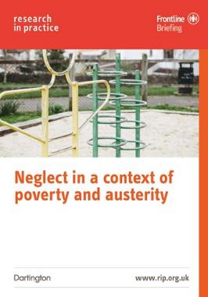
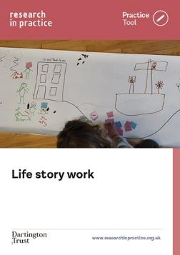
Resources to support you – briefings and tools
Neglect in the context of poverty and austerity: Frontline Briefing (2019)
Completing social work chronologies: Practice Tool (2022)
Life story work: Practice Tool (2022)

Slide 9
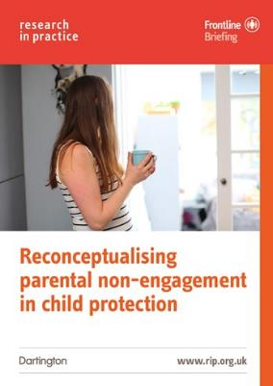
Resources to support you – briefings and tools
Reconceptualising parental non-engagement in child protection: Frontline Briefing (2020)
Parental mental health: Frontline Briefing (2018)
Parental mental health: Practice Tool (2018)

Slide 10
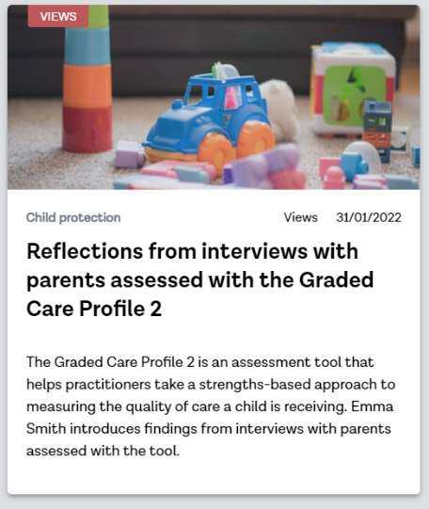
Resources to support you – quick reads
Reflections from interviews with parents assessed with the Graded Care Profile 2 (2022)
Helping professionals measure care and get the right support in place for parents-to-be (2020)
Growing interest and emerging evidence – how and why adolescent neglect is climbing the safeguarding agenda (2018)

Slide 11
Relationship between poverty and neglect
Many children who are not from families in poverty will experience maltreatment.
Most children in families who are living in poverty will not.
‘Poverty is neither a necessary nor sufficient factor but is perhaps the most pervasive factor’
(Bywaters et al, 2016)
Notes:
So what we are saying is poverty is not a defining factor here but it is important.

Slide 12
Relationship between poverty and neglect
Direct effects - material deprivation leaves parents less able to afford the basic items and services that children need to thrive.
Indirect effects – parental stress of managing day-to-day life in poverty reduces capacity to provide nurturing care.
Notes:
These interactions are complex and frequently circular. For example, poverty increases the risk of mental ill-health and mental ill-health increases the likelihood of poverty (Bywaters et al, 2016; Cooper and Stuart, 2013).

Slide 13
Relationship between poverty and neglect
Interaction with other factors: -
Parental domestic violence or substance use.
Low levels of education, especially literacy.
Social isolation.
Mental and/or physical ill health, learning disabilities.
Shame and stigma.
Positive adult and child behaviours, promoting social support and resilience.
The social and physical environment.
(Bywaters et al, 2016; Cooper and Stuart, 2013)
Notes:
These interactions are complex and frequently circular. For example, poverty increases the risk of mental ill-health and mental ill-health increases the likelihood of poverty (Bywaters et al, 2016; Cooper and Stuart, 2013).

Slide 14
Tackling Child Neglect - Key messages
Building an intervention - it is important to distinguish between:
inadequate parenting as a result of a lack of parenting skills and inappropriate expectations of children,
inadequate parenting because of social, environmental or parental risk factors (such as parental depression, anxiety, problematic substance use, financial difficulties, homelessness or mental ill-health).
(Scott and Daniel, 2018)
Notes:
It may be necessary to focus on addressing contextual problems (second bullet point) before it is possible to embark meaningfully on tackling neglect. Need to pick apart what is happening and why – the story again.

Slide 15
Tackling Child Neglect - Key messages
Child-centred responses:
Gather a clear understanding of the issues and of the quality of the parent/child relationship.
Focus on building the strengths of the parent.
Work should be culturally sensitive, whilst guarding against setting different standards for children from minority ethnic groups
(Scott and Daniel, 2018)
Notes:
Thinking about the perspective or the parent and the experiences of the child – voice of both.

Slide 16
Tackling Child Neglect - Key messages
Engaging with the family in a collaborative relational way
Creating a sense of safety for the child as an early goal
Increasing parenting sensitivity
Comprehensive, multi-layered and flexible response
Social supports and inclusion
(Scott and Daniel, 2018)
Notes:
- Developing a collaborative, authentic relationship is key. Meaningful. Modelling here - relational skills and conflict resolution skills.
This first phase of work should be done in collaboration with other services involved with the family. Safety of the living environment must be maintained.
Being mindful that parents of neglected children have often been maltreated in their childhood. Their child’s expressions of stress can evoke powerful feelings related to past experiences. Trauma-informed in your approach and aware of attachment (see Danny Taggart video on recurrent care proceedings page)
Clear objectives, achievable goals, regular monitoring, consistency and longevity of contact is important, but also flexibility if adaptations needed over time. Responses need to address how child neglect is experienced within a family, with each family member recognised in their own right and support thought through.
Neglectful parents may have poor social skills that make it difficult to maintain relationships and so may have reduced social support network. Behavioural parenting programmes have been successful in building interactional skills, but those with high levels of poverty-related stress and mental health problems derive the least benefit from these.

Slide 17
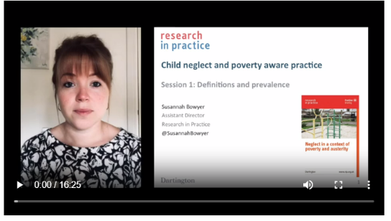
Resources to support you – frontline briefing
Neglect in the context of poverty and austerity: Frontline Briefing (2019)
Neglect and poverty aware practice: Online learning package (Undated)

Slide 18
Reflecting on the impact
What examples can you think of where services might expect or require things from people that:
puts additional and/or unintended financial pressure on them?
creates barriers or introduces factors that make it difficult for them to engage?
What impact might this have for them, and your relationships with them?
How could you change this?
Notes:
People may them become labeled as resistant / difficult / disengaged and so on.

Slide 19
Thank you

