Slide 1





Essex Children & Families: Sector Led Improvement Partners
Understanding Threshold Decisions
6th December 2022
Dave Barron Head of Childrens Improvement Partnerships
Sallie Bloomfield Consultant Service Manager
Stacey Smith Consultant Team Manager
Notes:
Add some context about the whole system being confident, we all do really good work with C&F so lets celebrate

Slide 2


Threshold
Notes:
Lets look at how the whole system can provide support for children and their families.

Slide 3
Do we need to change?
Nationally, number of children in care has increased by nearly 50% in the last 20 years
Number of babies removed at birth doubled last 10 years based on likelihood of significant harm
Only 50% of care proceedings result in removal of children
Between 2011 & 2018 referrals have increased by 7% while child protection assessments have increased by 77% (DfE Pressures on Children’s Social Care 2019)
LA’s overall spending power in real terms has reduced by 28.6% since 2010 (DfE Pressures on Children’s Social Care 2019)

Slide 4
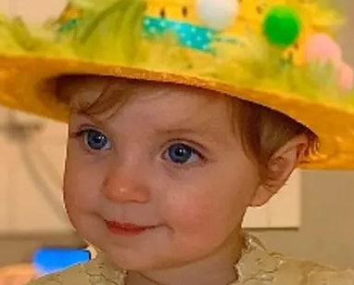
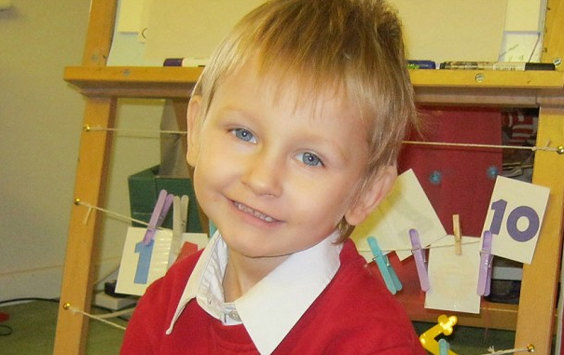
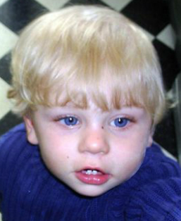
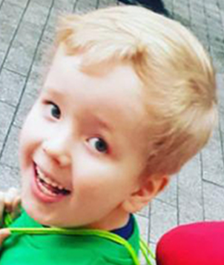
Introduction
17,856
Star Hobson
40%
Daniel Pelka
36%
Peter Connelly
40%
1st COVID Lockdown
Arthur Labinjo-Hughes
40 weeks
30 weeks
Disposal rates
Notes:
Dave

Slide 5
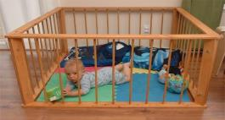

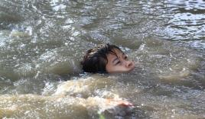
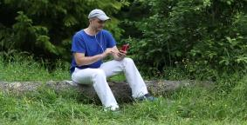
Barry Mason’s Safe Uncertainty
Safe
Safe
Certainty
Safe
Uncertainty
Certainty
Uncertainty
Unsafe Certainty
Unsafe
Uncertainty
Unsafe

Slide 6
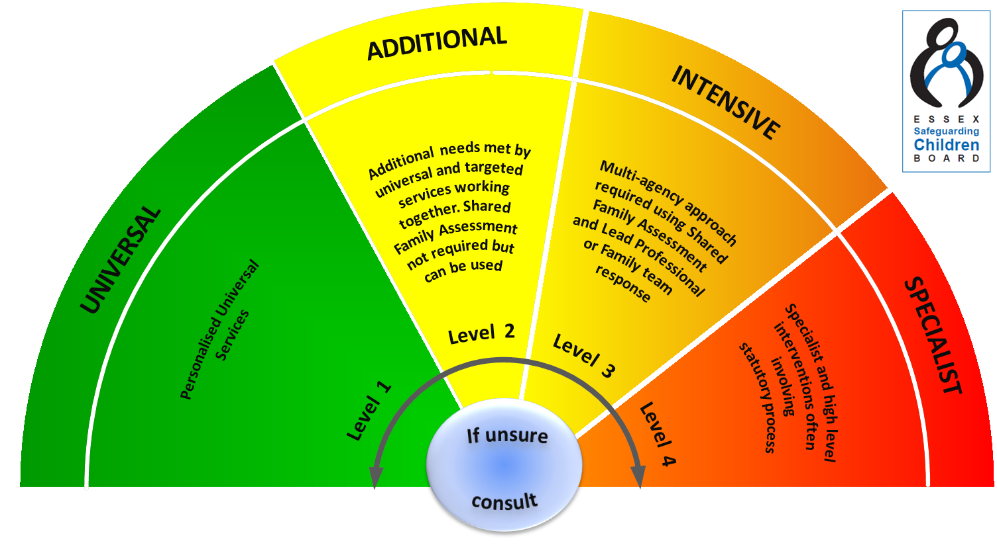

Wellbeing Effective Support Windscreen

Slide 7



Eyes Down - it’s time to play…
20 Case Studies
On your tables…
  Identify who from the group will lead the feedback
  Discuss the Case Study for 5 mins to decide the ‘outcome’
  Feedback
Repeat (we’ll have comfort breaks in between!)

Slide 8
Choice of outcomes
Level 2: Signpost
Signpost to Community Based Services / Local Offer / TAF
Allocate for Assessment
Level 3: EH
Need support but not at a Social Care level
Level 4: CIN
Need support that includes Social Care (Child In Need)
Level 4: CP
Needs s47 investigation and Child Protection

Slide 9
1
2
3
4
5
6
7
8
9
10
11
12
13
14
15
16
17
18
19
20

Slide 10
Case Study 1
Dan - 14 year old male
During an outreach education session Dan disclosed the following information: After talking about paranoia caused by cannabis use Dan said that paranoia was even worse for those using cocaine. He then talked about his dad’s recent addiction to this. He said he had started using again after the move to Harlow and this had led to him borrowing a lot of money from an elderly relative (Dan remarked that dad had been spending £200 a night) and rows with mum. He said dad had conquered his addiction a couple of weeks ago after seeing a psychic/spiritual healer known to his aunt. Dan seemed positive that things had now improved for the better. Dan also mentioned that one of mum’s former work colleagues at the caravan park had recently moved in to mum’s house and he felt she had a bad influence on mum, making her drink too much alcohol which then led to mum ‘showing off’. He said everyone else in the family hated this woman and wanted her to move out.

Slide 11

Case Study 1 Answer
Level 2: Signpost

Slide 12
Case Study 2
Bethany - 14 year old female, 12 year old sister
It has been reported to Police that since September 2021 there has been a number of arguments between Bethany and her mother. This has all started since Bethany has been moved to a new school, which she does not like. Bethany has anger management issues and is continually getting extremely angry during minor disputes within the home. As a result of her anger she is throwing things around the home and being aggressive towards her mother and sister. About 22.30hrs on 03/11/21 during an argument at the home address, Bethany has reacted angrily and assaulted her mother by kicking her in the leg. She has then thrown items around her room and banged her head against the wall. As a result Police were called and attended the address. On speaking with Bethany, she was initially angry and upset, however she eventually calmed down and apologised to her mother. She admitted kicking her mother, and received a community resolution. Due to her increasingly aggressive behaviour, her mother fully supports a Request for Support to social care to work with the family and provide them with support to cope with Bethany's behaviour.

Slide 13
Case Study 2 Answer
Level 3: EH

Slide 14
Case Study 3
4 children aged 14yrs,13yrs, 9yrs and 5yrs
Carly and her children are previously known to the Local Authority. A Request for Support was made after an incident on 19/10/21 where Matthew was arrested for strangling Carly during an argument. On 22/11/21, Carly called our service terrified that Matthew would kill her and described him as a "dangerous man". I gave ongoing support in helping Carly take out an injunction. On 30/11/21 Carly advised me that safety measures were in place, schools notified and we spoke about moving forward. On 7/12/21 heard at MARAC for incident in October. It was concluded that Carly disengages often from services. Carly is currently working with our service. There were concerns whether she would rekindle with ex-partner, but this wasn't known at that time. An action from MARAC was that Social Care would be notified if Matthew moves back into the family home. Carly has informed us that she discussed Matthew moving back into the family home and the oldest daughter Sarah was not happy about this, saying "How would you feel if the man who strangled your mum came back to live in your house?"

Slide 15
Case Study 3 Answer
Level 4: CIN

Slide 16
Case Study 4
Di - 7 months old, two older half-brothers aged 2yrs and 3yrs
Police referral Nov 2021. There has been a domestic incident at the caravan whereby the dad has hit the mother around the head by punching her. The children were in the caravan. The mother has gone to hospital and has had to have a CT scan. There is a previous DV in July 2020, dad has strangled the victim, she initially supported police prosecution however retracted her statement. Whilst speaking to a witness mother has called and said, please tell the police the children were with you when the incident happened. The witness told us she wouldn’t lie for her and the children witnessed the whole thing. Mum has previously lied to police about dad’s whereabout when he was wanted for the strangling.
Previous referral led to support from Early Help Tier 3 as mum had separated from dad which was only an on off relationship.

Slide 17
Case Study 4 Answer
Level 4: CP

Slide 18
Case Study 5
Referral from school
Mum, Sarah, has a diagnosis of Bi-polar, anxiety and depression and has had two “breakdowns” this year. One of which she was sectioned. She is currently staying with her eldest daughter because she is struggling with her mental health.
Her eldest son James (aged 14) has recently been diagnosed with anxiety and has suicidal thoughts. He is currently being medicated to manage this.
Her youngest son Tom (aged 11) is getting in trouble with the police, most recent involvement was due to him throwing rocks at oncoming traffic. There have been concerns regarding mum’s supervision Tom as he has been out in the streets late at night. Tom has a diagnosis of ADHD and autism and mother has recently taken him out of school to home educate him.
Tom has recently tried to end his life by tying a dressing gown belt around his neck and tying the other end to the wardrobe door.
Sarah reports that Tom is also extremely violent towards her. School have invited Sarah to a parenting support group but she does not want to engage in this.

Slide 19
Case Study 5 Answer
Level 3: EH

Slide 20
Case Study 6
Sidnee 5 yrs old & Albie 1 yr
All 3 children are currently staying with MGM. Danny (Mum’s partner) has previously been in prison, he has tried to take his own life. Sidnee has said to MGM that she has witnessed Danny putting a rope round his neck. MGM states that Danny is not allowed contact with his own child.
Concerns that Mum is suffering from post-natal depression and that she is being controlled by Danny.
Mum says that MGM has her children and that MGM advised her that if she did not leave the children with her then Social Care would take them away. Mum says that MGM is controlling. Over the past 2 weeks, Sidnee has not been in school and Mum has not seen any of her children.
Mum has advised that Danny did try to take his own life on 01/11/2021. It was not at her home it was at his mother’s home in Colchester and then again on the train line. Danny has a child who has been adopted, he went for custody with his mum but it was declined.

Slide 21
Case Study 6 Answer
Level 4: CIN

Slide 22
Case Study 7
Request for Support from School
Poppy - 14 year old female, 2 siblings aged 4 and 8 years old
Poppy (14) has been using a lighter and matches to burn paper at home in front of her younger siblings. Mum has found burn marks on her duvet cover and has also noticed a burn mark on her arm. Poppy said she had used a deodorant can to burn her arm. Poppy gets very angry at home and is constantly fighting with her younger siblings, including physical fighting. Poppy has been feeling depressed and spends the majority of her time when not in school in her bedroom, eating or sleeping. Mum is worried Poppy is overweight and her diet is very poor. Poppy has stated she doesn't like the way she looks and has been having panic attacks for the past 3-4 weeks. Mum has stated that Poppy sleeps a lot at the weekend and does not socialise outside of school and is spending a lot of time on social media. School attendance is very low at 71.4%. Poppy has been under a Consultant Paediatrician for a number of years due to her Arthritis but not currently taking any medication for this. Poppy has physio every 3 months but is refusing to follow their advice by keeping active and wearing supportive arm casts/insoles in her shoes to help her condition.

Slide 23
Case Study 7 Answer
Level 3: EH

Slide 24
Case Study 8
Request for Support from school
Donnie - 15 year old male
Consent: Yes
It has come to light that Donnie has posted on Instagram pictures of teachers who work in our school with comments of potentially racist and religiously intolerant nature over them. The first picture is of the Headteacher, then of a Religious Studies teacher and the final four are of an English teacher. Donnie has posted a number of comments on the pictures, which are perceived as being racist and threatening violence.

Slide 25
Case Study 8 Answer
Level 2: Signpost

Slide 26
Case Study 9
Gayle 12 and Hayley 9
Jim Turner is a High Risk Registered Sex Offender convicted in 1994 of Rape of a female under 16 yr and Indecent Assault of a male and female under 14. These offences were against his step children and he served a 12 yr sentence for them.
Jim’s 3 previous partners have alleged he raped them, all of which were NFA’d due to lack of evidence
Mum met Jim on line in August and he has been spending time at the family home. MOSOVO have evidence of contact between Jim and Gayle from his mobile phone.

Slide 27
Case Study 9 Answer
Level 4: CP

Slide 28
Case Study 10
Referral received from the Domestic Abuse Hub
Family comprises of mother Jane, Father Michael and Kayden 3 months old, Kacey 9 yrs and Jake 2yrs
Michael is reported to be physically and emotionally abusive towards Jane he has recently been physical while Jane was holding the baby (he pushed her)
Michael will regularly throw Jane out of the property when he is angry.
Michael has a history of drug and alcohol misuse. He takes cocaine and is addicted to pain killers. It is also reported that he has a diagnosis of bi-polar
Refuge has been offered to Jane and the children but she refused this as Michael threatened to kill himself.
Jane states that Michael is now wanting to work with drug & alcohol agencies.

Slide 29
Case Study 10 Answer
Level 3: EH

Slide 30
Case Study 11
Request for Support from Police
Peter and Michael Jones’ grandfather is Gary Rogers, a registered sex offender, convicted of Adult meeting a boy under 16 years of age, following grooming and Cause child under 16 to watch a sexual act. He was caught following work by the interceptors. There was not actually a child involved. He is due to be sentenced on the 28th October 2021.
Gary has a daughter Danielle, who lives in New Zealand and is due to visit the UK in December, with her husband and two sons. They intend to stay between Maternal Grandparents (Gary and Faye) and Paternal Grandparents. Danielle and husband have been informed by police of Gary’s offences and says that she will always be present when staying with her father.

Slide 31
Case Study 11 Answer
Level 2: Signpost

Slide 32
Case Study 12
Unborn H :- older half-sibling Tommy
Referral from Hillingdon. Tommy has been in care due to unexplained non accidental injuries. 4 adult bites on his limbs and body. They have 5 people in the perpetrator pool - mother, father of unborn H, Maternal grandmother, Great Grandmother and maternal uncle.
Mum has alleged rape by John G resulting in this pregnancy he has been arrested and bailed. Mum applied to Hillingdon to be rehoused and they have placed her in a “safe house” in Essex

Slide 33
Case Study 12 Answer
Level 4: CP

Slide 34
Case Study 13
Request for Support from School
Lizzi 14 yrs old seen for a consultation today – she disclosed that her step father sexually assaulted her while she was asleep in January 2022 and that her step-father hit her in the face in January in 2022. Lizzi stated her step-father and mother then went to police and social services and police were involved. Lizzi claimed ‘they did not believe me’ and case was closed after a few weeks. Lizzi said her dad now lives at home and she has three younger siblings 11yrs, 7yrs, 5yrs - the youngest is a girl.
2019 - CAIT - London - Lizzi disclosed inappropriate touching from a teacher. NFA
2020 - CAIT Referral - Joint Visit - Lizzie accused Dad of digital penetration. Argument occurred the night before. C&F Assessment - NFA
Lizzi had disclosed to her friend’s mum that she has been digitally penetrated by her step-father.

Slide 35
Case Study 13 Answer
Level 4: CIN

Slide 36
Case Study 14
Request for Support from School
13 year old male
Jamie disclosed that he had a difficult Christmas and he hates his step dad. He showed staff a bruise on the inside of his upper left arm (look like a grab mark). Mum, was aware that Jamie had a mark on his arm after his step dad had to physically remove his phone from his room after refusing to hand it over. Jamie had reacted angrily to his phone having to be removed, pushing step dad, throwing himself to the floor and slamming his door. Mum reported that they were struggling with Jamie’s behaviour at home, he refuses to listen to his step dad and increasingly herself. Repeatedly keeping his sister awake at night banging on the floor. Mum is concerned that her daughter is now copying Jamie’s behaviour. Mum reported that at one point she chastised Jamie, slapping him.
Jamie further disclosed to staff that his mum and dad hurt him. Mum has confirmed to school confirmed that they do require additional help with Jamie’s behaviour.

Slide 37
Case Study 14 Answer
Level 4: CIN

Slide 38
Case Study 15
Request for Support from school
15 year old female, 2 siblings – 12 year old brother and 7 month old sister
Hannah spoke to her Head of College saying that she felt unhappy a couple of weeks ago. She disclosed Mum constantly calls her dumb, horrid, ungrateful. Hannah disclosed that she has to do a lot of chores around the house and often helps out with the baby sister. Last Friday, she disclosed that Mum had thrown her mobile phone at her & it had hit her in the ribs, she then said that Mum picked it up & threw it at the wall which smashed it.
Yesterday, Hannah came in without any lunch saying that the bread was mouldy and there was nothing to make herself a packed lunch with. She said that she asked for money but Mum said she didn't deserve it. She also said that Mum calls her ugly. Yesterday we checked that her brother had food and he did.

Slide 39
Case Study 15 Answer
Level 2: Signpost

Slide 40
Case Study 16
Girls 13 and 14
20:22 TC from a family friend who is with the family now. She is a SW in another LA. Family are from Africa. Tonight mother has become distressed and has disclosed to friends that her older daughter Angel has been sexually abused by her father Timothy. Mother states that Angel is now 23 and at University. Mum states that she is 'traumatised' and has been having counselling. Angel has told her mum that she is concerned for the welfare of her younger sisters and is going to report her father to the police. Mother states that she knew this happened as she walked in on her husband and Angel ''in the act'' 10 years ago and believes that this carried on over the years. It is not known if the 2 younger siblings have been abused. Family friend has spoken with Angel who was very tearful but did not say anything. Mother and the 2 younger girls will be staying with a friend overnight. Not known if father is aware this has been disclosed.

Slide 41
Case Study 16 Answer
Level 4: CP

Slide 42
Case Study 17
Referral was made by the School. Family are comprised of dad and daughter (13).
School have concerns for daughter’s wellbeing. Mum died in June of this year and dad has a life limiting condition; he has Chronic Obstructive Pulmonary Disease (COPD), has experienced two strokes and has an aneurysm. Dad is struggling to manage his health needs as well as his daughter.
There is verbal aggression in their relationship. The daughter’s hygiene is deteriorating, she has spoken of depression and is also struggling with her sexuality. Attendance is poor and she is withdrawn when in school.
The plan for who will care for daughter in the event of dad’s passing is unclear.
Dad has suggested there are concerns around maternal family members as several have convictions. Family have been previously known to CSC (on and off since 2006). History shows mention of ongoing DV, missing episodes, Child in Need plan in 2018, and elder half-brother being convicted of rape of a female under 16 amongst other offences.

Slide 43
Case Study 17 Answer
Level 3: EH

Slide 44
Case Study 18
Archie:- 3 yrs old has 3 ½ siblings living with their father/s
Extensive history of social care’s involvement in Archie and his siblings lives. Main concern around domestic abuse particularly in respect of Lewis. Children previously subject to a CP Plan (2019) and risk reduced as mum was no longer in contact with Lewis.
November 2021 Housing officer reported 2 of mum’s neighbours had reported separately that a male is visiting the home frequently/living at the mother’s address. Housing officer confirmed it was Lewis visiting mum

Slide 45
Case Study 18 Answer
Level 4: CP

Slide 46
Case Study 19
Ambulance Request for Support
13 years old female
Jane (mum) had called the Crisis Team and the Ambulance service. Crisis team stated Jane has mental health issues and told the crisis team that she wants to take her own life. Jane did inform the crisis team that she has razor blades on her and wants to take an overdose. Crew is concerned that the patient's 13 year old daughter who is alone with her mum at the time.

Slide 47
Case Study 19 Answer
Level 2: Signpost

Slide 48
Case Study 20
Request for Support from School
9 year old male
Alfie refuses to eat school dinners and Mum will not provide a packed lunch consistently. Alfie has been eating out of the bins at school. He presents as dirty and heavily stained/creased clothes. Attends school in mother’s underwear as he says that there are no clean clothes for him to wear. Alfie avoids socialising with other children and regularly seeks adults to talk to, almost as if he hasn't spoken to people in days, although he is verbally abusive to adults including using sexual swear words. Alfie displays intimidating behaviour to children and adults, physically abusive to adults including punching, kicking, throwing objects (including chairs) at them with an intention to hurt, inappropriately touching of adults. Alfie will head butt walls/chairs to the point of injury, saying that he wishes he was dead. Family Solutions was previously involved to improve family finances and living conditions. Alfie said doesn't want to be left alone to sit up all night and spends most of the weekend looking at YouTube on his tablet.

Slide 49
Case Study 20 Answer
Level 4: CIN

Slide 50

Next steps
How are you going to take this forward into your services?
Take 10 minutes on each table to discuss
Feedback

Slide 51

Questions?

