Slide 1
Sam’s
Life Story

Slide 2
FOR INFO
A LIFE STORY BOOK SHOULD BE INDIVIDUAL TO THAT CHILD.
IT SHOULD BE TRUTHFUL AND WRITTEN IN A WAY THAT THE CHILD CAN UNDERSTAND THEIR HISTORY, WITHOUT BEING OVERWHELMED BY IT.
THE CHILD CAN BE INVOLVED IN THE DESIGN OF THE BOOK (AVOID CLIP ART) AND ALSO WHAT THEY WOULD LIKE TO SEE IN THEIR BOOK - FAVOURITE PHOTOS/CERTIFICATES OF ACHIEVEMENT/MEMORIES, ANYTHING THEY FEEL IS IMPORTANT.

Slide 3
This is Sam
MOST RECENT PHOTO OF CHILD ON THEIR OWN

Slide 4
Sam’s Family
PHOTOS OF CHILD WITH ADOPTIVE/FOSTER/RESIDENTIALOR EXTENDED FAMILY

Slide 5
Family

Slide 6
Family

Slide 7
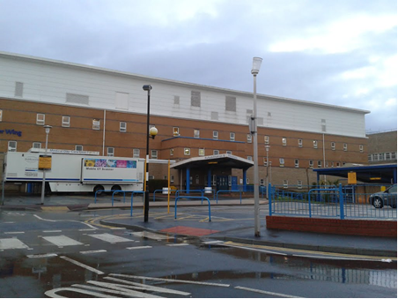
About Sam
When Sam was born he was named Sam Daniel.
BABY PHOTO
Sam was born on Saturday, 10th August, 2019 in Sunderland Royal Hospital at 5.53pm.
Sunderland Royal Hospital

Slide 8
FOR INFO
DETAILS REGARDING THE CHILD’S BIRTH ARE IMPORTANT FOR THE CHILD’S IDENTITY.
BABY PHOTOS
TIME/WEIGHT
WHY WAS THE CHILD GIVEN THEIR NAME.
WHO WAS PRESENT AT THE BIRTH?
HOW PARENTS CARED FOR THE CHILD?
WHAT DID PARENTS THINK ABOUT THE CHILD WHEN THEY WERE BORN?

Slide 9
Sam was born by normal delivery after being in his birth mother’s tummy for 39 weeks.
BABY PHOTO
Sam weighed 7 pounds 4 ounces (3.28kg). Sam was named after his paternal grandfather.

Slide 10
Birth Family
Who are birth parents?
Birth parents are the people who made you. Everyone has a birth mother and a birth father.
A birth mother is the person who carries you in their tummy for 9 months and then brings you into the world.

Slide 11
Sam’s birth mother is called Victoria. Victoria was born on the 10th June, 1996 in Sunderland Royal Hospital.
Victoria is 5 foot 10 inches tall and has blue eyes and blonde hair.
Victoria likes to watch Coronation Street on tv and cooking. Victoria likes all kinds of music.
Victoria
PHOTO OF BIRTH MOTHER

Slide 12
Sam’s birth father is called David Michael. David was born on the 11th March, 1989 in Sunderland General Hospital.
David is 5 feet 9 inches tall with dark hair and blue eyes.
David enjoys football and kick boxing. David’s favourite food is pizza.
Sam is Victoria’s 3rd child and David’s 1st child. Sam is Victoria and David’s 1st child together.
David
PHOTO OF BIRTH FATHER

Slide 13
Sam has 1 half-sister called Sarah who was born on the 11th June, 2016.
Sam has 1 half-brother called Leon, who was born on the 9th September, 2017.
Sarah and Leon are Victoria’s children from a previous relationship.
Sarah and Leon live with their birth father.
PHOTOS OF BROTHER AND SISTER
Sarah & Leon

Slide 14
Maternal Birth Family Tree
Birth Grandfather
Gary
Birth Grandmother
Joanne
Birth Mother
Victoria
Aunt
Lauren
Sam
Half-Brother
Leon
Half-Sister
Sarah

Slide 15
Paternal Birth Family Tree
Birth Grandmother
Sharon
Birth Father
David
Sam
Birth Grandfather
Samuel
Aunt
Sarah

Slide 16
FOR INFO
INFORMATION IS NEEDED REGARDING BIRTH PARENT’’S OWN CHILDHOODS TO ACKNOWLEDGE WHY THEY THEN STRUGGLED TO PARENT THEIR OWN CHILDREN.
START WITH MOTHER’S CHILDHOOD AND THEN ANY PREVIOUS CHILDREN AND WORRIES REGARDING HER RELATIONSHIPS AND PARENTING.
HOW BIRTH PARENTS MET AND THEN DETAILS ABOUT BIRTH FATHER’S CHILDHOOD.
THEN THE BIRTH OF THE CHILD.
WHAT THE WORRIES WERE BUT ALSO ANY STRENGTHS.
ISSUES RE. DV/ALCOHOL/NEGLECT/DRUG MISUSE/MENTAL HEALTH - ANY OBSTACLES WHICH IMPACT UPON PARENTING – EXPLANATIONS ARE TO BE GIVEN.
PHOTOS OF THE CHILD WHILE AT HOME
SOCIAL WORKER’S INVOLVEMENT

Slide 17
Why Sam was not able to live with his birth parents, Victoria and Ryan.
Victoria did not have a very good childhood.
Her father would hurt her mother and they could not keep Victoria safe.
Everybody should feel safe in their own homes, both grown-ups and children.

Slide 18
It is a parent’s job to protect their children and keep them safe. When grown-ups hurt each other this can be very scary for children to see or hear.
Sometimes children are not looked after properly when this is happening and this is called Neglect.
DISCUSS PREVIOUS CHILDREN AND WORRIES REGARDING RELATIONSHIPS AND PARENTING.

Slide 19
MEETING BIRTH FATHER. BIRTH FATHER’S CHILDHOOD.
BIRTH OF THE CHILD.
WORRIES.
ISSUES RE. DV/ALCOHOL/NEGLECT/DRUG MISUSE/MENTAL HEALTH OBSTACLES WHICH IMPACT UPON PARENTING – EXPLANATIONS GIVEN.
PHOTOS OF THE CHILD IF AT HOME

Slide 20
Neglect
Neglect happens when someone doing the parenting job for a child, is not able to do basic things a child/young person needs to be able to develop and grow, as we would expect.
This does not happen once or twice but happens most of the time.
This is what children/young people need..

Slide 21
A warm comfy house to live in.
Clothes and shoes that fit and keep you warm and dry in winter and cool in summer.
A safe place to be with a parent who can protect you from getting hurt.
Medical attention when you need it, visits to the dentist and/or opticians and you need to be taken care of when you are sick.
Enough food to keep you well and healthy

Slide 22
Love and care.
Time to play and relax.
Help to get to school and encouragement to do well.
If a child/young person does not have most of these things most of the time, we begin to worry they are being Neglected.
DISCUSS SOCIAL WORK INVOLVEMENT.

Slide 23
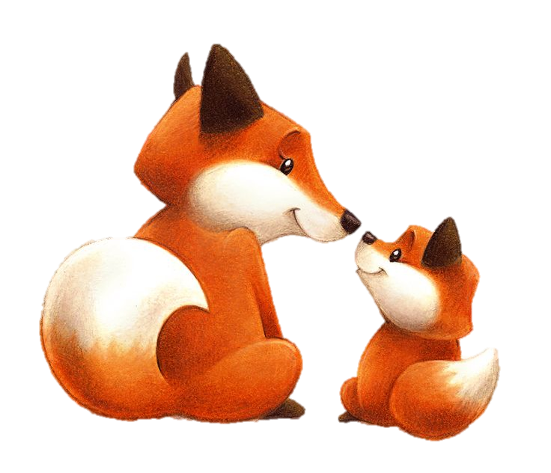
Because of all the worries a big meeting was held with all the professionals who knew the family really well.
The professionals knew that Victoria loved her children very much, but did not know what they needed to be happy, healthy and safe all of the time.
Victoria had stopped working with the Social Worker and was finding it too difficult to make the changes needed to keep her children safe.

Slide 24
So the professionals felt that the best plan for Sam would be for him to live with foster carers so that he was safe and looked after. Leon and Sarah would live with their father, Reece.
While in foster care, the Social Worker would still work with Victoria to see if she was able to do the job of mum to her children.
Sam went to live with foster carers, Mary and Peter and their family on the 8th April, 2020.
FOSTER CARER PHOTO

Slide 25
Foster Carers are……………….
People who want to look after children who are not able to live with their birth mum or birth dad, or any of their relatives.
Foster carers are not known as ‘forever families’ but they can look after children until they are old enough to look after themselves. But often it is days, weeks, months or years.
When you are in foster care your surname (birth family name) does not change.

Slide 26
FOR INFO
IT IS IMPORTANT THAT EVERY FOSTER HOME THE CHILD HAS STAYED IN IS DOCUMENTED AS A POSITIVE TIME FOR THE CHILD.
EVERY FOSTER CARER THE CHILD HAS STAYED WITH IS RESPONSIBLE FOR PROVIDING INFORMATION AND PHOTOS FOR THE CHILD’S LIFE STORY BOOK.
THE FOSTER CARERS SHOULD HAVE COMPLETED THE ‘FROM ME TO YOU’ BOOK AND ALSO MILESTONE BOOKS FOR THE CHILD WHILE IN THEIR CARE. THIS INFORMATION IS TO BE TRANSFERRED INTO THE LIFE STORY BOOK.
IT IS IMPORTANT TO EXPLAIN TO THE CHILD ANY MOVES THEY MAY HAVE HAD WAS BECAUSE THE CARER WAS NOT THE RIGHT FIT FOR THE CHILD, NOT BECAUSE THIS WAS THE CHILD’S FAULT.

Slide 27
Sam’s time with his foster carers.
INFORMATION FROM THE FROM ME TO YOU BOOK AND THE MILESTONE BOOK
PHOTOS

Slide 28
Sam loved the swings.
Sam’s 1st Easter!
Days Out
Halloween!

Slide 29
Sam’s 1st Birthday!

Slide 30
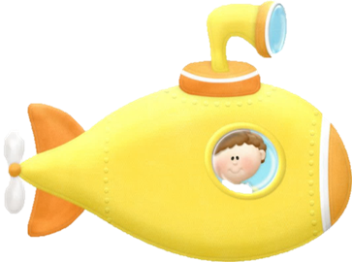
Sam grew into such a wonderful, happy little boy, we were so proud of him.
Even though Sam was in foster care he still had family time with his birth mother, Victoria.

Slide 31
Family time between Sam and his birth parents, Victoria and David.
Sam had family time with Victoria 3 times a week, 2 were with Victoria and 1 was with David, Sarah and Leon. Sam enjoyed his family time.
Family time means that children who do not live with their birth parents are still able to see them in a safe place. There is a family worker there to make sure that the child is safe and to help parents if they need it.
PHOTOS FROM FAMILY TIME HOW PARENTS PARENTED THEIR CHILDREN

Slide 32
Because of all the worries, the Social Worker went to see the Judge at the court.
The Judge is a wise person whose job is to make the right plans for children.
The Judge listened to both the Social Worker and birth parents before making the best plans.

Slide 33
The Judge agreed that even though Victoria and David loved Sam very much, they didn’t understand what he needed to grow up to be safe, happy and healthy.
The Judge did not feel that Sam would be safe in Victoria or David’s care.
When a child is not able to live with their birth parents, other family members are looked at to see if they are able to care for the child.

Slide 34
FOR INFO
IT IS IMPORTANT TO EXPLAIN WHY DECISIONS WERE MADE IN THE BEST INTEREST OF THE CHILD.
THESE INCLUDE PERMANENT FOSTER CARE/RESIDENTIAL CARE, LIVING WITH A FAMILY FRIEND/RELATIVE, ADOPTION AND ALSO WHY THERE MAY BE SIBLING SEPARATION.
BIRTH PARENT’S VIEWS ARE ALSO IMPORTANT TO DOCUMENT AND TO REASSURE THE CHILD THAT THEY WERE LOVED AND WANTED.

Slide 35
Sadly there were no family members who were able to care for Sam and keep him safe.
So the Judge decided that the best plan for Sam would be one of adoption.
Adoption means belonging to and growing up with a new family when you cannot live with the family you were born into.
Victoria and David loved Sam very much and was sad that they hadn’t been able to do the job of mum and dad, but agreed that they wanted him to be safe, loved and looked after.

Slide 36
These are the difficulties Victoria had which stopped her from being able to do the job of mum to Sam.
Victoria wasn’t able to keep her home clean, tidy and safe.
Victoria wasn’t able to protect her children from harm.
Victoria was drinking too much alcohol.
Victoria was in a relationship where she was being hurt.
Victoria had learning difficulties which made it hard for her to make the changes needed to keep her children safe.
There were worries that children would be neglected in Victoria’s care.

Slide 37
Gail became Sam’s Social Worker. It was Gail’s job to find Sam’s forever family.
Gail looked very hard until she found Amy, Gary and their daughter, Alysha, who had been looking everywhere for a special little boy to join their family.
Gail thought that they were the perfect family for Sam.
Gail
Amy, Gary & Alysha

Slide 38
Before Sam could meet his forever family it was time to say goodbye to his birth family.
Sam had his last family time with Victoria and David on the 6th January, 2021.
PHOTOS

Slide 39
When Sam met his Mammy, Daddy and big sister, Alysha.
Amy, Gary and Alysha first met Sam on the 9th February, 2021 at the foster carer’s home so that they could get to know each other better.
These visits went really well and Amy, Gary and Alysha fell in love with Sam and wanted him to become part of their family.
PHOTOS

Slide 40
Alysha was looking forward to being a big sister!
All the professionals agreed that this was the perfect forever family for Sam.
So Sam went to live with his forever family on the 16th February, 2021.
PHOTOS

Slide 41
FOR INFO
IT IS IMPORTANT TO DOCUMENT EVERY MOVE THAT THE CHILD HAS HAD IN THEIR LIVES.
THIS ENABLES THE CHILD AND CARERS TO ACKNOWLEDGE THE CHILD’S SENSE OF LOSS AND SEPARATION AND GIVE UNDERSTANDING REGARDING THE CHILD’S FRACTURED ATTACHMENTS.
THIS ENABLES THE ADULTS AROUND THE CHILD TO HAVE MORE EMPATHY AND UNDERSTANDING ABOUT HOW THIS CAN IMPACT UPON THE CHILD’S FUTURE RELATIONSHIPS.

Slide 42
Sam’s Moves
Sam was 1 day old when he left hospital to live with Victoria.
On the 8th April, 2020, Sam went to live with foster carers, Mary and Peter.
Sam’s last move was when he went to live with his forever family on the 16th February, 2021.

Slide 43
Victoria will get a letter once a year from Sam’s forever family so that she can hear about how Sam is growing and what he is doing.
Victoria can also send a letter to Sam once a year if she is able to.
Sometimes this might be too difficult for birth parents to do, as sometimes they don’t know what to say and sometimes it can give them hurt feelings, so they find it too hard to write anything. This doesn’t mean that they don’t love their children and will still want to hear about how they are doing.

Slide 44
Sam can also send letters to Sarah and Leon’s family to tell them all about how he is doing.
Sarah and Leon can also send a letter once a year to Sam to tell him how they are doing.
Any letters that are written will be sent to Sam’s forever family.
The month to send letters is FEBRUARY!

Slide 45
Sam’s Social Worker went to see the Judge at the Court on the 25th October, 2021. The Social Worker told the Judge how happy Sam was and how much he was loved by his Mummy and Daddy.
The Judge was very happy to hear how well Sam had settled and how much he was loved, so made an Adoption Order on that day which meant that Sam was now legally part of his forever family.
From that day Sam was called….
Sam Harry Smith

Slide 46
Sam’s Journey Continues!
PHOTOS WITH ADOPTIVE/FOSTER/RESIDENTIAL/EXTENDED FAMILY

