Slide 1
LANGUAGE AND LIFE JOURNEY
Louise Spragg
Principal Social Worker

Slide 2
Language and Life Journey
Developments
Background
Importance of language- building blocks to relational practice
Aims
How language can follow a child/young person throughout their journey from referral onwards.
How it effects people we are working with, children, young people, parents/carers- the lenses we view people with and the impact.
Overview of the guide
Next steps- reflect on the language used in our organisation/ what can we change.

Slide 3
Language and Life Journey
Language
‘Hard to engage’, ‘disguised compliance’, failure to engage’, ‘difficult to engage’ ‘won't engage’
None engagement where does this come from:
Recent study found that women who had experienced trauma and abuse in their own childhoods can often lead to a mistrust in professional help.
As children we turn to our care givers at times of fear and harm for protection however if this was absent or if this was the cause of our distress this undermines the child’s ability to seek safety through interpersonal relationships.
Relationships with professionals can trigger behaviours from childhood which kept the person safe, but which aren’t helpful as an adult.
Fight, flight, freeze- panic, anger, fear, avoidance of the perceived threat

Slide 4
Language and Life Journey
Language
Expect the worse
Hyper vigilance- survival mode, suspicion, self protection
Judgement and criticism can evoke previous patterns of behaviour
How can this show up? What is our experience in practice?
What can we do? – listening, empathy, honesty, respect , strengths based
Reframing the language- we haven’t found a way to connect with this person yet- their struggling with a difficult situation, they are avoiding pain/shame by not being around people who are trying to help , avoiding a difficult situation/avoiding further distress and harm/ worried about the consequences of telling the truth/ their story.

Slide 5
Language and Life Journey
Language- words matter
Words have the power to shame and the power to heal
Connection
Missing pieces – lifelong impact
How we frame birth parents
Words have the power to shame or the power to heal
Key words- Language, identity, lived experience
Connection
We consider the imprint we leave on others
We practice with kindness, empathy and compassion
We work alongside families in a manner which reduces shame and blame
Promotes strengths, empowerment and connection
We promote positive regard
Remain curious
We make our words matter – attending to our language within conversations and our recording
We model these principles when communicating with each other
We respectfully challenge when language is used which is not reflective of the above principles.

Slide 6
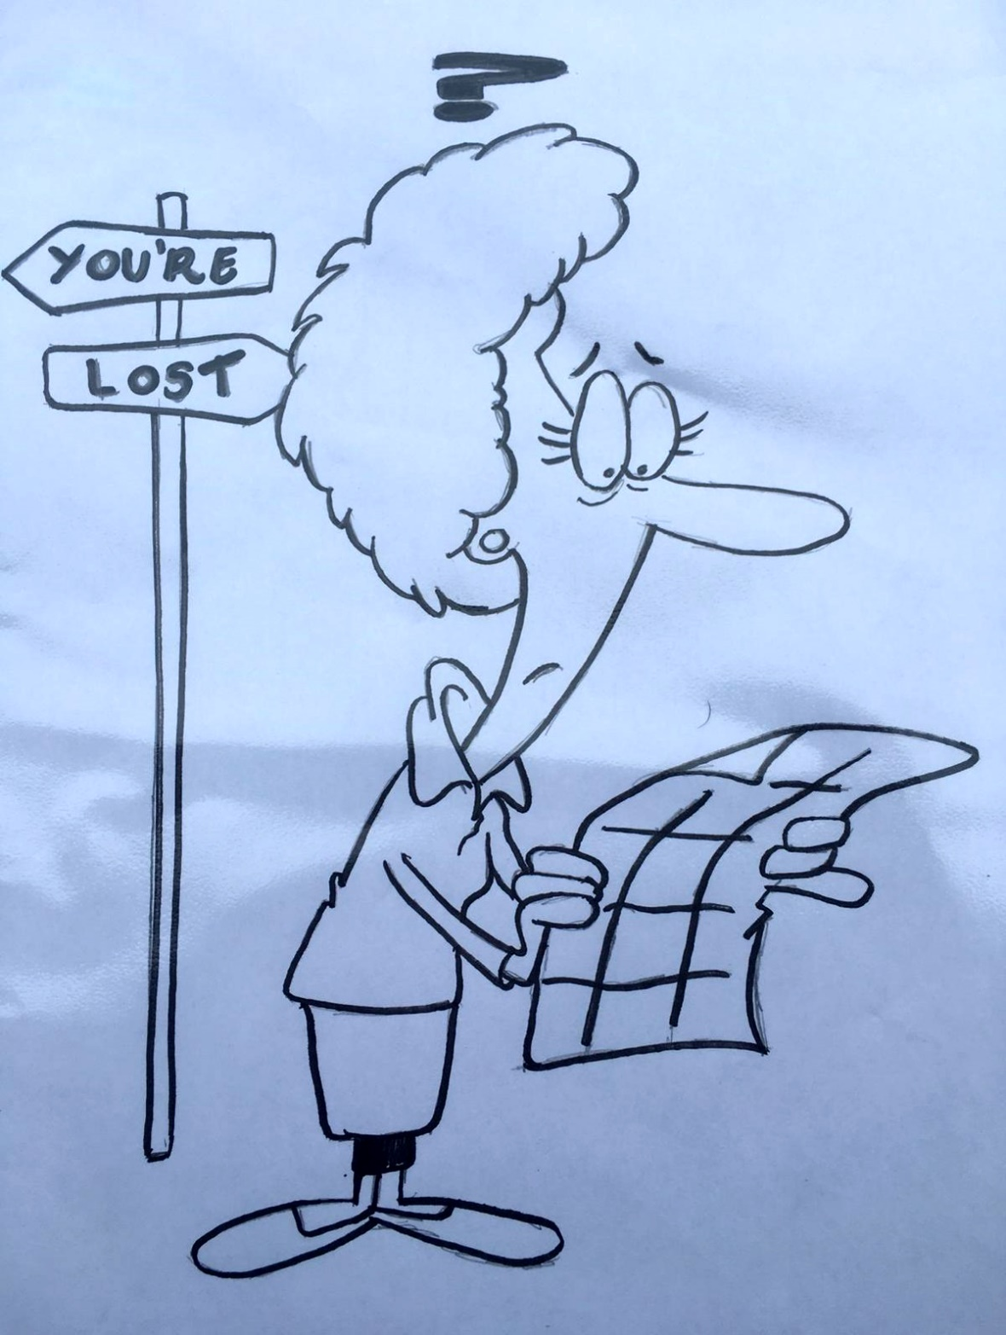
Language and Life Journey

Slide 7
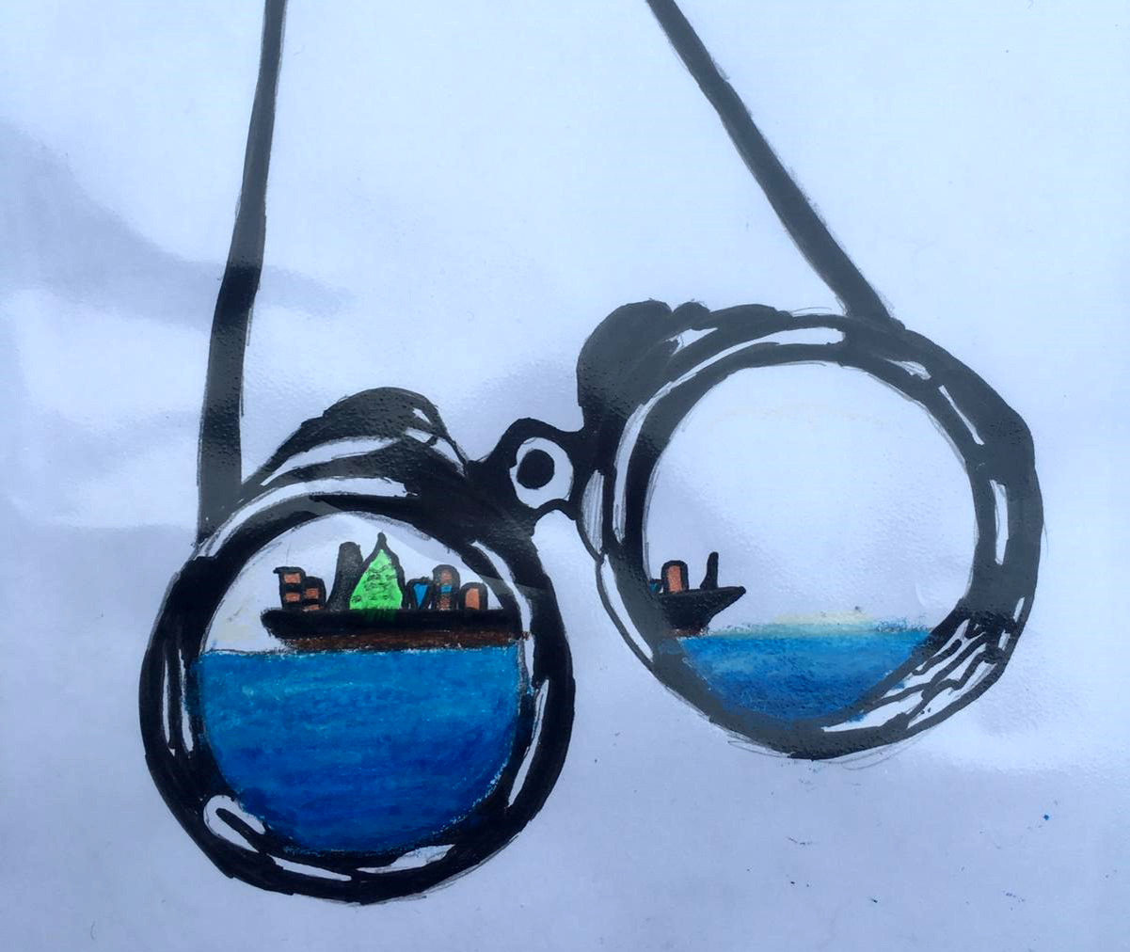
Language and Life Journey

Slide 8
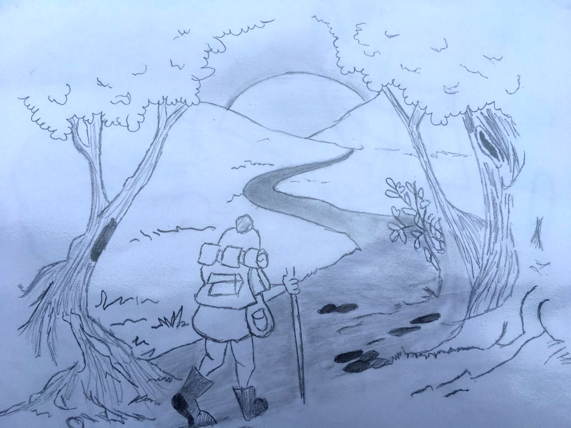
Language and Life Journey

Slide 9
Language and Life Journey
Life Journey
Key words- language, identity, lived experience
Connection
The gift of experience the truth unwrapped- your life your story 2021.
There is no greater agony then baring an untold story inside of you - Maya Angelou 1970
Write what should not be forgotten- Isabel Allende
We read to know that we are not alone- CS Lewis
Life journey guide- background and next steps

Slide 10
Language and Life Journey
Values
We record information which clearly evidences their lived experience, this is relevant for all children and young people that receive support via our service. ​
We ensure key events that occur include information from their own perspective, including triangulation of this by observations and the relationships held with professionals. ​
Recordings are person centred.​
We ensure we capture key information relating to their experience, strengths and relationships and these are evident on all records. ​
We promote all agencies to consider the child’s lived experience. ​
We ensure that children and young people are consulted and can participate in relation to their circumstances and the support they receive in an age-appropriate manner, which considers their individual needs. ​
We ensure that their life journey is shared with them in a sensitive, balanced manner. ​
We ensure birth family members are able to contribute to the child/young person’s journey. ​
Where direct work is completed with the young person or child this is underpinned by playfulness, curiosity, acceptance and safety. ​
Direct work will consider the child and young person’s age and understanding, developmental needs and identity. ​
Direct work enables children and young people to understand the past and move forward with the future. ​
Direct work is curious about the child and young person’s own account of what took place and provides alternative voices and perspectives alongside their own to aid them to make sense of their experiences. ​
Recording is completed considering the possibility that the child or young person will read this information as an adult. ​
Life journey work considers the individual nature of the culture of the family and this information is included. ​

Slide 11
Language and Life Journey
Lived Experience
Capturing the lived experience of children and young people including the parents narrative of their lived experience.
Including a hypothesis whereby the child is not of an age or ability to verbalise.
The voice of fathers
If the child/young person was to view the record as an adult, would we be comfortable with what they saw?
Would they understand why decisions were made and their lived experience at the time.
Balancing professional need and the lived experience of children
Writing to the child

Slide 12
Language and Life Journey
National Perspective
Understanding what the child’s daily life is like- voice and influence
Understanding what a child sees, hears, thinks and experiences on a daily basis, and the way this impacts on their development and welfare, is central to protective safeguarding work.
The complexity of situations in vulnerable families can lead to a particular focus on parental needs, which can get in the way of professionals understanding risks faced by the children.
A trusting relationship with the child that goes beyond listening and recording
Use a variety of ways to ascertain the child’s views
Challenging and help-seeking behaviour may well reflect harm and distress
Be aware of, and challenge where children seek to minimise risk of harm or show reluctance to accept help

Slide 13
Language and Life Journey
Further Thoughts
https://youtu.be/-ZrmxPIOP80 - A Child
https://youtu.be/Fnz1IOj2rYg - Redacted Essex Children in Care Council
Link to BASW recording tips from July 2020:-
Layout 1 (basw.co.uk)- Top Tips for recording BASW July 2020.
https://youtu.be/70k6MkxuZRU- Social Work Action Group
https://orb8.org/update-2020-10-08-a-thought-for-the-month-mind-your-language.php
Attending to language when working with exploitation
link to recording - https://youtu.be/PZtFUPQMNZk

