Slide 1

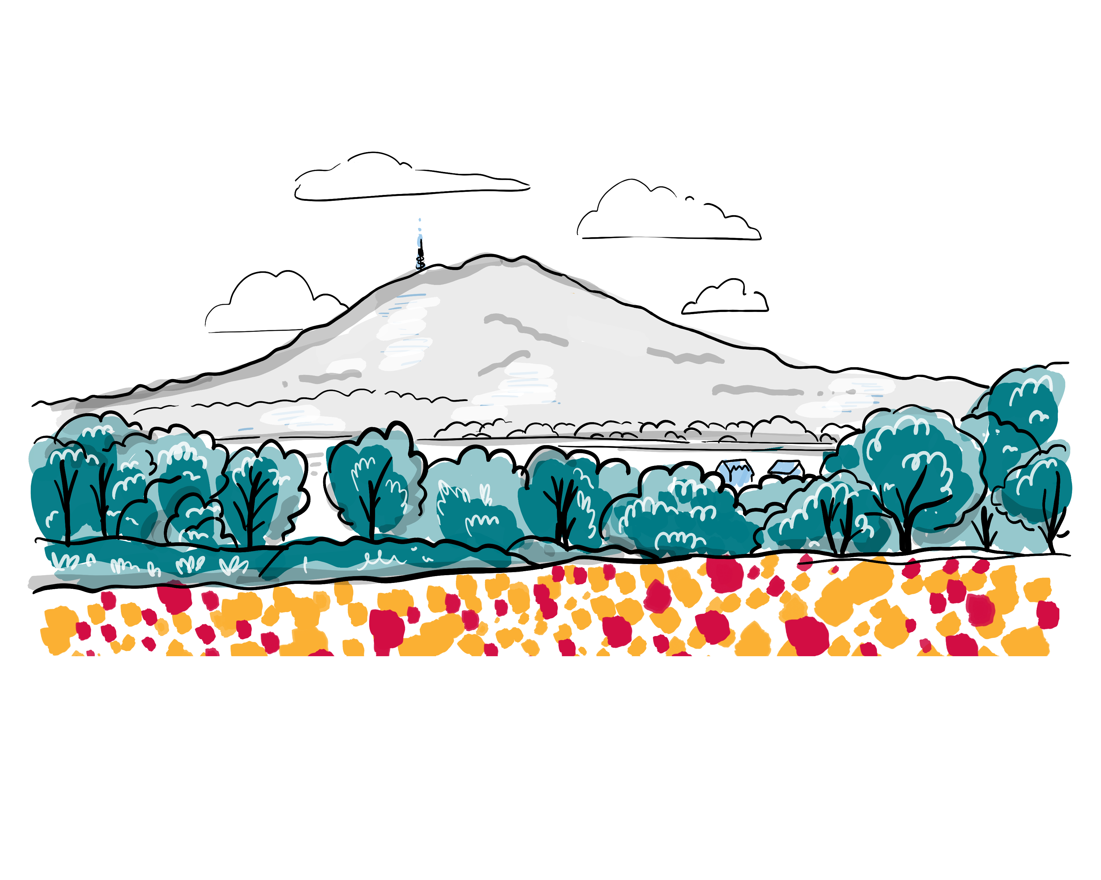
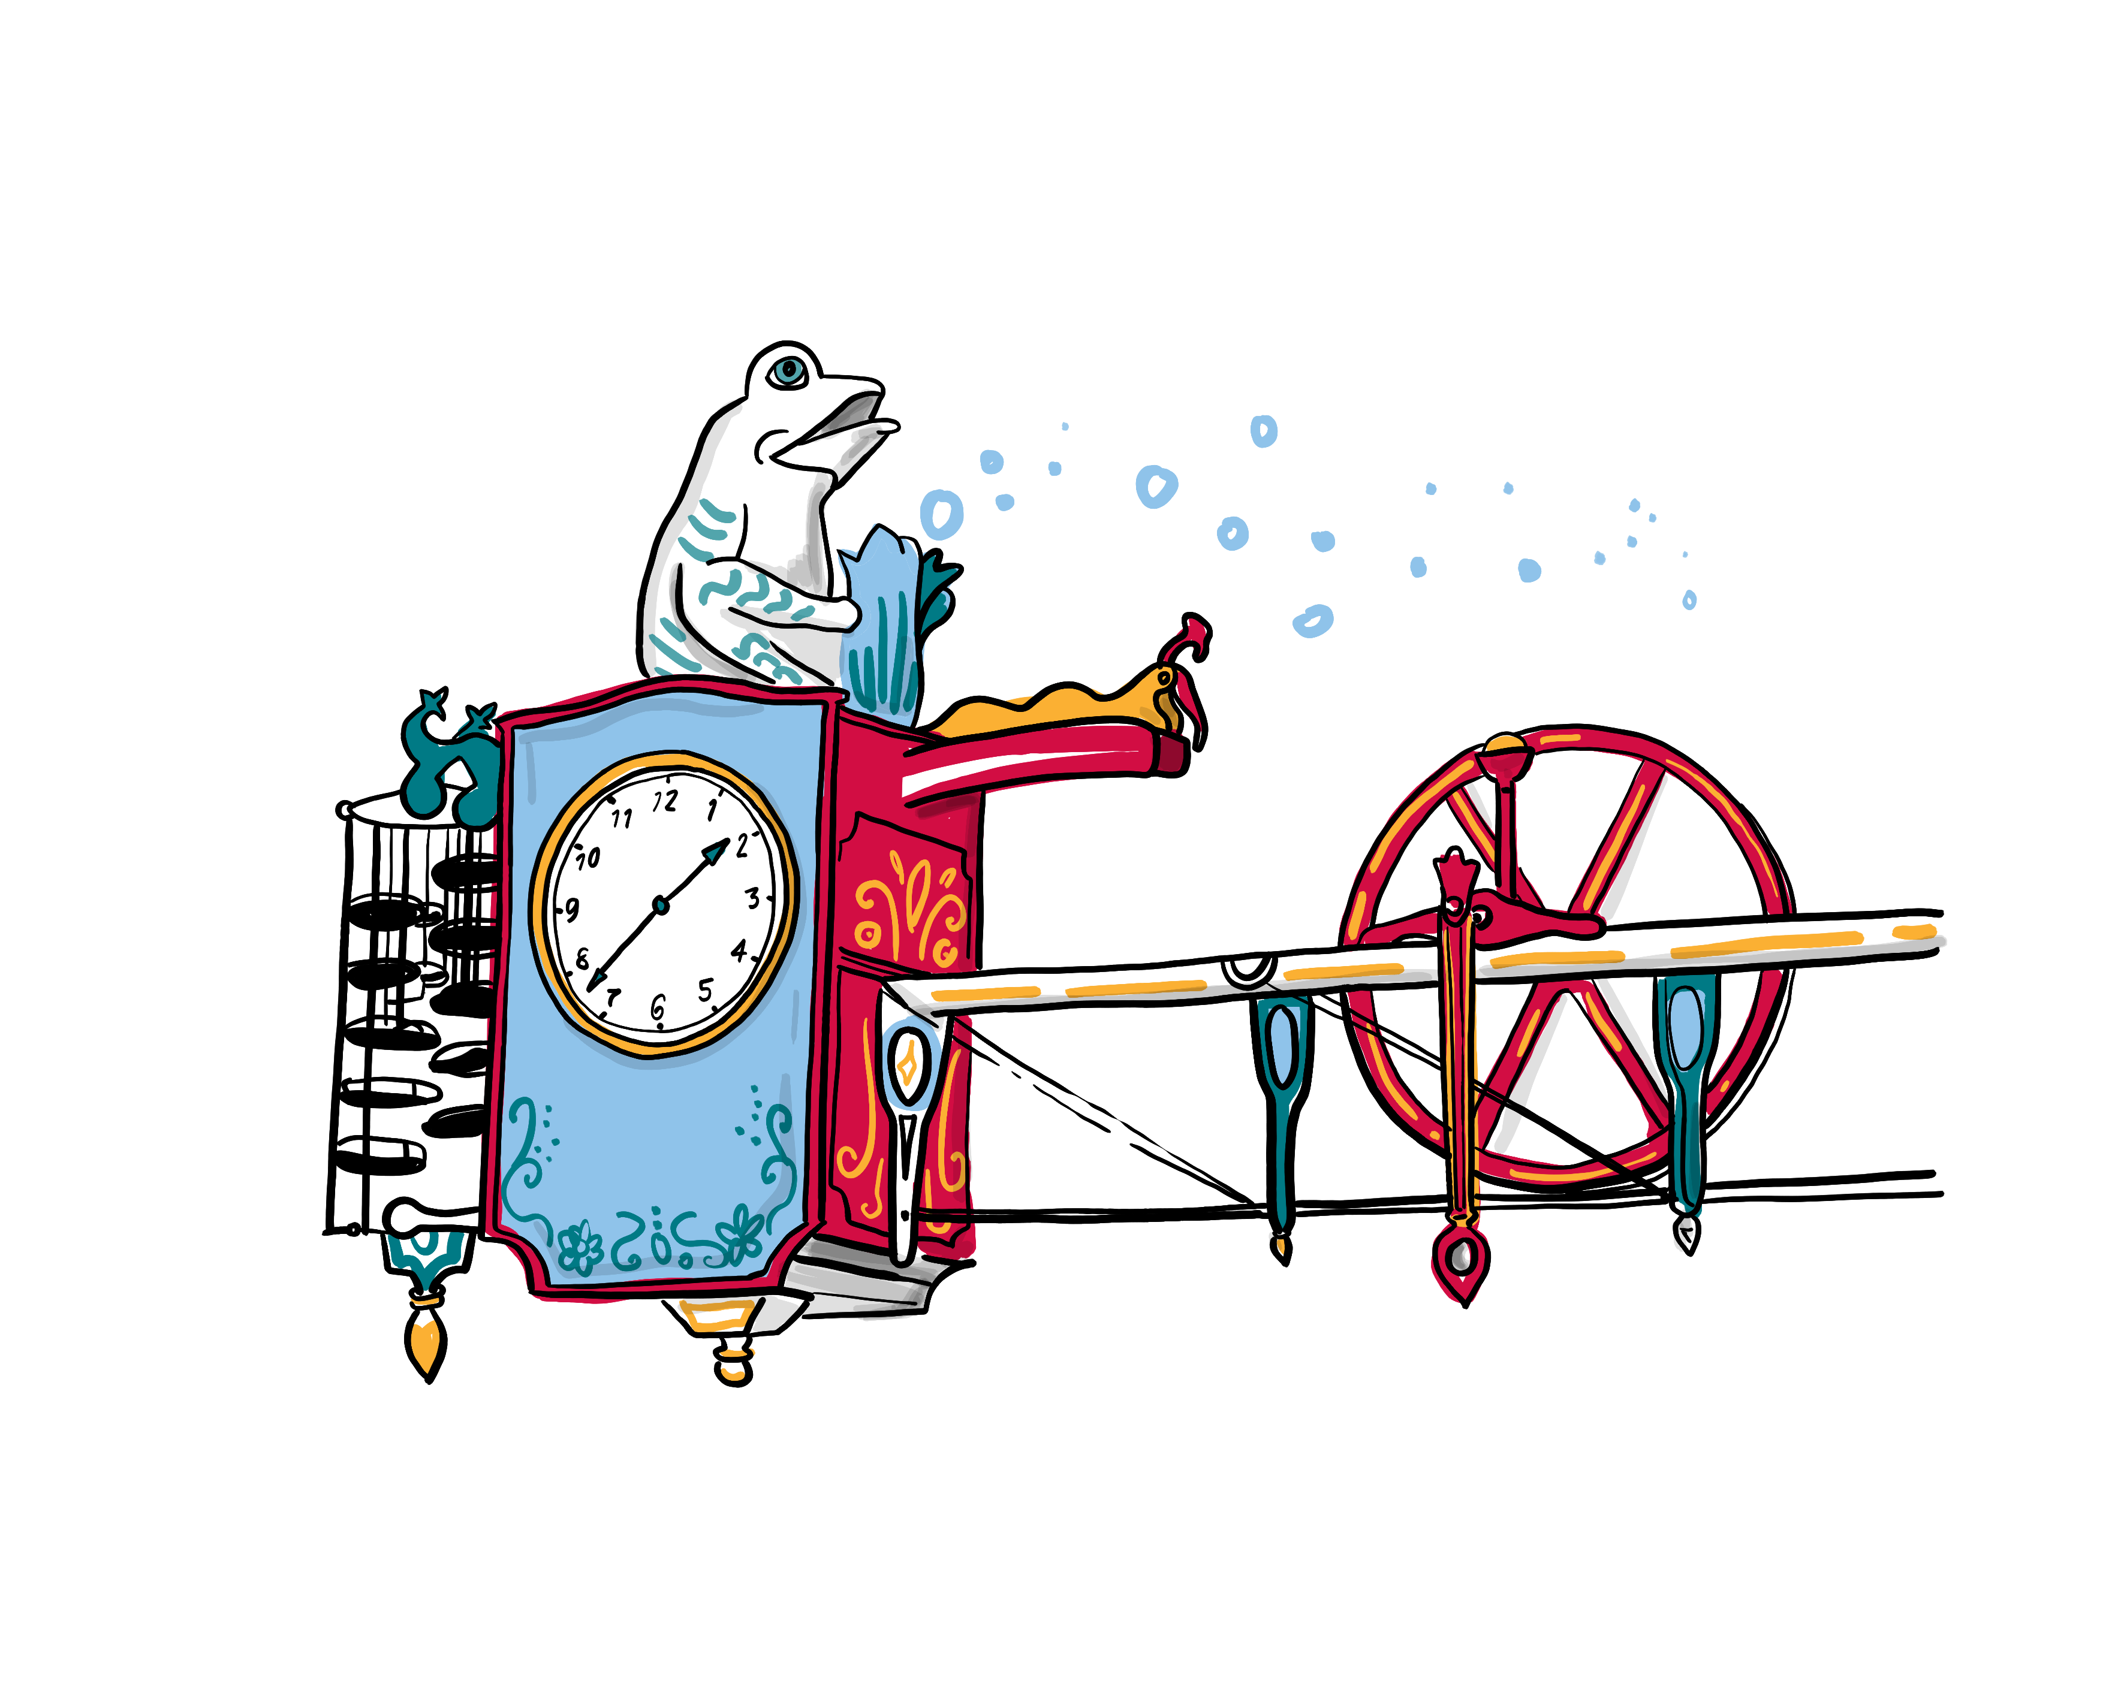
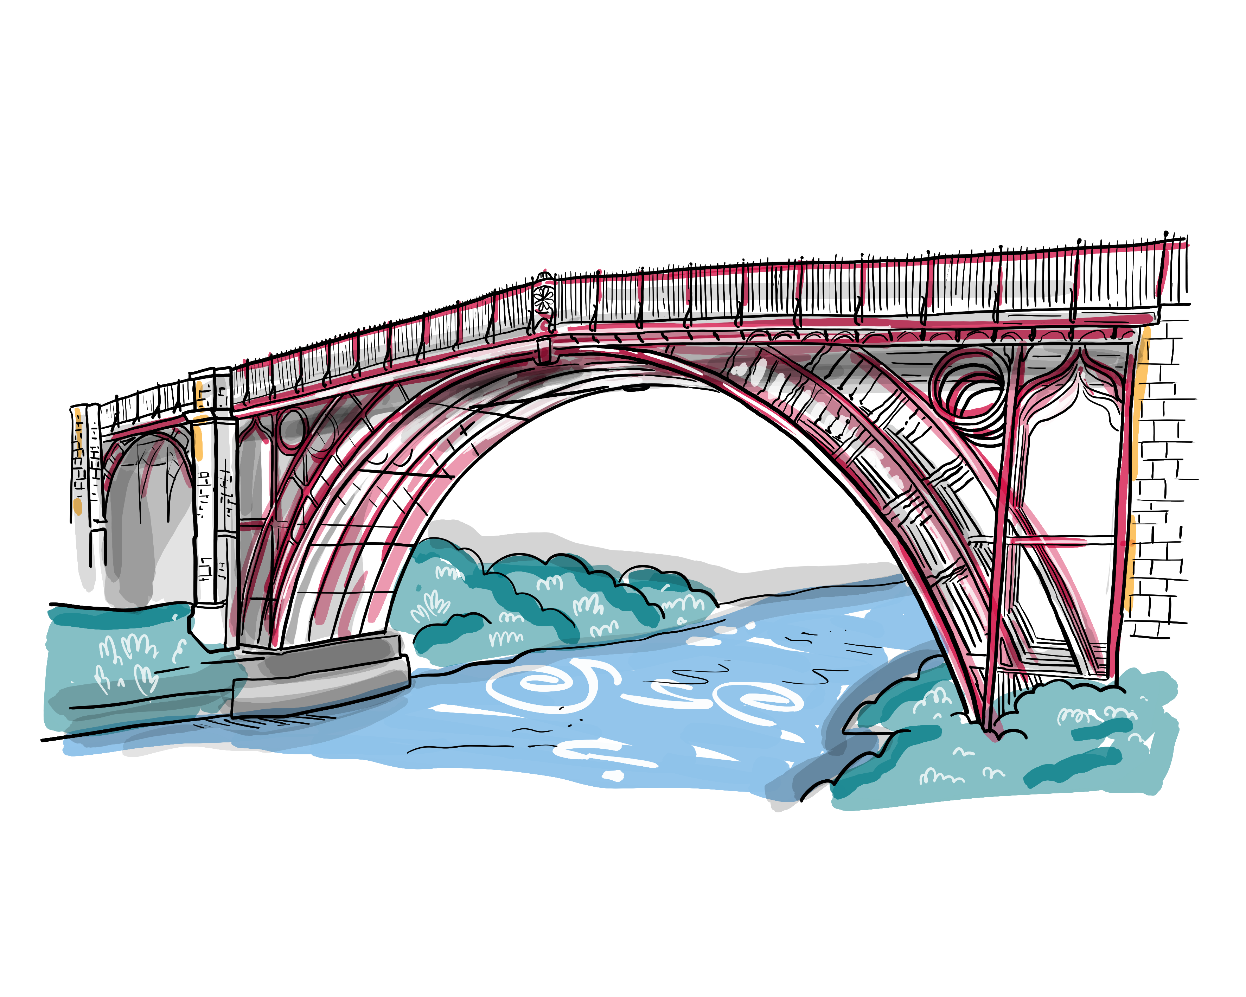
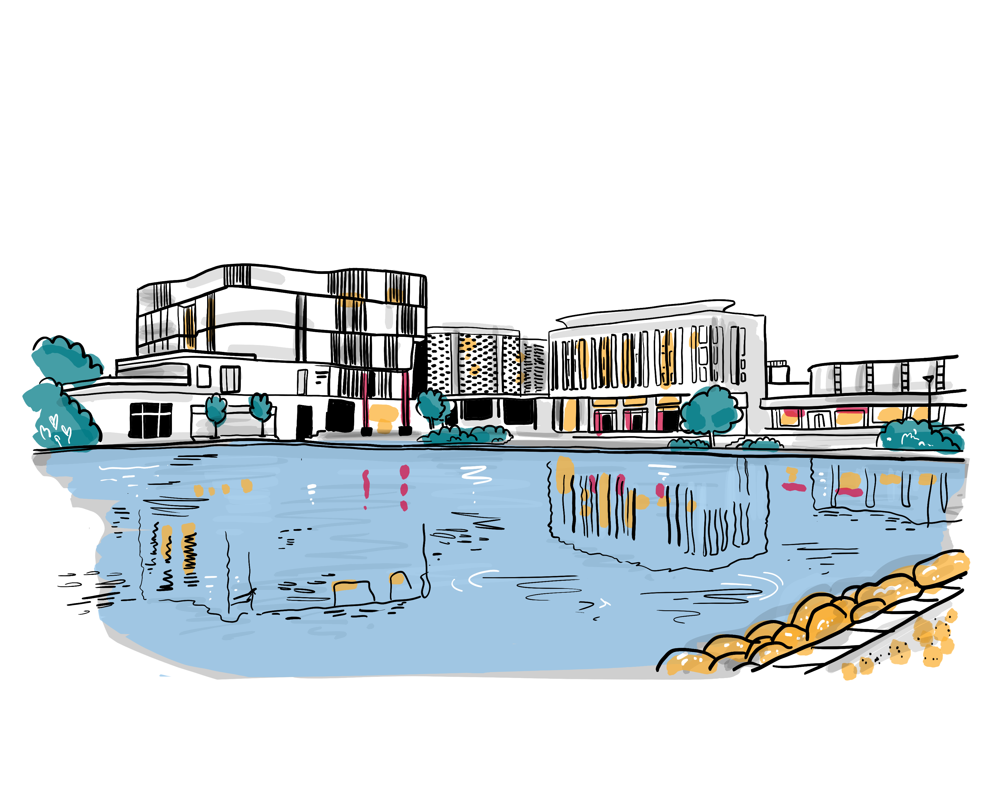
Corporate Parenting Young Persons’ Panel
1. Being an Individual
14th November 2022
We Will
Recognise that being in care is only one part of your lives, there is so much more to you;
Ensure that you are seen and treated as individuals worthy of respect. We will promote that respect wherever we can;
Ensure that you understand the reasons for your being in care;
Help you to understand where you are from and support you to understand your cultural identity;
Provide opportunities for you to have time to meet with others with lived experience and advocates to talk about cultural diversity;
Ensure that you are supported to do things you consider to be fun and similar things to your friends;
Encourage you to find and access clubs and hobbies that you are interested in;
Listen to you about spending time with family and friends, where safe to do so.
How we will know we have made
a difference:
Future surveys will show that you believe we treat you with respect and as individuals;
You will let us know that you have a strong sense of who you are, where you are from and that you understand the reasons for you being in care;
There will be more opportunities for you to engage with people with lived experience;
You will tell us that you have regular opportunities to do things that are fun and that you have access to clubs and hobbies;
You will feel listened to about spending time with family and friends, where safe to do so.
What is Going Well?
Treated with respect by key people such as friends, the Virtual School and Social Workers;
The Virtual School doesn’t leave people out, they provide opportunities to try new things out;
Having a social worker who listens to you and supports you;
Smash Life mentoring, knowing that there’s someone you can talk to;
Horse riding through the Cavalier Centre;
“I’m happy with the life I’ve got!”
“I’m looking forward to the Driving Experience next year.”
What Messages Do You Want to Pass on to Other Young People?
Think about which of your friends you talk to about being in care. If they are good friends they won’t treat you any differently after you tell them. Only tell your close friends.
If you are worried about your social worker cancelling appointments, talk to that social worker first, there’s probably a good reason. If you still aren’t happy, talk to your IRO at your review meeting or to an advocate.
What do you want to know about your past?
There is no one size fits all, so don’t assume that we all want to know all of the details about our past.
“I don’t know what happened in the past, I don’t want to know, I’m settled and happy with my life now.”
“I don’t know why I am in care, nobody has ever told me.”
“My memory of life with my parent isn’t the same as what my social worker tells me.”
“I had life story work, but I didn’t want this, I didn’t want to know.”
What Actions need to be added to the Action Plan?
Work with schools to develop their understanding of trauma and how to support young people who are “having a bad day” (Virtual School);
Guide for young people on all of the meeting for children in care and who to expect at each (IROs);
Transition from care to leaving care and support from older care leavers (CiC Team).
What Could be Even Better If …?
Understanding from school; teachers can call out SLT too quickly, shouldn’t be punished if having a bad day;
ALL teachers need to understand the difficulties that Children in Care can have;
Sometimes the social worker turns up late or doesn’t turn up, I understand why, they just need to let me know;
Social workers have to report what they are told, so I don’t always tell them everything;
People stop telling me they know how I feel, they haven’t been in my situation and don’t know how I feel, it makes me want to shout at them;
There are lots of meetings, I need to understand what all of these meetings are about;
More opportunities to meet with older Children in Care and Care Leavers so that they can share their experience.
What involvement and contact do you want with your family?
“I see my Mum every two weeks, this is about right, but I only see my brother once a month, this isn’t enough.”
“I don’t have contact with my family, that’s my choice, I’ve moved on with my life.”
“I get on with some of my siblings but not all of them, don’t put us all in a room together, we will fight.”
What are the Key Messages for The Corporate Parenting Strategic Group?
We are all individual with different ideas and experiences. Don’t make assumptions about what we want, talk to us first. We would like to discuss involvement with different members of our family and the option of Life Story Work; but don’t make us do this if we don’t want to.

