Slide 1



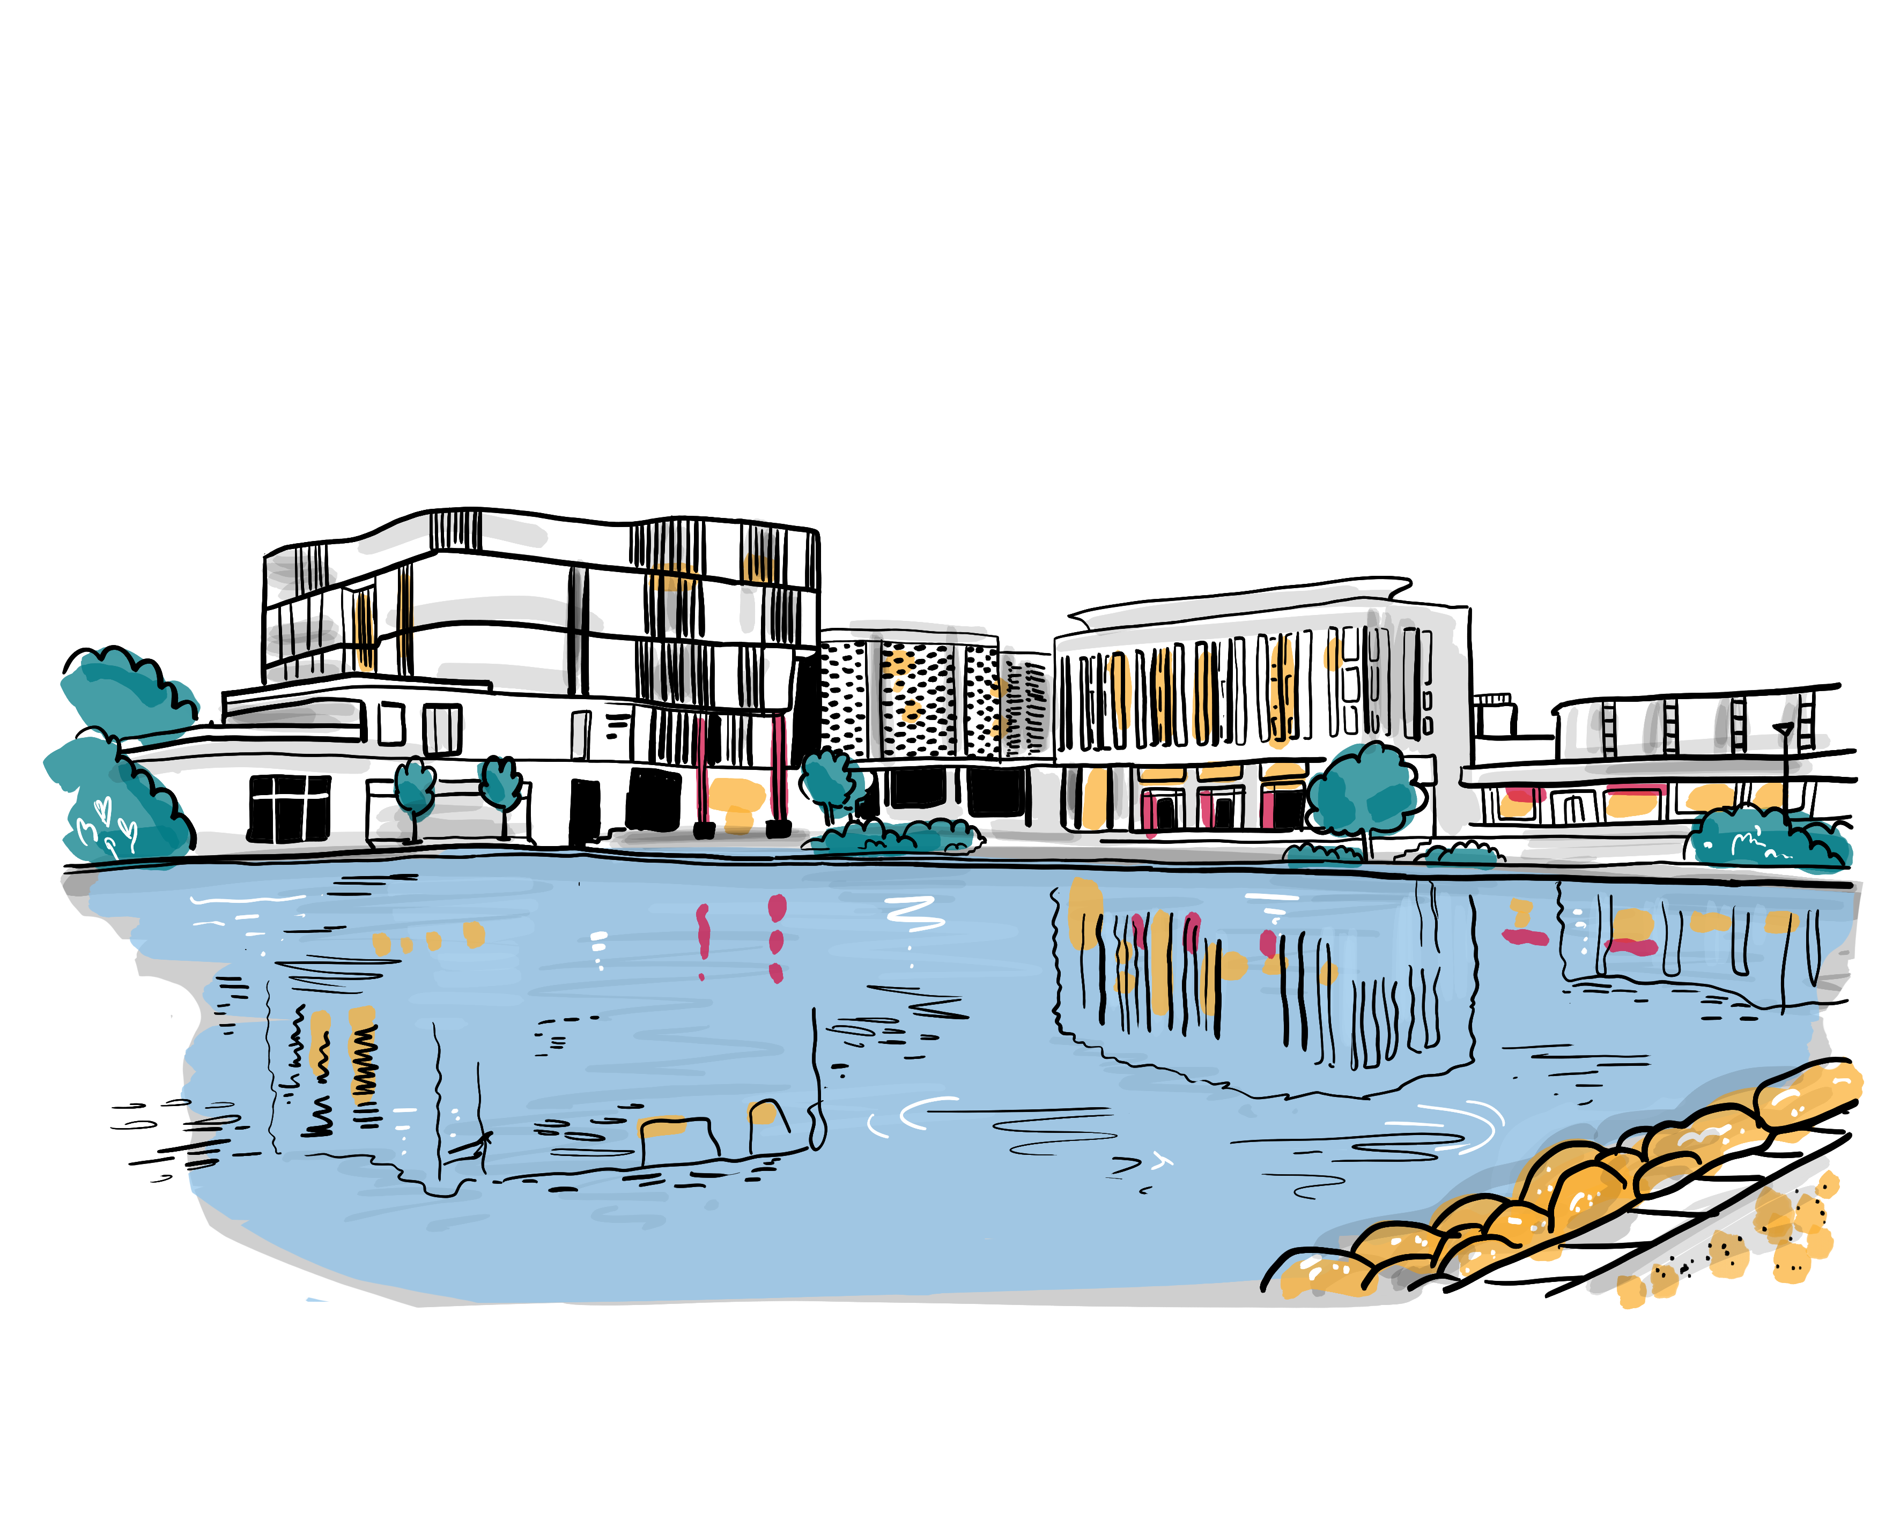

Corporate Parenting Young Persons’ Panel
7. Being Safe and Healthy – Part 1 ‘Healthy’
6th June 2023
We Will
Ensure that you have regular health reviews;
Embed and monitor a new Initial Health Assessment process to improve the quality of health assessments;
Ensure that Strengths and Difficulties Questionnaires (SDQs) are completed and are available at your health reviews;
Promote the uptake of health passports for Care Leavers;
Ensure that the adults you live with understand you by offering appropriate training, to include supporting them to understand that behaviours can be a different way of trying to communicate;
Continue to develop our placement sufficiency to ensure that you have the right home during your time in care and also as a care leaver;
Ensure that children in care reviews are held in a timely way with your voice at the centre.
How we will know we have made
a difference:
All children we care for will have a regular health and dental check;
All children new into care will have a timely initial health check;
Strength and Difficulties Questionnaires will be available to inform health reviews;
All care leavers will have access to a health passport and there will be more take up;
High uptake of training for foster carers to support emotional health and wellbeing;
More of you will feedback that you like where you live;
You will have timely reviews and your voice will be visible within the meeting records.
What is Going Well?
It is good that we have medical check ups, but we don’t want to feel different as our friends don’t have these;
Dental checks, we get dental checks every 6 months;
When registering with a dentist is written into the Pathway Plans for care leavers;
The Mental Health Support Team have given me good support in school;
Schools are more aware of mental health needs and provide support for this;
Access to an anger management course was good;
Other therapies such as Equine Therapy and mentoring such as SmashLife;
Drop in sessions and Calm Café in the Leavers Lounge.
What Messages Do You Want to Pass on to Other Young People?
Don’t take your health for granted (both physical and mental), always get help when you need it;
Don’t keep quiet, say what you need to help you to stay healthy;
If you have a concern, talk to a trusted adult, they are there to help you;
Always ask questions if you don’t understand, there’s no such thing as a stupid question where your health is concerned.
Strength and Difficulties Questionnaire (SDQ)
Not all of the young people have had the opportunity to complete an SDQ themselves, they are concerned that other people appear to be responding on their behalf without them having a say.
ADHD Case Study
One young person described difficulties in getting a diagnosis of ADHD and whilst in care the health professionals listened to the carer rather than the young person. Since leaver care that young person has now been diagnosed with ADHD and feels that the support and medication that is needed is now in place.
What Actions need to be added to the Action Plan?
Expectation that young people see the nurse without their carer once they reach the age of 11, but the young person can invite the carer when they want to;
Attachment and trauma training for school nurses;
Ensure healthcare and dental services are sign posted and written into pathway plans;
Ensure that young person SDQs are completed annually at least one month prior to health assessment.
Social Workers to update the designated nurse prior to healthchecks to reduce repetition of information.
What Could be Even Better If …?
Not having to repeat the same information time and time again;
When we get to secondary school age the expectation should be that our carers don’t come into the medical with us, but we can ask for them if we want them;
An option for health checks to continue beyond 18 for care leavers;
Support from PAs to register and access health services post 18;
NHS dentists prioritise places for care leavers as a Protected Characteristic;
Free prescriptions for care leavers;
We could see the same GP every time we go;
School nurses have a better understanding of our needs as children in care;
What are the Key Messages for The Corporate Parenting Strategic Group?
Thank you for ensuring we get regular health and dental checks. Please help us to make sure these are more meaningful to us, that our voice is listened to as well as those of the adults around us. Our voice can come from a number of different ways including having the opportunity to complete SDQs as well as the chance to talk to the nurse without our carers present at our health checks.

