Slide 1

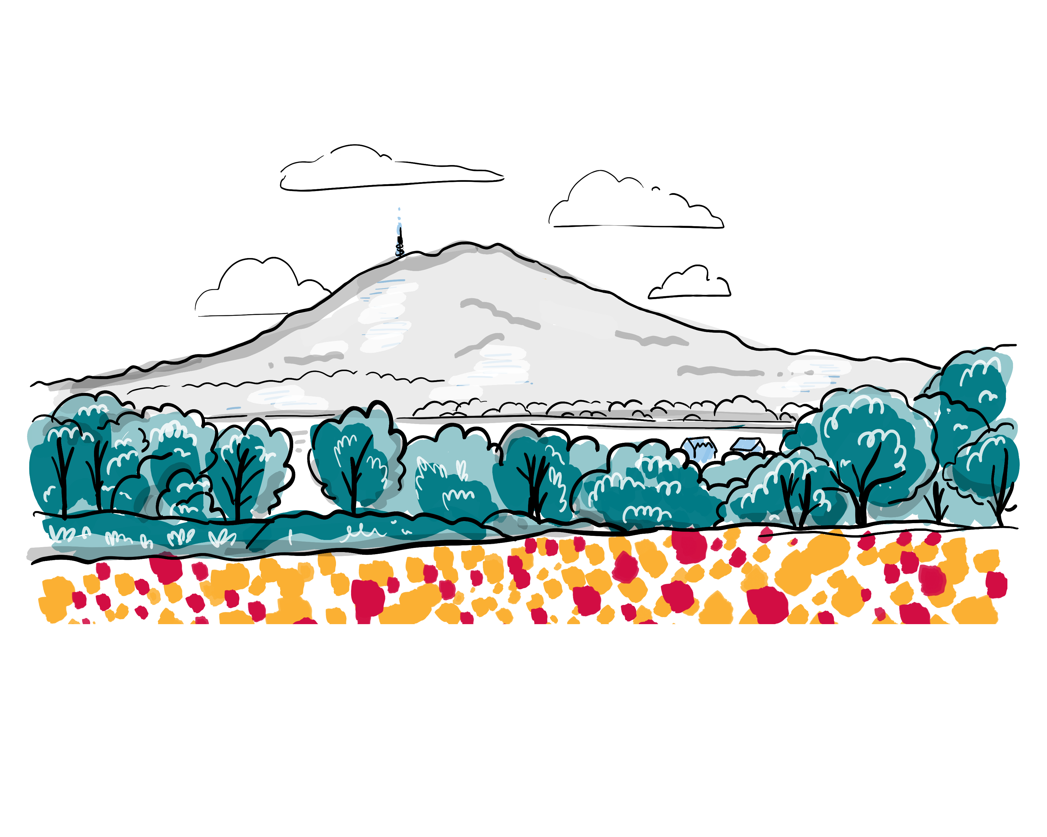
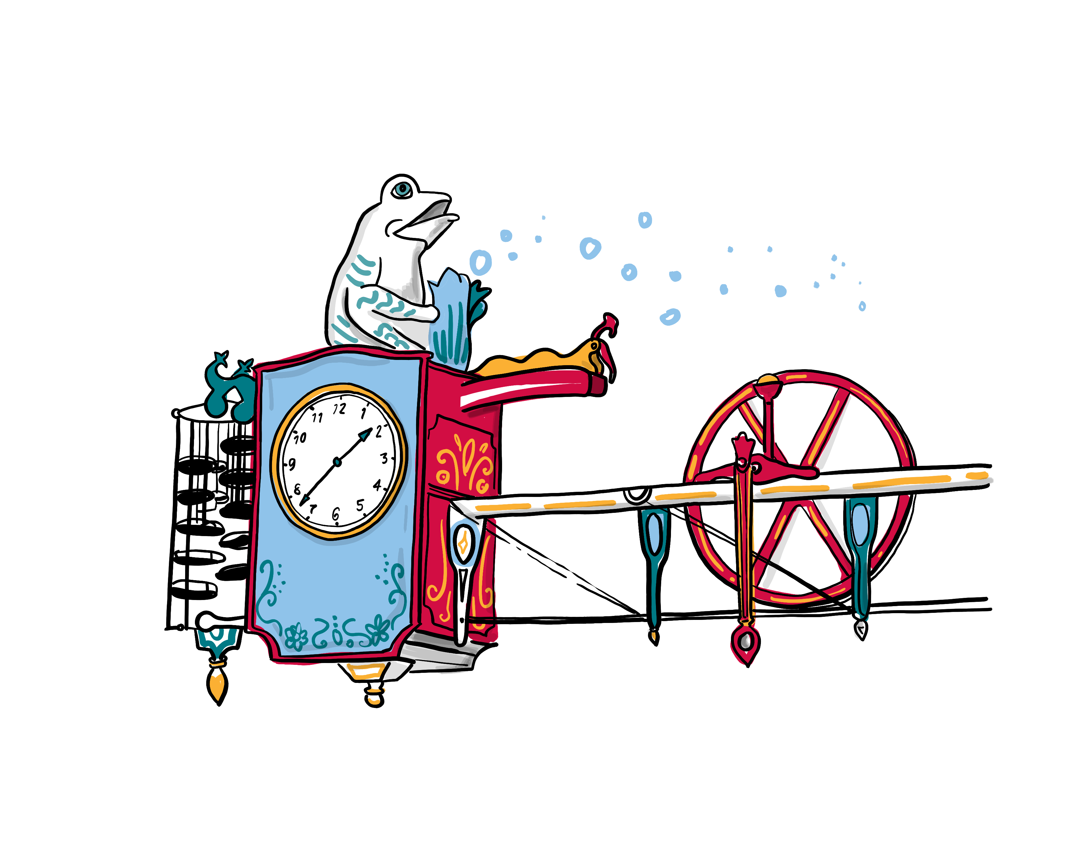
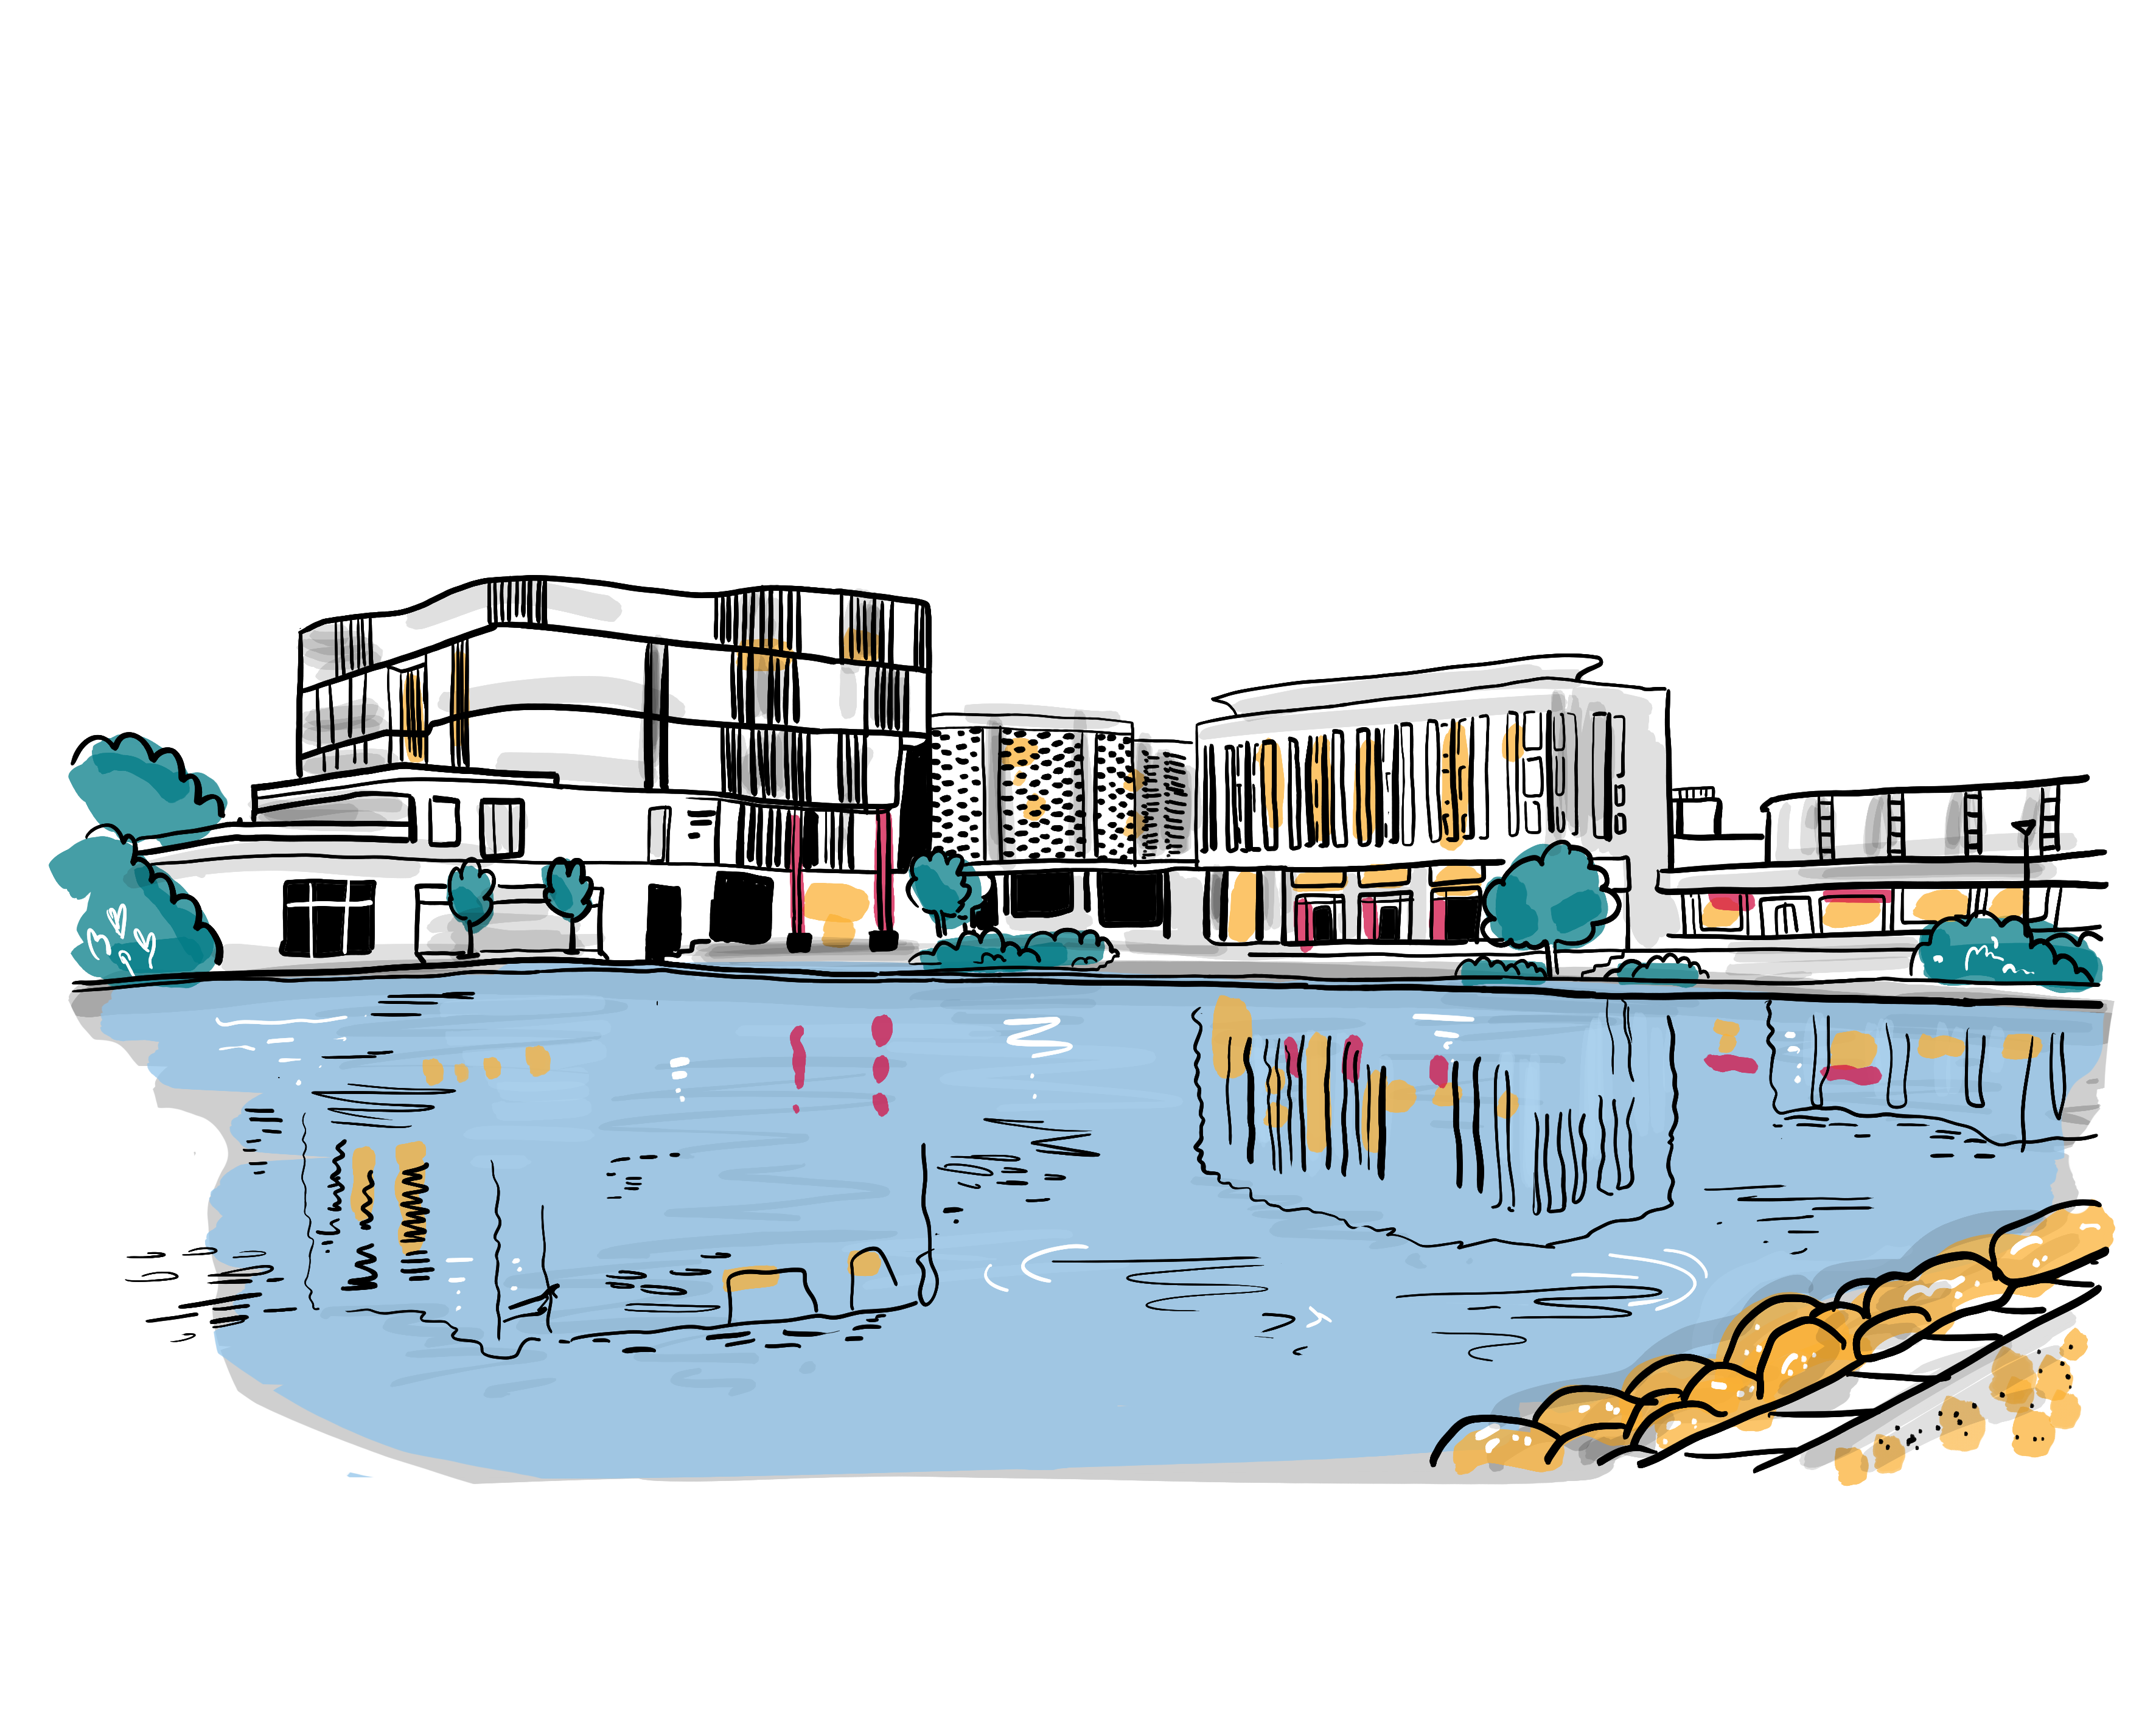
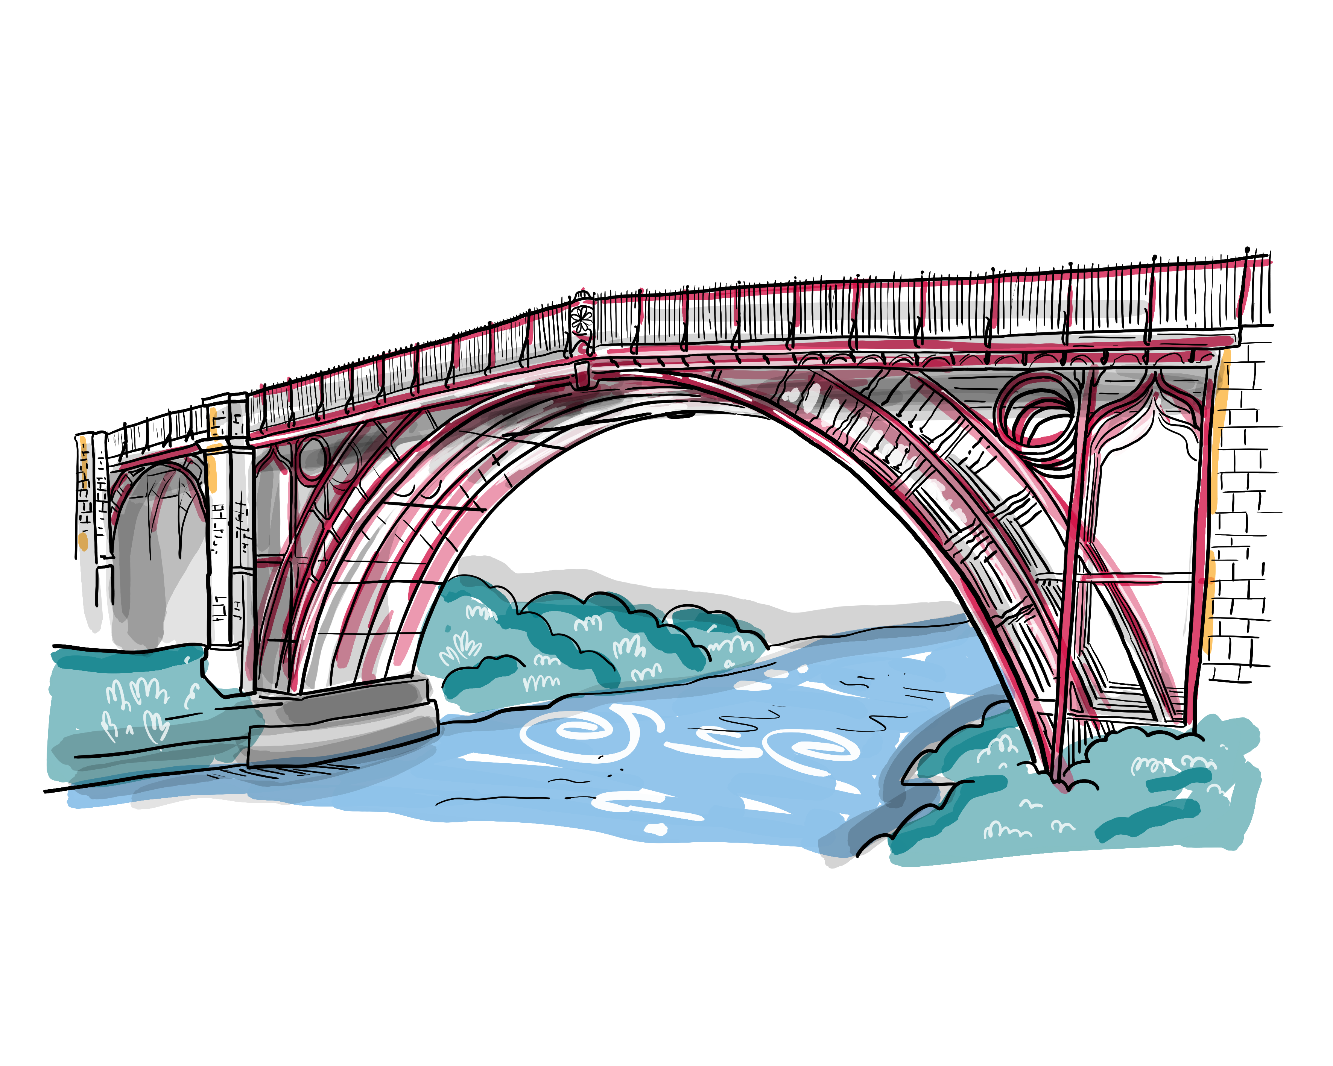
Corporate Parenting Young Persons’ Panel
6. Fulfilling Your Ambitions
28th September 2022
We Will
Always be aspirational for you;
Support you to make good progress in school through: tracking attainment; providing termly Personal Education Plans (PEPs); effective use of the Pupil Premium Grant to provide appropriate interventions; and by maintaining stability of education placements;
Support you to access positive destinations post 16; working closely with Further Education and Higher Education partners;
Support you to access education, employment or training;
Ensure that you have appropriate support in schools and settings and that you have access to well-trained designated teachers;
Ensure that you are supported to achieve at least the same, or higher rates of progress than your peers;
How we will know we have made
a difference:
You will have a good quality (Personal Education Plan) PEP every term;
There will be a high level of stability of education places;
A high proportion of post 16 children cared for and care leavers will be in education, employment or training;
A high proportion of designated teachers in schools will attend dedicated training;
You will be supported to make good progress in school;
A range of enrichment activities will be on offer.
We will celebrate your successes with you.
What is Going Well?
Support beyond the age of 18
Leavers Lounge is like a second home
Changes to legislation and benefit cap so can now seek work without impacting on cost of accommodation
Support from PAs when you leave care, for example with accommodation
Opportunities for extra-curricular activities including sport and academic support
Activities with the Virtual School such as Back to Basics
Summer Arts – great opportunities
PEPs are good when you go to them as you can talk about the support for yourself
Pathfinder charity with 5 days intensive driving experience
What Messages Do You Want to Pass on to Other Young People?
You get support up to the age of 21, make the most of it, for example free driving lessons.
You can access advice and guidance up to the age of 25.
Change to legislation regarding benefit cap, so go out and get a job!
Don’t spend all of the money from your trust fund when this matures age 18
Don’t doubt yourself, you are amazing, you can do it!
If you don’t pass your exams first time, don’t let it get you down, you can have another go
Grab opportunities such as trips, Summer Arts, sports and music
Your IRO can support you if you need help to get permission for school trips
Use your CiC review and your IRO to raise what will make your life better, for example contact with family
Try and go to at least one PEP per year, it’s about you and you can get help if you need it
What Actions need to be added to the Action Plan?
Working with accommodation providers regarding change to benefit cap
Getting the message to Care Leavers around change to Benefit Cap
Advice through schools re budgeting and being independent with finances
A card for all Children in Care and Care Leavers with key contacts, including IRO and Virtual School contacts as well as social workers
Creating more awareness around purpose and function of CiC Reviews and the role of IROs
What are your worries or Concerns?
Hitting 25 and having no support
My GCSEs are my big focus at the moment
Successes on the night
One young person now actively seeking work
One young person getting support to learn guitar
One young person getting support for revision techniques
What Could be Even Better If …?
Support, advice and guidance available beyond the age of 25, some people need this more.
Support in school to learn how to budget, pay tax and get into college
Not always clear where to go for help, for example if carers are saying no to a school trip
Try to make process for school trips simpler, for example where you need social worker permission which slows down the process
Making trips a reward for good behaviour; it can disadvantage children in care who are experiencing trauma
What are the Key Messages for The Corporate Parenting Strategic Group?
There is great support out there, but different people have different needs, so this does need to be taken into account. For those people who are less confident, it can feel like you are falling over a cliff edge at age 21 or 25.
It is important that we get at least the same opportunities as everyone else as we go through school and college, trips and extra-curricular events can be even more important when you are in care and might not have access to these opportunities elsewhere.

