Slide 1

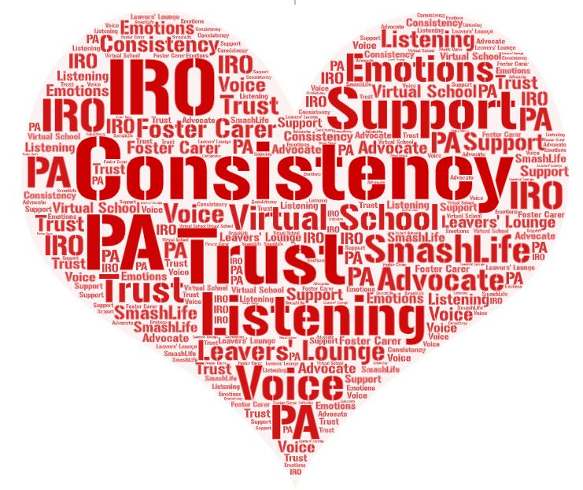
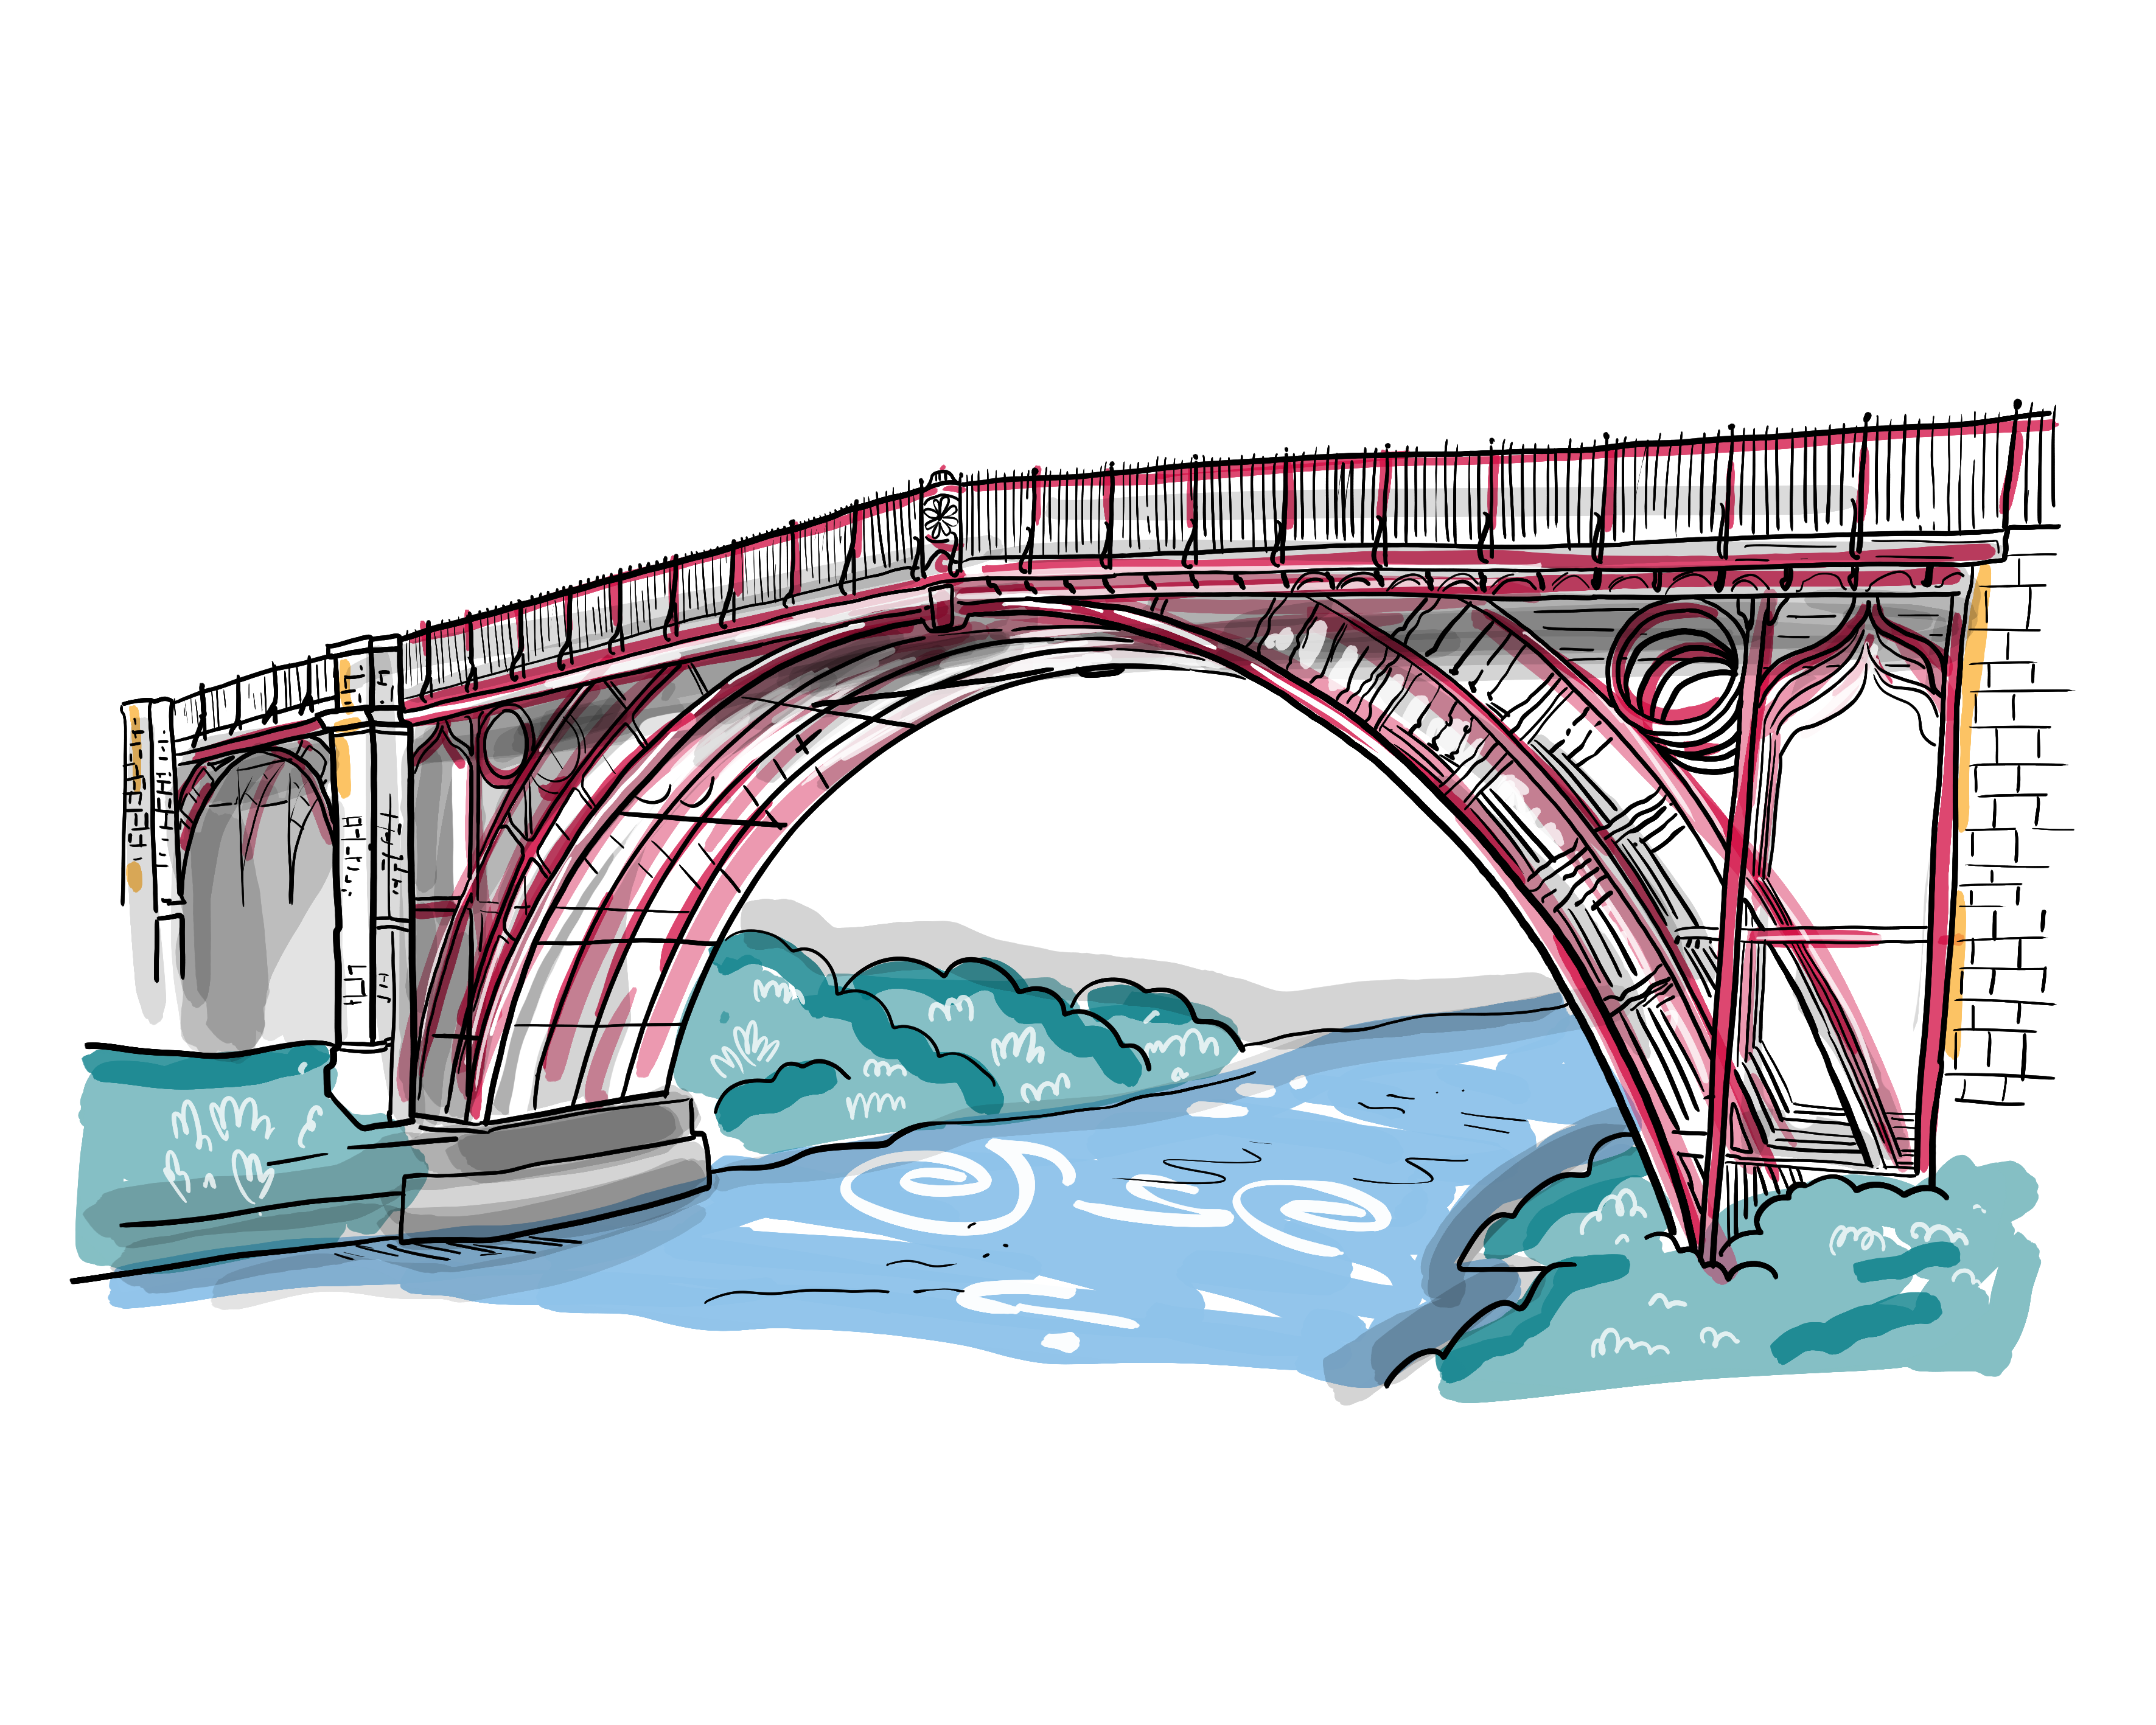
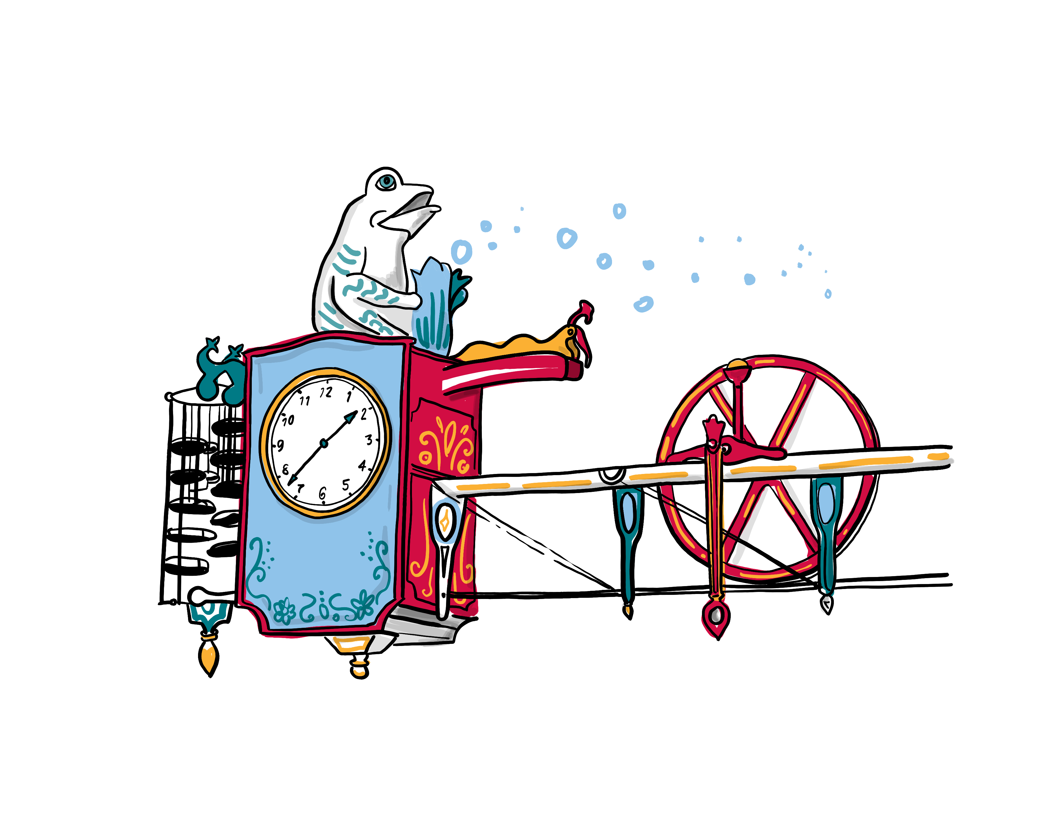
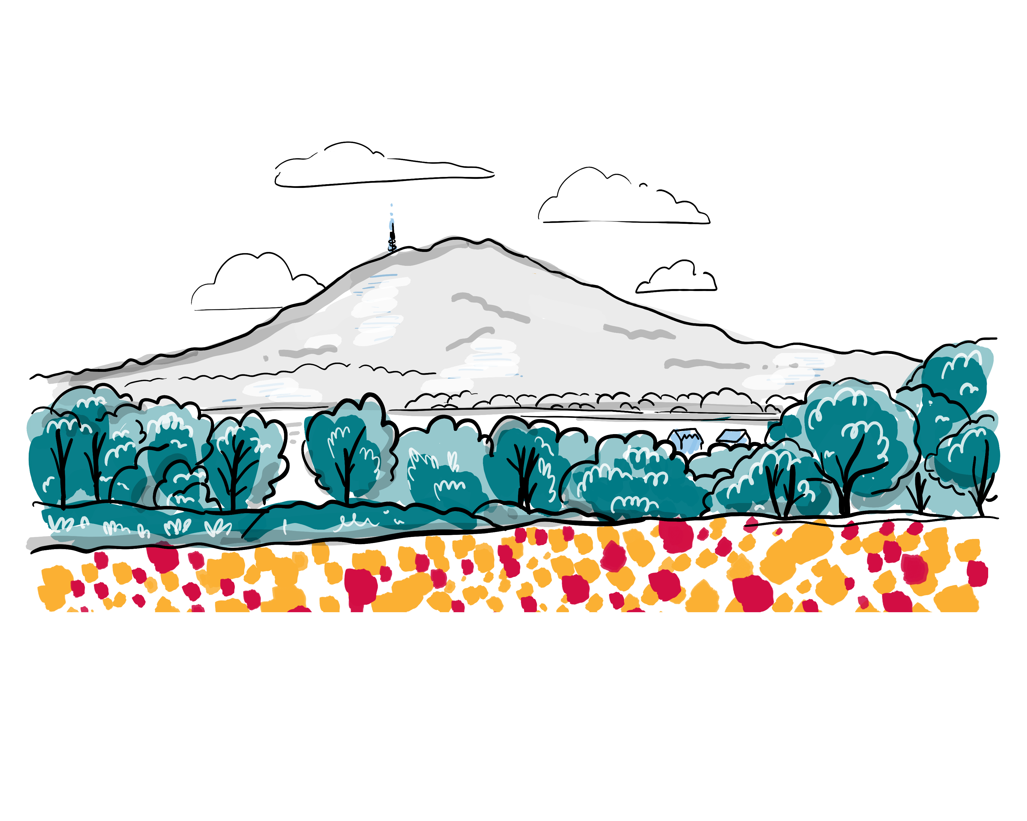
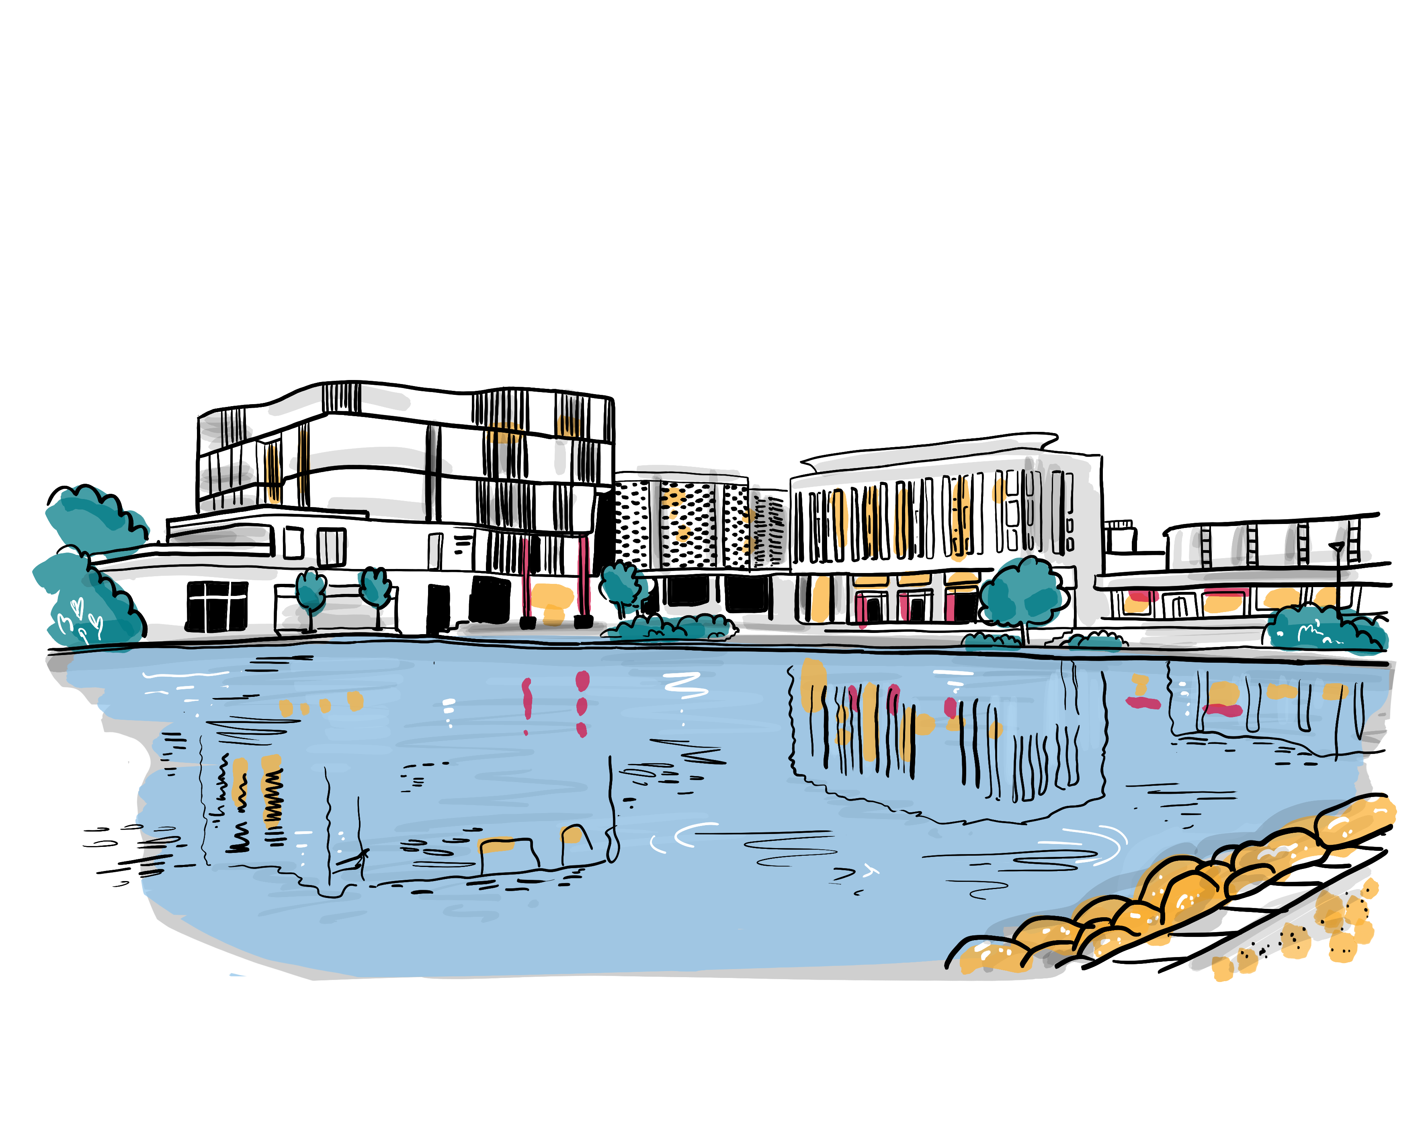
Corporate Parenting Young Persons’ Panel
3. Hearing Your Voice
14th March 2023
We Will
Make sure that you are routinely engaged, consulted and have a real say in your own lives;
Ensure that you are included in decision making;
Host regular participation activities and events through forums including VOICE and Leavers Come First;
Ensure that a participation offer is available, to enable you to develop networks and to provide opportunities to discuss worries and concerns with others with lived experience of being in care;
Ensure that you, our own children and young people, are represented and have direct input into our Corporate Parenting Strategic Group;
Include you in recruitment and selection panels for Senior Staff within children’s services;
Work closely with our virtual school team to support stability in your school placements when there is a care placement move. We will encourage you to be a part of this decision making.
What is Going Well?
Support for Care Leavers from PAs, there is a high level of trust and I am listened to;
We really appreciate the Leavers’ Lounge and the chance to talk to people;
SmashLife have always been there for me and helped me through a dark time;
The Virtual School has been a consistency and always listen;
The Virtual School came to visit me in school when I was having a wobble and supported me to manage my emotions;
My foster carers are great at listening to me and supporting my views;
I know who to go to if I need help;
The IRO has been the ‘narrator of my life’, I can talk to my IRO and I have had the same one for years;
Using my IRO as my voice when I don’t want to go to meeting myself;
My IRO has always visited me on my birthday and at Christmas;
My IRO took time to get to know me and listen to me;
When I told people I was in care, they supported me more;
The advocate helped me through a difficult time and used to visit me to check I was OK;
Being involved in interviews for people who support children; to ensure we have the chance to ask them questions about what they will do for us to make things better.
What Could be Even Better If …?
Fewer changes of Social Worker;
People properly listen rather than just tick a box;
People focus on what you can do rather than what you can’t;
Seeing IRO outside of school not just in school;
Feeling like I am able to attend meetings that are about me;
Not being taken out of lessons for meetings in school, it makes me feel different to other kids in school.
What Actions need to be added to the Action Plan?
Guide for children and young people to be published to include details of the different people who will support them; and what each of these people are able to support with;
This guide will explain the purpose of different meetings, why we have to hold these, the questions which will be asked and what will happen with the information shared at these meetings;
We will ensure that we ask young people where they would like meetings to be held and who they want to attend (IRO) and ensure that we listen to what you want;
We will ensure that you have a voice in any meetings about you, either directly by you attending the meeting or through an advocate where you don’t feel like you are able to attend.
What Messages Do You Want to Pass on to Other Young People?
Believe in yourself, but know there are people out there to help if you need help;
Ask for help if you need it, people won’t judge you if you ask for help.
To speak up and tell people working with you if we can do anything to make our services and support to you better
To engage in our young people’s forums and speak out to shape our services for ourselves and other children and young people
How we will know we have made
a difference:
Consultation activities will show input from a wide range of our children and young people;
More young people will engage in VOICE and Leavers Come First forums;
More young people will engage in participation events and activities;
Young peoples’ voices will be central at the Corporate Parenting Strategic Group;
Young people will be involved in recruitment and selection for senior roles;
More young people will be in stable education placements.
What are the Key Messages for The Corporate Parenting Strategic Group?
Please ensure that you listen to my views and help me to understand the meetings about me so that I can either attend or share my views in other ways, such as through an advocate.

