Slide 1
Specialist Child and Adolescent Mental Health Services in Luton – provided by ELFT
Dr Hilary Gahan, Associate Clinical Director
Linda Hurst, General Manager
Dr Marc van Roosmalen, Psychological Therapies Lead
All Luton CAMH Services, ELFT

Slide 2
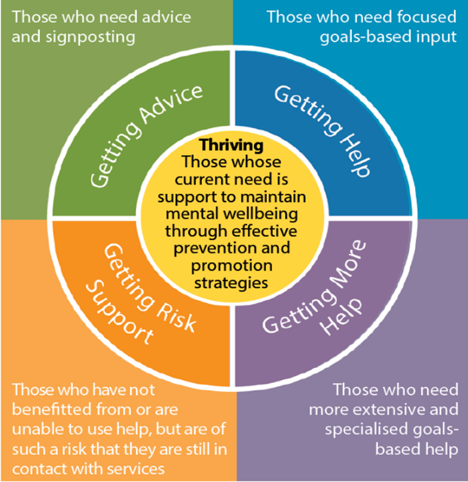
National iThrive CAMH Services model Needs-based service offer Episodes of care Integrated MH offer Common language EI+P – resilience based approach, including whole community resilience co-production

Slide 3
iThrive – Getting Advice
Primary/universal prevention – training, psycho-education, coffee mornings, drop-ins, assemblies, parents evenings, community engagement and co-production initiatives, …….
Secondary prevention – consultation in schools, GP practices, FPS, reflective practice/case discussion groups, training for particular groups/parents/children, signposting
GA not only based on individual, but on schools/communities resilience building
Notes:
Marc to discuss this quadrant

Slide 4
Getting Advice locally
Community Voluntary Sector
Single Point of Entry SPOE – self referral
Clinician of the Day
Integrated Schools Offer:
Mental Health Support Team (MHST)
Schools Mental Health Team (SMHT)
CSLT
Primary Care Access Service (PCAS)
CHUMS Family Wellbeing Team
Early Help/FPS
Notes:
All to discuss?

Slide 5
Getting Advice locally
Digital Offer
Local Offer/ CHUMS / Lumi Nova / Chat Health / Kooth / Alumina / Apps
CAMHS Integrated Schools Offer and PCAS
Alumina – CBT DSH course
Self Help – resource packs
Social Prescribing- Active Luton
Co-produced training offer – Gender Identity / Parent Psycho Education
Discovery College (DiSCO)
Notes:
All to discuss?

Slide 6
iThrive: Getting Help
Children, young people and families who need specific interventions relating to their mental health need. This group includes those who would benefit from evidence-based help and support with clear aims and agreed criteria for assessing if these aims have been achieved.
Mild to moderate mental health problems that require a brief episode of support
Depending on the needs of the young person, this therapeutic support can be offered by different agencies.

Slide 7
Getting Help Locally: CAMH Access Services
Two Mental Health in Schools Teams
One Camhs Schools Liaison Team
A third MHST coming on stream in September 2023
A Primary Care Access Team working in GP practices
Provide early intervention for mild to moderate mental health and emotional wellbeing issues
Supporting staff within a school or college or GP setting to provide a ‘whole school/primary care approach’ to mental health and wellbeing
Act as a link with local children and young people’s mental health services
Focussed in area’s of deprivation, where children’s emotional wellbeing is impacting on there opportunities to learn and achieve- reducing inequalities
Integrating with existing mental health schools provision to provide a comprehensive offer

Slide 8
iThrive: Getting More Help
Children, young people and families who need more extensive and specialised interventions and support relating to their mental health needs.
These children and families often require multi-disciplinary support, which may be medium term in length and moderate to severe in the severity of their difficulties.
This group includes those who would benefit from evidence-based help and support with clear aims and agreed criteria for assessing whether these aims have been achieved.
The input from CAMHS might be more extensive with specialist treatment, including inpatient admissions if required.

Slide 9
Getting More Help Locally
2 Emotional and Behavioural teams (moderate to severe MH)
Adolescent Mental Health team (severe mental health issues for young people where risk a strong feature)
Neuro-Developmental Team
County wide Eating Disorders Team
County Wide Children Looked After Team (now also covering Luton)

Slide 10
iTHrive: Getting Risk Support
Children, young people and families who have not benefitted from or are unable to use help, but are of such a risk that they still need contact with services. The group includes those who have already been offered extensive input with limited therapeutic progress.
The input from CAMHS will be risk management, crisis response and supporting the network
Clear crisis pathways into CAMHS, including A+E presentations, calling 111 and self-referrals
Crisis huddles in partnership with system
Diversion from A&E
Rapid escalation into services
Community / creative engagement

Slide 11
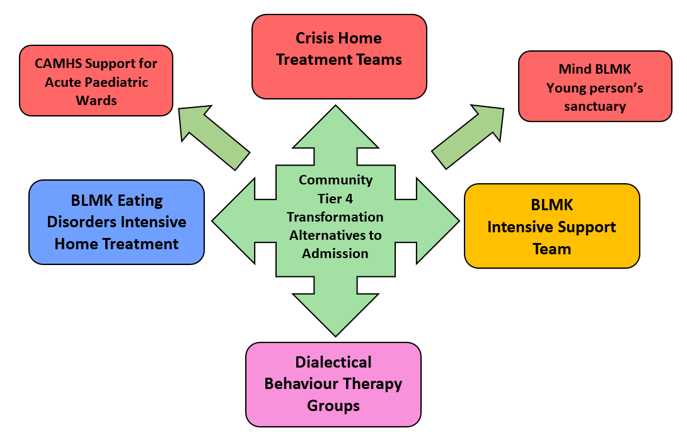
Tier 4 Offer

Slide 12
Quality Improvement (QI) lens Improving mental health equalities in the south neighbourhood – a quality improvement programme through MHST
What is a triple aim project:
- improve patient/family/client experience
- improve population health
- improve value for money
Understand the needs and assets of children, young people and their families in the community
Three part data review:
- review available data
- engagement with teams/services/agencies providing care
- service user and citizen views/engagement with
- understand their views and perspectives

Slide 13
Why QI?
Significant increase in demand, complexity and acuity of need, is not tailing off following pandemic.
Cannot only respond by doing more of the same – an overwhelmed system – NHS, nationally
Working preventatively – at primary and secondary levels – in the community – strengthen and empower communities, not just to be the subject of interventions/support
To embed a relational and resilience based model in the communities of Luton, that is trauma-informed - will destigmatise and normalise mental well-being
Take into account the social determinants of mental health

Slide 14
How to strengthen resilience..
Strengthen social relationships and community connections for CYP and families
Enable and build social capital, social networks and social support within and between communities
Strengthen and/or repair relationships between communities and health and social care agencies, eg enhancing community control by co-production
Improve the quality of the social relationships of care between CYP and families and professionals
(Friedli and Carlin, 2009, substantiated by subsequent longitudinal studies)

Slide 15
Aims of QI project:
Co-producing the focus and delivery for MHST W5 with the community
An asset based and resilience focused approach
Empowering communities, increasing social capital
A relational, resilience and social model of mental health
Integrated early intervention and prevention through community venues – family hubs?
A collaborative of meeting mental health, including the social determinants of mental health

Slide 16
Co Production Strategy
Integral to everything we do
Dedicated team of experts by experience – young people / parents
Service Development
Chameleon Newsletter
Parent / Carer groups
Recruitment
Training
Film / promotions / Breaking the Stigma / podcasts
Better Days Campaign

Slide 17
Transition Strategy
Clear Process to review cases
Embedded Transition Support Workers – enhance experience
Trust Strategic Lead appointed
Local transition audits with adult partners
Refreshed Transition Policy and shared across LAs
Local Transformation workshops – series on ongoing events

Slide 18
Service Challenges
Demand
Mapping demand across the system
Pressure on partner agencies
External expectations
Increasing access – BLMK Deep Dive recommendations
Recruitment
Non recurrent funding

Slide 19
Service Achievements
Expansion of MHST
An integrated approach – Multi-agency CAMH integration
A SEND Lead – priority area
Workforce development, greater skills mix, clinical leadership and project management
Co-production / People participation
Community Resilience Model
Expansion of Discovery College
County Wide Children Looked After Team expanding to cover Luton
Dialectic Behavioural Therapy (DBT)
Tier 4 Offer
SPOE mapping demand – workshops
QI projects

Slide 20
Next steps for CAMHS
Triple Aims QI Stakeholder event – 9 March at Hampton Hilton – 9.30 -14.00hrs
Continued partnership opportunities with LBC
Child Friendly Town Ambition / Better Days Campaign/ Residential Provision
Opening of Evergreen
Widening PP audience to capture voice of all
NDD pathway development across BLMK
SPOE Workshops – mapping demand

Slide 21
Thank you for listening,
happy to take any questions?

