Slide 1
Bedfordshire and Luton CAMHS
Admission Avoidance

Slide 2
System Partnership to improving urgent cases flow:
Daily huddles with local CAMHS teams and local acute wards – strong relationships
CAMHS Practitioners embedded on wards
Emphasis on admission avoidance / creative community packages of care where clinically appropriate / safe.
Positive risk taking
Rapid same day response for assessment by CAMHS crisis staff
Diversion from A&E depts. for urgent cases – ie: GP / school / Home
Twice weekly crisis huddles with system partners (inc. LA / EoE Collaborative and acute leads)
Clinical oversight of urgent cases within the system
Partnership approach with LA’s – clear escalation process in place
Development / need for local social care placement provisions – ie: LBC
Strong links with adult colleagues

Slide 3
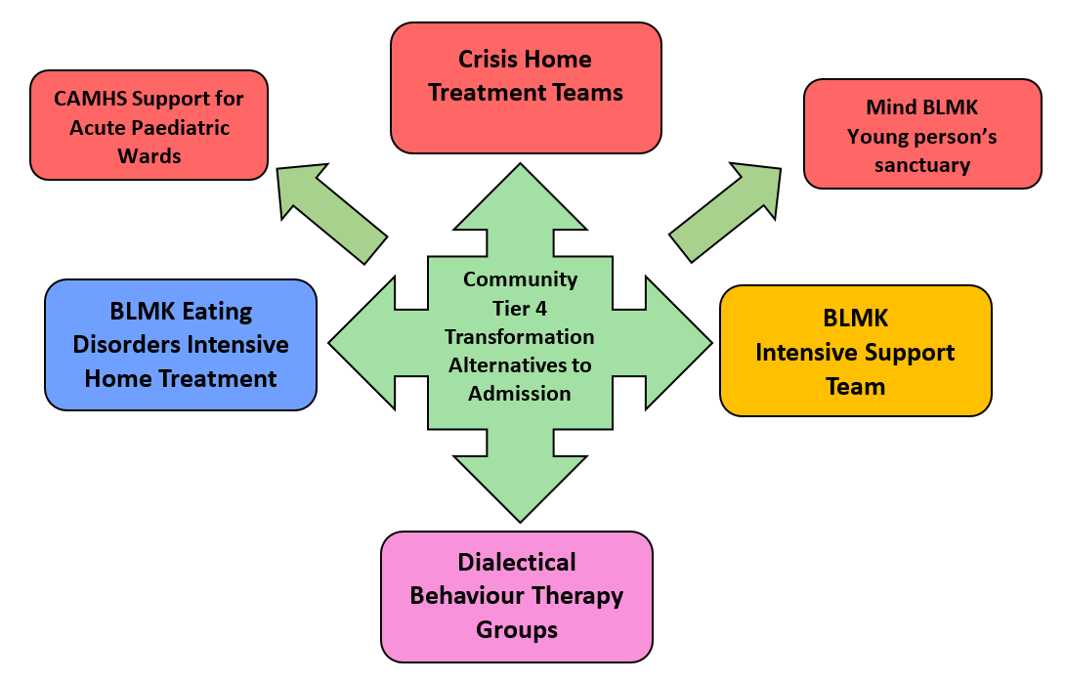

Slide 4
BLMK Eating Disorders Intensive Home Treatment Team
“To provide therapeutic support to young people and their families, in their homes to enable them to manage the illness to stay out of hospital or return home earlier than would otherwise be possible.”
Referral criteria:
Young people who are under the age of 18 and being treated by CEDS
been medically stabilised on the acute wards and now ready for discharge back into the community with support.
Who are at risk of needing a specialist inpatient admission (Tier 4).
Facilitate safe discharge from Tier 4 units
Staffing
1x Lead Nurse (seconded from CEDS)
3 x Nurses (2 in post, 1 vacancy)
6 x Support Workers (4 in post, 2 going through recruitment)
8am-8pm M-F + weekend calls at present, when fully staffed will be 8am-8pm 7 days a week
Intensive support for meals, snacks and post meal distraction:
On the ward
In clinic or in home
Face to face or remote
Positive meal support modelled to parents
Empowering parents to make appropriate decisions
Positive behavioural support
Engagement with FT-AN
Basic CBT
Tier 4: liaison, home leave support, discharge planning
Bespoke care plan for each family:
CEDS clinicians continue input
HITT support reviewed every 2 weeks (for up to 6 weeks).
This model supports the FT-AN (Family Therapy for Anorexia Nervosa) approach which is a NICE concordant treatment for eating disorders.

Slide 5
North and South Bedfordshire Crisis Home Treatment Teams
“To provide therapeutic support to young people and their families, in their homes to enable them to manage the illness to stay out of hospital or return home earlier than would otherwise be possible.”
Aims of the service
Provide an alternative and reduce admissions to Tier 4 CAMHS provision (mental health inpatient units).
Reduce the length of stay for young people that are in Tier 4 CAMHS Provision
Reduce the number of young people with mental health needs being admitted on to local acute hospital paediatric or adult wards where there is no indication for medical treatment.
The service will operate between 9am and 9pm Monday to Friday and 10am to 8pm weekends and bank holidays.
Staffing
Professional Lead
Psychiatry
Mental Health Nurses/Social Workers
Support Workers
Senior Social Worker
Psychologist
Systemic Practitioner
Administrator
Recruitment is underway across BLMK and the teams are starting to develop with new starters working closely with the current crisis teams.
Intensive Home Treatment Support as an alternative to inpatient admission:
Up to 3 direct appointments a day which may include a blended approach of face to face, telephone, virtual or text support.
Home Treatment support offered for up to a maximum of 8 weeks
Young people will be discussed on daily basis in crisis huddle and offered a review from psychiatrist on weekly basis.
Aim of intervention is to stabilise Crisis, improve understanding of current crisis, restore coping for young person and family and reduce the assessed associated risks of harm to self or others, provide short term treatment for presenting mental health needs.

Slide 6
BLMK Intensive Support Team
Staffing
Professional Lead
Mental Health Nurses
Social Workers
Support Workers
Recruitment is underway across BLMK and the team has started to take young people onto their caseload.
The Professional Lead will work across BLMK and will have responsibility for each of the four clusters aligned to the local authorities.
Intensive Support Team will be working across Bedford, Luton and Milton Keynes providing support for with children and young people (CYP) with Learning Disabilities (LD) and Autism Spectrum Disorder (ASD) at risk of admission to more complex inpatient treatment (Tier 4) provision and/or becoming a Looked After Child.
IST model will require a ‘Spend to Save’ approach.
Spend to Save is based on the principle that investing in appropriate interventions and packages of care will significantly result in contributing and maintaining a robust and holistic infrastructure to support C&YP and will help to avoid and avert C&YP further falling into crisis.
The service will operate Monday to Friday 9am to 5pm.

Slide 7
Dialectical Behaviour Therapy (DBT) Groups
DBT is a type of talking therapy that helps young people who may self-harm, have difficulty regulating their emotions effectively and struggle to tolerate distress. It is a structured treatment plan that involves you attending individual weekly therapy & weekly group skills training. This pathway will be closely aligned with our Crisis Home Treatment Teams.
North and South Bedfordshire
Both services are coming to the end of groups that have run in 2021 and 2022 for different lengths of time.
Working is being done to develop a rolling programme of DBT groups for young people and parents, offering weekly DBT skills group, weekly 1to1 sessions and telephone support.
Aim to have two separate teams across North and South Beds CAMHS, with a standalone cohort of staff who have time built into their job plans to undertake DBT work.
Milton Keynes
Service has been up and running for a number of years.
Offer 9 month DBT programme including
Weekly DBT skills group
Weekly 1to1 DBT sessions
Telephone support from DBT clinicians

Slide 8
Mind BLMK
Young Person’s Sanctuary
CAMHS Support for Acute Paediatric Wards
“To provide therapeutic support to young people and their families, in their homes to enable them to manage the illness to stay out of hospital or return home earlier than would otherwise be possible.”
Aims of the service
The Bedfordshire and Luton mental health crisis provision will support people in crisis to better self-manage their symptoms and distress in a safe and appropriate environment, in order to reduce activity in Emergency Departments and the wider system including mental health services, police and ambulance services.
Aims of the service
The aim is to improve the experience and outcome of the young people within the wards and ease pressure on the staffing needs.
Having continuity of care will increase patient experience and reduce the reliance on agency and bank staffing. It will also help increase staff awareness of emotional health needs and increase staff confidence when managing such cases.
The support will consist of:
identifying coping strategies and improving wellbeing
information and signposting
1-1 conversations, group/ peer conversations
Referral for a mental health assessment when appropriate
To supplement the current staffing resources for Bedfordshire Hospital’s paediatric departments at both in Luton & Dunstable Hospital and Bedford General Hospital.
The additional resource will enable Bedfordshire Hospitals to recruit fixed term staff to support existing skill mix within the wards with a focus on improving care to young people presenting with emotional health needs.
The services will open from 1600 - 2200, open Monday-Friday.
In accessible venue across Bedford, Central Bedfordshire and Luton.

