Slide 1
BLMK CAMHS IST

Slide 2
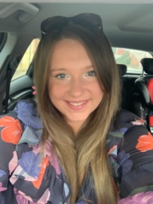
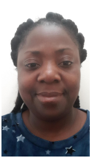
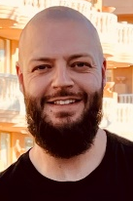
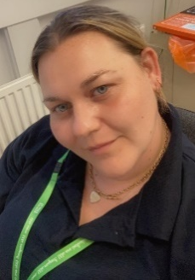
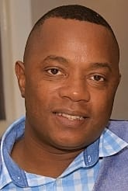
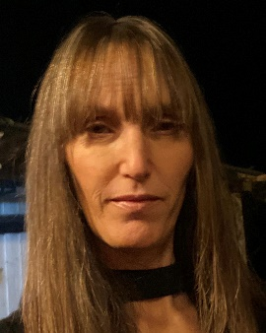
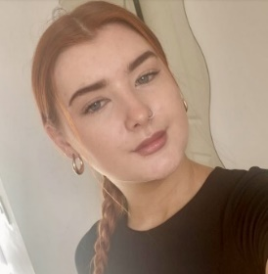
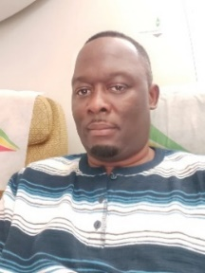
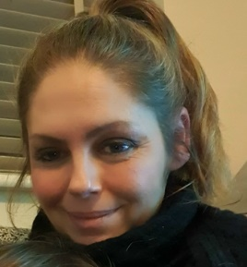
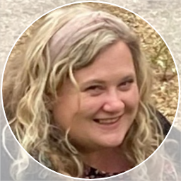
Meet The Team
Chelsea Laing – Operational Lead
Claire Evans –
Senior Creative Therapist
Naisha Parkin – Senior Social Worker
Angelina Osei Tutu (RNLD), Corey Birdsall (RMN), Vickie Prince (RMN), Denford Nyambawaro (RNLD) and Sarah Monk (RNLD) –
Senior Nurses
1 x Band 7 vacancy
Maisie Von Tersch, Evans Nyoni, Deborah Duval and Alexandra Heginbottom – Senior Support Workers

Slide 3
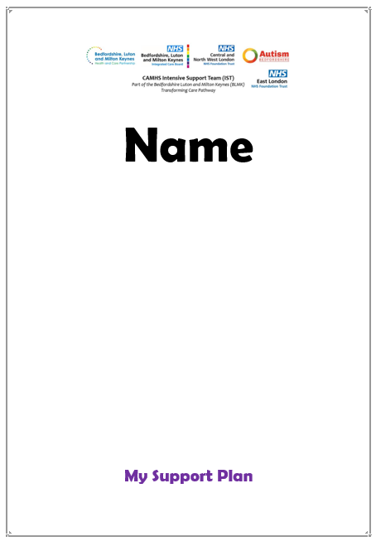
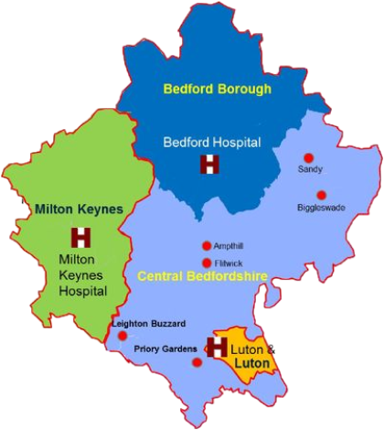
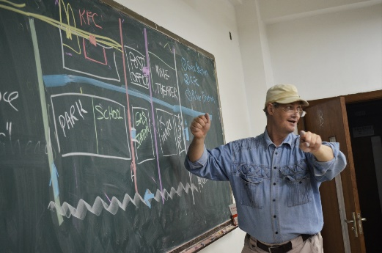
What do IST do?
Short term, intensive home treatment (usually 6-8 weeks), for young people with a diagnosis of Autism and or Learning Disabilities at imminent risk of Tier 4 admission or family breakdown.
Co-ordinating visit matrixes and support plans
Developing and implementing PBS/Behaviour Support Plans, Hospital Passports, Communication Passports, Safety Plans
Home/community visits across the whole of BLMK
Attend meetings – DSR, LAEP, Core Group Meetings, Child Protection Meetings, CPA meetings, professionals meetings, team meetings, planning meetings
Delivering CPD for other CAMHS Teams

Slide 4
IST Update
From April – end of September 2023 (Q1 &2 Q2)
Current open cases (as of 1st Oct 2023) | No of CYP
Bedford Borough | 0
Central Bedfordshire | 7
Luton | 0
Milton Keynes | 4
Out of Area | 0
Young People Discharged from IST | Number discharged
CAMHS/CAMHS + Keyworker | 26
CMHT (adults) | 1
Keyworkers only | 2
YP admitted to Tier 4 | 4 3 have since been discharged, one remains on an out of area ward
Out of area LAC moved back out of area | 2

Slide 5
Weekend Working
Not always a need for weekend support. E.g. if someone has had a LAEP meeting in the week they may need urgent support at the weekend. However, if there CYP IST are supporting are having a “settled” week there is not always the need for weekend support.
Additional ASD/LD specialist support at weekends (CAMHS Crisis/LIST offer varies across BLMK and is generic crisis support)
Continuity of care. CYP with ASD/LD feeling safe with clinicians they know well, and who know them well
IST staff having the option to work this as ad-hoc bank (if additional funding sourced) or swapping for a weekday shift.

Slide 6
Case Study
Weekend Support
X is a 15-year-old girl with a diagnosis of Moderate LD and Autistic Traits. Due to an increase in behaviours that her parents found “challenging”, she was brought to A&E on multiple occasions. Her parents didn’t feel able to take her home, and social care didn’t feel she needed to go into care. X spent several weeks on a paediatric (physical health) ward whilst decisions were made about her discharge pathway. During this time X became increasingly agitated and aggressive due to the environment (noisy, busy and overstimulating). X was subsequently detained under Section 2 of the Mental Health Act 1983.
The clinical opinion of IST was that if X had been in an appropriate environment, X would not require detention under the Mental Health Act. The provider collaborative who arrange Tier 4 beds agreed. X’s dietary intake and physical health also significantly deteriorated to the point where most days she had no food intake and minimal fluid intake. X was temporarily moved to an Adult Mental Health Ward, as the paediatric bed was needed for physically unwell children. An external agency who IST work regularly with were put in place to support X on the ward.
With the support and perseverance of IST, in collaboration with NDT, the ward and carers; we were able to work with social care, for X to be discharged into a placement with the carers. Having weekend working in place meant IST were able to support the transition daily with specialist care on the ward and into the placement. This has included using a flexible approach to build therapeutic relationships with X, using visual prompts, and offering support and training for the home staff. X is now increasing her hours at school, attending sensory sessions at the CAMHS clinic, engaging positively with home staff; including dancing and cooking. X’s dietary intake has also significantly improved, and she is starting to eat a variety of solid foods. She is also rebuilding positive relationships with her Mum and Dad.

Slide 7
IST Feedback
“Just wanted to say how great IST have been with X! Evans and Denford have made a really good relationship with him! He asks about them most days!” Evergreen Ward Manager
“_____ and I want to thank you for all the hard work that you and your team have put in to support _____ and us as a family. It really did make a huge positive difference to our lives.” Parent
“Working with Claire has been absolutely amazing – I’ve really enjoyed every session. She’s always helped me with whatever I need and has always provided a safe space where I can express myself creatively with the huge range of art materials she has. Being with Claire has definitely made a difference in my life. The Art sessions have made me feel happier and given me something to look forward to and Claire has always been kind and caring and always listens to me. I appreciate the sessions I’ve had with her and that she always goes out of her way to help me.” Parent
From a parent regarding LDA award- The article really emulates what you guys do in often, let’s face it, emotionally charged situations! We are forever great full for the kindness you’ve shown us as a family 😊 Congratulations on your award, you’ve definitely earned it.
Everyone who has had contact with K and us as a family have all been amazing. However, the time, energy, compassion and care that has been demonstrated by Claire and Sarah over the course of the last 3 months has been something I am hugely grateful of. They have paid great attention to K's (and the family at times) needs, enabling them to tailor sessions in a way that has allowed K to fully engage and feel positive and learn from. I am hopeful that what K has gained from her 3 months with IST will continue to support her recovery longterm. Parent

Slide 8
Moving forward…
Identified gaps –
The need for a specialist short term placement facility for young people with ASD and/LD, where parents feel unable to keep them safe at home but would not benefit from a Tier 4 admission. This could be a short-term placement with the view of IST and Autism Bedfordshire support re-integration into the family home, reducing lengthy stays on paediatric wards, Tier 4 admissions, and care placements.
Difference in CAMHS offer across BLMK – for example no Neurodevelopmental Team in Milton Keynes.
Specialist ASD/LD support for CYP increasing in risk but not imminent risk of admission.

Slide 9
Moving forward…
Consideration for extension of extended hours to match CAMHS Crisis hours
Consideration of additional pathway for brief crisis support for CYP with ASD/LD
Delivering training for core crisis teams
Crisis Team led joint assessments
Consideration for extension to support 18-25’s
If not risk of Tier 4 – IST to give advice and signpost to alternative support e.g. NDT, AMHT, core crisis
If risk of Tier 4 (not imminent) –
Add to DSR as Green/Amber
If IST have capacity – IST to offer 2-4 weeks support for further assessment, safety planning and signposting
If imminent risk of Tier 4 –
Add to DSR as RED
IST to complete initial assessment and develop plan of support (usually for 6-12 weeks).
(Current IST OFFER)
1 x Band 7 to go out to advert for OT!

