Slide 1


SEND and EHCP Practice for Health Professionals
Helen Watson - Designated Clinical Officer Luton/ CBC

Slide 2
Training Content
Background and relevant legislation
SEND Review Green Paper
What is a Special Educational Need (SEN)
The graduated approach
EHC Plan processes and timescales
Tribunals and the National Trial
What is and isn't included in an EHC Plan
Your contribution to the EHC Plan
Writing outcome focused advice
What does a good EHC Plan look like
Discussion
Session feedback

Slide 3
Facts and Figures – SEND data for 22/23
1.5 million children and young people in England have SEND
Nearly 1 in 6 children/young people
In classroom of 30, approx. 5 children/young people
Increase of 87,000 from 2022
4.3% children and young people have EHCPs
13% children/young people on SEND support without EHC Plans
(Special Educational Needs in England statistics June 2023)

Slide 4
Relevant Legislation and Guidance
The Children and Family Act 2014
and
SEND Code 2015
Improving outcomes for CYP with SEND AGED 0 - 25
The Children Act 1989: gives every child the right to protection from abuse and exploitation and the right to have inquiries made to safeguard their welfare.
Equality Act 2010: An Act that provides a legal framework to protect the rights of individuals and advance equality of opportunity for all.
Mental Capacity Act 2005: aims to protect people who lack capacity, and maximise their ability to make decisions or participate in decision-making
The Care Act 2014: aims to ensure the wellbeing of people in need of care and support services.
The Chronically sick and Disabled Persons Act 1970: requires local authorities to provide welfare services to chronically sick and disabled persons
The Health and Social Care Acts 2012: is the most extensive reform of the NHS and "puts clinicians at the centre of commissioning, and empowers patients
The NHS Mandate: is an agreement between the government and the NHS Commissioning Board on what the NHS duties are

Slide 5
Human Rights Act
It can be hard for families to make sure that their child’s legal right to an education that meets their needs is something that exists not just in principle but in practice
https://www.bihr.org.uk/blog/why-the-human-rights-act-matters-for-children-and-young-people-with-special-educational-needs
A child with SEND meets the definition of a disabled person under the Equality Act 2010, and should therefore be protected against discriminatory decisions. The result of a test case for all children and young people with SEND is that there is no longer a gap in legal protection: schools are no longer allowed to exclude a pupil who has unmet needs or for whom reasonable adjustments have not been made.

Slide 6
SEND Review The Government’s Green paper – SEND and Alternative Provision Review – Right Support, Right Place, Right time was published in March 2022 following a two year delay.
The paper is a joint publication from the Secretaries of State for Health and Education
The review is highly critical of the current system and the negative experiences children and young people face within the SEND System.
The review has identified 3 key challenges facing the SEND and alternative provision system.
• Navigating the SEND system and alternative provision is not a positive experience for too many children, young people and their families.
• Outcomes for children and young people with SEND or in alternative provision are consistently worse than their peers across every measure.
• Despite the continuing and unprecedented investment, the system is not financially sustainable.
The SEND review will deliver the changes through 5 key areas which health are an integral partner in:
• A single national SEND and alternative provision system-
• Excellent provision from early years to adulthood
• A reformed and integrated role for alternative provision
• System roles, accountabilities and funding reform
• Delivering change for children and families.

Slide 7
SEND Code of Practice 0-25 Years
details of legal requirements that you must follow without exception
statutory guidance that you must follow by law unless there’s a good reason not to
It explains the duties of local authorities, health bodies, schools and colleges to provide for those with special educational needs under part 3 of the Children and Families Act 2014.
Chapter 9 and 10 for EHCPs and children in special circumstances

Slide 8
What is a Special Educational Need (SEN)?
A child or young person has a SEN if they have a learning difficulty or disability which calls for special educational provision to be made for him or her.
A child of compulsory school age or a young person has a learning difficulty or disability if he or she:
has a significantly greater difficulty in learning than the majority of others of the same age, or
has a disability which prevents or hinders him or her from making use of facilities of a kind generally provided for others of the same age in mainstream schools or mainstream post -16 institutions. (Code Of Practice, 2015)

Slide 9
What is a Special Educational Need (SEN)?
A child or young person could have a range of different needs at different stages in their life.
Social, emotional and mental health difficulties
Sensory and/or physical needs
Communication and interaction
Cognition and learning
They may have difficulties in a particular category or it extend to multiple categories.
They may have mild or major needs in these categories.

Slide 10
Meeting Special Educational Needs
Graduated Response – SEN Support
Most children and young people with SEN will have their needs met at their mainstream nursery, school or college through a process of SEN support using the delegated resources available to settings.
This includes timely referrals to services , and signposting to support .
Assess
Plan
Do
Review

Slide 11
Meeting Special Educational Needs
Graduated Response – EHCP
A small number of children will require support beyond that available through the resources available to settings.
Who can request an assessment for an EHC Plan?
A child’s parent
A young person over the age of 16 but under the age of 25
A person acting on behalf of a school, early years setting or post-16 institution
You can bring a child or young person who has (or may have) SEN to the attention of the Local Authority

Slide 12
Know your Local Offer
Look up your Local Offer
It’s your first go to for support for CYP with SEND – what is on there for them , and is your service included ?
Every local authority must talk with children and young people with special educational needs or disabilities and their families to find out what sort of support and services they need. The Local Offer must be developed and reviewed in partnership with children and young people, parents and local services.
It includes:
Education – Support in early years, schools and colleges, including transport
Health – Specialist clinics, support and advice for children and young people with medical needs
Social care – Support for personal care and practical assistance, short breaks and personal budgets
Transitions – Moving between phases of education and preparing for adulthood
Education, Health and Care Plans (EHCPs) – The statutory EHCP process explained, including applying for a plan, transfers and reviews
Every local authority must get feedback on its Local Offer from young people and their families. They must show what feedback they have been given and say how they are going to make improvements to the Local Offer and services.

Slide 13
EHCP Statutory timeline
Once a request for an EHCP is received the Local Authority have a statutory duty to complete the EHC process within 20 weeks.
Week 1
Week 2
Week 3
Week 4
Week 5
Week 6
Week 7
Week 8
Week 9
Week 10
Week 11
Week 12
Week 13
Week 14
Week 15
Week 16
Week 17
Week 18
Week 19
Week 20

Slide 14
What can be appealed?
A decision by the LA not to carry out an assessment or re assessment of Education, Health and Care needs
A decision by the LA not to amend an EHC plan
A decision by the LA to cease an EHC plan
Section B: The child or young person’s SEN needs
Section F: The special educational provision required by the child or the young person
Section I: Placement

Slide 15
What is this?
The Government are extending the powers of the First-tier Tribunal (SEND), sometimes referred to as the ‘SEND Tribunal’, to make non-binding recommendations about the health and social care aspects of Education, Health and Care (EHC) plans. Originally a two-year trial that applied to decisions made or EHC plans issued/amended from 3 April 2018. This has now been extended and appeals are now Known as Extended Appeals.
Why?
Provides a single route of redress for families
Promote collaborative working and coordinated approach
Improve outcomes for children, young people and families
Non-binding recommendations – health and social care since 3rd April 2018
Context by the end of August 2021 there were 3524 applications under the National Trial, 2717 –child, 812 young person.
In excess of 75% families are successful across the various areas of challenge

Slide 16
Non-binding recommendations – health and social care since 3rd April 2018
What this means for health and social care?
It places responsibility on health and social care to:
Attend the hearing if required
Provide information and assessments required by the tribunal
Following a decision, respond to the family and the LA within 5 weeks setting out the steps they have decided to take or why they are not going to follow the recommendation
You may get asked for input – your DCOs can support so get in touch if you need to .

Slide 17
Health Top Issues Include:
CAMHS Assessment Cognitive Behaviour Therapy
OT assessment sensory needs
Nursing support diabetes or tracheostomy care
Physiotherapy sessions for health needs not educational provision
Toileting & personal hygiene

Slide 18
EHC Sections
Section A The views, interests and aspirations of the child and their parents, or of the young person
Section B The child or young person’s SEN
Section C The child or young person’s health needs which relate to their SEN
Section D The child or young person’s social care needs which relate to their SEN
Section E The outcomes sought for the child or young person
Section F The special educational provision required by the child or the young person
Section G Health provision
Section H1 Social Care provision (resulting from CSDPA)
Section H2 Social Care provision
Section I Placement
Section J Personal Budget
Section K Advice and Information

Slide 19
Developing a high quality EHC Plan
The golden thread
Aspirations
Needs Led
Outcome Focused
Provisions - specified & quantified

Slide 20

Promoting the voice of the child or young person
Listening and Hearing
Participation and involvement
Flexibility
Provide opportunities for preparation
Promotes values
Use feedback to make improvements
Consent and confidentiality
Focus on:
The ‘GOLDEN THREAD’ linking aspirations, needs and provision.
How does the child/ YP manage at school?
If the child is non-verbal what are their likes and dislikes?
Notes:
Not time to give too much theoretical underpinnings, but a few words to describe what we mean by pupil voice
At least two elements:
CLICK
Listening and hearing pupils’ voice in order to understand, better understand that young person’s perspective
CLICK
Participation – this is about involving and empowering CYP in the decision making process
So listening and empowering
Pupil voice can be thought of as rights based but its also likely to lead to better outcomes and change because seeing the world through the eyes of the young person leads to more effective support
In addition, as the young person is empowered, this supports the change process and their sense of having control over their life.
CLICK
The new code of practice talks about pupil voice at an individual, community & strategic level
CLICK
It’s linked to the values of inclusion, it’s outcome focused and it’s strengths based.
CLICK
More important that any person centred planning tools, are the way in which we work when we are being person centred. Again, only time to highlight a few examples.
These include issues of consent and confidentiality. For example, Does the young person know what information is shared and with whom? Are they happy with what information is shared?
Are we being flexible?
Have we prepared the young person to develop their decision making skills? Are we giving them opportunities to practice?
Are we feeding back to young people how we’ve acted on their views?
Alongside these considerations,
CLICK
There are also a number of ‘tools’ to promote pupil voice.
In this presentation, I’m going to highlight two areas of current practice and think about how we can make these as person centred as possible. I’m also going to share one approach for more radical step.
So two ‘easy wins’ and one more ambitious idea

Slide 21
Describing Health Needs
If the family have not had involvement from your health team, confirm from the information received whether there is a need for further assessment or support from your health area and explain your decision .
Do not respond “not known to service” as this may appear in the Plan and is not informative...
Avoid too much historical or complex medical information
Keep it simple as possible – make sure it can be understood by a non-specialist
A diagnostic label does not describe need – focus on practical implications of any health conditions or impairments on different areas of the child or young person’s life including their education.
How do health needs relate to the child/ young persons SEN?

Slide 22
Outcomes
Child or young person centred and ‘not expressed from a service perspective’
Outcomes are not a description of the service being provided
Outcomes are the benefit or difference made to a child or young person as a result of an intervention.
From 14 years onwards must include Preparing for Adulthood outcomes, however this should also be a focus in EHC Plans from the earliest years.
Must specify what needs to be achieved by end of a phase or stage
Must be specific, measurable, achievable, realistic and time bound (SMART).

Slide 23
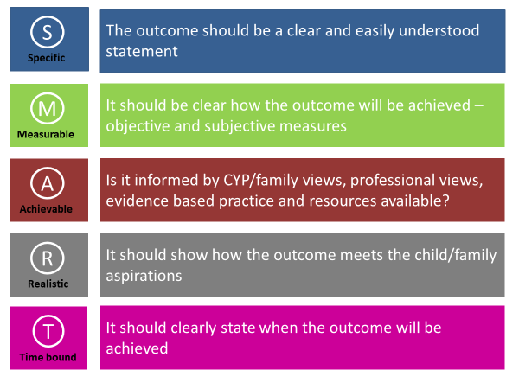

Slide 24
Example Outcome
By the end of KS4, Edina (14 years old) will be able to move around her community safely.
She will:
Walk independently to and from the bus stop, school and local club.
Explain what she will do if she gets lost.
Reliably recognise key symbols and words that are part of her everyday environment.

Slide 25
Co-Produced Outcomes
how we define ‘outcomes’ in relation to children/YP with SEND
how we can support children/ YP in thinking about what they want to achieve
how we can work collaboratively with children/YP and parents to meet such outcomes.
this must be part of a personalised discussion/process; not ‘done to’ but produced collaboratively.

Slide 26
Provision
Health Provision should meet the Health Needs identified in Section C and clearly show how it will support the Outcomes sought in Section E (including those secured through Personal (Health) Budgets). Provision that ‘educates or trains’ must be in Section F,
Provisions should be detailed, specific and quantified –
What?
Who is going to do it, what skills or training they need?
How often?
When will it be reviewed?

Slide 27
Example Provision:
Bharat (10 years old) will:
Attend appointments at the hospital every eight weeks where his condition will be monitored by his consultant neurologist.
Within the first week of term, a school nurse will deliver a two-hour training session on managing his seizures for all school staff who work with Bharat. This will be delivered at the school.
Refresher training and updated advice from the school nurse will be made available once a term.

Slide 28
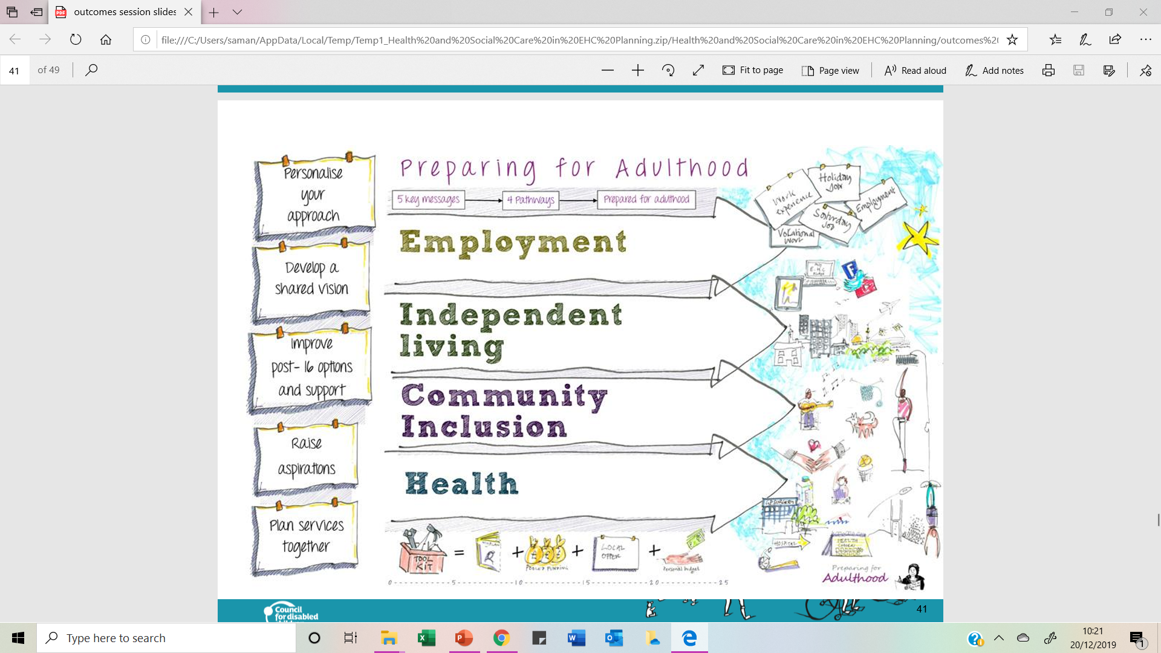
Preparing for adult (PFA) outcomes

Slide 29

Annual Learning Disability Health Checks
The check is offered/ available to young people aged 14 years and over who are on the GP Learning Disability register.
The checks were initiated as children/ young people with a Learning Disability can sometimes have difficulty in recognising they are unwell and find it a challenge to verbalise this to others. This affects in turn their health outcomes in the future. (NHS England)
The NHS Long Term Plan set an ambition that by 2023/24, at least 75% of people aged 14 or over with a learning disability will have had an annual health check.
Recent BLMK data indicates that only 20.82% of YP aged 14-25 years have accessed the checks in 2023/24.
What are the aims of the Learning Disability Annual Health Check?
Give the child/ young person and their family an opportunity to speak to their doctors/GP about their concerns and worries.
Better health through identifying problems earlier.
Young person and family can get used to visiting their GP practice.
Completion of a GP Heath Action Plan.
https://www.england.nhs.uk/learning-disabilities/improving-health/annual-health-checks/#:~:text=People%20with%20a%20learning%20disability%20can%20sometimes%20find%20it%20hard,going%20to%20visit%20the%20doctor.

Slide 30
Review of an EHC Plan
EHC plans should be used to actively monitor children and young people’s progress towards their outcomes and longer term aspirations.
Reviews should focus on a child’s or young person’s progress towards achieving outcomes specified in the EHC plan.
EHC’s should be reviewed minimally every 12 months.
The first review must be held within 12 months of the date when the initial EHC Plan was issued, and then within 12 months of any previous review.
Professionals across education, health and Social Care must co-operate with local authorities during reviews

Slide 31
What should good Health Advice Include
Link Aspirations, Needs, Provision and Outcomes (The Golden Thread)
Views of the Child/ Young Person / Parent /Carer are evident
Health needs linked to what that means for child’s education
Use the Template

Slide 32
Check your advice – consider using the audit tool as a guide ?
Health information and advice submitted clearly shows where other professional views have been sought (if applicable)
Diagnosis and medical information is present under “Needs”
Health needs relating to the child or young person’s SEND and what impact this would have in accessing their education is clearly identified.
Health provision relating to the child or young person’s SEND and what is required to support them in meeting their needs to access their education is clearly identified.
Health Provision required to meet the child’s SEND needs states if the service is able to provide this in core commissioned health service or clearly indicates additional resource is needed above the service available and what action has been taken
The desired or predicted outcomes from the provision being provided is clearly outlined in the report
The advice includes measures in place to monitor progress and/or change in need and provision
Are the Outcomes stated SMART?
Outcomes include a Preparing for Adulthood focus – this must be present if young person is in year 9 or beyond

Slide 33

Health Advice Template Completion -Practice Session

Slide 34
Useful Resources
https://www.gov.uk/government/publications/send-code-of-practice-0-to-25
https://www.legislation.gov.uk/ukpga/2014/6/contents/enacted
https://councilfordisabledchildren.org.uk
https://www.ndti.org.uk/resources/preparing-for-adulthood-all-tools-resources/pfa-ehc-planning

Slide 35
Discussion and Questions

Slide 36
Contacts
Helen Watson- Designated Clinical Officer (DCO). helen.watson25@nhs.net 07855951685
Rosie Newbigging -SEND lead for CAMHS. Rosie.newbigging@nhs.net

Slide 37


Local SENAT and SENDIAS
Service Contact Details
Luton SENAT
Luton Council
Town Hall Extension
Upper George Street
Luton
LU1 2BQ
Tel: 01582 548 132
Email: senat@luton.gov.uk
Luton SENDIAS
Tel: 01582 548 156
Email: sendias@luton.gov.uk
Website: www.sendiasluton.co.uk

Slide 38

Central Bedfordshire:
SEND Team
Email: statass@centralbedfordshire.gov.uk
Telephone: 0300 300 8356
Central Beds SENDIASS
Tel: 0300 300 8088
Email:sendiass@centralbedfordshire.gov.uk
Website: https://cbsendiass.org/contact/

Slide 39

Bedford Borough:
SEND Team
Email: sendteam@bedford.gov.uk
Telephone: 01234 228 375
Bedford SENDIASS
Tel: 01234 276 267
Email: Sendiass@bedford.gov.uk
Website: https://bedfordsendiass.org/

Slide 40


Parent Carer Forums
Central Beds - http://www.snappcf.org.uk/
Luton - https://www.epiclutonpcf.org/
Bedford - https://www.bbpcf.co.uk/

