Slide 1
Home Treatment Team Report
South CAMHS Luton – Dunstable - Beds

Slide 2
Introduction: What We Do
The crisis home treatment service became operational in the Luton and South Bedfordshire area on 1st March 2022.
The service is available to young people aged 0-17 in a mental health crisis who have presented/been referred through agreed crisis referral pathways and/or may be at risk of Tier 4 adolescent inpatient admission.
The team covers Luton and South Bedfordshire offering crisis assessment, brief intervention and intensive home treatment intervention as an alternative to inpatient admission and to facilitate early/timely discharge for young people in Tier 4 settings.

Slide 3
Criteria
Our service aims to provide assessment and on-going intervention (where indicated) for young people who:
Are on our local crisis pathway through A&E or NHS 111.
Have been referred by an agreed recognised professional who believes the young person may be presenting with a mental health crisis.
May be at immediate or imminent risk of being admitted to a Tier 4 CAMHS Provision (Mental Health Inpatient Unit) without crisis and/or home treatment intervention.

Slide 4
Operational Hours
Our current operational hours are 9am-9pm Monday-Sunday.
Since 1st September 2022, the service was extended to offer weekend telephone support to the young person and their families/primary carers.
We also offer support to our colleagues in the CAMHS Crisis Team who cover the Luton & Dunstable Hospital.

Slide 5
Home Treatment Team Composition
Professional Lead
Chris Lodder
Band 7 Nurse
Mojisola (Ola) Kelani
Band 7 Nurse
Joseph Adeoye
Band 7 Nurse
Charles Olajide
Band 7 Nurse
Florence Sule
Social Worker
Elizabeth Merritt
Social Worker
Judith Mshana
Support Worker
Leonie Dwyer
Support Worker
Chris Horwood
Support Worker
Lauren Goodman
Support Worker
Arooj Sajid
Support Worker
[TBC]

Slide 6
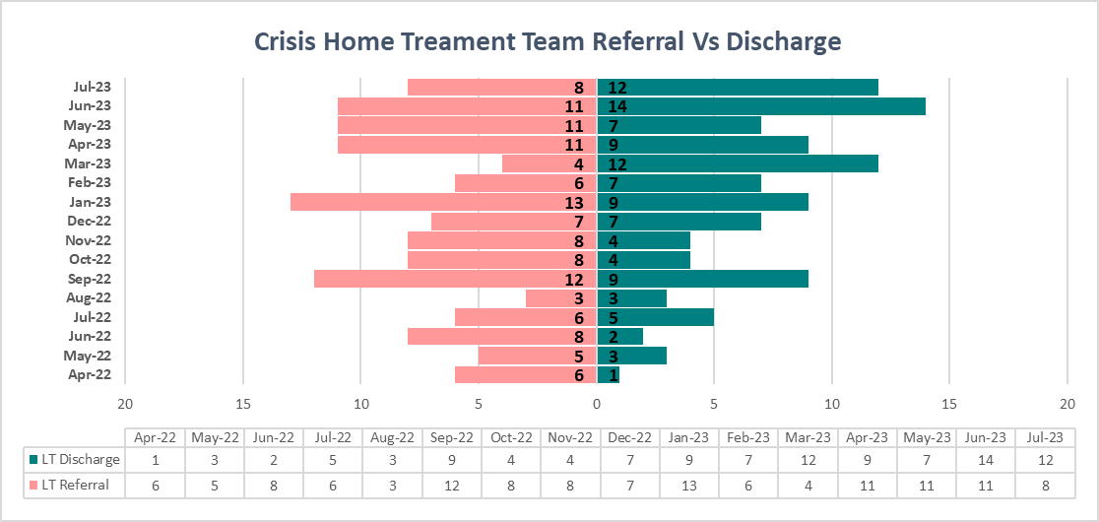
Home Treatment Team Data
In Fig 1. the pink graph highlights the referrals into Home Treatment and the green graph highlights completed treatment and discharge. If we compare April 2022 with July 2023 we can see as the Team has become more established the service has got better in terms of capacity, treatment and discharge.
The total referrals into the team as July 2023 is 127 and the total number of discharges from the team as of July 2023 is 108.

Slide 7
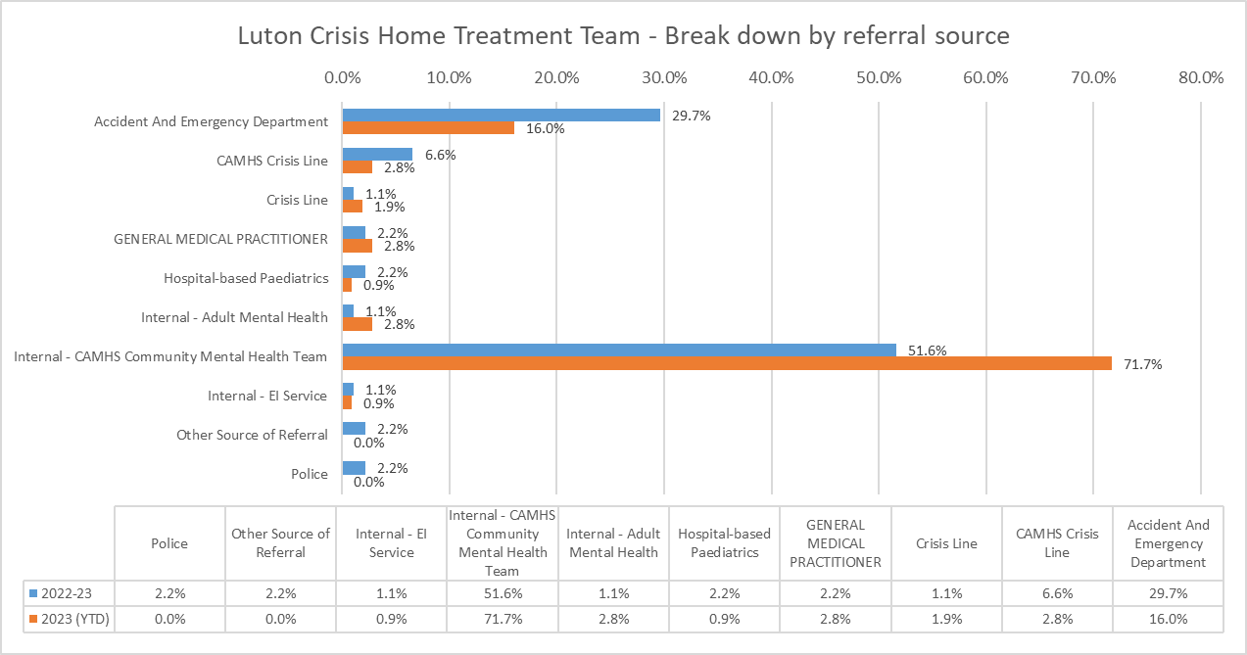
Home Treatment Team Data
Fig 2. gives us a comparison of referral sources into the team. The blue graph highlights figures from last financial year and the orange graph highlights this financial year. We can see that internal referrals from CAMHS Teams made up just over half of the teams referrals and just over 29% of our referrals coming via A&E Department/ Crisis Team.
When we compare this financial year to last year financial year we can see a significant increase in the number of referrals the team has had from other CAMHS Teams. We also see a reduction in the number of referrals received via A&E Department/Crisis Team.

Slide 8
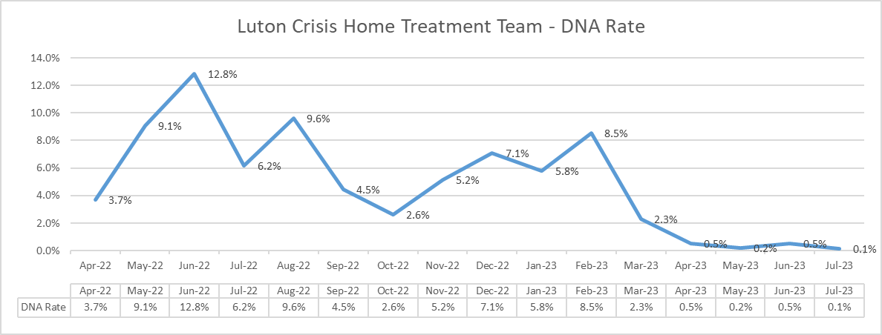
Home Treatment Team Data
This graph shows a higher rate of young person DNA’s in the initial months of the Team being set up.
However, as the team has become more established the DNA rate of young people to the team has become very low, indicating that the team is doing a good job of engaging with both young people and their families.

Slide 9
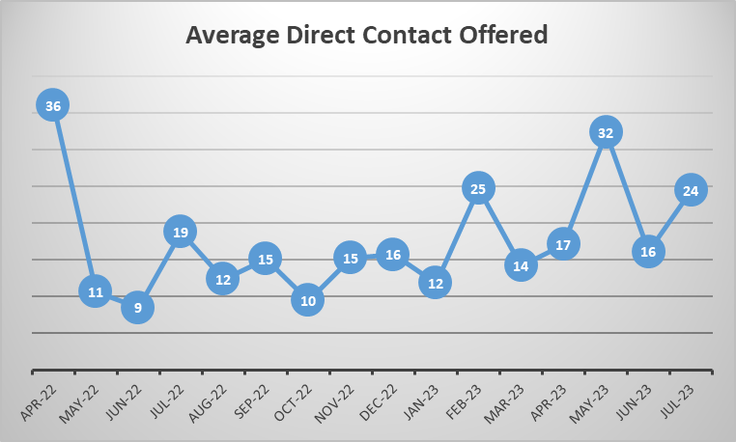
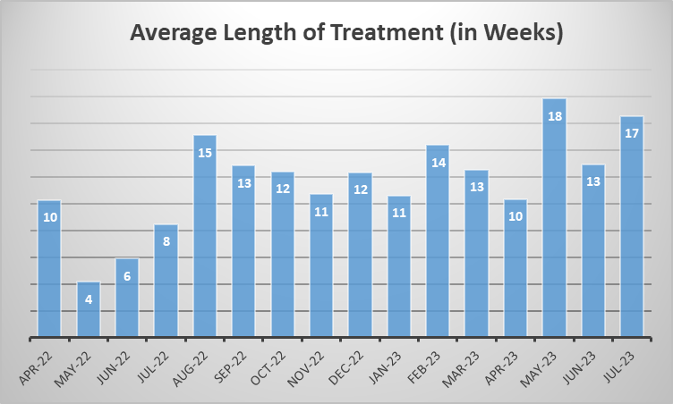
Home Treatment Team Data
The overall average direct contacts is 18 per referral. Direct contact can be interpreted as being face-to-face, telephone contact or virtual contact.
The average length of treatment is 12 weeks at point of discharge

Slide 10
Conclusion
The Luton & South Bedfordshire Home Treatment Team has now been operational for approximately 18 months. Since going live the team has received 127 referrals to date and receive, on average, 9 referrals per month.
Quantitative data suggest that the team is accepting more referrals, primarily coming from in-house CAMHS teams, with the young person and their families engaging and working well with their treatment. This is reflected in the DNA rate within the team. The average length of treatment contact is 12 weeks.
Qualitative data suggests that since the Home Treatment Team became operational the team has impacted on the number of bed days CAMHS young people are admitted on to our local Paediatric ward for. Those CAMHS young people that have a lengthy tend to have more complicated social issues that delay discharge.

Slide 11
Conclusion
The team have also had a positive impact on the number of cases live on the Crisis team, thus allowing our Crisis Team colleagues the opportunity to work more efficiently and creatively.
From the teams humble beginnings we can see that the team is moving in the right direction in the service they are delivering to young people and their families.
The Team needs to continue to strengthen its processes and continue to develop clear lines of communication with the core CAMHS Team.

