Slide 1
MISSING
Last reviewed: November 2023
Reviewed by: Jackie Clementson
Next review date: April 2024

Slide 2
Missing Children Process
Updated procedure for children MISSING in Surrey and those placed at distance.
No Triage Point: all children should be offered a RHI within 72h of returning home.
Currently 10 working days to complete process from allocation to completion. We need this reduced! RHI are about the moment – is 10 days the moment?
Outcomes from RHI should be about the ‘So What’. What are we doing to support this child to stay where they should feel safest.
Actions from RHI must be in any plans for children, from CiN and CP to Asset and YJ planning.
Remember ‘SO WHAT!’

Slide 3
Return Home Interviews (RHI’s)
WHEN THEY ARE NEEDED, WHO DOES THEM AND HOW WE RECORD THEM

Slide 4
The importance of Return Home Interviews
RHIs are extremely important – Provides opportunity to hear child’s view
Missing children are often vulnerable to abuse or exploitation
They are an opportunity for signposting to crisis and support services
They can give an enriched picture of the child’s story and views of those in their network
Police will conduct a Prevention / Safe & Well Check – often a check the child has returned home to a safe environment and no crimes have been committed
They are a statutory requirement and Ofsted inspect responses
RHIs contain Police intelligence and crime trends, eg. hotspots, other linked children etc that help to find children and target disruption efforts
Management data is driven from RHI forms including push and pull factors and team responses to missing children

Slide 5
Missing Children Process
When a child goes missing in Surrey, Surrey Police will contact the Early Help Hub
When a child living outside of Surrey goes missing the Early Help Hub should be advised by a local Police force or the child’s placement/home
When the child returns home, or to a safe place, a Return Home Interview is required (RHI)
Early Help Hub will email Police notifications to the Quadrant Team allocated worker, manager & Duty Inbox, or Contact to Assessment Team Duty Box for unopen cases
Quadrant Teams will be responsible for opening and closing the missing episode on LCS and undertaking the RHI
The RHI should be undertaken by the person the child is most likely to talk to, this can be the allocated worker or Family Worker
Every attempt should be made to undertake the RHI within 72 hours of the child’s return
All responses to RHI’s should be completed using the embedded form on LCS, even where the RHI is not required or declined

Slide 6
ALL CHILDREN DEEMED MISSING IN SURREY WILL BE OFFERED A RETURN HOME INTERVIEW (RHI)
ANY CHILD FROM ANOTHER LOCAL AUTHORITY RESIDING IN SURREY WILL HAVE THEIR MISSING EPISODE DIRECTED TO THE RESPONSIBLE LOCAL AUTHORITY FOR RESPONSE (SURREY EXPECT A COPY OF ANY RHI COMPLETED ON CHILDREN LIVING IN SURREY.

Slide 7
Consent and Sharing RHIs
Due to the layers of legislation, each child’s case being unique - Professional Judgement will be required to establish the level of harm and risk posed to the child before proceeding with services, including RHIs
A child’s level of competence should be considered when parental consent cannot be obtained
RHIs are a statutory requirement and children can consent to take part in an RHI without parental consent
Professionals must clarify where RHI information will be held, whom it will be shared with and the circumstances around this.
Professionals have a responsibility to share relevant information with the Police e.g. child subject to concerns around sexual or criminal exploitation
Professional judgement to be used and evidenced when sharing, or not sharing, sensitive information with partners; Schools, Police, Health
- RHI form contains summary overview section for school and can PDF to Police / Partnership Intel Form

Slide 8
Process nuts & bolts
Missing episodes must be opened on LCS to ensure we meet our statutory requirements – daily process
Tableau will report on Surrey children currently missing & RHIs undertaken
Once a missing lozenge is opened the record will sit within the work tray of the person/team that opened it. Only those with access to the tray can finalise the record.
RHI forms can only be accessed whilst the episode is open (found info can be added)
Once the child returns the missing lozenge must be updated with the Found information, available at that time but do not finalise episode if RHI required as this removes access to the form
The RHI can be undertaken by the allocated worker or any other worker
Once the RHI is signed of by the manager a notification will be sent back to the case holder to finalise the record.
A PDF of the RHI should then be sent to the police using MissingPersonsIssues@surrey.pnn.police.uk
Tableau will then show RHI completed information, timescales and feed into thematic push and pull factors

Slide 9
Undertaking the RHI
Every attempt should be made to engage the child in the RHI
Highlight the importance of RHIs as an opportunity to hear the child’s voice, the parent/guardian and school’s views
This may be done as part of a scheduled statutory visit or separately
Multiple missing episodes can be recorded on one form
The RHI form on LCS must be completed in part in all cases
If the child refuses an RHI or it is not appropriate to undertake one, the form should still be completed to show why e.g.
Child declined
Parent declined
RHI not required – SW approved (also used for episodes / children that do not meet threshold criteria)

Slide 10
Management Oversight (MO)
RHI interviewer selects most appropriate Manager on each RHI
MO – agrees if thorough RHI undertaken
MO – agreeing with partnership sharing decision
MO – threshold decision (if child not open Assessment Team Manager to decide if referral to be started)
Form Issues – Once a form has been sent to a Manager it cannot be edited! We are waiting on an IT release to change this.
New Staff / Unsure of RHI process – instead of ‘Sending for authorisation’ you can ‘Reassign’ form to your Supervisor / Manager so they can edit / check the document before it is authorised and locked down.

Slide 11
Crime and intelligence
Police have advised the following circumstances should always be reported to them:
Imminent danger to person / persons = 999
Crime committed and/or evidence of a crime – no immediate danger = 101 or report online
RHI assessment PDFs from LCS = can be emailed in part of fully to Missing Police mailbox MissingPersonsIssues@surrey.pnn.police.uk
Information via a 3rd party and/or information of interest to the Police should be submitted via a Partnership Intelligence Form. Intelligence is sanitised and sources hidden from main Police systems. Forms can be accessed on S Net

Slide 12
strategy meetings
The child’s social worker is responsible for convening an Intervention/Strategy meeting to develop a strategy whenever :
OR
OR
This must be based on the risk assessment and the child’s individual circumstances and must take place within a maximum of 5 working days of the episode starting. If a Strategy/Intervention meeting is not held, clear rationale for the reason needs to be identified within case notes.
a child is missing for more than 24 hours
a child repeatedly goes missing (3 or more episodes in 90 days)
where indicators of particular risk are identified, eg contact with a person who poses a risk to children, a Registered Sex Offender, risk of child sexual exploitation or a high risk incident

Slide 13
Cause for Concern (CforC) Reporting
If a child is missing for more than 24 hours, where the child is Looked After, subject to a Child Protection Plan or otherwise vulnerable, the first line manager aware is responsible for sending a briefing report to the Assistant Director for Children’s Services
Situation resolved: (e.g. missing child returned), the Assistant Director, Children’s Services must be briefed, with any learning points identified which can be picked up within the wider organisation
The purpose of the briefing is to alert the senior managers of the incident and to provide the information needed to form an initial opinion on what, if any, action is required on behalf of the service.
As a situation develops, it may be necessary to provide regular updates

Slide 14
Step by step LCS Instructions
Add, update, close a missing episode and complete an RHI form

Slide 15
Police inform EHH of missing child
IF child is OPEN to CS
EHH triages episode & outcome, emails Missing Episode Details to Allocated Worker and Team Manager
EHH adds case note to case management system child is open on – either EHM or LCS and assigns this to worker
Allocated worker – opens Missing Episode on LCS immediately with Missing Date/time and Found Date/times.
Allocated worker - creates contact and attaches Police SCARF if available.
Allocated worker – proceeds with RHI or assigns it to another worker
Allocated worker – once RHI form completed and sent for Management Oversight – consider sharing with police, school and/or other partners
Missing Episode task / RHI finalisation process goes into Mash Missing Tray – accessed by RET admin or Business Support TBC (DO NOT Finalise Missing Episode Task until RHI completed)
IF child is CLOSED to CS
EHH triages episode & outcome, adds Contact on LCS to and sends to quadrant Assessment Team (if child unknown, EHH add child to LCS)
EHH adds case note to LCS and assigns this to the Assessment Duty Team tray
Area Assessment Team – Creates Missing and Found Episode on LCS
Area Assessment Team - Attaches Police SCARF, if available
Area Assessment Team – allocated to worker to carry out RHI interview
Allocated worker – once RHI form completed and sent for Management Oversight – consider sharing with, school / and/or other partners
Missing Episode task / RHI finalisation process goes into Mash Missing Tray – accessed by RET admin or Business Support TBC (DO NOT Finalise Missing Episode Task until RHI completed)

Slide 16
Access LCS programme and look up YP you wish to add missing episode
From the Personal ‘Basic Demographics’ tab, scroll to the RIGHT hand side - Select ‘Add Missing Person Record’
Select Missing Tab ‘Missing Status’ type and input ‘Episode Start Date & Time’, ‘Missing Reasons’ and Primary Missing Reason’ the checkbox ‘Is this an approximate Start Date and time?’ enables you to change if need be.
If no found information available you can save entry at this point but NO other Missing Episodes can be added.
Child found - Select Found Tab Select ‘Episode End Date’, ‘End Reason’ and ‘Checkbox for approx. time etc.’
Add notifications if none selected (e.g. Not OPEN add the Assessment Team tray by area appropriate)
Finally Select ‘Create’ (Create a new Missing Person)
Notes:
Remember if ‘found date and time’ not entered you cannot add another missing episode and the MISP Flag Lozenge will be open and on ALERT
Don’t forget to add a tray notification if you are assigning to a team/manager
Always select ‘is this an approximate date and time?’ this allows us to amend if need be

Slide 17
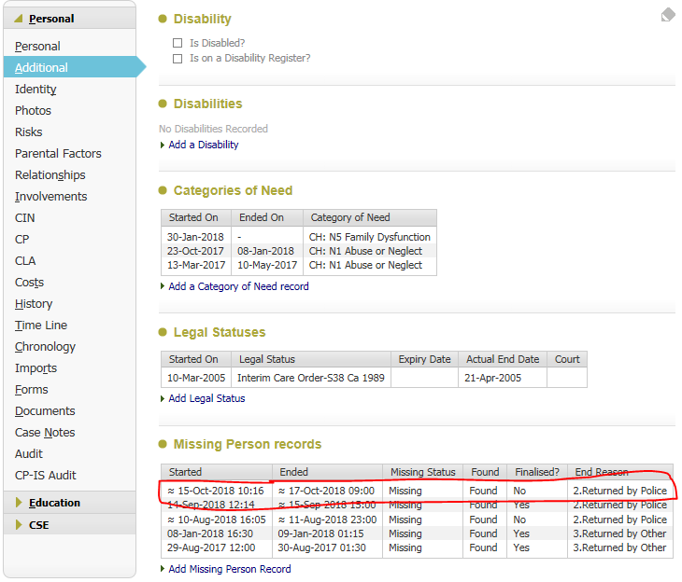
Creating a RHI Form
Select ‘Additional’ from ‘Basic Demographics’ from left hand side
Select/Click on the Missing Incident you wish to complete an RHI on shown below

Slide 18
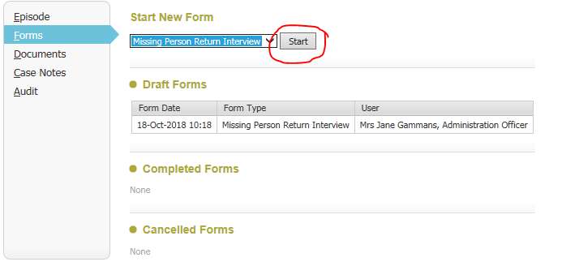
Select ‘Forms’
From ‘Start New Form’ Select ’Missing Person Return Interview’ and then click START
Select/Click on the Missing Incident you wish to complete an RHC on
Select Start

Slide 19
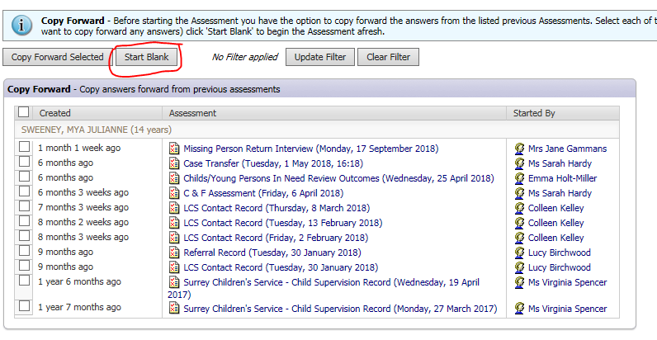
Select ‘Start Blank’ always

Slide 20
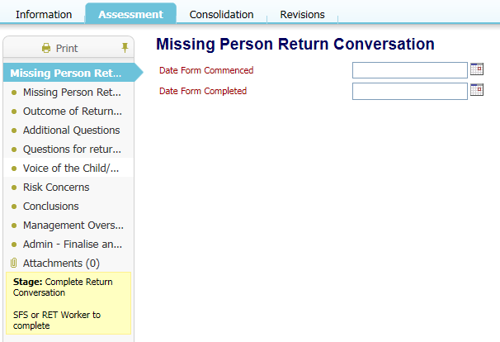
Select ‘Start Blank’ always
Date RHI calls/work started
Date form completed

Slide 21
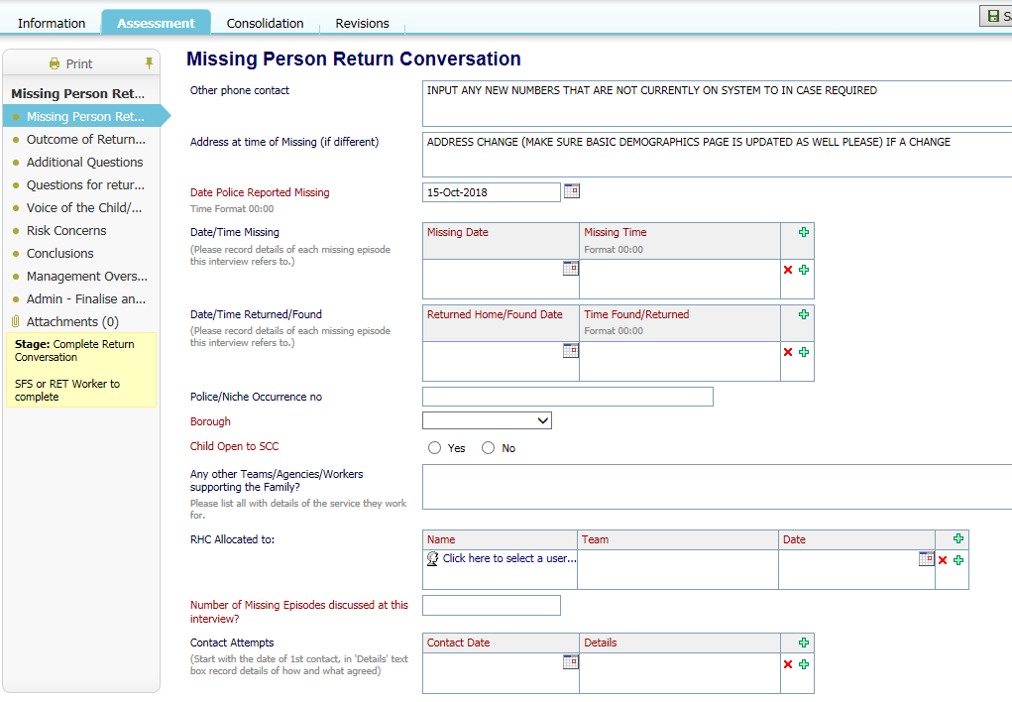
Mandatory sections in ‘RED’ Black is an optional section
Record dates/times you have confirmed child was missing, the information received from the EH Hub/SCARF are the Police reporting times and child may have returned home before Police undertake Prevention Checks and update their records

Slide 22
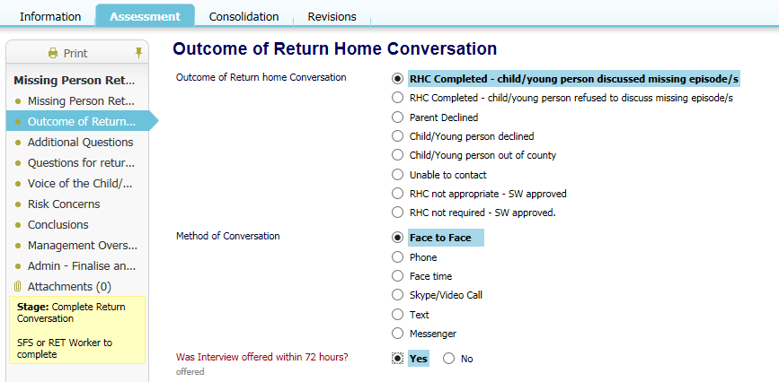
Select relevant radio buttons if RHI is not required or if it has been completed / part completed.
- Note – SCC used to call RHIs Return Home Conversations – RHCs, awaiting systems development to update the language

Slide 23
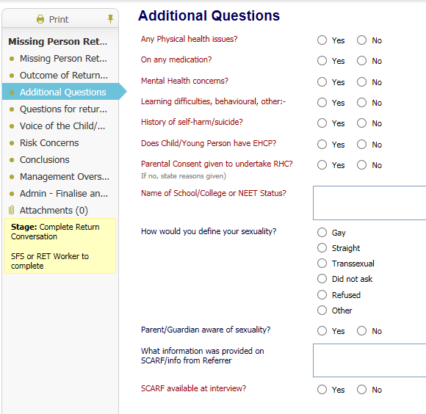
If you select Yes to these questions a box will open to allow you to record more information
At any point you can ‘save’ the RHI form and come back later – there is NO auto complete function
Notes:
Only send for authorisation if 100% happy with the assessment if you require Manager/colleague to amend then reassign to the task to them – if you authorisation the FORM locks down.

Slide 24
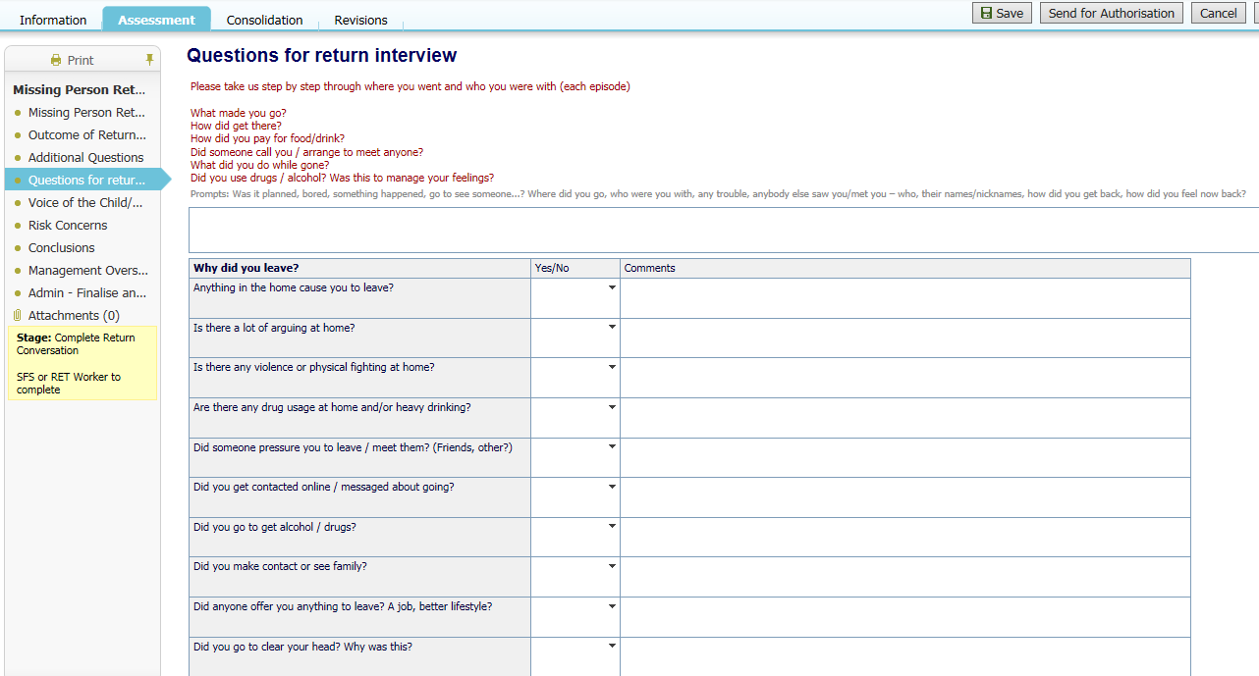
The child does not have to answer all the questions, mandatory section in RED captures child’s voice, step by step what happened for them.
Professionals can print this form and take children through these questions or they may only ask some of the questions.
Answers to these questions will inform Push & Pull factor reports on Tableau so where appropriate please complete
Most important section – step by step where, who you were with when you went missing
Notes:
Not all sections need to be added Yes/No – not always appropriate answer – you can add comments and not answer Yes or No
Only RED sections need to be completed – black sections are optional

Slide 25
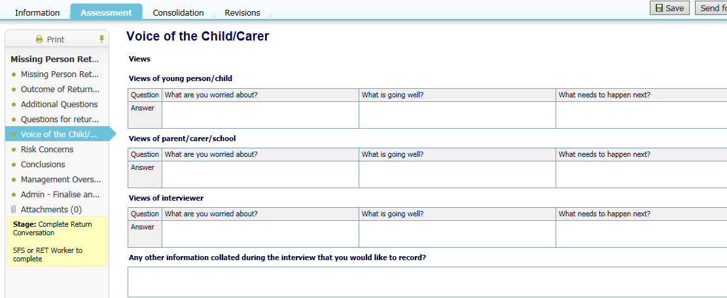
Important to capture the child’s views and what they are worried about.
SOS style questions can be complemented with Motivational Interviewing open ended questions and supporting the child / parent / guardian to identify solutions for themselves.
Contextualised safeguarding approach can be built into What Needs to Happen
Other information may include Intelligence about neighbours / friends or other information that doesn’t sit within other boxes on the form

Slide 26
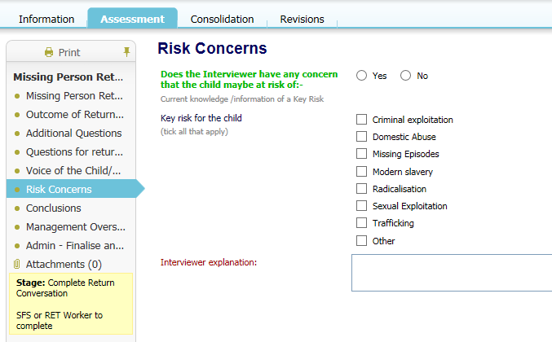
If you have risk concerns for the child, select the relevant button and reasons for this concern
If you are concerned about Child Exploitation you should ensure an up to date Child Exploitation & Missing Children Risk Assessment tool has been completed and where appropriate submitted to the Risk Management Meeting

Slide 27
If you part complete the form and wish another worker to complete the form, you can Re-Assign the form to another worker.
If you feel you would like a senior worker/manager to view and possibly edit your RHI form BEFORE authorising – use the ‘Re-Assign’ function for this also
The form has a section for providing schools with a summary outcome of the RHI under Operation Encompass. SCC is now using ‘professional judgement’ in all cases instead of a systematic process. Please complete this section if appropriate to provide school with a summary
When you are completely happy with the form select ‘Send for Authorisation’ the form cannot be edited after this point
Select the appropriate Manager/Social Worker / Senior you wish to add Management Oversight on the RHI

Slide 28
Management Oversight is required to check the quality of the interview and that sound professional judgement has been applied.
Until the RHI Development work is undertaken Managers cannot amend the form at this stage, a Social Care Helpdesk request is required to roll back changes.
This button will not allow you to amend the RHI until the forms development work is undertaken. You can Re-Assign the sign off process
Manager or Senior please select your details and write in your team & department
Once you are happy with the RHI select the ‘Send for Completion’ button

Slide 29
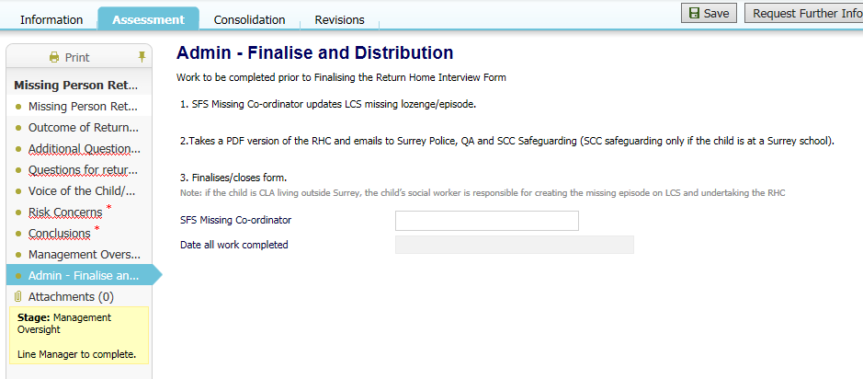
Admin Task – Finalise & complete RHI Form
This screen was for the RET Admin/Missing Co-ordinator - before closing the Missing Episode on LCS but will now sit as a function within teams.
A name and date needs to be added so the form closes down and the Tableau reports are updated.

Slide 30
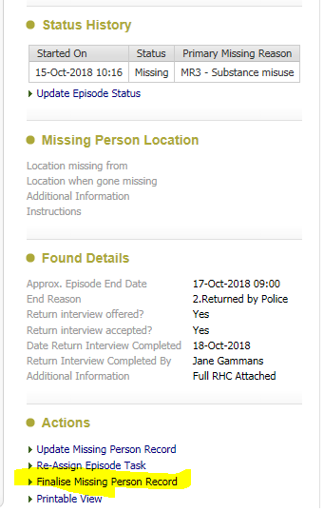
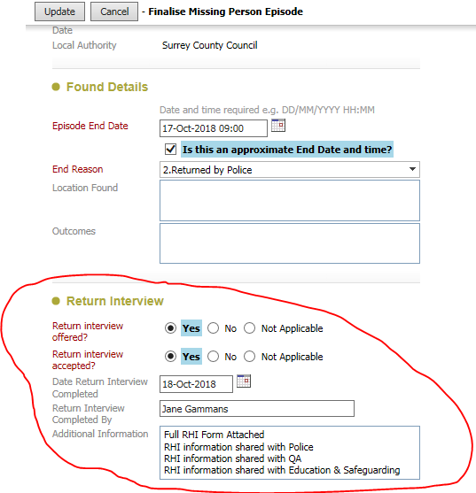
Finalisation task for BS or Social Worker as nominated by manager
To finalise a ‘Missing Episode’ once a RHI Form has been completed from your tray the Missing Episode you wish to close.
To finalise a Missing Episode once RHI is completed
Pickup Missing Episode task from your tray
Scroll to the bottom of Status History
Select ‘Finalise Missing Episode’
Complete the ‘Return Interview’ section
Enter in the ‘Additional section’ whether information has been shared with Police, QA or Education Safeguarding
Once all sections complete select update this will finalise the Missing Episode task down.

