Slide 1
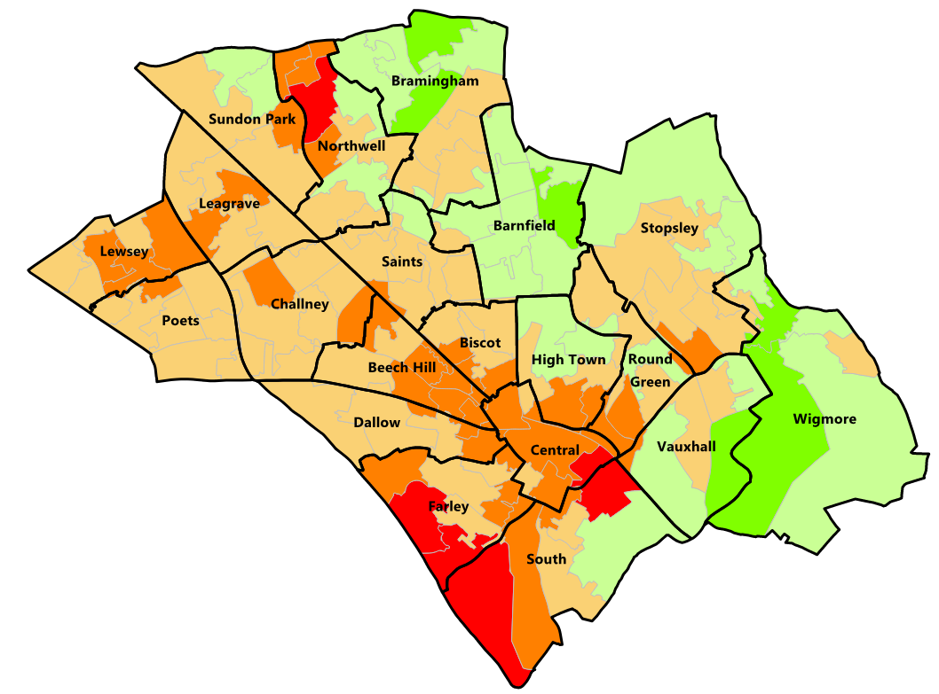
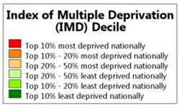
Luton IMD, 2019
© Crown Copyright and database rights 2023 Ordnance Survey 100023935

