Slide 1



PROFESSIONAL CURIOSITY
Resource pack for sharing learning and improving practice

Slide 2










How to use this resource
This resource pack aims to raise awareness about the topics we want to embed into practice.
The expectation is that you will share this resource pack widely and use it:
  in team meetings
  as part of group/individual supervision or for own development
You can look at it as a whole or dip in or out of it at your convenience.
Information within this resource pack has been collated from a number of safeguarding partnerships including Swindon, Waltham Forest, Manchester and Norfolk Safeguarding Adults Board.
Some external resources can be accessed by either click on the logo or hyperlink.
Please find the LSAB Professional Curiosity 7-minute briefing here: link to be added once briefing is on new website
Navigation bar – dip in/out
What is professional curiosity?
Top Tips
Barriers
Aplication to risk assessment
Difficult conversations
Watch/Listen to films
Resources
Scenarios: to discuss
Managers Section

Slide 3
What is professional curiosity?
It is the capacity and communication skill to explore and understand what is happening within a family rather than making assumptions or accepting things at face value.
Curious professionals engage with individuals and families through visits, conversations, observations and asking relevant questions. Curious professionals then analyse this information to gain an understanding of the person’s background and story to assist in providing a personal approach.
For safeguarding, care, and support to be truly personal there needs to be a good understanding of the person and family being delivered the services and seeing the case from the perspective of the person and family. For this to happen effectively the person and their family’s circumstances needs to be understood.
It is a combination of looking, listening, asking direct questions, checking out and reflecting on and analysing the information received.
It means:
testing out your professional hypothesis and not making assumptions
Triangulating and analysing information from different sources to gain a better understanding of individuals and family functioning
getting an understanding of individuals’ and family’s history which in turn, may help you think about what may happen in the future
obtaining multiple sources of information and not accepting a single set of details you are given at face value
having an awareness of your own personal bias and how that affects how you see those you are working with
being respectfully nosey

Slide 4
The line between professional curiosity and respecting the right to private and family life
It is justifiable to probe for further information for the following reasons:
Uncover potential harms and risks to themselves and others
To prevent a situation of harm/risk escalating
When alerted by tension, uncertainty or repeating patterns in people’s situations
To enable a greater understanding of a person’s situation/story to enable appropriate support to be provided
When faced with conflicting information of a person’s situation
To develop a holistic assessment and enable multi-agency working
To make connections between events
Enable the person to learn about themselves to keep them safe
Identification of strengths and assets, which can lead to new ways to work with risk.
When risk management measures are not being effective

Slide 5
How is it achieved?
It is better to help children or an adult as early as possible, before issues get worse.
All agencies and professionals working with children, adults and families need to work together; the first step is to be professionally curious.
Curious professionals will spend time engaging with the individual and families on visits, using their skills to observe and interact.
Curious professionals take a wider view than the task or specialism they have entered the home for.
Do not presume you know what is happening in the family home, ask questions and seek clarity if you are not certain. Equally, do not presume other organisations are dealing with the family’s needs.
Do not be afraid to ask questions of families and do so in an open way so they know that you are asking to keep the children or adult safe, not to judge or criticise.
Be open to the unexpected information that does not support your initial assumptions into your assessment of what life is like for the child or adult in the family.
Professional curiosity is the ability to enquire, investigate and explore what is happening with the child, adult or family beyond the presenting concerns.
Professionals need the time to reflect and analyse information and if supervision or time is not readily accessible to do this then this should be escalated within your organisation.

Slide 6
How is it achieved? cont’d
The following will support professional curiosity being achieved;
Skills in analysis of the information received
Appropriate time allowances are built into workload allocations to facilitate reflection
A holistic view; i.e. wider than the reason you are meeting with the person e.g. medical care
Practitioner supervision
Appropriate questioning during interactions
Relationship building with children, adults, families and other agencies
Direct work with children, adults and families
Communication skills and
The courage to have a difficult conversation
Good record keeping reflecting professional curiosity and the voice of the person

Slide 7

Why is it important?
Professional curiosity is a golden thread through Safeguarding Partnership learning reviews and audits and is an essential part of safeguarding. Nurturing professional curiosity is a fundamental aspect of working together to keep children, young people and adults safe.
A lack of professional curiosity can lead to:
missed opportunities to identify less obvious indicators of vulnerability or significant harm
assumptions made in assessments of needs and risk which are incorrect and lead to wrong intervention for individuals and families
the presenting issues are dealt with in isolation
Professionals asking questions and seeking explanation from parents/carers is something to be valued; healthy challenge is good and can provide assurance that your assessment of the situation is accurate.
A high reliance by professionals on self-report by parents/carers brings with it significant risks of proceeding on false information.
Good information sharing, supervision and open discussion at key decision-making meetings to ‘check and test’ information can be crucial in ensuring this does not happen.

Slide 8
Is exercising professional curiosity easy and straightforward?
Not always. Especially if working with parents/carers who demonstrate disguised compliance or coercive control.
Families may appear to engage with professionals but are not able or willing to change as a result of an intervention.
Some families are unable through fear to be open and honest about family dynamics.
In these cases, professionals will need to exercise more curiosity.

Slide 9





Top Tips
LOOK
LISTEN
ASK
CHECK OUT

Slide 10
Top Tips
LOOK
Is there anything about what you see when you meet with this child/adult/family which prompts questions or makes you feel uneasy?
Are you observing any behaviour which is indicative of abuse or neglect?
Does what you see support or contradict what you’re being told?

Slide 11
Top Tips
LISTEN
Are you being told anything which needs further clarification?
Are you concerned about what you hear family members say to each other?
Is someone in this family trying to tell you something but is finding it difficult to express themselves? If so, how can you help them to do so?

Slide 12
Top Tips
ASK
Are there direct, open questions you could ask when you meet this child/adult/family which will provide more information about the vulnerability of individual family members?
Here are some examples:
  Tell me how do members of your family deal with conflict?
  Explain to me how the adults in the household respond to stress?
  Describe the arrangements that are in place for the child or young person to access education?
  Tell me who is working with you or your family?
  Explain to me what it is like to be (name) living in this family/household?
  Describe a typical day for you?
  Who is this with you at this appointment?
  Tell me about the last time you felt happy?
  Who is living with you?
  What do you look forward to?
  Tell me about the people who regularly visit your home?
  Are you in fear of the consequences of doing something, or not doing something?
  Do you want to tell me anything else?

Slide 13
Top Tips
CHECK OUT
Are other professionals involved? If so, don’t presume they are dealing with your concerns.
Have other professionals seen the same as you?
Are professionals being told the same or different things?
Are others concerned? If so, what action has been taken so far and is there anything else which should or could be done by you or anyone else?
Analyse all the information collected.

Slide 14
Guidance when appointments are cancelled by partners, carers or parents where there is a pattern of missed appointments
When appointments and/or care packages are cancelled by partners or carers on behalf of an adult; make all attempts to speak to the individual the appointment is being cancelled for on their own, tailored to their individual communication needs, to explore whether this is their choice and the reasons underlying this.
When appointments are being cancelled on behalf of a child, taking into consideration their age and communication abilities, make all attempts to speak to the child to check their welfare and hear their view on the cancellation.
If it is not possible to speak to the person, be curious with the person cancelling the appointment, as to why it is being cancelled. Explore if the carer/parent needs additional support.
Where the person cancelling the appointment is the individual’s partner and carer, keep in mind any concerns around domestic abuse and if this forms part of controlling behaviour.
Discuss the impact of the cancelled appointment on the individual and their partner, carer or parent.
Does this form a pattern of not attending appointments? If so, explore with the individual the reasons underlying this behaviour. Contact other agencies involved and query if this is the case with their service.
Analyse the cancelled appointment in the context of other information on the person and family.
Please see LSAB’s ‘Did Not Attend or was Not Supported to Attend’ guidance for adults. For children, please check your organisation’s own policies and consider this video.

Slide 15
Guidance when a carer, parent or other speaks on an adult’s behalf
In most circumstances when an adult has capacity, obtain information from the adult directly.
When a carer, parent or other speaks on behalf of an adult with capacity, check with the adult this is their wish and offer if they would like to speak privately.
When an adult agrees for another adult to speak on their behalf, document this.
When a carer or other refuses treatment on behalf of an adult with capacity, investigate the reasons for the refusal, if this is the adult’s wish and assure the adult understands the implications.
Remember, if it’s not recorded it didn’t happen. Evidence your professional curiosity and the adult’s voice within records.

Slide 16
Top Tips - Remember to…
Question your own assumptions about how individuals/families function and watch out for over optimism
Recognise your own feelings (e.g. tiredness, feeling rushed or illness) and how this might impact on your view of a child/adult/family on a given day
Think about why someone may not be telling you the whole truth
Demonstrate a willingness to have challenging conversations
Address any professional anxiety about how hostile or resistant individual/families might react to being asked direct or difficult questions
Remain open minded and expect the unexpected
Appreciate that respectful scepticism/nosiness and challenge are healthy. It is good practice and ok to question what you are told
Recognise when individuals/adult repeatedly do not do what they said they would and discuss with them
Understand the cumulative impact of multiple or combined risk factors, e.g. domestic abuse, drug/alcohol misuse, mental health
Ensure that you analyse the information received and that you have access to regular supervision

Slide 17

Barriers to Professional Curiosity
It is important to note that when a lack of professional curiosity is cited as a factor in a tragic incident, this does not automatically mean that blame should be apportioned. It is widely recognised that there are many barriers to being professionally curious. Some of the barriers to professionally curious practice are set out below;
➢Disguised compliance: A family member or carer gives the appearance of co-operating to avoid raising suspicions, to allay professional concerns and ultimately to reduce professional involvement. We need to establish the facts and gather evidence about what is actually happening. We need to focus on outcomes rather than processes to ensure we remain child or adult centred.
➢The ‘rule of optimism’: A strengths-based approach, does not mean that new or escalating risks should not be treated seriously. The ‘rule of optimism’ is a well-known dynamic in which professionals can tend to rationalise away new or escalating risks despite clear evidence to the contrary.
➢Accumulating risk: Reviews repeatedly demonstrate that professionals tend to respond to each situation or new risk discretely, rather than assessing the new information within the context of the whole picture or looking at the cumulative effect of a series of incidents and information.
➢Normalisation: This refers to social processes through which ideas and actions come to be seen as 'normal' and become taken-for-granted or 'natural' in everyday life. Because they are seen as ‘normal’ they cease to be questioned and are therefore not recognised as potential risks or assessed as such..
➢Professional deference: Workers who have most contact with the child or adult are in a good position to recognise when the risks to them are escalating. However, there can be a tendency to defer to the opinion of a ‘higher status’ professional who has limited contact with the person but who views the risk as less significant. Be confident in your own judgement and always outline your observations and concerns to other professionals, be courageous and challenge their opinion of risk if it varies from your own.
Escalate ongoing concerns through your manager and use the Joint Professional Resolution and Escalation Protocol

Slide 18
Barriers continued…
➢Confirmation bias: This is when we look for evidence that supports or confirms our pre-held view and ignores contrary information that refutes them. It occurs when we filter out potentially useful facts and opinions that don't coincide with our preconceived ideas.
➢‘Knowing but not knowing’ This is about having a sense that something is not right but not knowing exactly what, so it is difficult to grasp the problem and take action.
➢Confidence in managing tension, Disagreement, disruption and aggression from families or others, can undermine confidence and divert meetings away from topics the professional wants to explore and back to the family’s own agenda.
➢Dealing with uncertainty: Contested accounts, vague or retracted disclosures, deception and inconclusive medical evidence are common in safeguarding practice. Practitioners are often presented with concerns which are impossible to substantiate. In such situations, ‘there is a temptation to discount concerns that cannot be proved’.
A person-centred approach requires professionals to remain mindful of the original concern and be professionally curious;
‘Unsubstantiated’ concerns and inconclusive medical evidence should not lead to case closure without further assessment,
Retracted allegations still need to be investigated wherever possible,
The use of risk assessment tools can reduce uncertainty, but they are not a substitute for professional judgement. Results need to be collated with observations and other sources of information,
Social and health care practitioners are responsible for triangulating information, seeking independent confirmation of information from a range of practitioners. This can be challenging, particularly when there are differing accounts, theories and research to understand the situation.
Other barriers include: Poor supervision, complexity and pressure of work, changes of case worker and repeatedly ‘starting again’ in casework, closing cases too quickly, fixed thinking, preconceived ideas and values, and a lack of openness to new knowledge are all barriers to a professionally curious approach.

Slide 19
Application to risk assessments:
Ensure that when you are assessing and monitoring concerns that you use a process of triangulation:
Have you included the perspective of the child/young person or adult in your assessment?
Have you had a case discussion with a / your supervisor or safeguarding team / professional?
Has multi-agency information sharing taken place?
Do you understand the role of the people supporting the person to inform the risks and protective factors?
Have you ensured that any personal or professional bias is removed from your assessment?
What information do the case records hold (chronology), are there any themes/patterns/trends?
What are the family/friends/neighbours saying, does it corroborate self-reporting or are there discrepancies to follow up?
What information is held by other professionals and what is their analysis of the current situation?
Have you used your professional skills to articulate “gut feelings” so that they can be monitored and reviewed?
Have you used the information to inform decision making and to reflect upon and review current strategies?
Do you know when to use the Lincolnshire Safeguarding Children Partnership or Lincolnshire Adult Safeguarding Boards escalation/resolution policy?

Slide 20
Holding difficult conversations and challenging
Tackling disagreements or hostility, raising concerns or challenge, and giving information that will not be well received are recognised as hard things to do.
The following are some tips on how to have difficult conversations.
Planning in advance to ensure there will be time to cover the essential elements of the conversation.
Keeping the agenda focused on the topics you need to discuss. Being clear and unambiguous.
Having courage and focusing on the needs of the service user.
Being non-confrontational and non-blaming, and sticking to the facts.
Having evidence to back up what you say. Ensuring decision-making is justifiable and transparent.
Showing empathy, consideration and compassion – being real and honest.

Slide 21
Holding difficult conversations and challenging
Demonstrating congruence i.e., making sure tone, body language and content of speech are consistent
Acknowledging ‘gut feelings’, sharing these with other professionals, and seeking evidence.
Understanding the elements and indicators of behavioural change.
Holding a healthy scepticism.
Understanding the complexities of disguised compliance.
Applying professional judgement.
Supervision is an opportunity for practitioners to debrief difficult situations and managers can offer support to give them the confidence to offer respectful challenge.
Never be concerned about asking the obvious question and share concerns with colleagues and managers. A ‘fresh pair of eyes’ looking at a case can help practitioners and organisations to maintain a clear focus on good practice and risk assessment and develop a critical mindset.

Slide 22
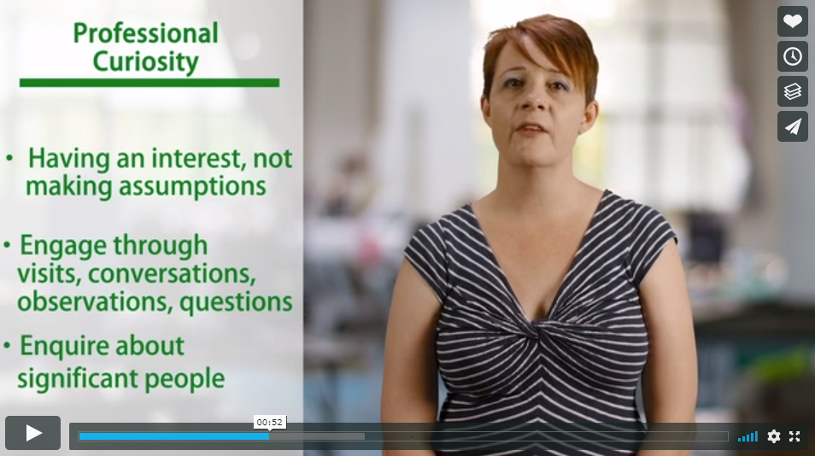
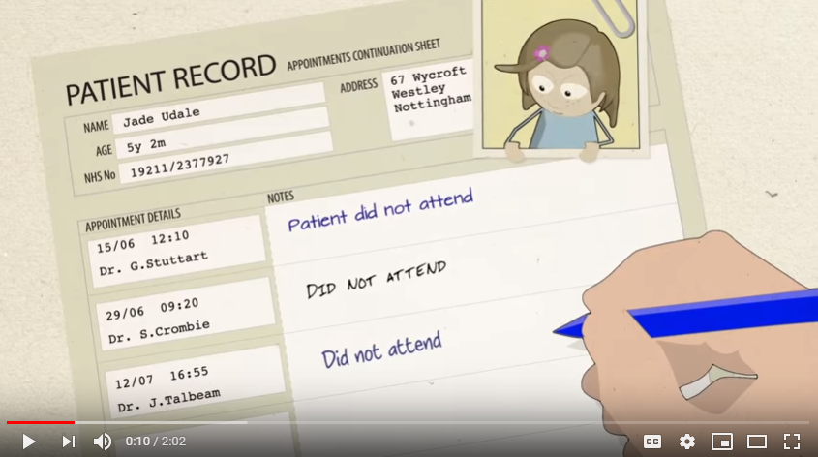
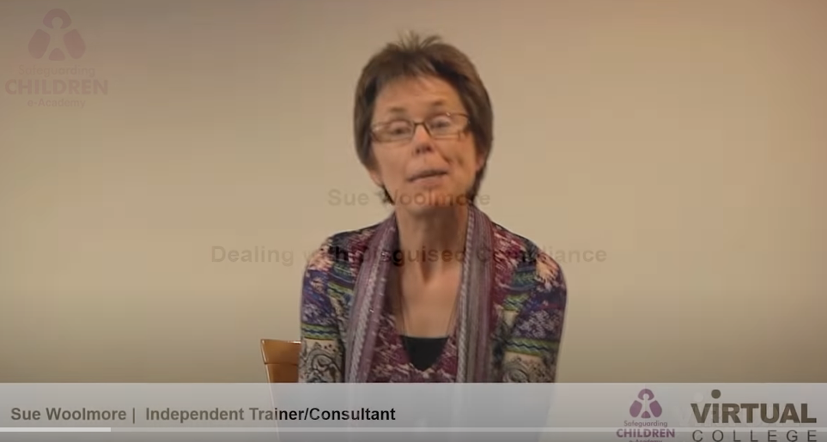
Useful clips to watch/listen
Bitesize video guide on professional curiosity
Re-thinking did not attend
Disguised Compliance
2 minute clip encouraging practitioners to identify children as ‘Was Not Brought’ as opposed to ‘Did Not Attend’ when referring to them not being presented at medical appointments.
(Nottinghamshire Safeguarding Partners )
4 minute clip where Sue Woolmore talks about disguised compliance and the importance of professional curiosity.
3 minute clip from Waltham Forest Safeguarding Partnership which provides some context when working with families.

Slide 23

Useful resources
Children
LSCP Procedures on line
Thresholds Guidance
Learning and development opportunities
Lincolnshire Safeguarding Children Partnership and Safeguarding Adults Board offers a wide range of face to face and e:learning training opportunities. Each course has embedded professional curiosity as a theme. For further information contact Safeguarding_Training@lincolnshire.gov.uk
Attend training and make use any guidance offered by your individual agency.
Make use of 1:1/reflective supervision meetings with your manager in order to reflect upon any concerns or risk assessments and gain support to examine the evidence base.
If your agency offers group supervision opportunities these are beneficial as it allows for peers to act as a “critical friend.”
NSPCC Learning from practice reviews where professional curiosity has been a theme.
Professional curiosity in safeguarding adults Research in Practice

Slide 24
Scenarios for you consider
On the next slides there are scenarios for you to consider
Discuss the scenario and consider what questions you would ask?
What would you then do with the information?

Slide 25
Discuss this scenario –
what questions would you ask?
Alex aged 46 and lives alone
In Alex’s mid-30s, serious health issues resulted in them becoming a wheelchair user, with limited mobility. Alex now has a range of more acute health concerns: muscular spasms, physical impairments and intermittent speech loss
Home is a ground floor one bedroom flat which is very cluttered, not wheelchair friendly and in need of major repairs. Alex likes the flat to be ‘cosy’, with a preference for living in darkness
Alex is well known to health and social care professionals. Capacity assessments concluded that they do have mental capacity
Alex often cancels medical appointments or does not turn up and the last professional that visited the home noticed that medication was stacked up unopened in the kitchen
On a recent admission to hospital following a urine infection, health professionals noticed that Alex was unkempt, underweight and dehydrated
Alex has become isolated from groups of friends and family
Alex has recently lost a lot of weight and is known to self-medicate with alcohol
Alex has started to refuse anyone entry to the home including utility services

Slide 26
Discuss this scenario –
what questions would you ask?
Bilal aged 15 and lives with his mother, elderly grandparents and 4 younger siblings
Home is a compact four bedroomed house in an area of social deprivation
Bilal shares a room with two younger brothers (twins aged 7) but is often missing from home. This is not always reported by his mother
Although he has no criminal record, Bilal is known to the Police who say that he is a nuisance
School says he is regularly absent. When he does attend, he is late and disruptive in lessons. Bilal never has his PE kit and he goes missing at lunch times. The only time he does seem to engage is at events where lunch is provided. Teachers have noticed that Bilal often looks somewhat dishevelled
Bilal’s mum says she is fed up of the shame her oldest son has brought to the family and that he is good for nothing
A local youth group have banned Bilal from their activities following an incident where he came into the youth club seemingly drunk, disrupted the activities and was suspected to have stolen a coat on his way out.
Bilal appears to have a constant cold and a deep, hacking cough but his GP has not seen him since he was 11 years old.

Slide 27
Discuss this scenario –
what questions would you ask?
Cox family Mum (Cal) aged 38, Dad (Chris) aged 36, Ella aged 6 and Oli aged 2
Home is a spacious two bedroomed flat that is always immaculate
Mum has physical and mental health needs. Dad is her main carer and works full time
Health visitor reports that on the last two visits, she saw Oli and Ella with Dad who explained that Mum was in bed unwell. Healthwise, all seemed well with both children although Ella seemed a little on edge on both occasions
Ella has mentioned to her teachers that Mum and Dad sometimes argue at home and she worries about this
There have been multiple occasions when Ella and Oli have not been brought to health appointments
Mum has missed many of her health appointments, some of which have been cancelled by Dad
Mum puts herself down quite a lot. Since losing her mother whom she was very close to about 5 years ago, she says that she has lost contact with family and friends and often feels isolated
Mum has mentioned that Dad likes things at home to be neat and orderly. She states that he earns the money for the family and creatively manages the budgets e.g. by keeping food locked away - she says she likes to snack and often gets carried away. She says that she is very lucky to have him and that he sometimes reminds her that she would probably not cope without him around

Slide 28
Discuss this scenario –
what questions would you ask?
Dina aged 4 and lives at home with Mum, Uncle and two older brothers aged 10 and 15.
Home is a three bedroom flat. Dina sleeps in Mum’s room, her brothers share and Uncle sleeps in the box room. This was previously Dina’s room
Dina’s father left the family home about a year ago and was physically abusive to Mum and Dina’s brothers. Dina often witnessed this
Dina was very close to her dad and has expressed that she misses him
Mum works long hours so as to financially support the family
Mum has a good support network and her brother (Uncle) moved in about 6 months ago. He needed somewhere to live after his relationship broke down and he was able to help Mum with childcare while Mum is working. Dina’s two brotherS were previously helping with this
School recently noticed bruising around Dina’s thigh when she was changing for P.E. When questioned about it she went very quiet and tried to cover it up
During play time recently, Dina was found touching another girl’s genital area and staff overheard her making sexual references

Slide 29
Discuss this scenario –
what questions would you ask?
Hilda is elderly, frail, and has lived in a care home for 4 years. (extracts taken from SAR Hilda 2019)
Hilda has advanced Alzheimers and is doubly incontinent. She is reluctant to eat and drink.
The nursing care home has identified that there is a high risk of tissue viability issues which indicate that preventative measures are necessary to maintain skin integrity.
Record entries regarding Hilda’s skin integrity are irregular and there is evidence of inconsistent monitoring of care.
On 17th April there is reference in care records to a Grade 1 pressure ulcer which are not reflected in the care plan or tissue viability risk assessment. On 19th April there is reference to a pressure relieving mattress.
During May, Hilda’s daughter visits who is advised of her mother’s breakdown of skin integrity to her groin but not informed of a Grade 4 pressure ulcer. This is not (as required) reported to the ICB, CQC or safeguarding.
On 4th June a Grade 4 pressure ulcer is photographed and records state a Tissue Viability Nurse should be contacted. This is not acted upon until 18 days later. On the same date the wound care plan records the ulcer as Grade 2-3.
The recommendation on Hilda’s care plan is that she should be turned every 2 hours. The evidence that this is followed is variable.
Hilda’s GP is contacted for the first time on 6th June, asking for their support in treating Hilda’s pressure ulcer which is described as a Grade 4. Antibiotics are prescribed but no visit is arranged to see her.

Slide 30
Discuss this scenario –
what questions would you ask?
Fred a man in his sixties with a mild learning disability (extracts taken from SAR MDS 2019)
Fred is out of work and attending a drop-in centre for food when he is approached by family A, offering work and accommodation.
Fred is in receipt of benefits. Family A ensure they are with him when he collects his benefits.
Fred comes to the attention of Police on a number of occasions involving theft and rogue trader activities. Police reports from these incidents describe Fred as appearing unkempt, dirty and thin.
Fred attends A&E, when he was collecting scrap a large piece of metal went through his leg. He is accompanied by family A.
A GP record states: ‘he says he was abducted by gypsies… he comes up with a very strange story of being abducted by travellers and being made to work’
Gerek
Gerek comes into A&E with diarrhoea and sickness having not eaten for four days.
He is accompanied by a ‘friend’ who helps to complete forms. This friend is also referred to as the work boss and then later as Gerek’s cousin.
Gerek has limited English. The member of Family A acts as interpreter and gives a history that Gerek has stopped drinking and is being cared for by Family A. He asks for Gerek to receive a shower before being discharged.

Slide 31
Discuss this scenario –
what questions would you ask?
Jane aged 85 and lives in a registered Care Home for residential care
A referral was received from a residential care provider for older adults indicating a person had been pushed by another resident, with no injury sustained.
At face value, the incident appears to be low risk, with management by the care provider recommended, and the safeguarding threshold for a Section 42 enquiry not reached.
However, a check of the records of the perpetrator, the person who was pushed, and the care provider, indicated a history of one off incidents by the perpetrator on both the current ‘victim’ and other residents.
A record check revealed the ‘victim’ had been assaulted multiple times by both the perpetrator and other residents, which called into question assurances from the provider that the situation was being managed.
A check on the provider’s record revealed a history of quality assurance and safeguarding concerns.
These things escalate the risk to the individual who is the subject of the latest safeguarding concern.
Checking case history and making links between what may initially appear to be unrelated incidents, would be a demonstration of professional curiosity and identification of ‘cumulative’ or ‘accumulating’ risk.

Slide 32
Discuss this scenario –
what questions would you ask?
Anthony aged 63, lives with his brother at rural farm premises (extracts taken from SAR Anthony)
Both brothers are believed to have been reliant on their mother for support up until she went into residential care, where she died. Anthony is described in agency records at various times as having a learning difficulty or learning disability, these at times are used interchangeably.
There are other men living at the farm at various times, who are described variously as relatives, lodgers, or friends.
An ambulance is called to Anthony’s address where he is found on the floor, unable to stand and was confused. The house is very cluttered, with bags of rubbish raising a health risk.
During Anthony’s stay in hospital an OT visits the farm home address and deems that the address is uninhabitable and not suitable for Anthony to be discharged to.
Anthony’s mental capacity is assessed over two separate days whilst he is an inpatient at the hospital. He is assessed as having capacity to make informed decisions regarding his care and support needs. Anthony is clear that he wishes to return to the farm where he previously lived.
On the first community visit, staff are shown to Anthony by a man presumed to be his brother. Anthony was found to be staying in what is described as a brick-built outhouse. The condition of the building is poor, dirty, and cluttered.

Slide 33

Managers Section
Developing skills in professional curiosity
How strategic leaders and managers can support professionally curious practice
Managers can maximise opportunities for professionally curious practice
Enablers to support professional curiosity

Slide 34
Developing skills in professional curiosity
The following is used with thanks and based on guidance issued by the Norfolk Safeguarding Children Partnership and is designed to be used with staff to discuss ways of removing the barriers to professional curiosity:
Be flexible and open-minded, not taking everything at face value. Check your own emotional state and attitudes. Leave time to prepare yourself for managing risk and uncertainty and processing the impact it has on you.
Think the unthinkable; believe the unbelievable. Consider how you can articulate ‘intuition’ into an evidenced, professional view.
Use your communication skills: review records, record accurately, check facts and feedback to the people you are working with and for. Never assume and be wary of assumptions already made.
Use case history and explore information from the person themselves, the family, friends and neighbours, as well as other professionals (triangulation).
Pay as much attention to how people look and behave as to what they say; e.g. the individual states they are taking care of themselves however they are visibly underweight and there is no food in the house; use concern regarding this to drive your professional curiosity.
Actively seek full engagement. If you need more support to engage the person or their family, think about who in the network can help you. Consider calling a multiagency meeting to bring in support from colleagues in other agencies.
Take responsibility for the safeguarding role you play, however large or small, in the life of the person in front of you. cont’d

Slide 35
Developing skills in professional curiosity
Professional curiosity is likely to flourish when practitioners:
Attend good quality training to help them develop.
Have access to good management support and supervision.
Have empathy (‘walk in the shoes’) of the person to consider the situation from their lived experience.
Remain diligent in working with the person and their family/network, developing professional relationships to understand what has happened and its impact on all involved.
Always try to see the person separately.
Listen to people who speak on behalf of the person and who have important knowledge about them.
Be alert to those who prevent professionals from seeing or listening to the person.
Do not rely on the opinion of only one person, wherever possible.
Have an analytical and reflective approach.
Are alerted by tension, uncertainty or repeating patterns in people’s situations, recognising this as a signal to push for further information (Burton and Revell, 2018)
Develop the skills and knowledge to hold difficult conversations
Have confidence to use the full range of legal options available – anxiety can reduce curiosity. Research in Practice has developed resources to support legal literacy.
Work in partnership – be respectful of each other’s expertise, coming together in multi-agency meetings to share information, plan and coordinate actions

Slide 36
How strategic leaders and managers can support professionally curious practice
The values of an organisation or partnership will have a deep impact on the likelihood that curiosity will thrive.
Strategic leader actions to support professional curiosity:
Decide on an approach to involvement that enables children, adults and carers to share their feedback with strategic leaders and adapt practice and service development accordingly (Troy and Lawson, 2017).
Develop systems that allow professionals time and capacity to build relationships
Review recruitment and retention practices (pay, learning and development offer and adequate staffing levels are key to promoting professional curiosity).
Implementation of remote working policy that ensures practitioners have access to support.
Implementation of a strength-based framework to practice
Provide systems and structures to support operational managers and enable to access their own reflective supervision and establish an expectation that reflective supervision will be offered and prioritised by managers
Evidence suggests that an open culture within organisations encourages professional curiosity to flourish, by enabling challenge to existing norms, and developing innovative practice (Mantell & Jennings, 2016).
Both operational managers and strategic leaders have a responsibility to balance the needs of the organisation to collect data and evidence performance, alongside the needs of practitioners to reflect, critically analyse and focus on quality.

Slide 37
Managers can maximise opportunities for professionally curious practice
Provide opportunity for practitioners to have formal and informal discussions with managers and colleagues, particularly if the person is remote working.
Reflective supervision incorporating opportunities to reflect and analyse, promote emotional resilience, and manage challenging or difficult conversations, stress and pressure, is vital for developing and maintaining professional curiosity (Broadhurst et al., 2010)
Playing ‘devil’s advocate’ – asking ‘what if?’ questions to challenge and support practitioners to think more widely around cases. Question whether outcomes have improved for the child or adult and evidence for this.
Present alternative hypotheses about what could be happening.
Provide opportunities for group supervision which can help stimulate debate and curious questioning, and allow practitioners to reflect, analyse and learn from one another’s experiences.
Ask practitioners what led them to arrive at their conclusion and support them to think through the evidence.
Ensuring consistency of practitioners with a child or adult to enable to build a relationship and develop trust
Monitor workloads and practitioner’s levels of stress and pressure. Support practitioners to recognise when they are tired and need a fresh pair of eyes on a case.
Ensure learning and development opportunities are available that support professional curiosity
Encourage expression of concerns from practitioners and escalate these appropriately.

Slide 38
Enablers to support professional curiosity
 | What strategic leaders can do | What operational managers can do
Involving people | Develop strategies to involve adults and carers and adapt practice and service development in accordance with their feedback (Droy & Lawson, 2017). | Use resources to review the extent to which MSP is implemented in the organisation and make changes as necessary (Local Government Association, 2020). Capture feedback from adults and carers and share with strategic leaders via local systems (Droy & Lawson, 2017). Adapt practice and service development in accordance with feedback from adults and carers (Droy & Lawson, 2017).
Time and capacity | Review recruitment and retention practices (such as pay, learning and development offer, policy on secondments/study leave) as adequate staffing levels are key to promoting professional curiosity (Mantell & Jennings, 2016). Develop strategies to promote the efficient use of resources across the system to meet actual and projected need (Local Government Association, undated resource). | Build in time for themselves and their teams to reflect and analyse (Broadhurst et al., 2010). Monitor workloads and worker stress levels (Burton & Revell, 2018). Review process and practice to become more efficient and release capacity so individual workloads become more manageable and staff are freed up/enabled to develop and use curiosity in their practice (Hampshire SAB, 2015).
Structure and working practices | Develop remote working strategies to enable and encourage frequent discussion and support across teams (Cooper, 2019). Introduce a strengths-based practice framework which requires that the person’s story is heard and where there is continuity in support (SCIE, 2015a) | Carefully plan the introduction of working practices such as agile or remote working to build in opportunities for regular discussion and support for practitioners (Cooper, 2019) . Work with practitioners to embed their understanding and consolidate their strengths-based and professionally curious practice

Slide 39
Enablers to support professional curiosity
 | What strategic leaders can do | What operational managers can do
Recording, processes and procedures | Balance performance data gathering with quality, reflection and critical analysis when setting recording and reporting strategies (Revell & Burton, 2016). | Balance performance data gathering with quality, reflection and critical analysis when designing forms and recording practices, and when carrying out quality assurance checks (Revell & Burton, 2016).
Supervision and support | Model a curious approach (Revell & Burton, 2016). Provide systems and structures to support operational managers and enable them to access their own reflective supervision (Revell & Burton, 2016). Establish an expectation that reflective supervision will be offered and prioritised by managers (Broadhurst et al., 2010; Revell & Burton, 2016). | Model a curious approach (Revell & Burton, 2016). Provide regular reflective supervision for all practitioners and managers, asking reflective questions and facilitating critical analysis of work, including a focus on wellbeing, emotional resilience and the ability to initiate and manage challenging or difficult conversations (Broadhurst et al., 2010; Revell & Burton, 2016). Don’t overestimate the abilities or resilience of staff, particularly long-serving or experienced people (Revell & Burton, 2016).
Legal and safeguarding literacy | Offer training in legal and safeguarding literacy, noting the importance of up-to-date knowledge about the application of the Mental Capacity Act 2005 and changes to legislation as appropriate (Preston-Shoot & McKimm, 2013; Preston-Shoot 2017). | Develop practitioners’ legal and safeguarding literacy in supervision using reflective questions and approaches that include curiosity (Preston-Shoot & McKimm, 2013; Preston-Shoot, 2017).

Slide 40
Enablers to support professional curiosity
 | What strategic leaders can do | What operational managers can do
Learning and development | Design or commission a comprehensive learning and development offer with a range of methods to support different ways of learning (Shennar- Golan & Gutman, 2013). | Review the continuing professional development of team members, identifying gaps and supporting individuals to meet skill and knowledge deficits - including those that relate to professional curiosity (Preston-Shoot, 2017).
Open culture | Listen to and act on the concerns of operational managers about staffing pressure and stress levels (Burton & Revell, 2018). Review the organisation’s culture to promote one of openness and willingness to learn and improve (Mantell & Jennings, 2016). | Escalate concerns about staffing pressure to senior managers (Swindon SAB, undated). Carefully plan the introduction of working practices such as agile or remote working (Cooper, 2019). Support staff when mistakes are made and encourage reflection, review and learning (Mantell and Jennings, 2016).
Partnership work | Speak positively about, and set an expectation of, partnership working - respecting and valuing the contribution of other agencies (Martineau et al., 2019; Petch, 2008; Thacker et al., 2019). Consider introducing multi-agency panels for discussions to support practitioners (Braye et al., 2014). Develop and implement procedures for managing professional and organisational difficulties between agencies (Martineau et al., 2019). | Support staff to manage professional difficulties when the situation is complex (Martineau et al., 2019). Respect and value the contribution of professionals from other agencies (Petch, 2008). Use established procedures to support strong partnership working (Thacker et al., 2019).

