Slide 1



Unannounced Visits in Residential Settings for children with complex health and education needs
PLANNING
  Placement meetings should happen within 5 working days of the start of a placement and should clearly outline the expectations and agreements around unannounced visits.
  Minimum of 1 unannounced visit per year, with space to increase if circumstances change for the child or safeguarding concerns develop. It is recommended to take place within 6 months of beginning the placement.
BEFORE
THE VISIT
  Check the records of the child or young person to confirm the number of known incidents.
DURING
THE VISIT
  Speak to all relevant and available staff involved.
  Review the risk assessment
  Review behavioral support/management plan and implementation.
  Review communication plans and implementation.
  Review incident reports on their files. Does that match with our records?
  Review key information and contact details.
  Check where medication is stored and how it is logged.
  See the young person’s bedroom.
  Inquire about the young person’s leisure and social opportunities.
  Inquire about school attendance.
  Inquire about any recent Regulation 44 or Ofsted visits
  Visit the young person alone if they’re available.

Slide 2

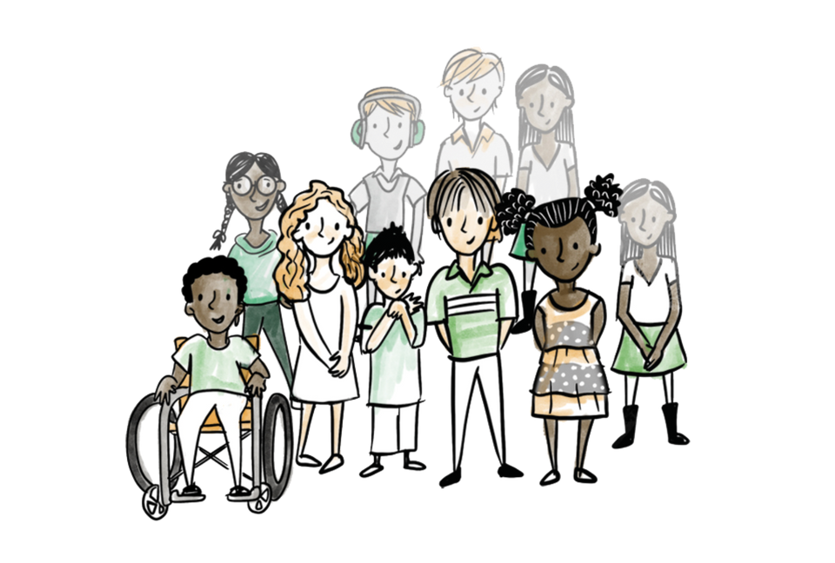
Unannounced Visits
AFTER
THE VISIT
  Recording: The unannounced visit is recorded using the Children Looked after visit template (for CwD) that has the additional information added to cover the unannounced visit requirements.
  Where the child has been seen, it should be cross-referenced on the child/young person’s recordings. The room check must be logged on the child/young person’s recording.
  Where the child/young person and the residential staff or key worker were not seen for one reason or another, the attempt should be recorded on LCS and the plan for the next attempted visit . – Regardless of child being seen, ensure you capture on their records what documents and reviews have taken place during your visit.
Read the full procedure: link

