Slide 1
Wirral Youth Justice Service – Strategic Plan 2021/22
Each Local Authority is required under the Crime and Disorder Act 1998 to have a Youth Justice Plan that sets out how local Youth Justice Services will be delivered within the available resources.
The Strategic Plan 2021/22 sets out our strategy, plans and priorities for 2021-2022, which directly aims to prevent offending and re-offending by children and young people.
Links to:
Youth Justice Board Strategic Plan 2021-2024.
HMIP Annual Report 2020.
The Wirral Plan 2021-2026.
Safer Wirral Strategy (Community Safety Partnership, including OPCC)
WSCP Safer Adolescence Strategy 2021-2023.
Wirral has a Youth Justice Management Board, made up of statutory and wider partners and led by Elizabeth Hartley – Assistant Director of Early Help and Prevention within Wirral Children’s Services.
WIRRAL PLAN 2025

Slide 2
Strategic Vision
Wirral Youth Justice Vision Statement
  • For our young people involved, or on the cusp of, the Criminal Justice System are seen as “Child First, Offender Second”.
  • For our young people to be treated fairly by the youth justice system; and receive help that recognises their individual needs and builds on their strengths, through statutory work or preventative support.
  • To bring about change for our young people, families and their communities, so they can achieve the best outcomes and live a brighter future, in safe and pleasant communities.
WIRRAL PLAN 2025

Slide 3
Analysis – What do we know about or Young People?
Based on young people working with Youth Justice in the year 2021/2021, we know:
87% Male – Primarily males who offend and work with YJS.
98% White – 2% are Black, however this still remains disproportionate base on Wirral population of young people.
50% 16+ - Most of the cohort are older young people.
20% CLA – Looked after children are particularly vulnerable and are over represented within the YJS cohort. We want to improve our prevention support.
18% CE– This is a consistent area of focus, linked to those working with YJS for drugs matters but also wider offending. Focus here is to recognise the risk as victims and support, working across the CE services within the partnership.
High proportion of NEET/Not attending School or poor attendance.
15% SEN – Some young people have additional needs which need to be taken into account when working with them, and across partners.
17%ADHD - Some young people have specific needs and personal factors which need to be taken into account.
Children’s Services contacts - Increased proportions of contacts relating to Peer on Peer issues, Harmful Sexual Behaviour, Anti Social Behaviour, Substance misuse, Mental Health.
WIRRAL PLAN 2025

Slide 4
What are our Priorities?
National
FTE, Re-Offending and Custody – Ensuring the core group of young people are diverted, supported and prevented from re-offending.
Local
Child to Adult Violence – Seen an increase in Covid periods.
Harmful Sexual Behaviour – Everyone’s Invited and Ofsted Rapid Review of abuse in schools and colleges.
Serious Youth Violence and Exploitation – A national theme and Wirral has a high incidence of injuries from bladed articles and violence (especially peer on peer) is around 50% of youth justice work. CE remain a national focus.
EET – 16+ and School – Because education employment and training prevents offending and re offending, improving life chances.
Enhanced Case Management – Working with young people with complex needs and trauma.
Participation and Engagement – Ensuring we know what works for young people and consider their voice in our work, planning and development.
Mental Health – Impacted during covid, can lead to poor engagement, further offending and poorer life chances moving into adulthood.
Prevention – Wider Council Strategy and Coordination. Stopping young people being drawn into offending.
WIRRAL PLAN 2025

Slide 5
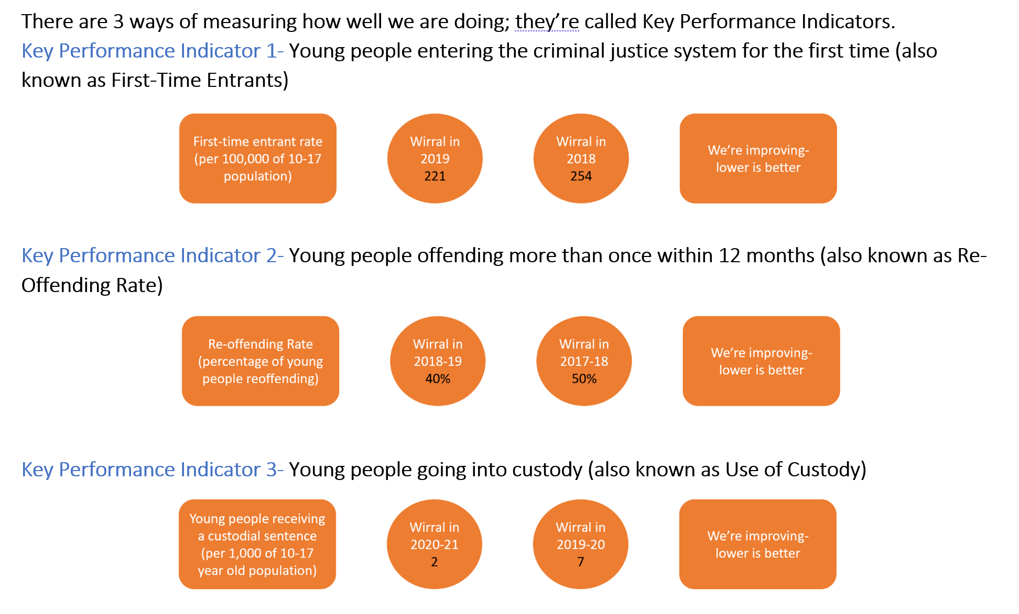
Performance – How are we doing?
WIRRAL PLAN 2025

Slide 6
Development Areas
Equality Objectives
To remove or minimise disadvantages suffered by children due to their protected characteristics.
To take steps to meet the needs of children from protected groups where these are different from the needs of other children.
To encourage children from protected groups to participate in ways that meet their needs.
Personal Factors:
Maturity, socio economic (Deprivation/Disparity in ability to access resources/services)
Resettlement – This relates to young people coming out of custody and how we ensure the way in which this is managed reduces the risk of re-offending and risk of harm to others and the wider community. Recent peer review has identified areas in which we can work together more effectively to support young people, manage risk and protect communities.
WIRRAL PLAN 2025

Slide 7
Principles of Working with Young People
Work with us.
We want to feel included – not just having work done for us or around us.
We can help.
Our experiences can help improve services; and create new and different ways of working.
Stay with us.
It’s better when we get to know and trust the people who want to help.
Help us build relationships.
When we are supported to create other friendships; or you help support our family connections we feel safer and more able to cope.
Listen to us.
Spend the time to find out about us and what our whole life is like.
    Sometimes things we are worried about happen away from home.
    Don’t assume we are all the same. Everyone is unique.
Help us dream and achieve.
Your passion, skills and teamwork can make a big difference to our lives.
WIRRAL PLAN 2025
Notes:
Intro:
The Principles and values are taken from our partnership safer adolescence strategy 2021-23.
As a partnership we are committed to working together and taking a child first approach. Young people have helped us develop a set of guiding principles and values that should underpin ‘how’ we work with them.
These principles were shaped for Wirral using the Research in Practice study: ‘That Difficult Age: Developing a more effective response to risks in adolescence (2014)’ by Dr Elly Hanson and Dez Holmes.

Slide 8
Values
We will
• Work together with young people in a partnership culture of inclusion, understanding and empathy.
• Take Ownership and accountability.
      Safeguarding does not start or end with a referral. It is a continuum of activity and effort - and is everybody’s business.
      This means that a wide range of agencies, communities and individuals play an active role and commit to an approach, this creates a ‘collective capacity’ to safeguard young people.
WIRRAL PLAN 2025
Notes:
An example of how we as professionals can live these values is through our collective use of language. Victim-blaming language may reinforce messages from perpetrators around shame and guilt. This in turn may prevent the child or young person from disclosing their abuse, through fear of being blamed by professionals.
More information on appropriate language can be found at the following link, produced by the National Police Chief’s Council, Victim Support and The Children’s Society.
https://csepoliceandprevention.org.uk/toolkits

Slide 9
Youth Justice Prevention Service
Prevention work is completed on a voluntary basis with young people aged 10 to 18 years who are involved in or at risk of involvement in high level anti-social and or offending behaviour.
One on one or group basis. Addressing risk and vulnerability.
Interventions have a planned intervention timescale of up to 12 weeks once each young person and there family have committed to engaging to the programme.
Can include signposting to universal services or service partners during the intervention, or as part of each young person exit plan as required.
For more information:
Wirral Youth Justice Service | www.wirral.gov.uk
WIRRAL PLAN 2025

Slide 10
More Information? - Key Contacts & Volunteering
Service Manager: Kathy Gill
kathygill@wirral.gov.uk
Volunteering:
Mentoring is a service offered to young people throughout the Youth Justice Service. A young person is matched with a volunteer mentor, who will act as positive role model and can offer support and guidance to the young person to focus on making positive steps away from offending. You can also make a referral for mentoring which will be assessed and consulted upon across professionals.
Referral Order volunteers are key to the delivery of our Referral Order Panels, Volunteers take an active role in the decision making and Referral Order Contract of work to be completed with the young person who is sentenced to a Referral Order.
For more information on volunteering contact
carlloughlin2@wirral.gov.uk
For more information in general on the Youth Justice Service in Wirral
Wirral Youth Justice Service | www.wirral.gov.uk ‘Youth Justice Service’
WIRRAL PLAN 2025

