Slide 1
Team Around the Family Meetings

Slide 2
Team Around the Family Meetings:
It is expected that TAF meetings are used for all cases, except in the event that we are the only agency working with the family. (In this instance we would review a Family Action Plan using the ‘Review Action Plan’ tab on EHM)
A TAF meeting needs to be completed as soon as possible into your work with the family but definitely within 12 weeks of the case being open.
A TAF Review meeting is required at a minimum of every 12 weeks.
At TAF Review meeting, the family action plan should be reviewed with all professionals and the family.
It is TYS lead workers’ responsibility to chair the meeting, coordinate all the partners attending and obtain reports from them if they can’t.
The TAF minutes need to be recorded on EHM using the appropriate template

Slide 3
Helpful tips:
When attending in person, it can be helpful to have an attendance sheet which is handed round before the meeting starts. This means you can gather everyone’s contact details in one place for ease of recording and dissemination of the notes. (Please see useful links).
Request another attendee take minutes; this can be rotated at each meeting. You can then decide with them who will write up and send out the minutes.
If another attendee is taking minutes; it is helpful for you to minute the reviewed action plan so you have a copy and can record on EHM.
If professionals are not able to attend the meeting; request a report/update from them prior to the meeting to be shared. Ensure they have shared this with the family before the meeting so there are no surprises.
You may wish to invite attendees formally via email so you have a record of who has been invited and when. This is also helpful as Professionals who cannot attend can reply with their reports/updates.

Slide 4
Capturing the Family’s voice:
If a young person does not wish or is not able to attend, it is helpful to meet with them prior to the meeting to share what will be discussed, who will be attending and to gather their views and questions. You can then arrange to see them following the meeting to feedback and ensure they understand what was discussed, the reviewed plan and answer any questions they may have.
If family members do not wish to attend together; consider splitting the meeting whereby they attend separately. This can sometimes mean a longer meeting but ensures all parties’ views are captured.
Consider using interactive tools and resources to capture the family’s views i.e.
Using poster paper to record what’s working well/what are we worried about/actions during the TAF
Supporting a child or family to write down questions/views prior to the meeting and agreeing how they wish for these to be shared at the meeting
Agreeing a code word/sign/phrase with a young person which indicates they want to leave the meeting if used
Agreeing a place the young person can go if they do leave the meeting; on the understanding they will be safe and can return when they wish to

Slide 5
Holding TAF Meetings remotely:
If you have multiple agencies attending, you may wish to book a conference call via TYS Business Support and/or Manhattan. It is worth noting that we cannot share passcodes with families; therefore a practitioner will need to call them into the meeting using their mobile and ‘merging’ the call. Please see useful links for a guide on how book a conference call and how to merge calls into a conference call
If you have no more than three attendees you can complete a merged call via an I-phone (however this is limited to only three calls).
If completing a TAF Meeting remotely; you can gain verbal agreement of the plan from the family via the call. You can then seek written consent and share a copy of the plan and minutes with them at your next face to face visit.
If all Professionals and the family have access; TAF Meetings can be held using a Professionals Account on Zoom.

Slide 6
Completing TAF Meetings on EHM

Slide 7
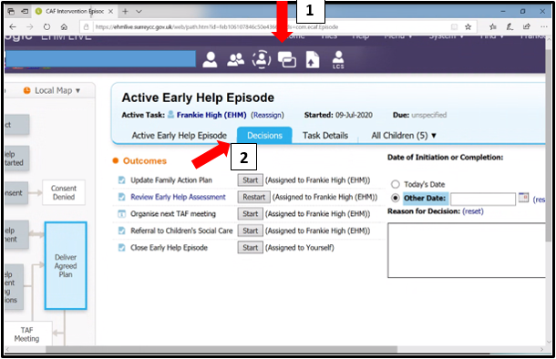
Select the ‘decisions’ tab within the young person’s case pathway:

Slide 8
Alongside ‘organise next TAF Meeting’ select ‘start’:

Slide 9
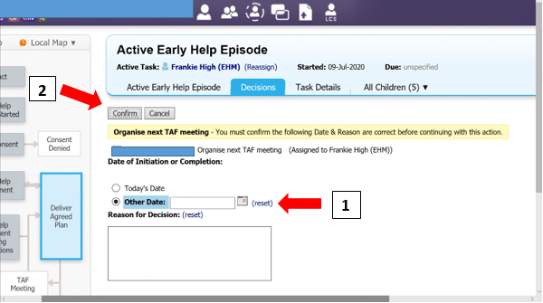
This will open the TAF Meeting tab and requests you ‘organise next TAF Meeting’.
Enter the date the TAF Meeting was held. This will be retrospective in most cases, unless you are entering the meeting details on the same day the TAF was held
Once entered, select ‘confirm’:

Slide 10
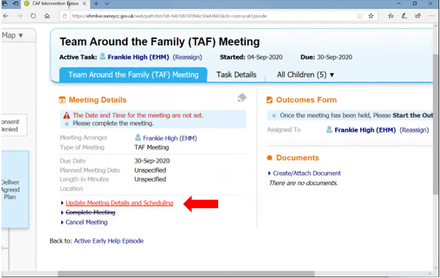
Having entered the date; a TAF Meeting has now been created for your young person.
You will receive a warning message to advise that the time and date for the meeting are not set. To address this, select ‘Update Meeting Details and Scheduling’:

Slide 11
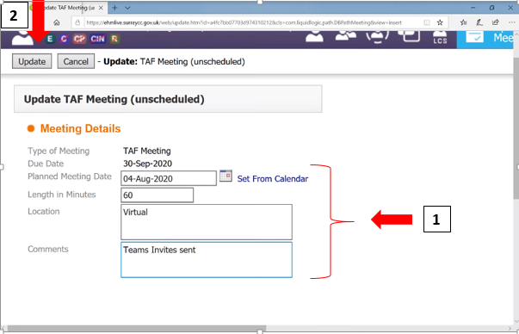
Then enter the date the TAF Meeting was held, the length, location of the meeting and any additional comments (if required).
If you have held a TAF Meeting virtually, by phone or conference call, you can note this in the ‘Location’ box.
Then select ‘Update’:

Slide 12
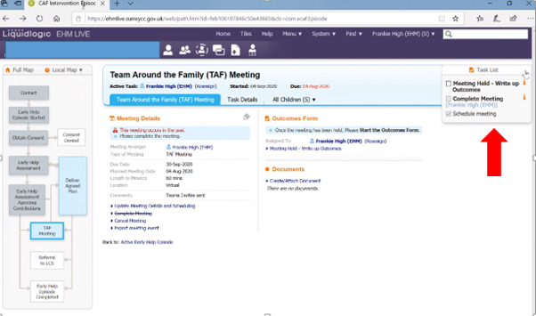
This will open up the TAF you have created as an ‘open TAF Meeting’.
A ‘Task List’ is generated as an orange tab on the top right hand side of the screen. This provides you with a tick list of tasks in order to complete the TAF Meeting. You cannot progress onto the next task until the one before it is completed.

Slide 13
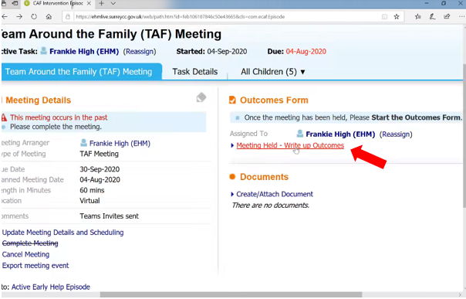
Select ‘Meeting Held – Write Up Outcomes’:

Slide 14
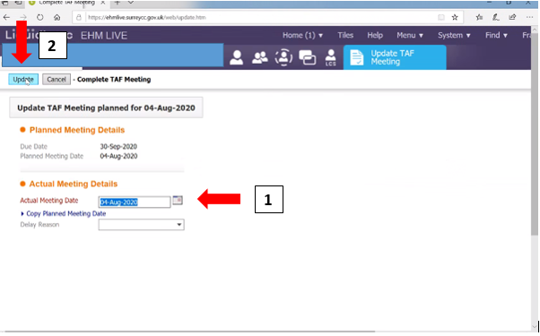
EHM will bring up the ‘planned meeting date’ and request you enter the ‘Actual Meeting Date’. (You can copy the planned meeting date if they are the same).
Once entered, select ‘Update’:

Slide 15
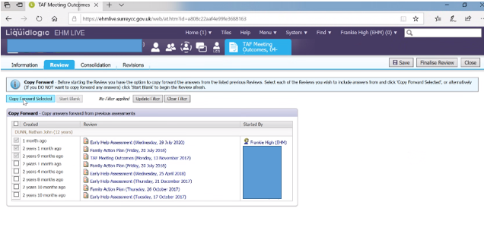
Copy forward any relevant information.
It is helpful to ensure that the last Action Plan (whether it is within the EHA or a previous TAF) is selected, as this will pull through the most recent Action Plan for the family which you can then update. This saves you having to re-enter the entire plan at future steps:

Slide 16
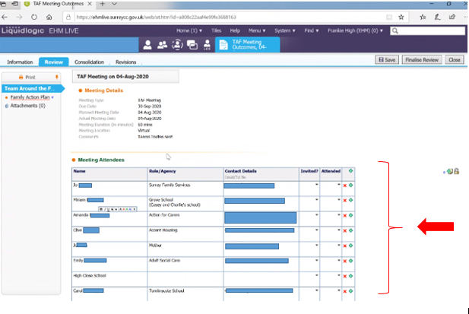
Using the tab list on the left hand side, you are then able to enter the details of your TAF Meeting. The first tab will ask you to enter the names and details of attendees. You can enter all who were invited (including family members) and then note whether they were able to attend or not.
If a name has been pulled through who was not invited (as they had historic involvement with the family), you can delete them from the list using the X
You can add new invitees/attendees using the +

Slide 17
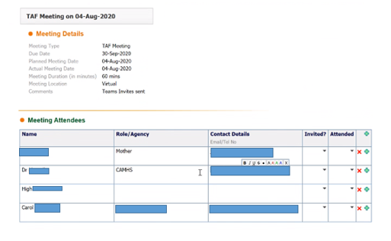
Continued..
Save as you go along!

Slide 18
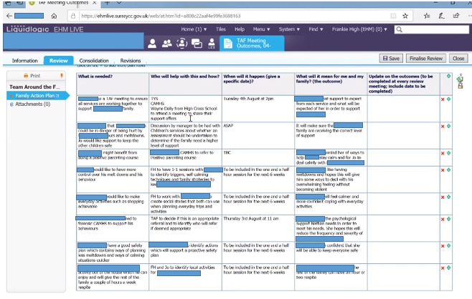
The next tab pulls through the family’s most recent action plan, which you can then amend to reflect the review of the plan and outcomes of the TAF Meeting:

Slide 19
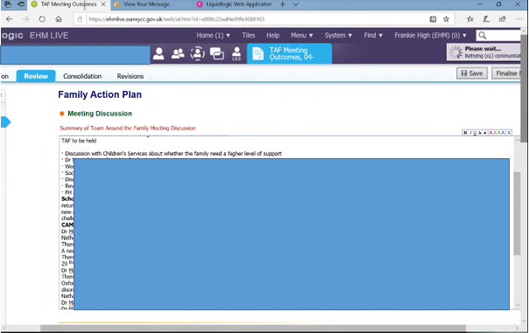
You can add notes/minutes or additional detail in the ‘Meeting Discussion’ Box:

Slide 20
When completed; ensure you have included the family’s views about the plan in the ‘Views and Comments’ Box:

Slide 21
Next, select the intended outcome.
If you will be holding another TAF; select ‘organise next TAF Meeting’ and this will pull through and create a new meeting for your scheduled time and date. You can then complete the above steps when this TAF has been held. This is sometimes helpful in keeping meetings within timescales.
If you do not intend to hold another TAF, select ‘Continue with Intervention’. You can then review the plan via the ‘Review Action Plan’ tab. (This would likely only be used in the event we are the only agency working with a young person or family).
If you are closing your involvement and have completed a TAF as part of the closure process, you can select ‘Close Early Help Intervention’. This will trigger a closure episode however so it is helpful to ensure you have completed all of your other closure steps (i.e. closure summary, finalised case notes etc) before this one.

Slide 22
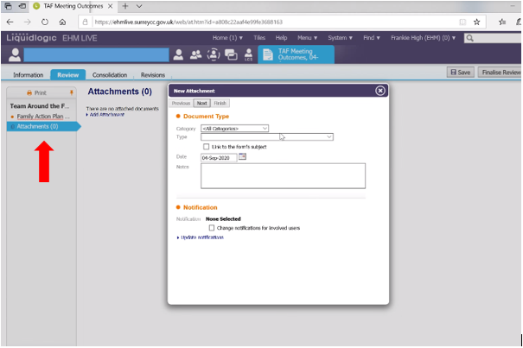
If you have taken minutes, have notes, evidence of family’s views, Professionals reports etc, these can be uploaded using the ‘Attachments’ tab on the left hand side. This will attach the documents specific to the TAF Meeting so everything can be found in one place.
It is most helpful to upload these documents under the ‘Paper TAF’ category.
You can then search and upload documents from your F Drive and add notes if you wish to.

Slide 23
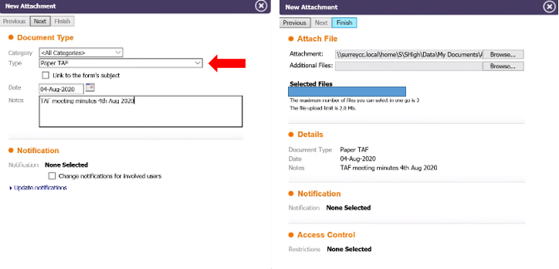
Continued…

Slide 24
Once uploaded; this will show as an attachment within the TAF Meeting tab:

Slide 25
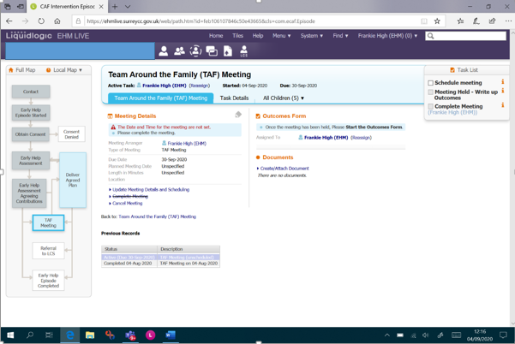
Once completed, save and then select ‘Finalise’ and ‘Complete Meeting’.
This will then bring you back to the TAF Tab where the details for your next scheduled TAF meeting will be showing. You can amend the time and date as necessary:

Slide 26
This will generate two tasks in your EHM Task Tray entitled ‘Meeting – Organise TAF Meeting’ and ‘Meeting – Complete TAF Meeting Outcomes’. As long as you are holding TAF meetings for a young person, these will be regenerated each time you schedule the next TAF.
To complete the next TAF, select this task from your tray and it will take you straight to the TAF Tab.

Slide 27
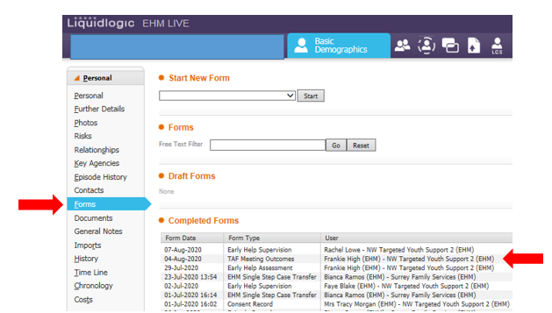
This completed TAF Record will then pull through into the young person’s ‘Forms’ entitled ‘TAF Meeting Outcomes’ and can be accessed from here in the future.

Slide 28
Useful links:
Meeting Attendance Sheet Template:
I:\CSF\SFS\TYS\Area Team Folders\NW Area\NW Resources File\Meeting Attendance Sheet Template.docx
Booking phone lines for conference calls:
I:\CSF\SFS\TYS\Area Team Folders\NW Area\NW Resources File\Booking phone lines for Conference Calls.docx
How to add non professionals to a conference call:
I:\CSF\SFS\TYS\Area Team Folders\NW Area\NW Resources File\How to Add Non-Professionals to a Conference Call (002).pdf

